Slide 1
Food Investigation of Genetically Modified Crops
Results of Workgroup 15
Tested food: corn porridge
Hartsville (USA) June 1st – June 5th 2026

Slide 2




GROUP 15
Dan Askins
Mayor of Hartsville
USA
Jürgen Braun
Teacher at JWS
Germany
Hana Melcherová
Student at GSFA
Slovakia

Slide 3
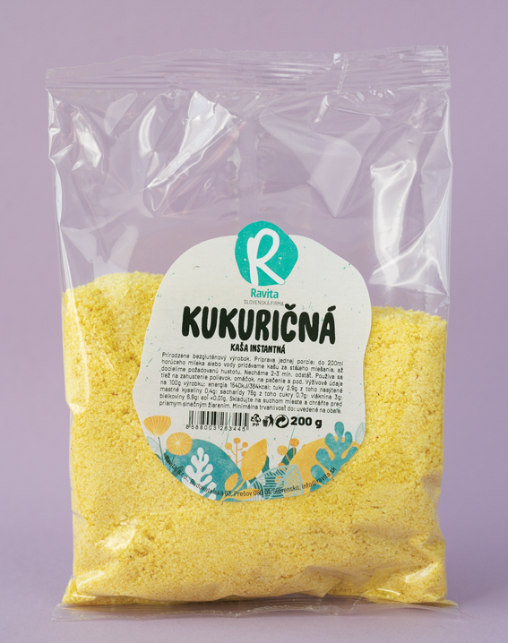
Tested food: CORN FLAKES
Grown: Slovakia
GMO signed: „not genetically modified“
Country of origin: Slovakia
Brand: Ravita
Mass: 200g
Calorific value: 364 kcal per 100g

Slide 4
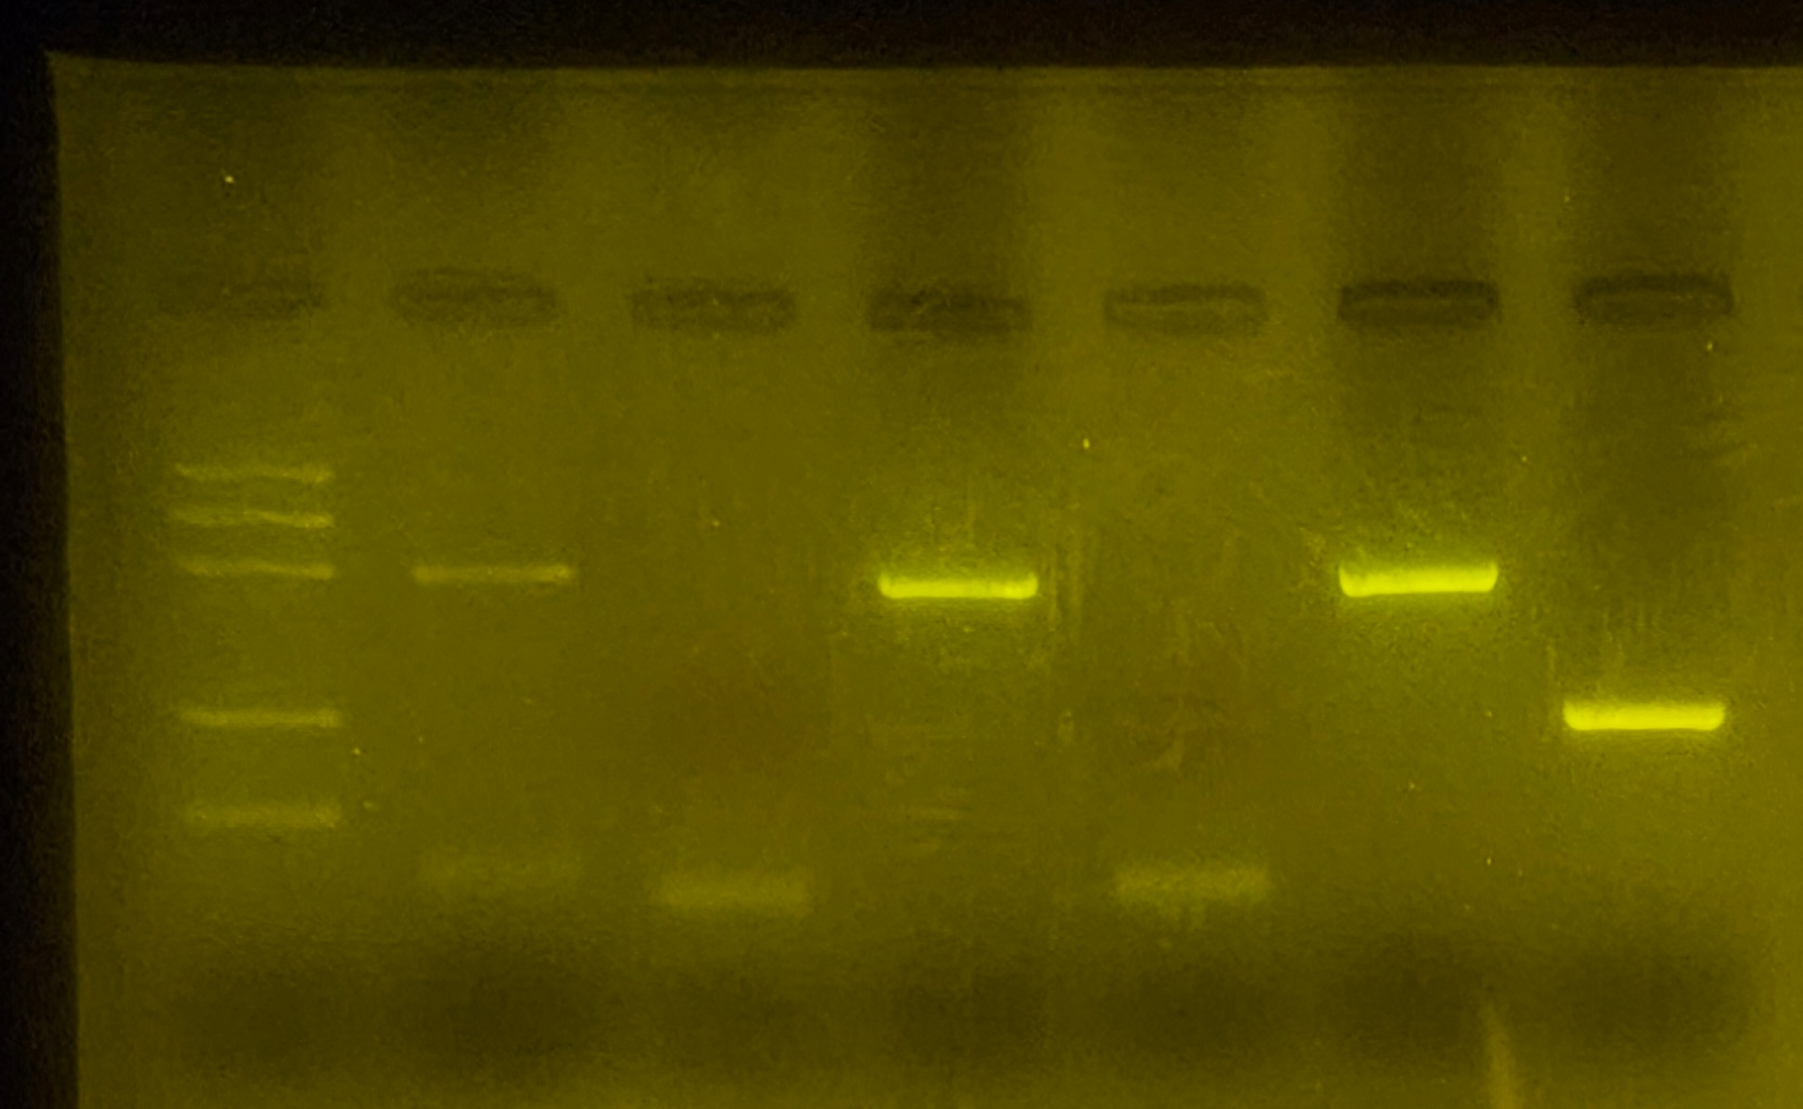
Observation: Bands in Agarose Electrophoresis
S1
PMM
S1
GMM
S2
PMM
S2
GMM
S3
PMM
S3
GMM
S1 -control PMM (oatmeal)
S1 –control GMM (oatmeal)
S2 Corn Porridge PMM
S2 Corn Porridge GMM
S3 +control PMM
S3 +control GMM
M
PS II (455 bp)
CaMV or/and NOS (203/225 bp)
Rest of primers (15-25 bp)
+Rest of dNTPs
Notes:
Clear straight bands
Less dna in oats

Slide 5
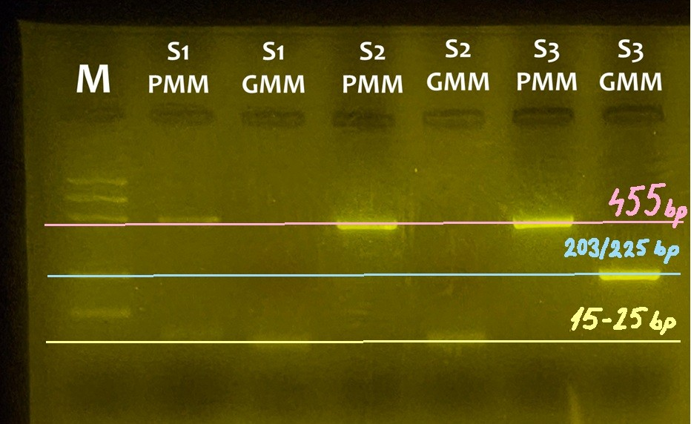
Observation: Bands in Agarose Electrophoresis
S1
PMM
S1
GMM
S2
PMM
S2
GMM
S3
PMM
S3
GMM
S1 -control PMM (oatmeal)
S1 –control GMM (oatmeal)
S2 Corn Porridge PMM
S2 Corn Porridge GMM
S3 +control PMM
S3 +control GMM
M
PS II (455 bp)
CaMV or/and NOS (203/225 bp)
Rest of primers (15-25 bp)
+Rest of dNTPs

Slide 6
Evaluation:
Oat flakes – plant origin
Oat flakes - without genetic modification
TESTED FOOD – CORN PORRIDGE – plant origin
TESTED FOOD – CORN PORRIDGE – without genetic modification
Positive control – plant origin
Positive control – genetic modification

Slide 7
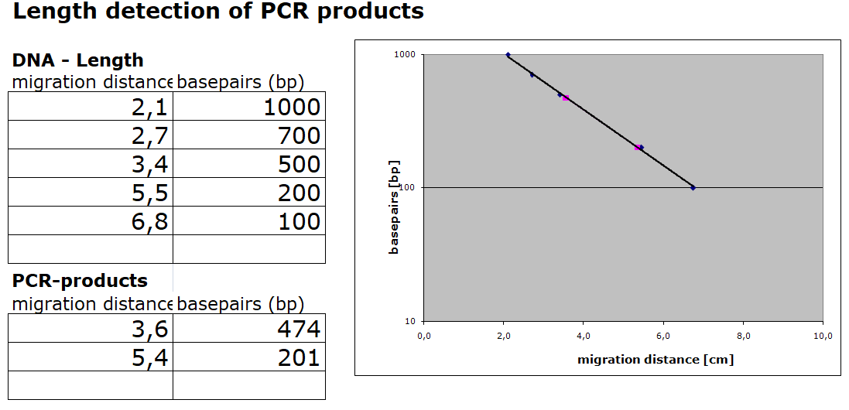
Evaluation:
We estimated the lenght of PCR products according to marker

Slide 8
Conclusion
Test food was not genetically modified.
Length of gene fragment PS II: 474 bp (455 bp)
Length of GM fragments: 201 bp (203/225 bp)
Slovak corn porridge labeled as not genetically modified didn´t contain any of two regulating sequences frequently used in GMO´s.

Slide 9

Thank you for your attention!

