Slide 1
Food Investigation about Genetical Modified Crops
Results from Workgroup 9
Tested food: Grits
Hartsville (USA) June 1st – June 5th 2026

Slide 2



GROUP 9
Haashini Baskaran
Samruthaa Senthil
U.S.A
South Carolina Governors school for Science and Mathematics
Lucia Bizoňová
Slovakia
Gymnázium sv. Františka Assiského, Levoča

Slide 3

Tested food: Grits
Grown: U.S.A
GMO signed: yes
Country of origin: U.S.A
Brand: Jim Dandy
Mass: 1g
Calorific value: 170kcal per 46g

Slide 4
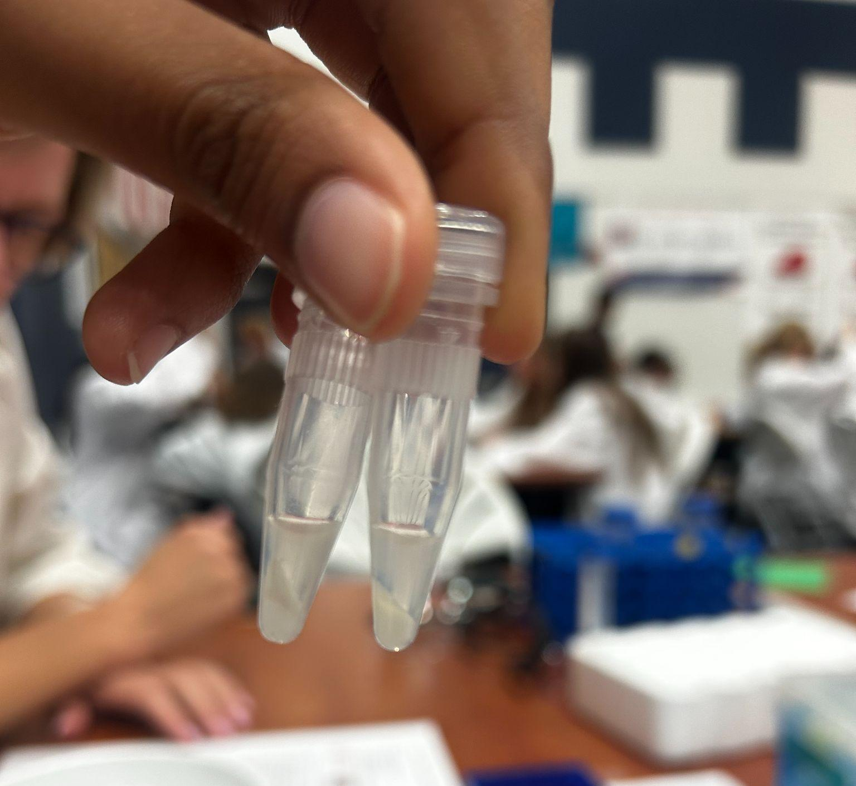
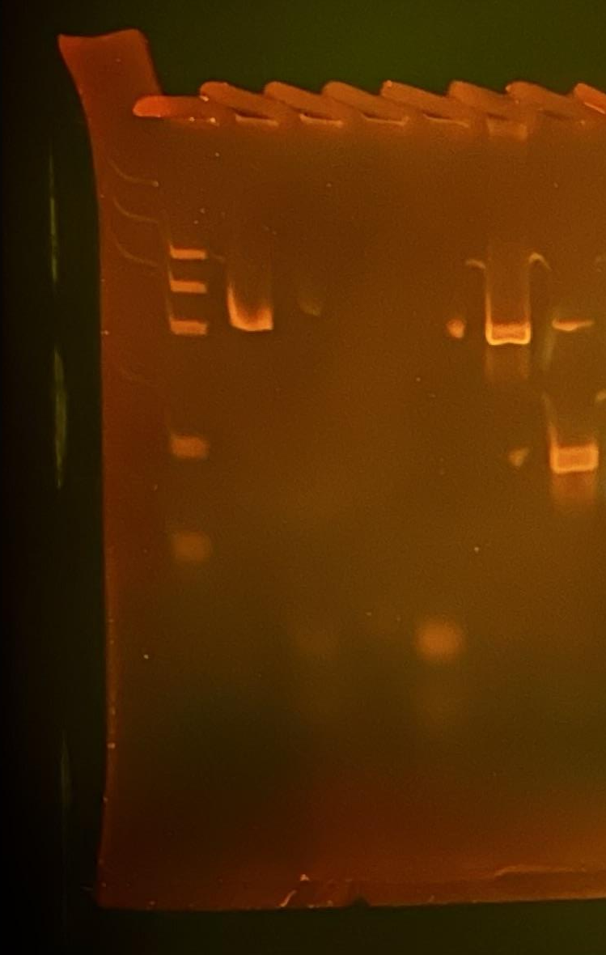
Observation: Gel Pattern of Electrophoresis using PAGE
M
1
2
3
4
5
6
1. -control PMM
2. –control GMM
3. Tested FOOD PMM
4. Tested FOOD GMM
5. +control PMM
6. +control GMM
PS II (455 bp)
CaMV or/and NOS (220 bp)
Rest of primers (25 bp)
Rest of dNTPs

Slide 5
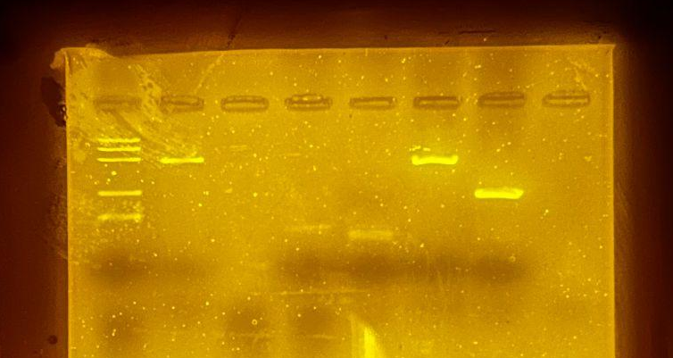
Observation: Gel Pattern of Electrophoresis using Agarose
1. -control PMM
2. –control GMM
3. Tested FOOD PMM
4. Tested FOOD GMM
5. +control PMM
6. +control GMM
M
1
2
3
4
5
6
PS II (455 bp)
CaMV or/and NOS (220 bp)
Rest of primers (25 bp)
Rest of dNTPs

Slide 6
Evaluation:
Corn Meal – plant origin(positive for PSII)
Corn Meal - genetic modified(negative for CAMV and NOS term)
TESTED FOOD – Jim Dandy Grits – plant origin (FAILED)
TESTED FOOD – Jim Dandy Grits – genetic modification(FAILED)
Positive control – plant origin(positive for PSII)
Positive control – genetic modified(negative for CAMV and NOS term)

Slide 7
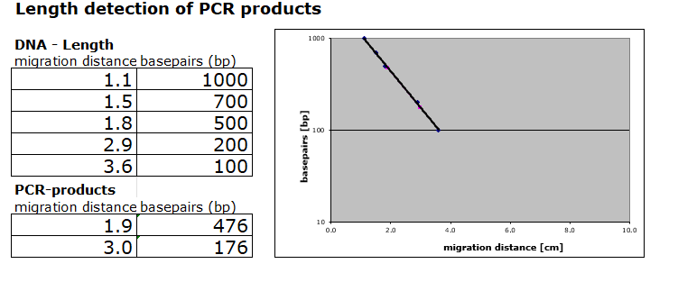
Evaluation:
Length Estimation of Bands in PAGE Gel by Calibration Curve

Slide 8
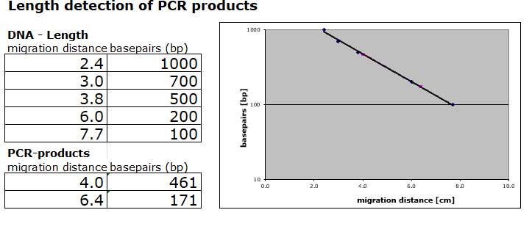
Evaluation:
Length Estimation of Bands in Agarose Gel by Calibration Curve

Slide 9
Conclusion
We were unable to come to a conclusion on whether the test food was modified or not due to the complications.
Notes:
Theories as to why no DNA was amplified:
1. When grinding test food, did not grind enough and DNA was not extracted.
2. After centrifuging the solution was still cloudy so there is no guarantee that Instagene beads were not in the solution

