Slide 1
Food Investigation about Genetical Modified Crops
Results from Workgroup 8
Tested food: Honey Nut Cheerios
Hartsville (USA) June 1st – June 5th 2026

Slide 2




GROUP 8
Mentor: Sarah Thiem
Germany
Johanna-Wittum-Schule, Pforzheim
Elon Mack
USA
SC Governors School for Science and Mathematics
Simas Ignativicius
Lithuania
Vilniaus jezuitu gimnazija

Slide 3
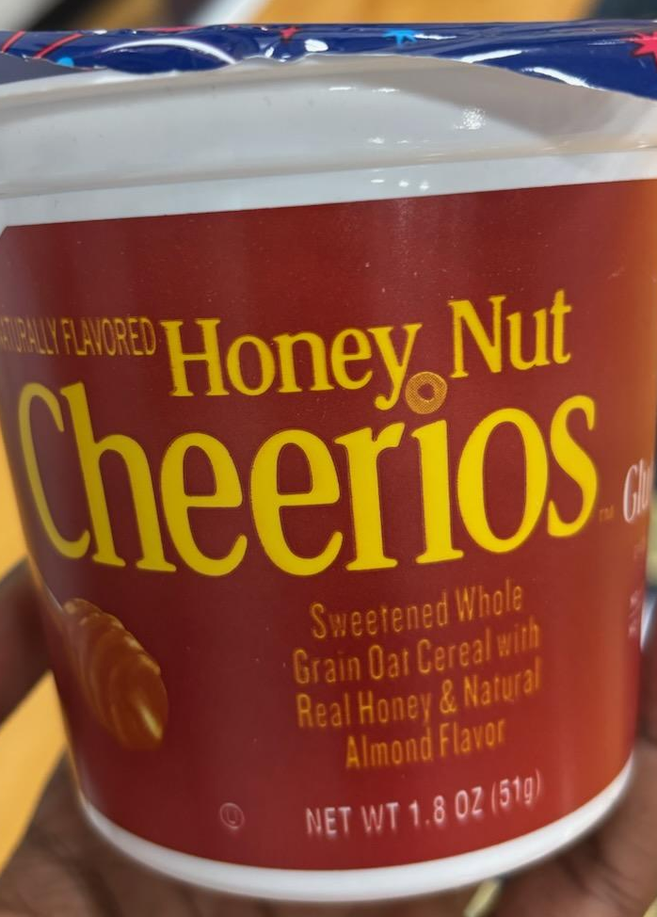
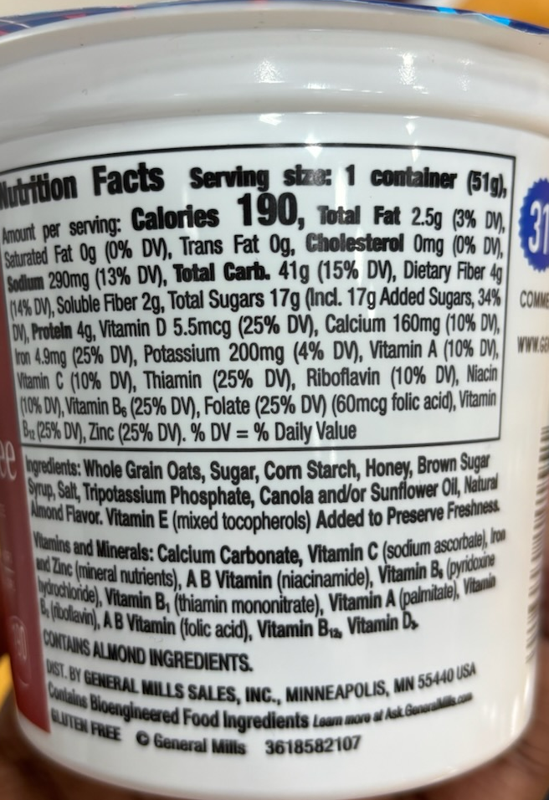
Tested food: Honey Nut Cheerios
Grown: not written
GMO signed: yes
Country of origin: United States
Brand: General Mills
Mass: 51g
Calorific value: 190 kcal per 51g

Slide 4
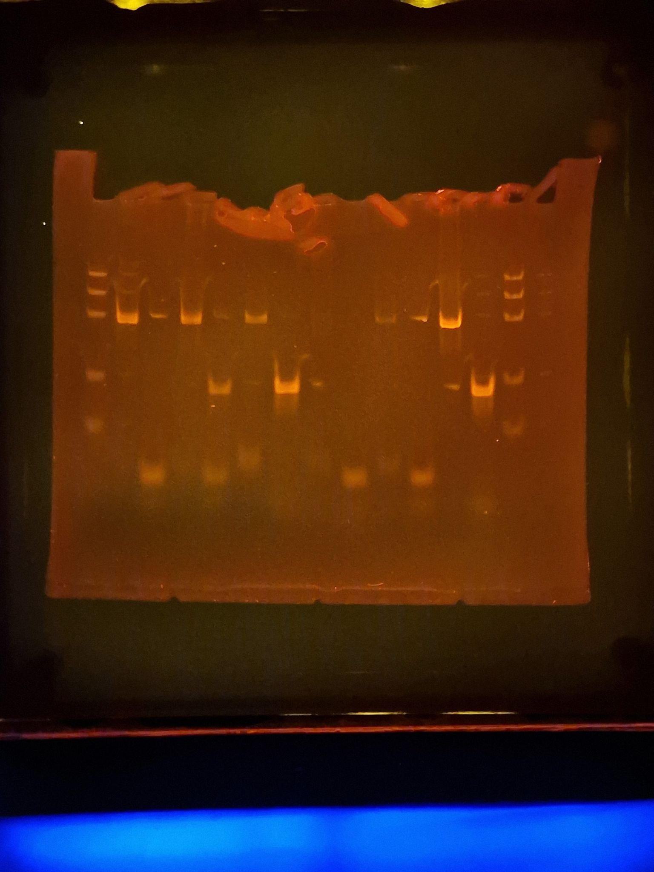
Observation: Gel Pattern of Electrophoresis
1
2
3
4
5
6
M
1. -control PMM
2. –control GMM
3. Tested FOOD PMM
4. Tested FOOD GMM
5. +control PMM
6. +control GMM
PS II (455 bp)
CaMV or/and NOS (220 bp)
Rest of primers (25 bp)
Rest of dNTPs

Slide 5
Evaluation:
Corn Semolina – no plant origin
Corn Semolina - not genetic modified
TESTED FOOD – CHEERIOS – contains plant origin
TESTED FOOD – CHEERIOS – not genetic modified
Positive control – plant origin
Positive control – genetic modified

Slide 6
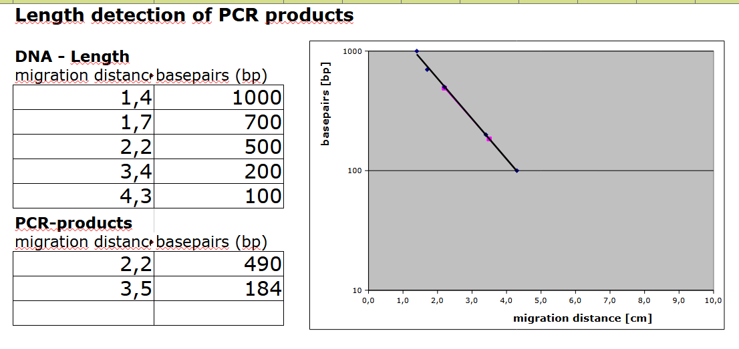
Evaluation:
Length Estimation of Bands in the Gel by Calibration Curve

Slide 7
Conclusion
Test food is not modified.
Length of gene fragment PSII: 490
Length of modification is 0 bp
Modification is not done by regulation sequence of CaMV-Promoter or/and NOS-Terminator

