Slide 1
Food Investigation about Genetical Modified Crops
Results from Workgroup 7
Tested food: Oat Flakes
Hartsville (USA) June 1st – June 5th 2026

Slide 2




GROUP 7
Marissa Eckard
United States
South Carolina Governor’s School for Science and Mathematics
Stanislava Piňsová
Czech republic
Biskupské gzmnázium Brno a mateřská
šklola
Michaela Labudová
Slovakia
Gymnázium sv. Františka Assiského, Levoča

Slide 3
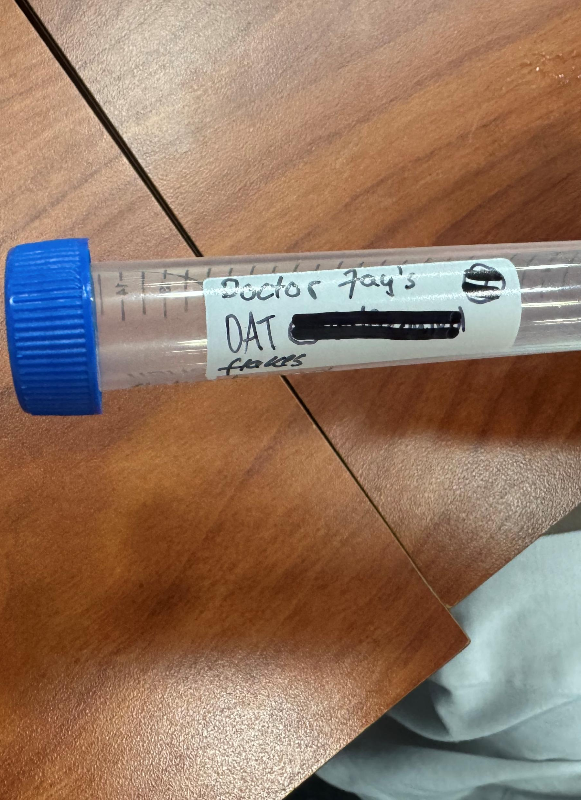
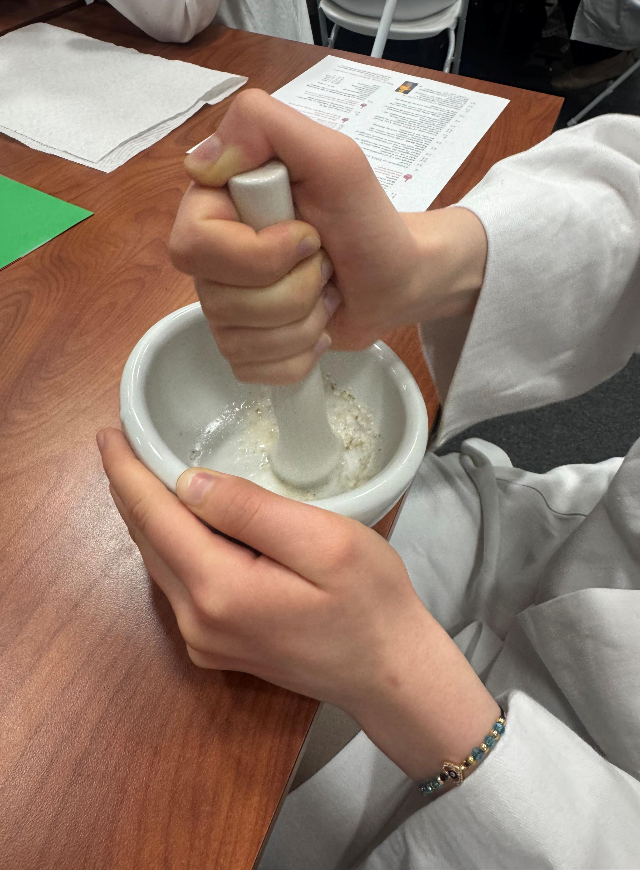
Tested food: OAT FLAKES
Grown: not written
GMO signed: not available
Country of origin: America
Brand: Dr. Jay’s
Mass: not available
Calorific value: not available

Slide 4
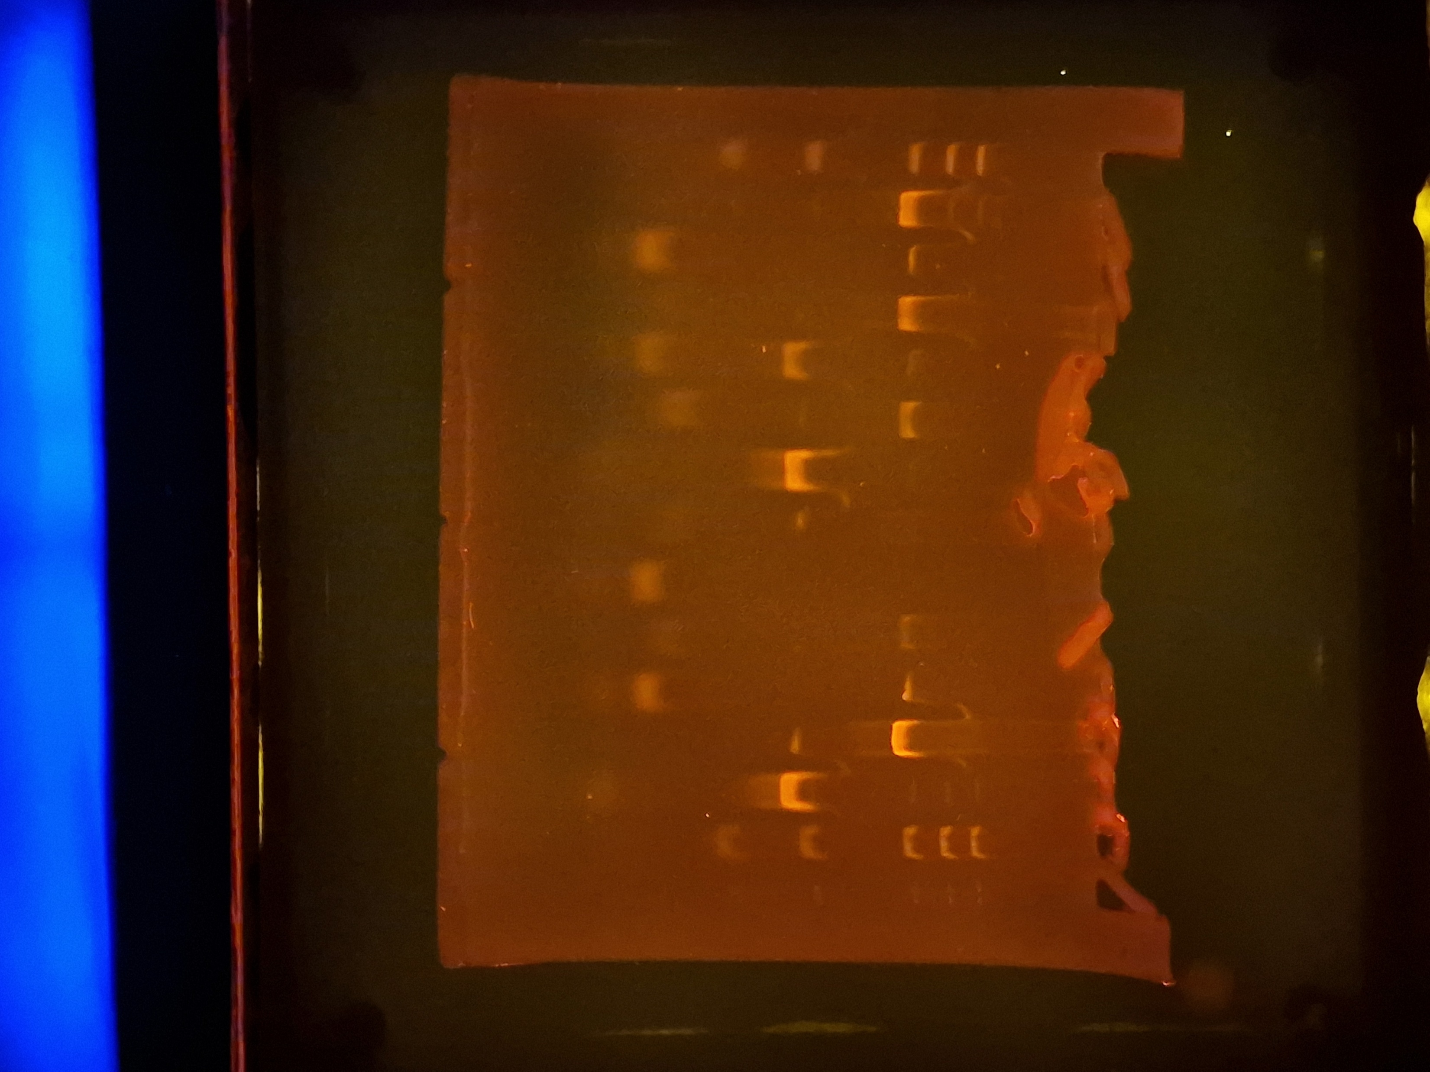
Observation: Gel Pattern of Electrophoresis
M
1
2
3
4
5
6
M: Marker
1: -control PMM
2: -control GMM
3: Tested FOOD PMM
4: Tested FOOD GMM
5: +control PMM
6: +control GMM
1000
700
500
PS II (455 bp)
200
CaMV or/and NOS (225, 203 bp)
100
Rest of primers (25 bp)
Rest of dNTPs

Slide 5
Evaluation:
Negative Control (Corn Grieß) – plant origin
Negative Control (Corn Grieß) – not genetic modified
TESTED FOOD – OAT FLAKES – plant origin
TESTED FOOD – OAT FLAKES – genetic modified
Positive control – plant origin
Positive control – genetic modified

Slide 6
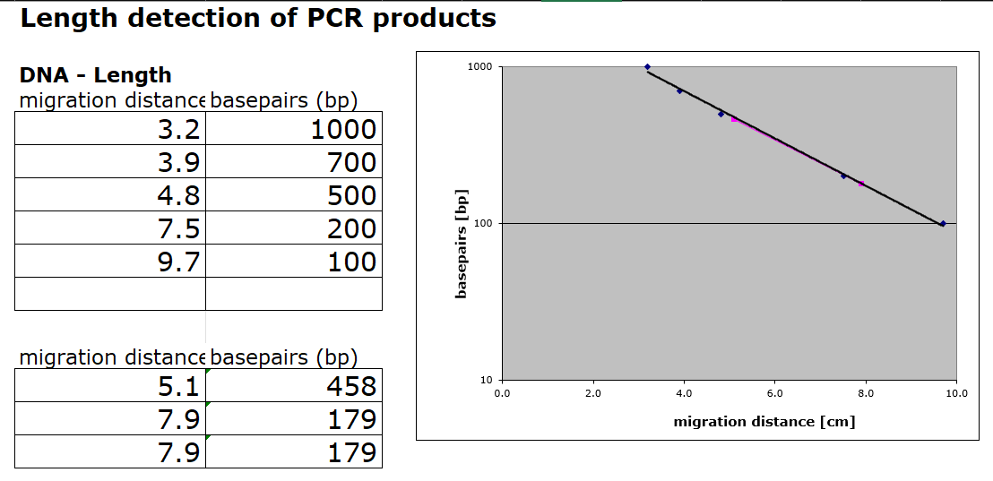
Evaluation:
Length Estimation of Bands in the Gel by Calibration Curve
Notes:
Mention that there is no differentiation between camv and nos on our gel

Slide 7
Conclusion
Test food is genetically modified.
Length of gene fragment PSII: 458 bp
Length of modification: 179 bp
Modification is done by regulation sequence of CaMV-Promoter
Notes:
- lower than 200 and camv (203) is lower than nos (225)

