Slide 1
Food Investigation about Genetical Modified Crops
Results from Workgroup 5
Tested food: SOY SCHNITZEL
Hartsville (USA) June 1st – June 5th 2026

Slide 2




GROUP 5
Nela Horňáčková - student
Czechia
Biskupské gymnázium Brno a mateřská škola
Shree Patel - student
USA
Governor‘s School of Science and Mathematics
Amelie Grözinger - mentor
Germany
Johanna-Wittum-Schule

Slide 3
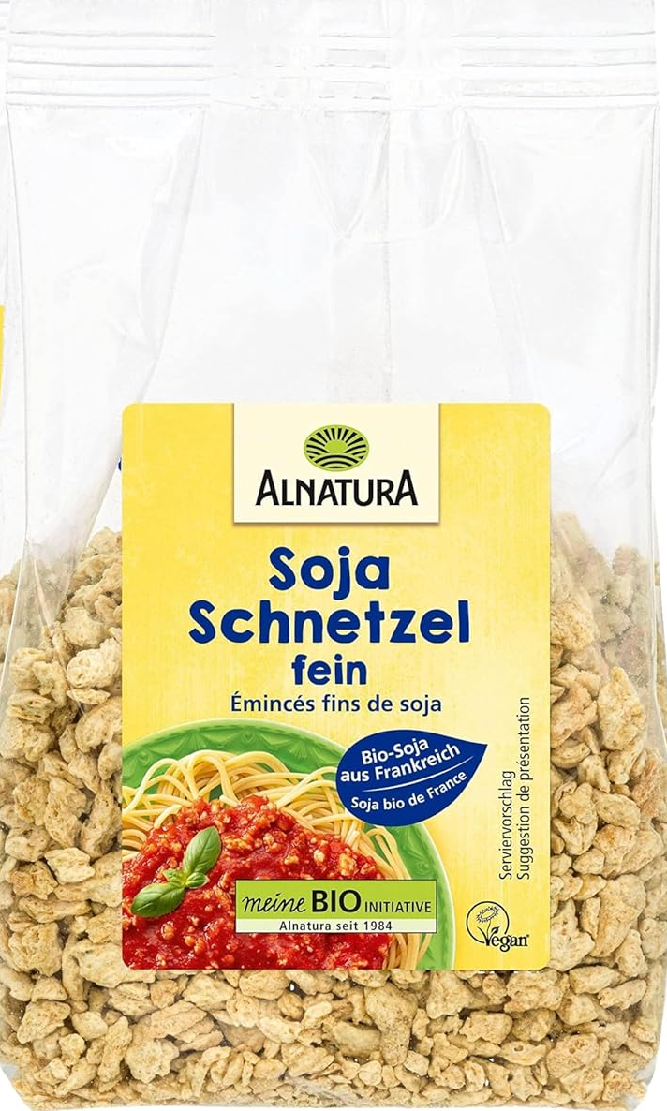
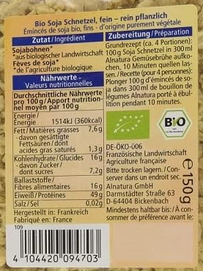
Tested food: soy schnitzel
Grown: france
GMO signed: no
Country of origin: Germany
Brand: Alnatura
Mass: 150g
Calorific value: 360 kcal per 100g

Slide 4
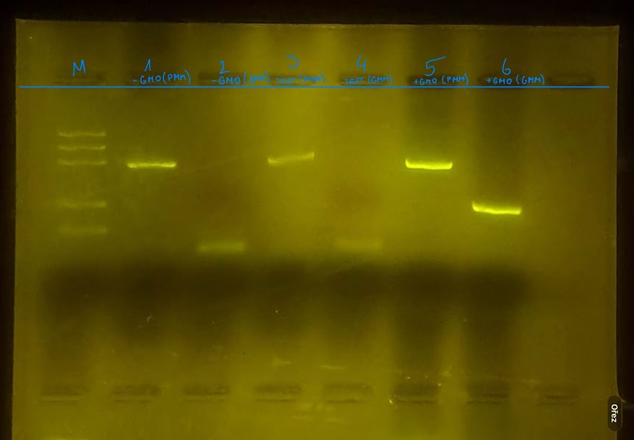
1. -control PMM
2. –control GMM
3. Tested FOOD PMM
4. Tested FOOD GMM
5. +control PMM
6. +control GMM
Observation: Gel Pattern of Electrophoresis
M
3
4
1
2
5
6
PS II (455 bp)
CaMV or/and NOS (220 bp)
Rest of primers (25 bp)

Slide 5
Evaluation:
Oat flakes – plant origin
Oat flakes - not geneticaly modified
TESTED FOOD – SOY SCHNITZEL– plant origin
TESTED FOOD – SOY SCHNITZEL– not geneticaly modified
Positive control – plant origin
Positive control – geneticaly modified

Slide 6
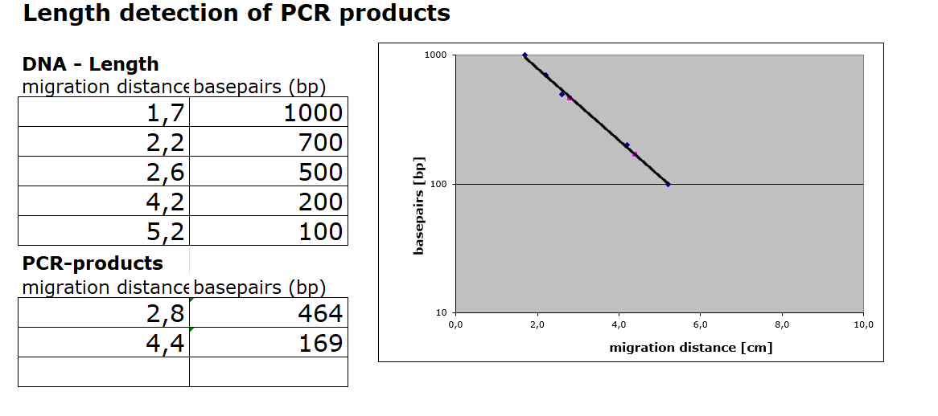
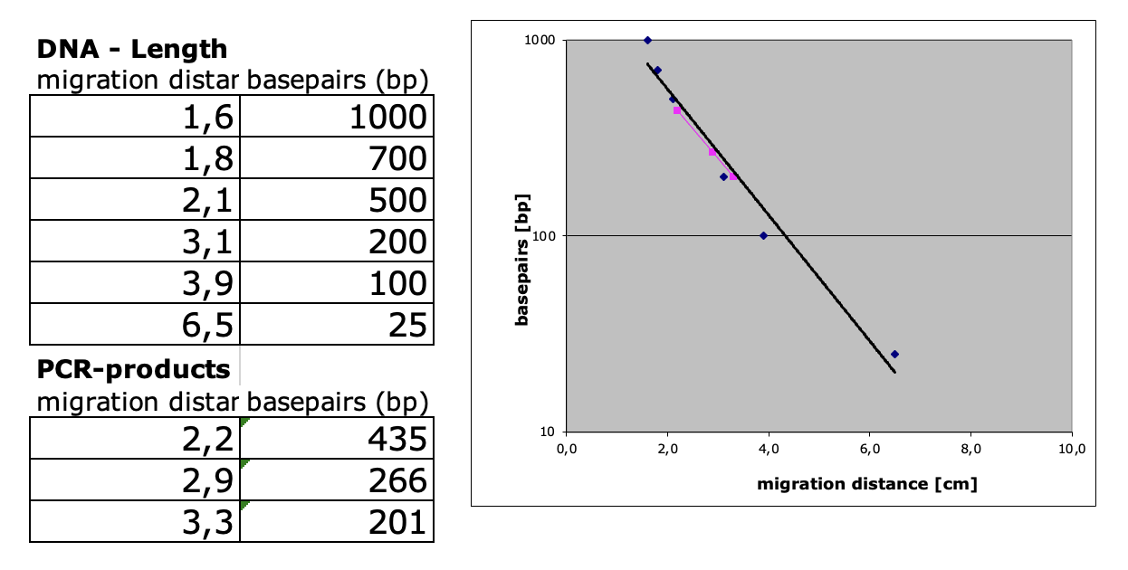
Evaluation:
Length Estimation of Bands in the Gel by Calibration Curve

Slide 7
Conclusion
Test food is not modified.
Length of gene fragment PSII: 464 bp
Length of modification is 0 bp
Modification is not done by regulation sequence of CaMV-Promoter and NOS-Terminater
Or
It was not modefied at all.

