Slide 1
Food Investigation about Genetically Modified Crops
Results from Workgroup IV
Tested food: CORN MEAL
Hartsville (USA) June 1st – June 5th 2026

Slide 2



GROUP IV
Abhi Samala
Mary Kim
USA
South Carolina Governor’s School for Science and Mathematics
Izabelė Prieskienytė
Lithuania
Vilniaus jėzuitų gimnazija

Slide 3
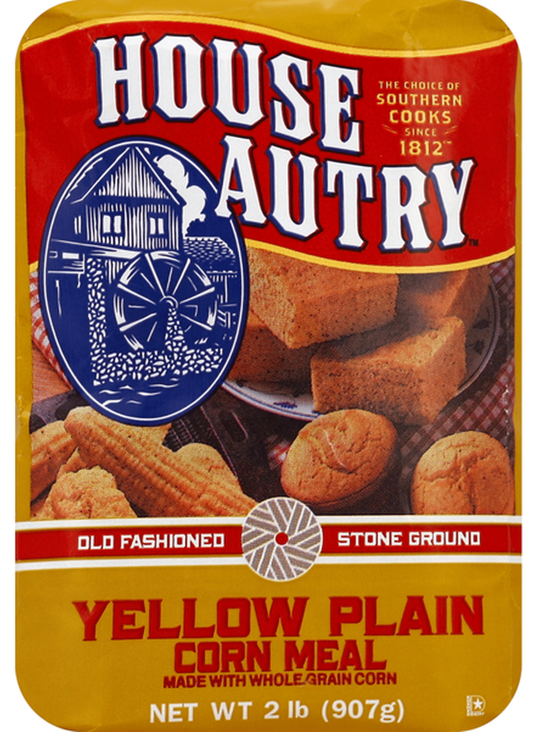
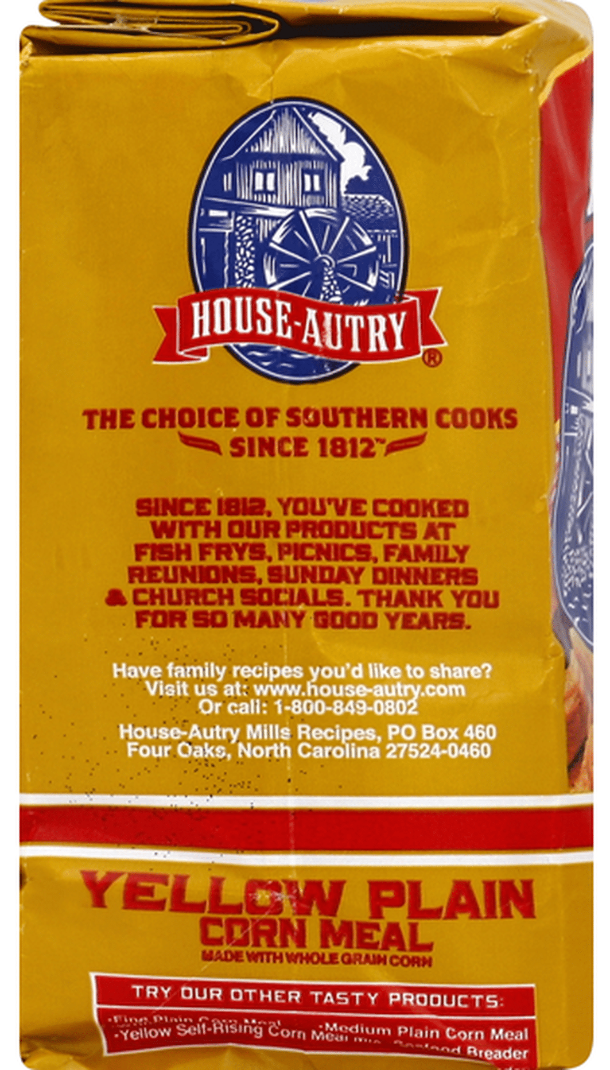
Tested food: CORN MEAL
Grown: North Carolina (USA)
GMO signed: no
Country of origin: USA
Brand: House Autry
Mass: 907g
Calorific value: 110 kcal per 30g

Slide 4
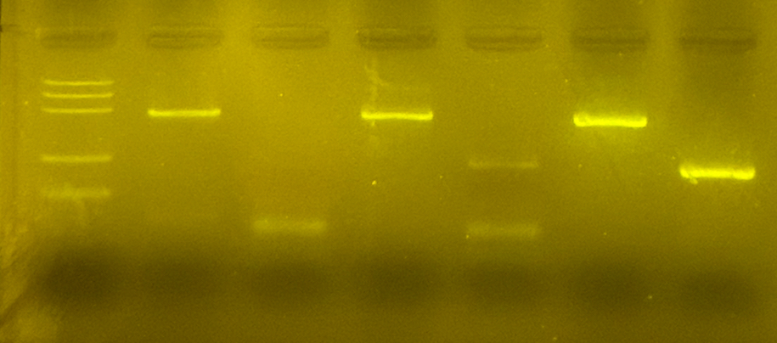
1. -control PMM
2. –control GMM
3. Tested FOOD PMM
4. Tested FOOD GMM
5. +control PMM
6. +control GMM
Observation: Gel Pattern of Electrophoresis
M
1
2
3
4
5
6
PS II (455 bp)
CaMV and/or NOS (220 bp)
Rest of primers/dNTPs (25 bp)
Notes:
Primer base, spillage (possibility), CaMV and NOS

Slide 5
Evaluation:
Soy flakes – plant origin (positive for PS II)
Soy flakes – genetically modified (negative for CaMV/NOS)
TESTED FOOD – CORN MEAL – plant origin (positive for PS II)
TESTED FOOD – CORN MEAL – genetically modified (positive for CaMV/NOS)
Positive control – plant origin (positive for PSII)
Positive control – genetically modified (positive for CaMV/NOS)

Slide 6
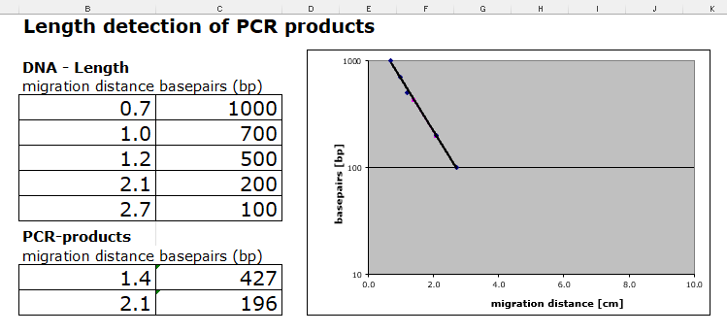
Evaluation:
Length Estimation of Bands in the Gel by Calibration Curve

Slide 7
Conclusion
Test food is modified.
Length of gene fragment PSII: 427 bp
Length of modification is 196 bp
Modification is done by regulation sequence of CaMV-Promoter (more probability) and/or NOS-Terminator

