Slide 1
Food Investigation about Genetical Modified Crops
Results from Workgroup 3
Tested food: Hodgson Mill Soy Flour
Hartsville (USA) June 1st – June 5th 2026

Slide 2



GROUP 3
Patrik Ráček
Slovakia
Biskupské gymnasium a mateřská škola,
Brno
Samuel Lewis
America
South Carolina Governors School for Science and Mathematics,
Hartsville

Slide 3
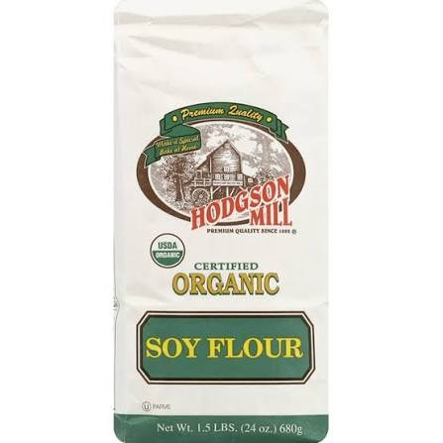
Tested food: Soy flour
Grown: United States (midwestern states)
GMO signed: no gmo label
Country of origin: United States
Brand: Hodgson Mill
Mass: 680g
Calorific value: Around 400 kcal per 100g

Slide 4
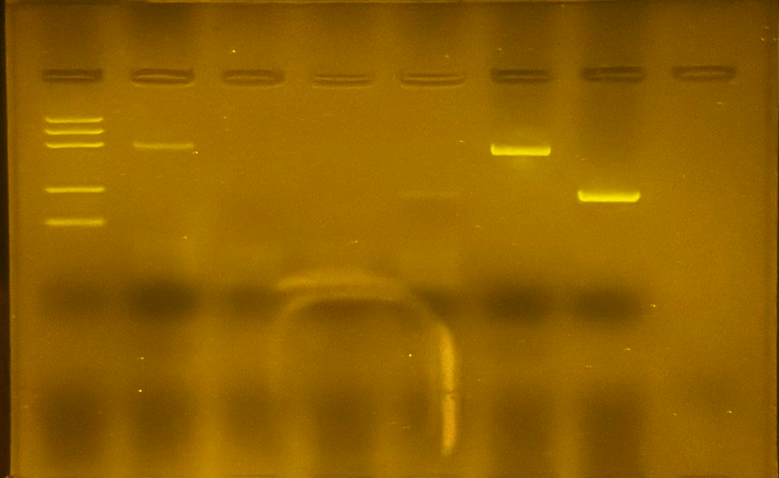
Observation: Gel Pattern of Electrophoresis
1. -control Alnatura Soy PMM
2. -control Alnatura Soy GMM
3. Tested Hodgson Mill Soy Flour PMM
4. Tested Hodgson Mill soy Flour GMM
5. +control PMM
6. +control GMM
M
1
2
3
4
5
6
PS II (455 bp)
CaMV or/and NOS (220 bp)
Rest of primers (25 bp)
Rest of dNTPs

Slide 5
Evaluation:
Alnatura Soy - plant origin, tested positive for the PS2 protein
Alnatura Soy - genetic modified, tested negative for both gene sequence lengths
Hodgson Mill – Soy Flour – plant origin, no result
Hodgson Mill – Soy Flour – genetic modified, tested positive
Positive control – plant origin, tested positive for the PS2 protein
Positive control – genetic modified, tested positive for CAMV or NOS terminator

Slide 6
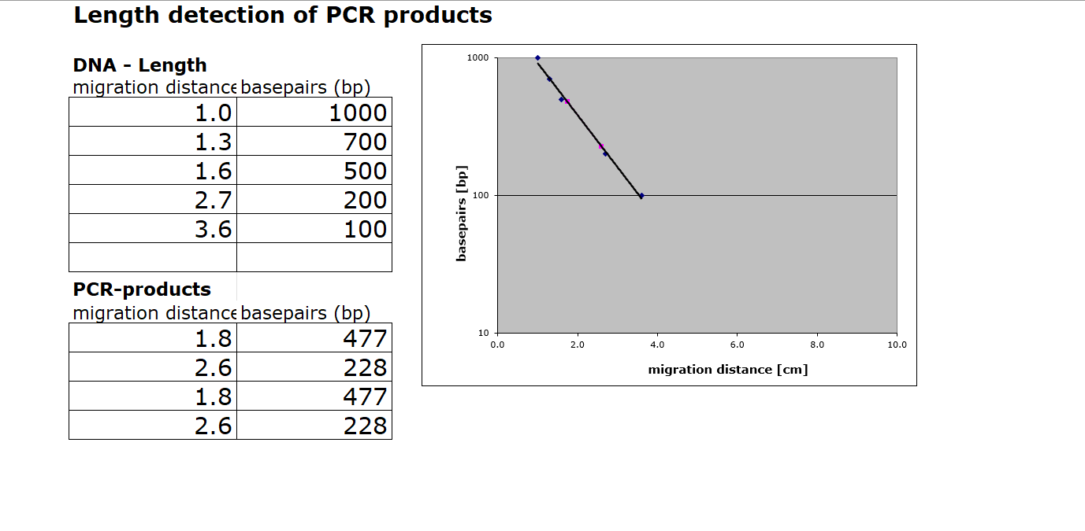
Evaluation:

Slide 7
Conclusion
Test food is modified.
Length of gene fragment PSII: 455bp, our found to be similar at around 477bp
Length of modification is 203 Or 225 bp, ours seemed to be 228bp being closer to the NOS Terminator
Modification is most likley done by regulation sequence of NOS terminator

