Slide 1
Food Investigation about Genetically Modified Crops
Results from Workgroup 2
Tested food: Czech Corn
Hartsville (USA) June 1st – June 5th 2026

Slide 2



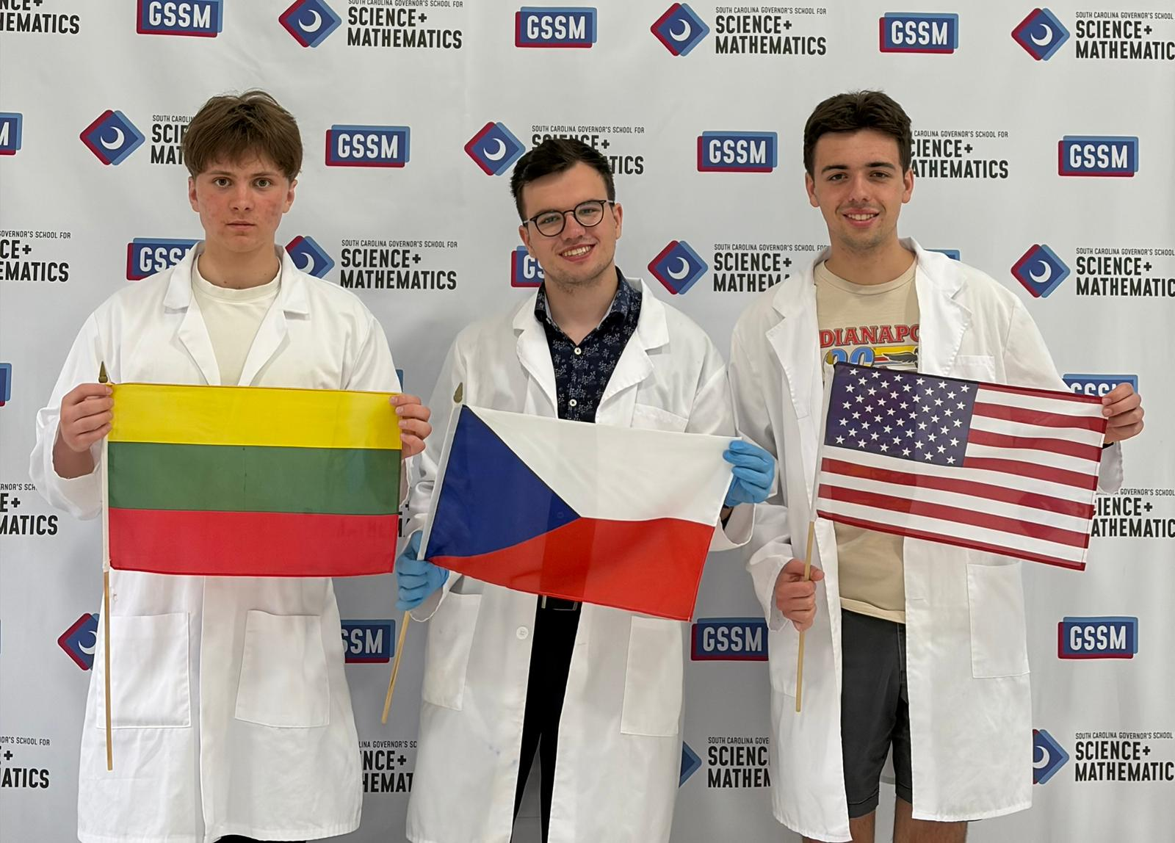
GROUP 2
Pranciškus Petrauskas
Lithuania
Vilniaus Jėzuitų Gimnazija
Štěpán
Vlach
Czech Republic
Biskupské gymnázium Brno
Albert Mathisz
U.S.A.
South Carolina Governor’s School for Science and Mathematics

Slide 3
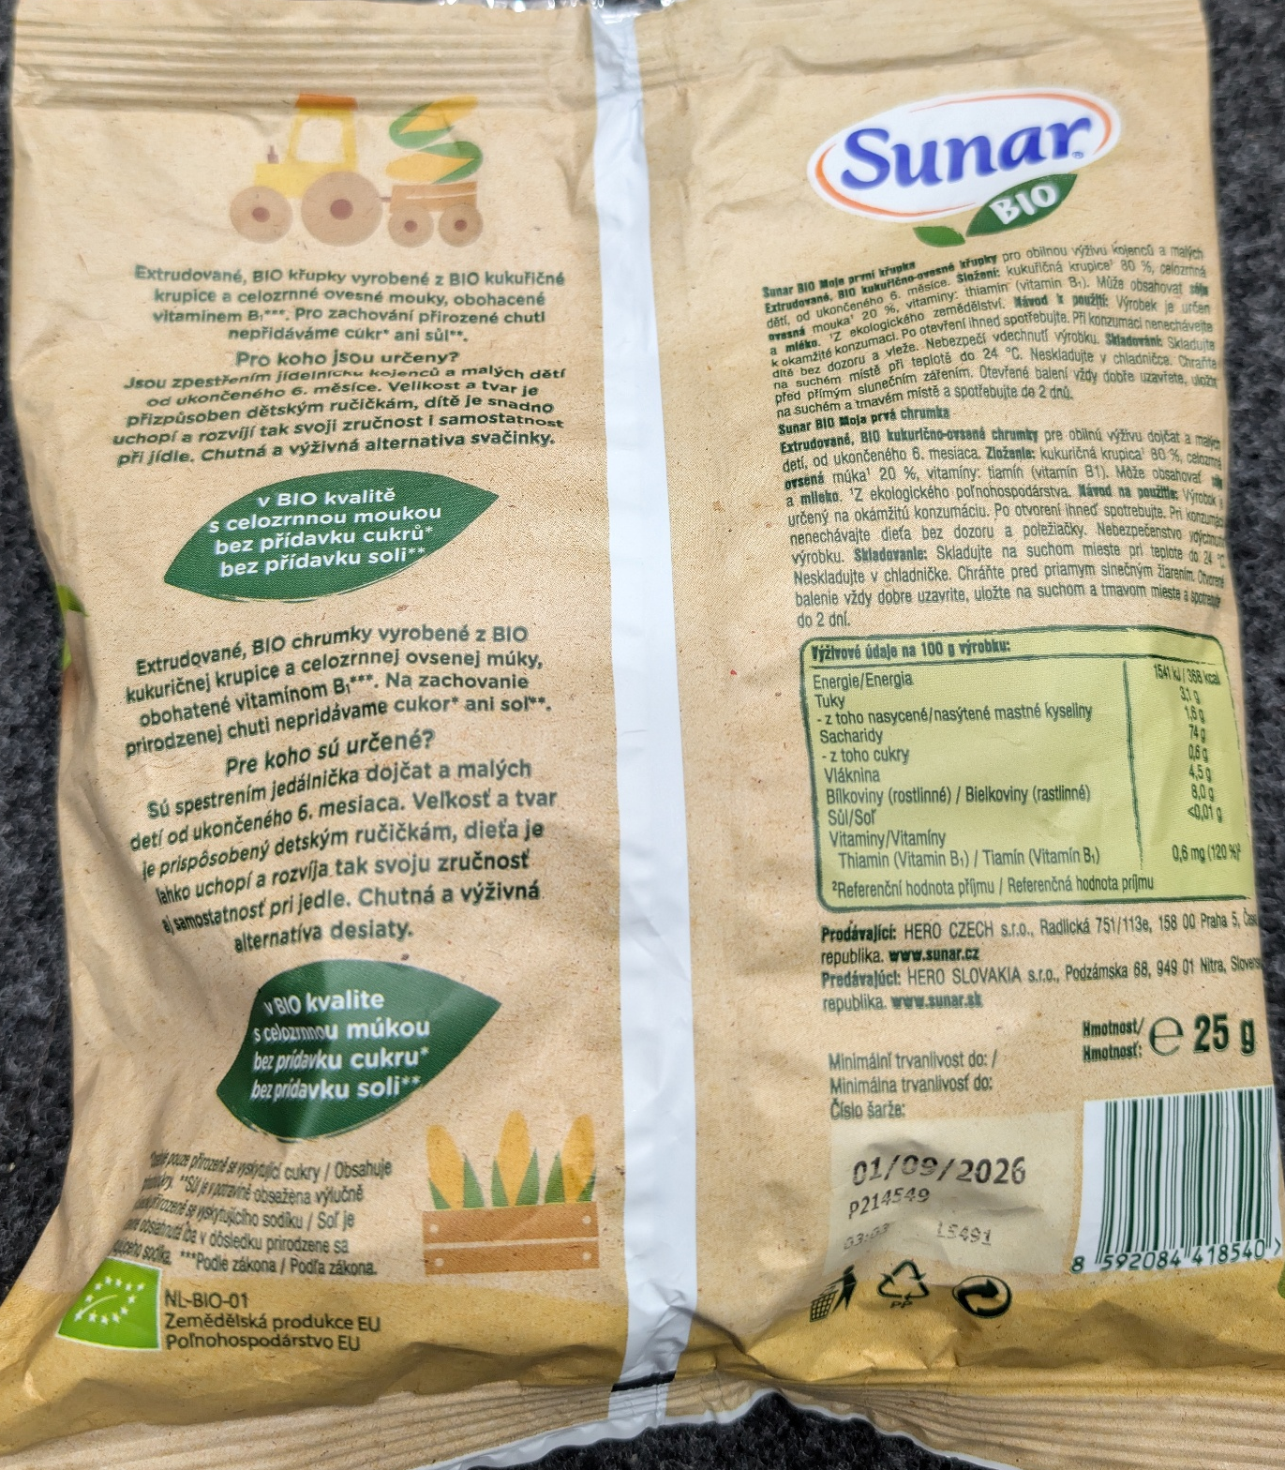
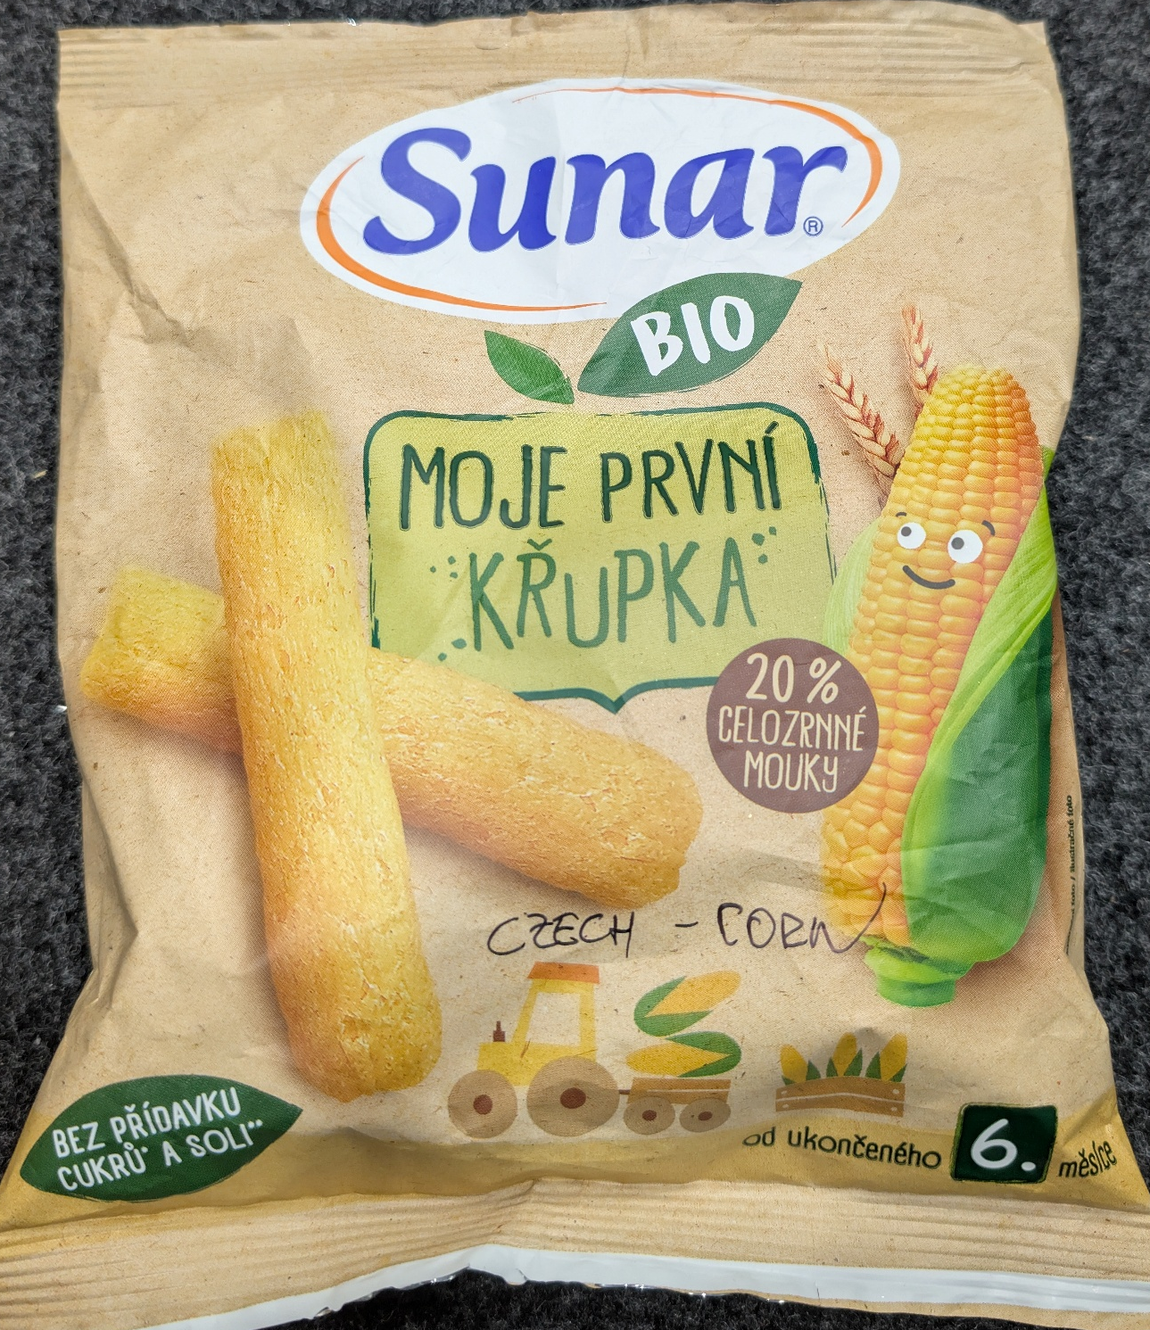
Tested food: Czech Corn
Grown: European Union
GMO Signed: NOT Signed
Country of origin: Czech Republic
Brand: Sunar
Mass: 25g
Calorific value: 368 kcal per 100 g

Slide 4
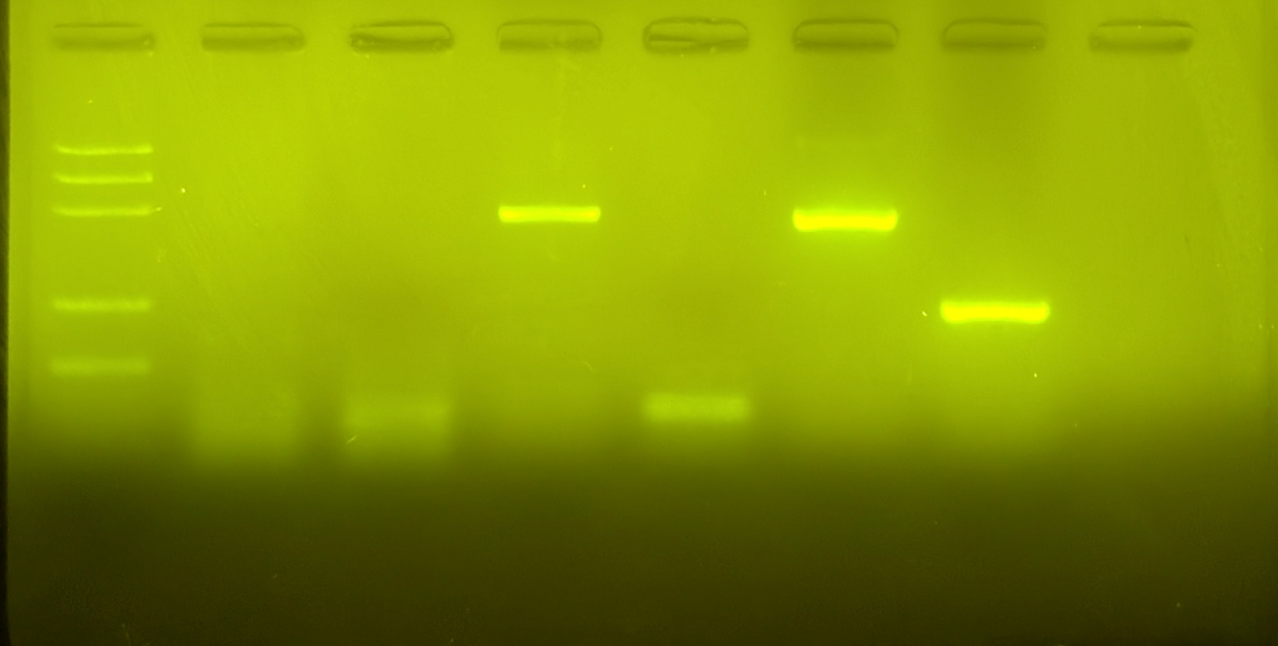
Observation: Gel Pattern of Electrophoresis
1. -control PMM
2. –control GMM
3. Tested FOOD PMM
4. Tested FOOD GMM
5. +control PMM
6. +control GMM
M
1
2
3
4
5
6
PS II (~466 bp)
CaMV or/and NOS (~217 bp)
Rest of primers (~25 bp)
Rest of dNTPs

Slide 5
Evaluation:
Crushed Wheat – Plant Origin (FAILED)
Crushed Wheat – Non-genetically Modified (FAILED)
TESTED FOOD – Czech Corn – Plant Origin
TESTED FOOD – Czech Corn – Non-genetically Modified
Positive control – Plant Origin
Positive control – Genetically Modified

Slide 6
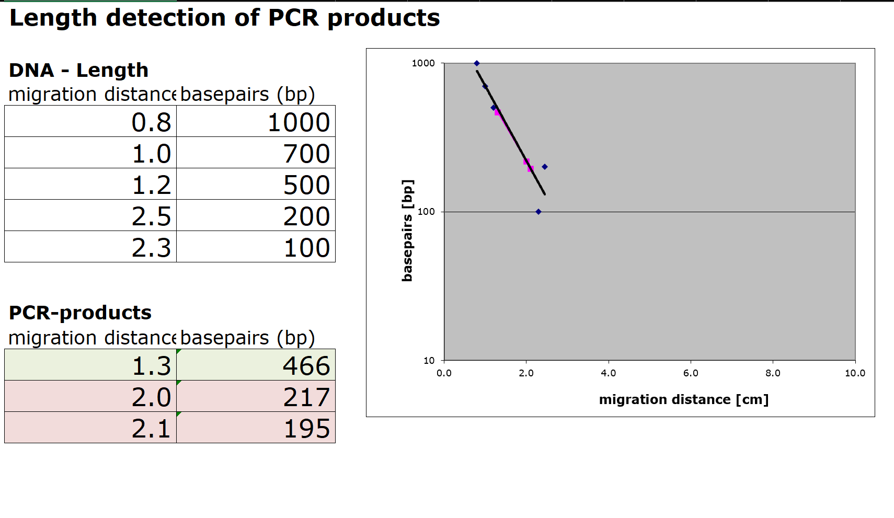
Evaluation:
Length Estimation of Bands in the Gel by a Calibration Curve
PS II --->
CaMV ->
NOS --->

Slide 7
Conclusion
Test food is NOT modified.
Length of gene fragment PSII: 466 bp
Length of modification is 195 or/and 217 bp
We did not find modifications containing a CaMV-Promoter or/and NOS-Terminator.

