Slide 1
Food Investigation about Genetically Modified Crops
Results from Workgroup 14
Tested food: Dr. Jay’s OAT
Hartsville (USA) June 1st – June 5th 2026

Slide 2

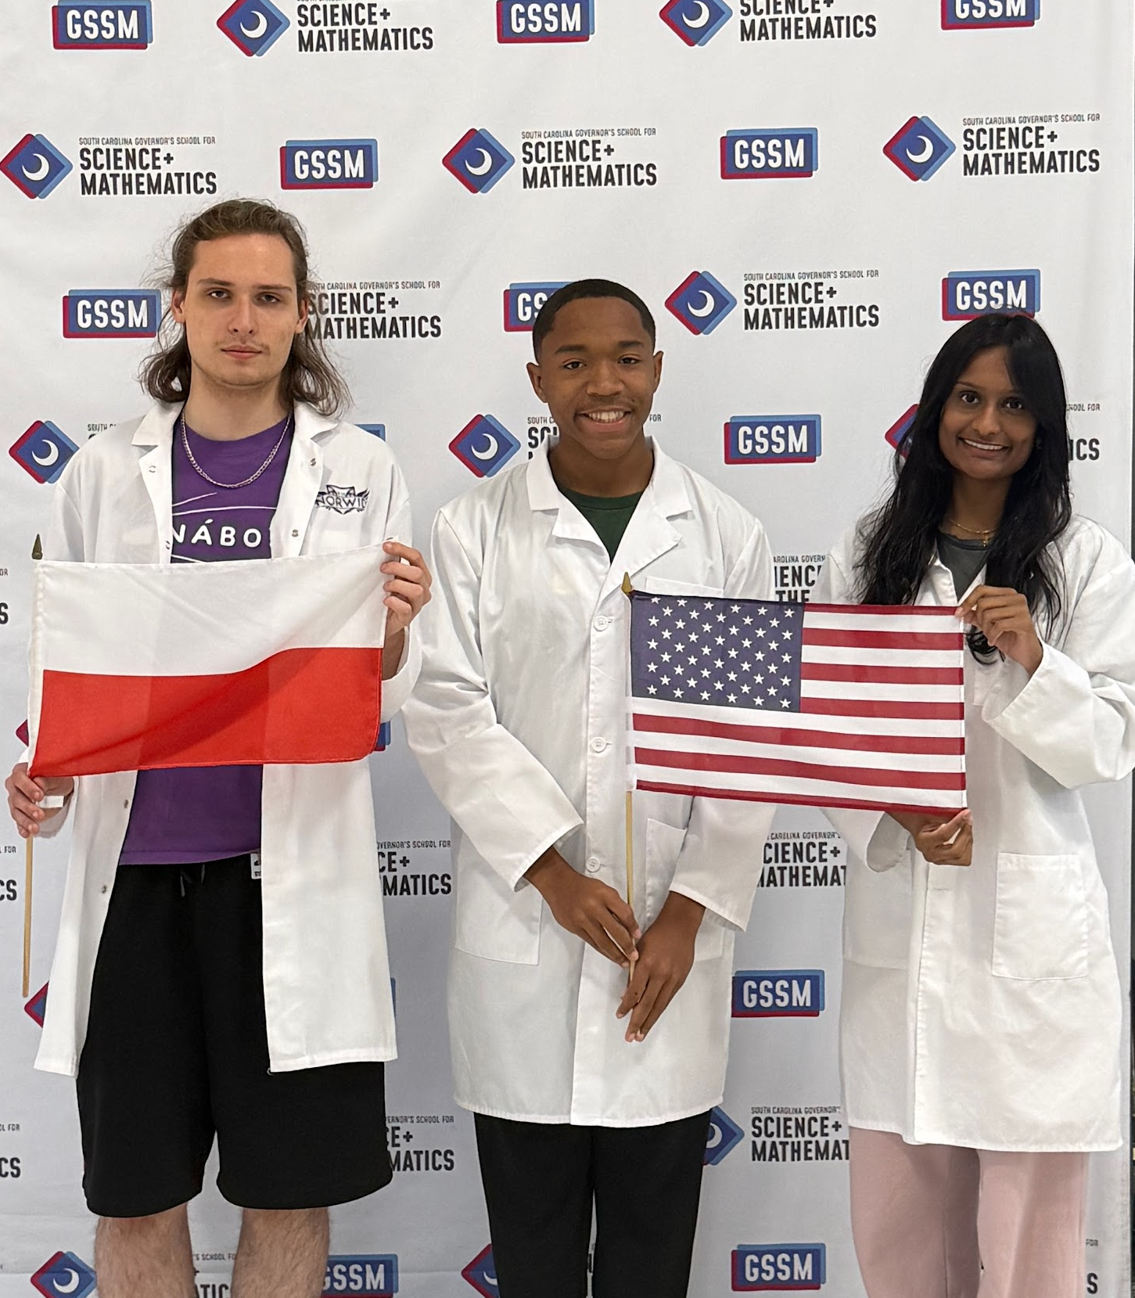

GROUP 14
Janki Patel (M oF Ms)
United States
Konrad Brodziak (M)
Poland
Noah Coleman (M)
United States

Slide 3
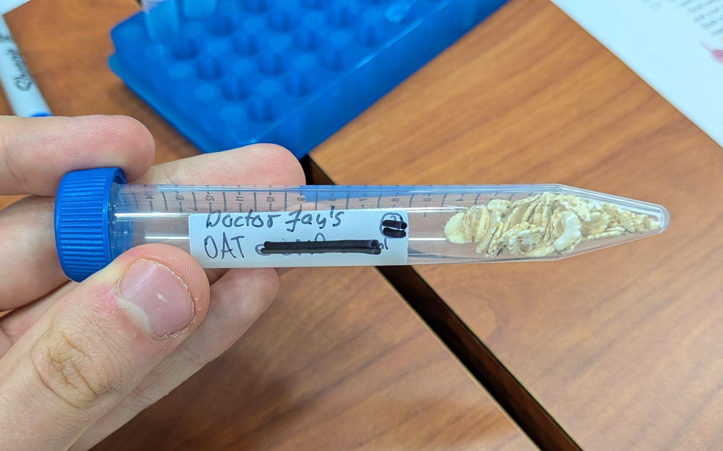
Tested food: Dr. Jay’s OATs
Grown: N/A
GMO signed: N/A
Country of origin: America
Brand: Doctor Jay
Mass: N/A
Calorific value: N/A

Slide 4
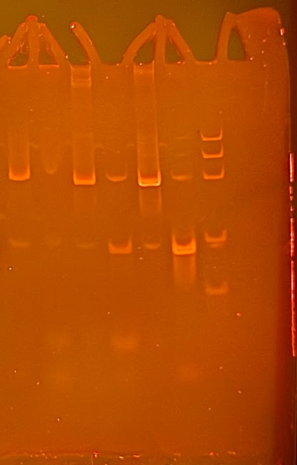
Observation: Gel Pattern of Electrophoresis
PAGE Gel is stained by ethidium bromide
M
1. -control PMM
2. –control GMM
3. Tested FOOD PMM
4. Tested FOOD GMM
5. +control PMM
6. +control GMM
1
2
3
4
5
6
M
Observations:
Bands around 500 bp in PMM samples
band around 180 bp in sample 4. and 6.
There is spillover in every sample
PS II (455 bp)
CaMV or/and
NOS (220 bp)
Rest of primers
(25 bp)
Rest of dNTPs
Notes:
Evaluation
PSII is detected in every sample
Genetic modifications are found in test food
Conclusion
Test food is genetically modified

Slide 5
Evaluation:
Negative Control (Alnatura Soy Flakes) - plant origin (PSII detected)
Negative Control (Alnatura Soy Flakes) - no genetic modifications
TESTED FOOD - Dr. Jays Oats - plant origin (PSII detected)
TESTED FOOD - Dr. Jays Oats - genetically modified (NOS/CaMV detected)
Positive control - plant origin (PSII detected)
Positive control - genetically modified (NOS/CaMV detected)

Slide 6
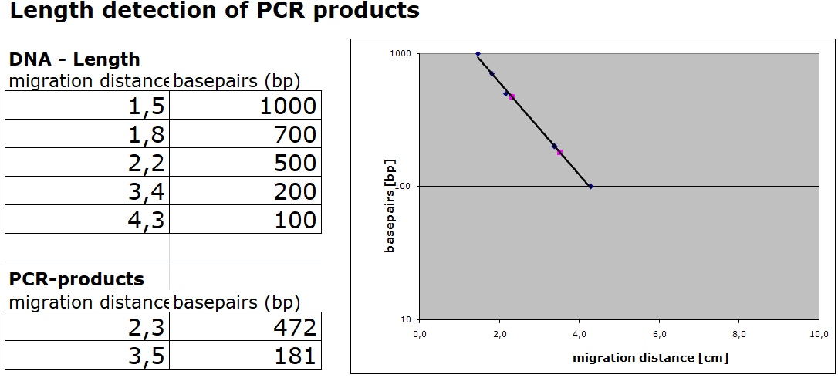
Evaluation:
Length Estimation of Bands in the Gel by Calibration Curve

Slide 7
Conclusion
Test food (Dr. Jays Oats) is modified.
Length of gene fragment PSII: 472 bp (exp. 455bp)
Length of modification is 181 bp (exp. 203/225bp)
Modification is done by regulation sequence of CaMV-Promoter

Slide 8
Thank you for your attention

