Slide 1
Food Investigation about Genetically Modified Crops
Results from Workgroup 13
Tested food: Oat Flakes
Hartsville (USA) June 1st – June 5th 2026

Slide 2


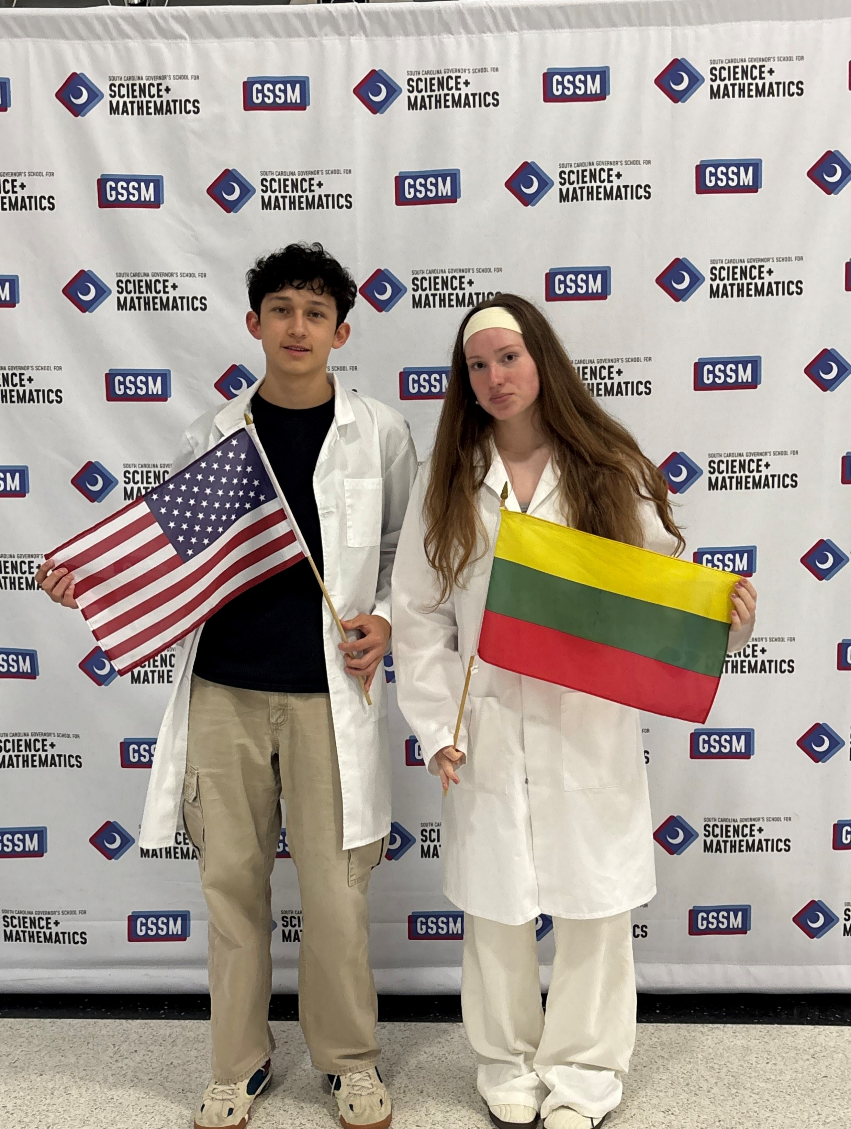
GROUP 13
Christian Torres
USA
Ieva Stundžytė
Lithuania

Slide 3

Tested food: Oats Flakes
Grown: N.D
GMO signed: N.D
Country of origin: America
Brand: Dr. J’s Oats
Mass: N.D
Calorific value: N.D

Slide 4
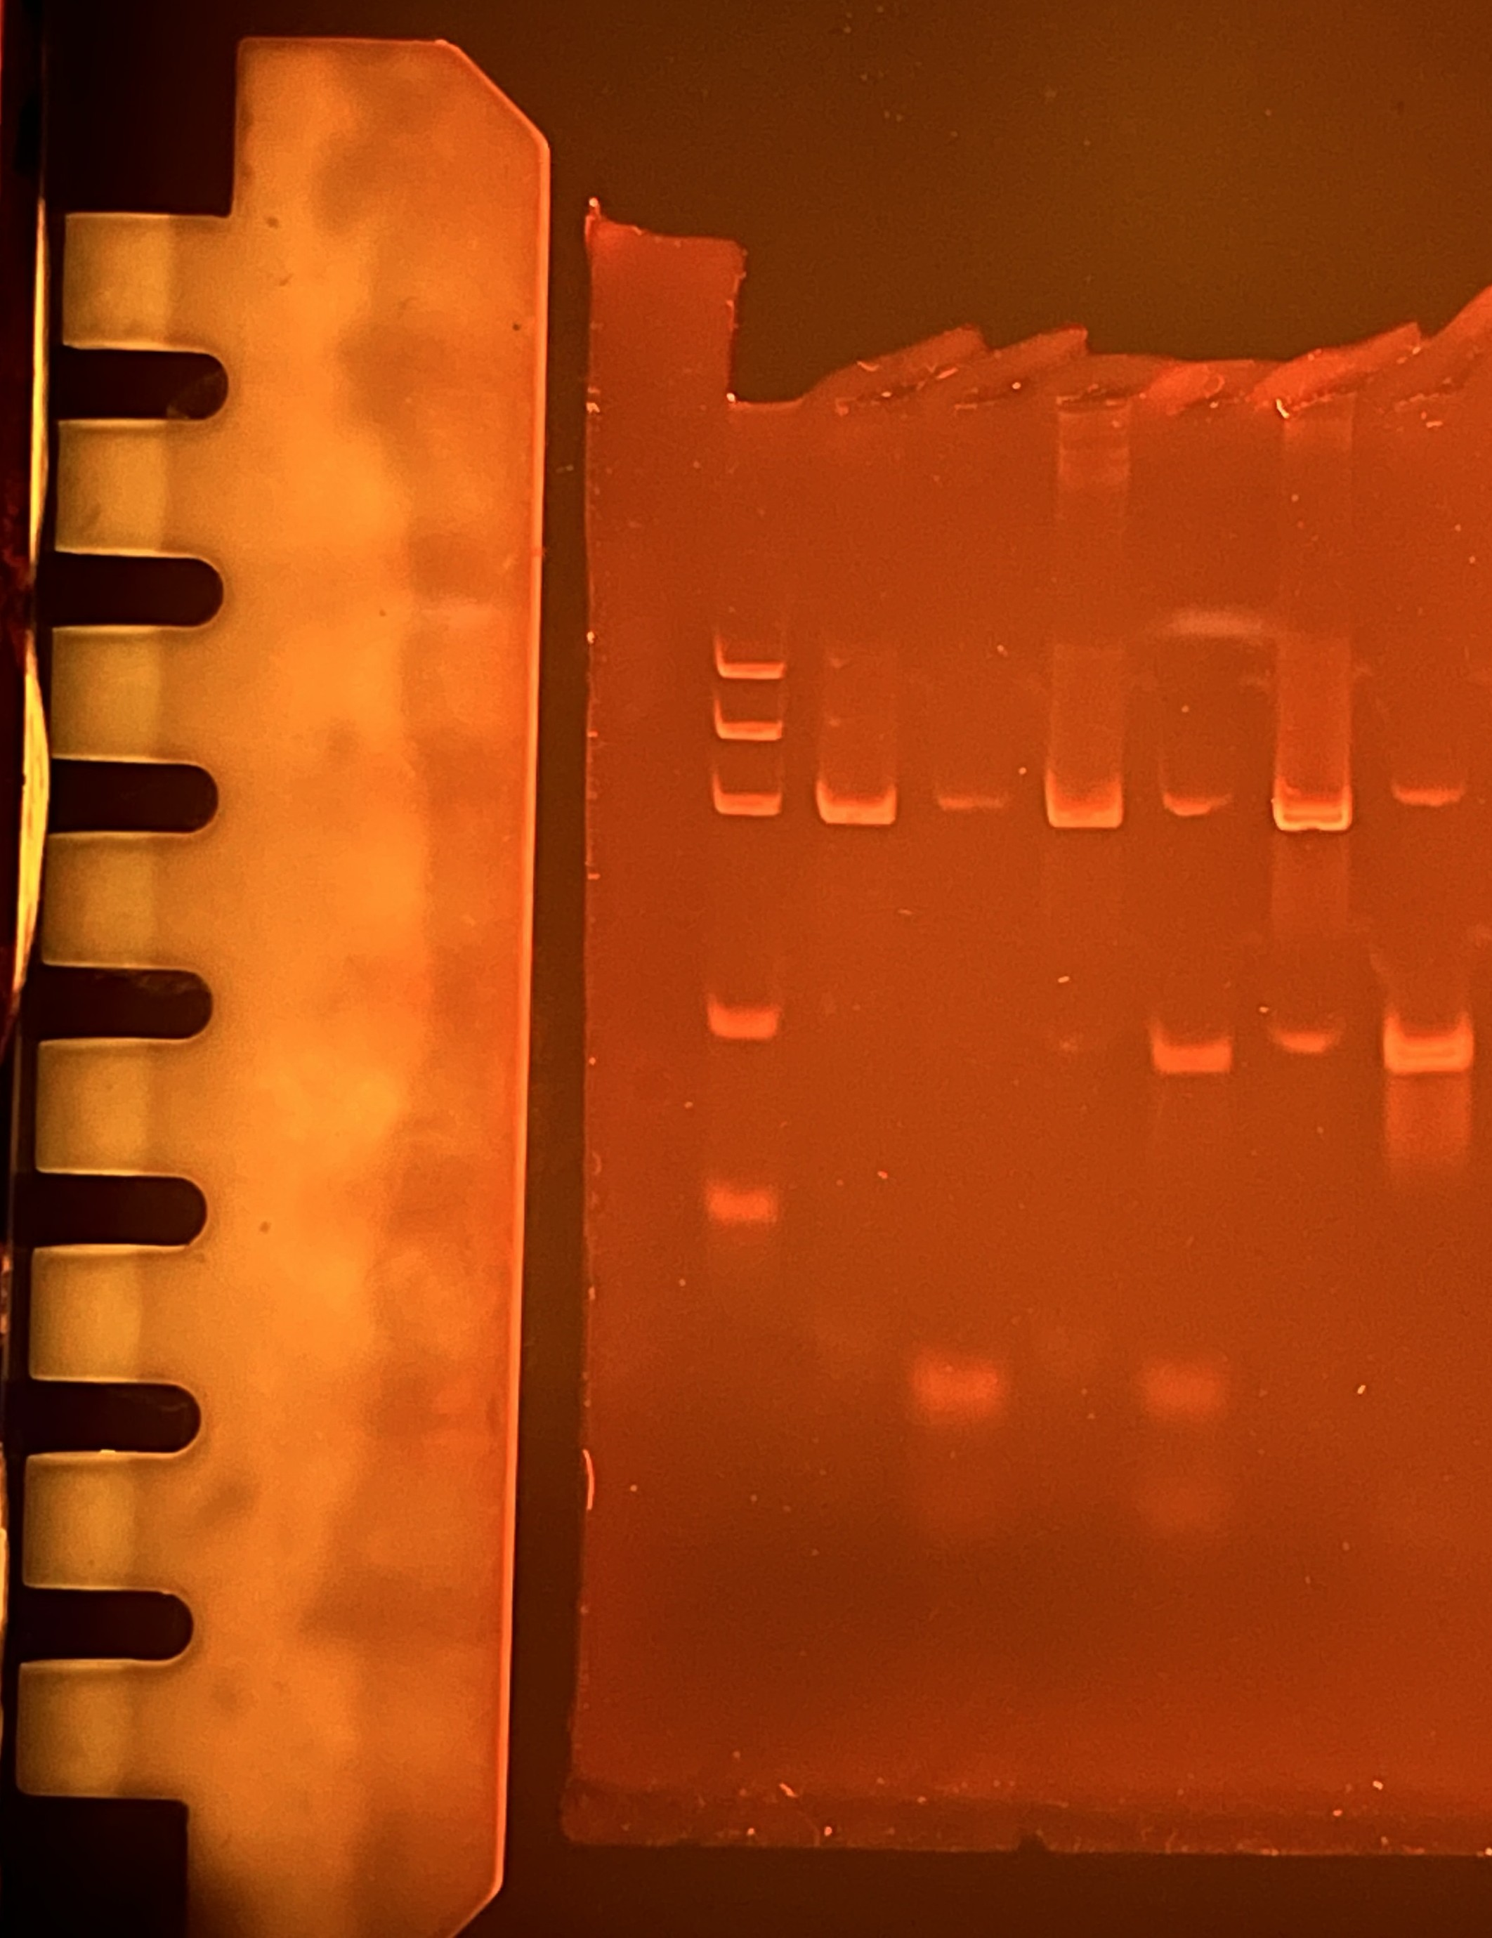
Observation: Gel Pattern of Electrophoresis
M
1
2
3
4
5
6
1. -control PMM
2. –control GMM
3. Tested FOOD PMM
4. Tested FOOD GMM
5. +control PMM
6. +control GMM
PS II (455 bp)
CaMV or/and NOS (203/225 bp)
Rest of primers (25 bp)
Rest of dNTPs

Slide 6
Evaluation:
Oat flakes (- control) – if plant origin
Oat flakes (- control) – if genetically modified
TESTED FOOD – OAT FLAKES – if plant origin
TESTED FOOD – OAT FLAKES – if genetically modified
Positive control – if plant origin
Positive control – if genetically modified

Slide 7
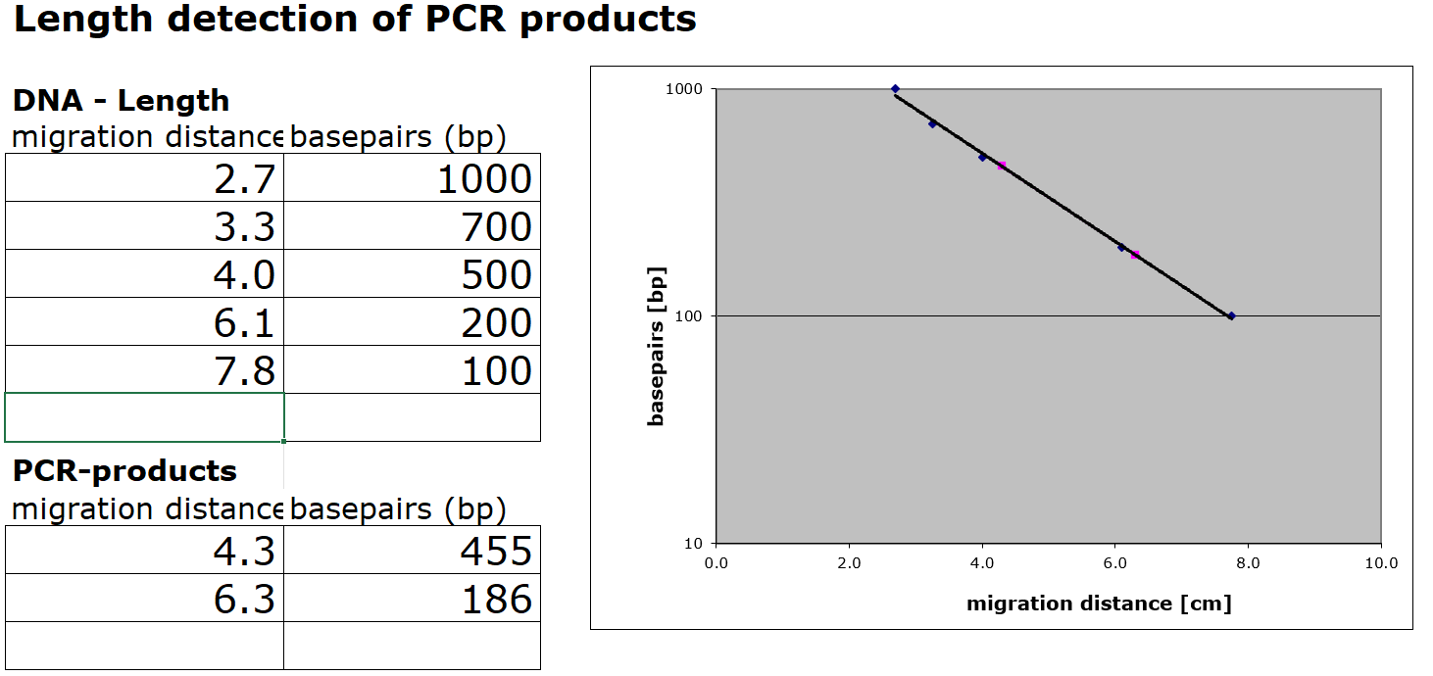
Evaluation:
Length Estimation of Bands in the Gel by Calibration Curve

Slide 8
Conclusion
Test food is modified.
Length of gene fragment PSII: 455 bp
Length of modification is 186 bp
Modification is done by the regulation sequence of CaMV-Promoter.

