Slide 1
Food Investigation about Genetical Modified Crops
Results from Workgroup 12
Tested food: CORN MEAL
Hartsville (USA) June 1st – June 5th 2026

Slide 2


GROUP 12
Dr. Murray Brockman & Rachel Kim
U.S.A
SC Governor’s School for Science and Mathematics
Divya Rustgi (Mentor)
U.S.A
SC Governor’s School for Science and Mathematics

Slide 3
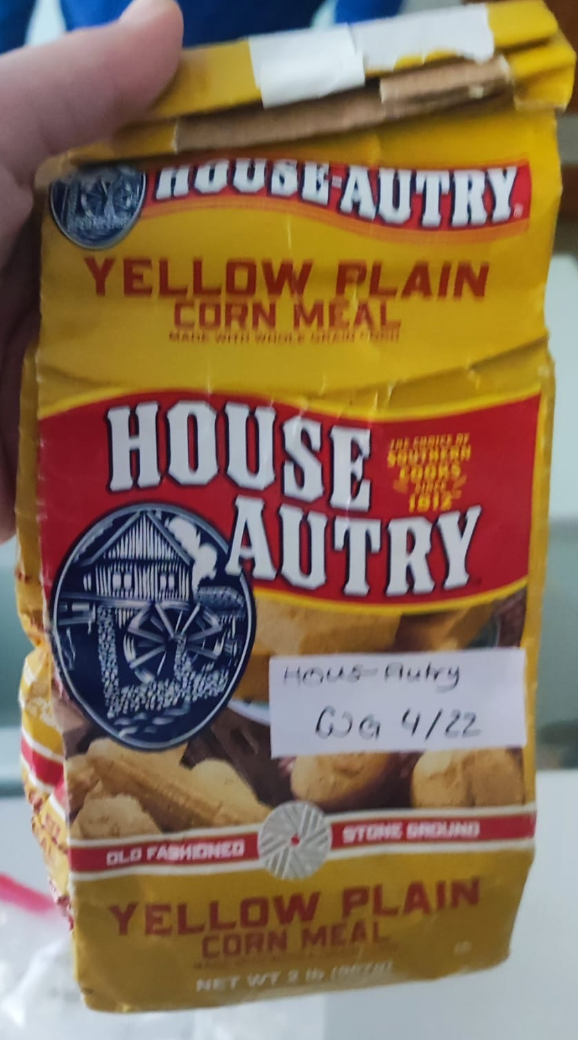
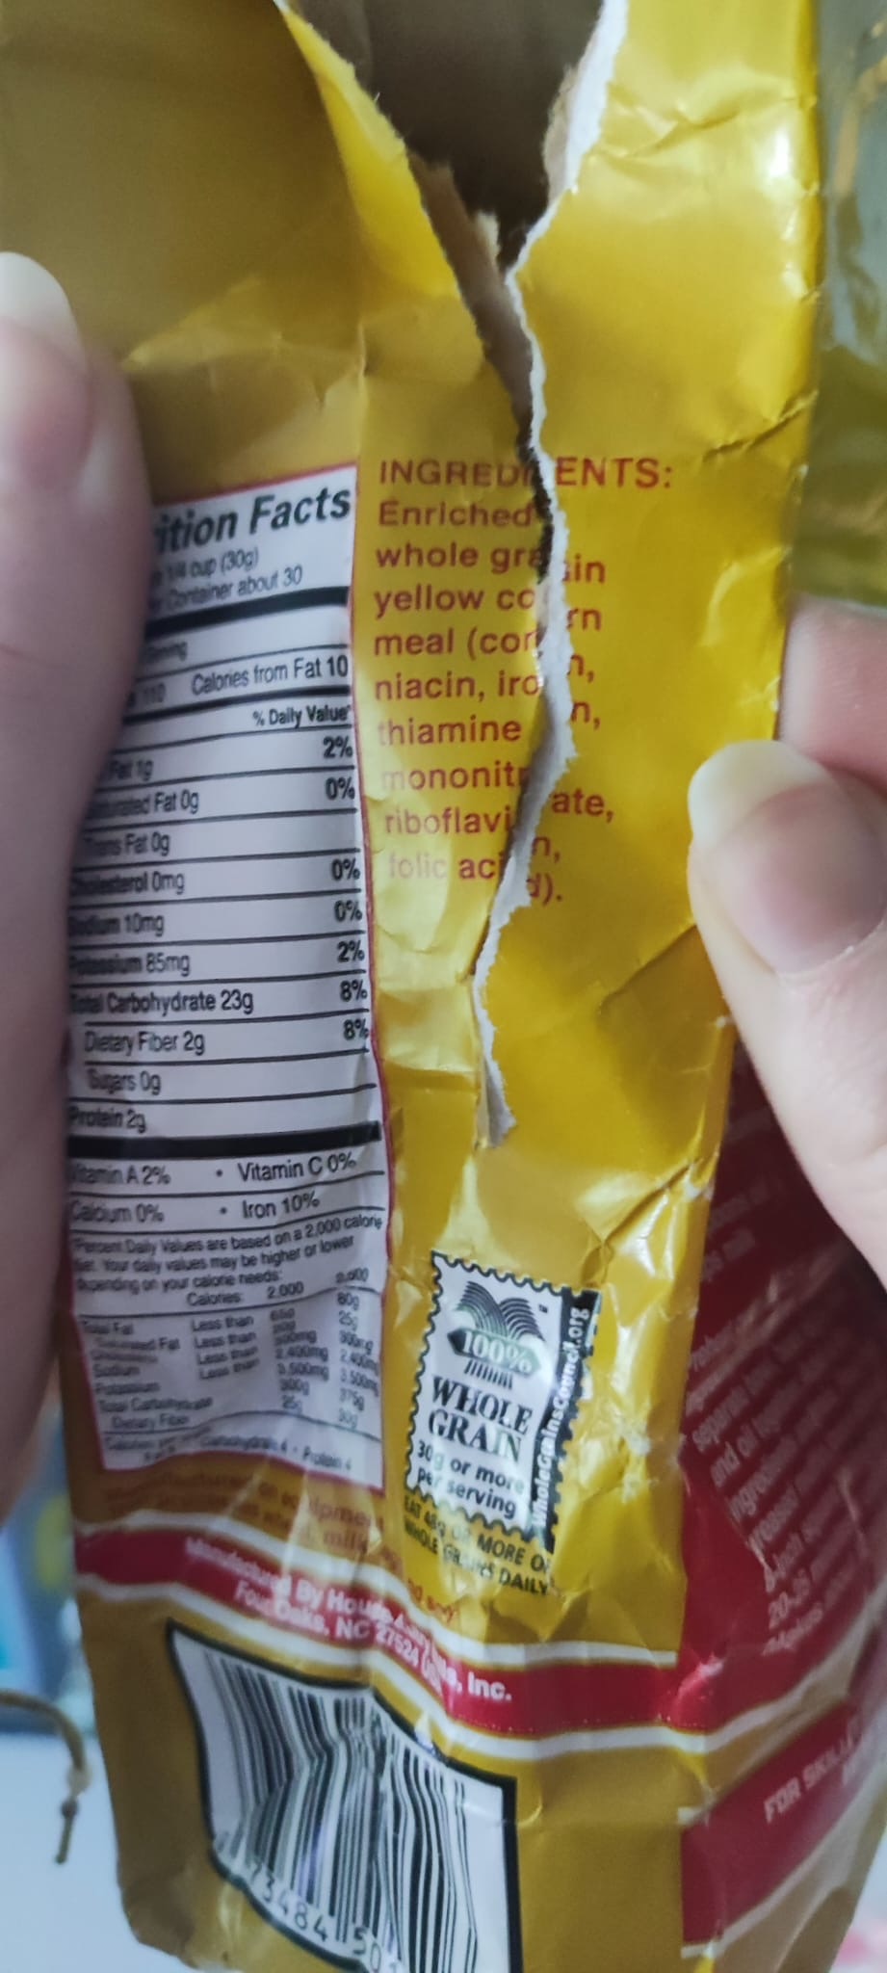
Tested food: CORN MEAL
Grown: North Carolina (USA)
GMO signed: no
Country of origin: USA
Brand: House-Autry
Mass: 907g
Calorific value: 110kcal per 30g

Slide 4
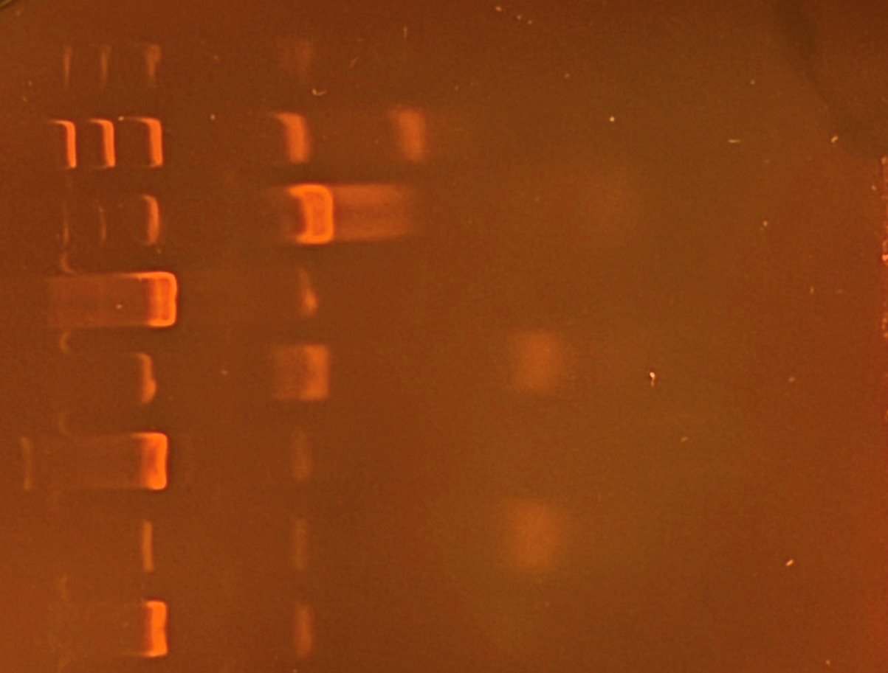
Observation: Gel Pattern of Electrophoresis (PAGE)
1
2
3
4
5
6
M
1. - GMO control +PMM
2. - GMO control +GMM
3. Tested FOOD +PMM
4. Tested FOOD +GMM
5. +GMO control +PMM
6. +GMO control +GMM
PS II (455 bp)
CaMV or/and NOS (220 bp)
Rest of dNTPs

Slide 5
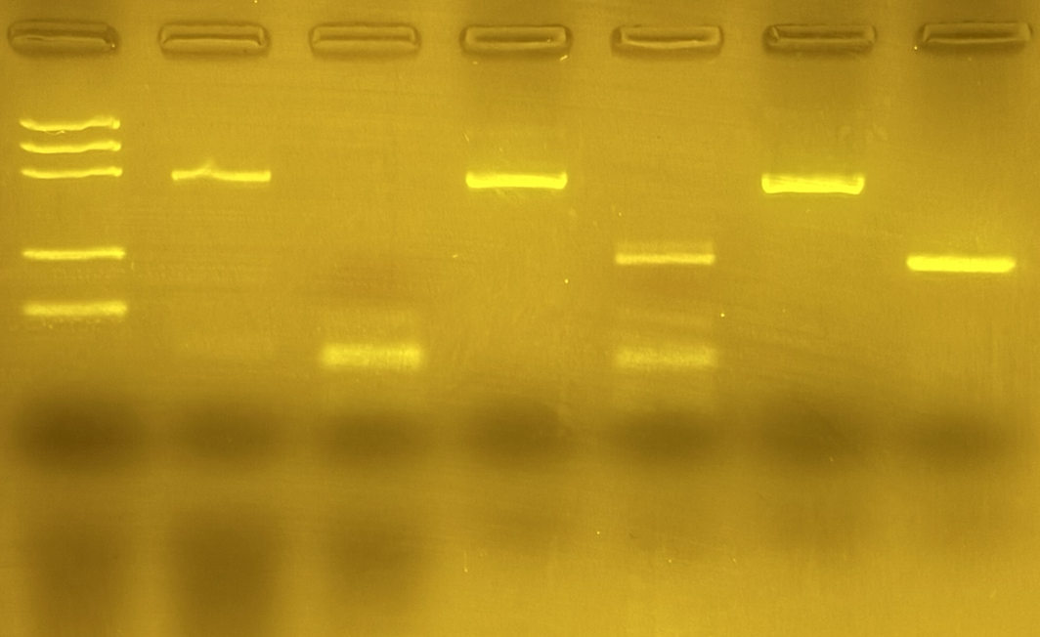
Observation: Gel Pattern of Electrophoresis (Agarose)
M
1
2
3
4
5
6
1. -GMO control +PMM
2. -GMO control +GMM
3. Tested FOOD +PMM
4. Tested FOOD +GMM
5. +GMO control +PMM
6. +GMO control +GMM
PS II (455 bp)
CaMV or/and NOS (220 bp)
Rest of dNTPs

Slide 6
Evaluation:
Oat flakes (-GMO) – plant origin (PMM)
Oat flakes(-GMO) - genetic modified (GMM)
TESTED FOOD – CORN MEAL – plant origin (PMM)
TESTED FOOD – CORN MEAL – genetic modified (GMM)
Positive control – plant origin (PMM)
Positive control – genetic modified (GMM)

Slide 7
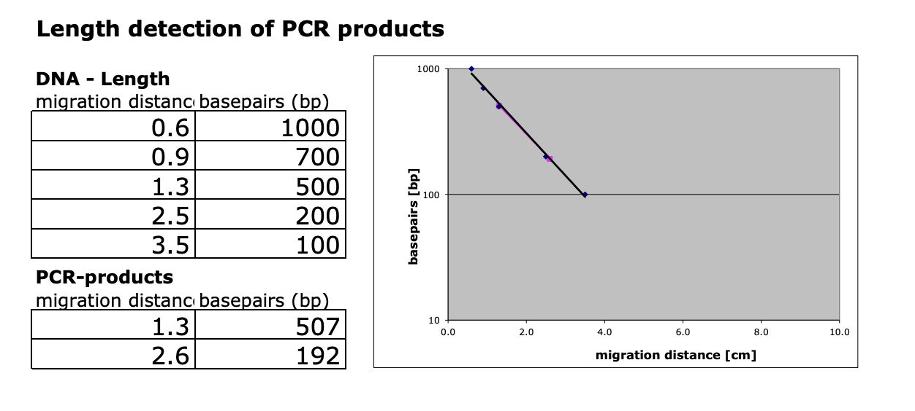
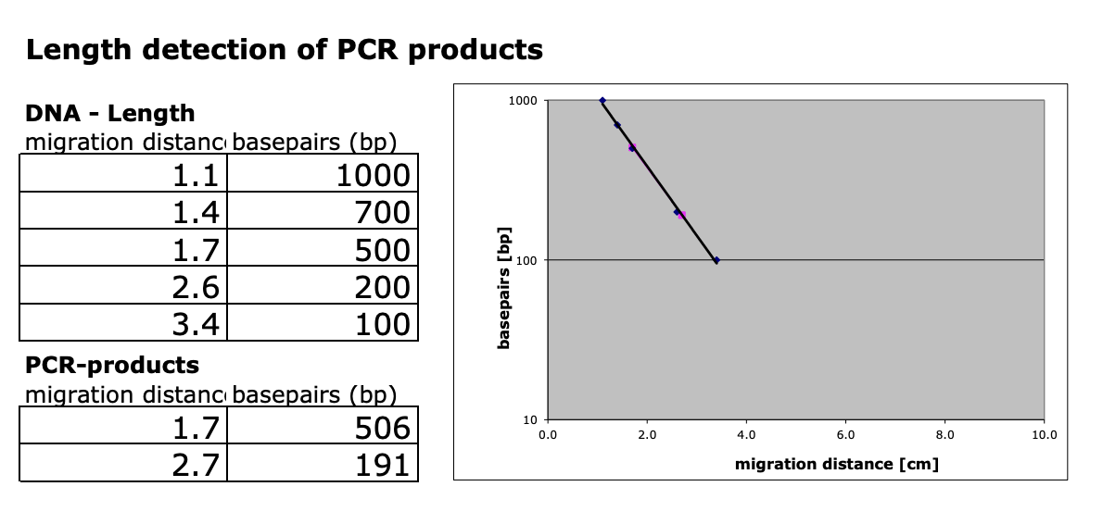
Evaluation:
Length Estimation of Bands in the Gel by Calibration Curve
PAGE
Agarose

Slide 8
Conclusion:
PAGE
Agarose
Test food is modified.
Length of gene fragment PSII: 507bp
Length of modification is 192 bp
Modification is done by regulation sequence of CaMV-Promoter or/and NOS-Terminater
Test food is modified.
Length of gene fragment PSII: 506bp
Length of modification is 191 bp
Modification is done by regulation sequence of CaMV-Promoter or/and NOS-Terminater

