Slide 1
Food Investigation about Genetical Modified Crops
Results from Workgroup 11
Tested food: SOY FLOUR (Hodgson Mill)
Hartsville (USA) June 1st – June 5th 2026

Slide 2



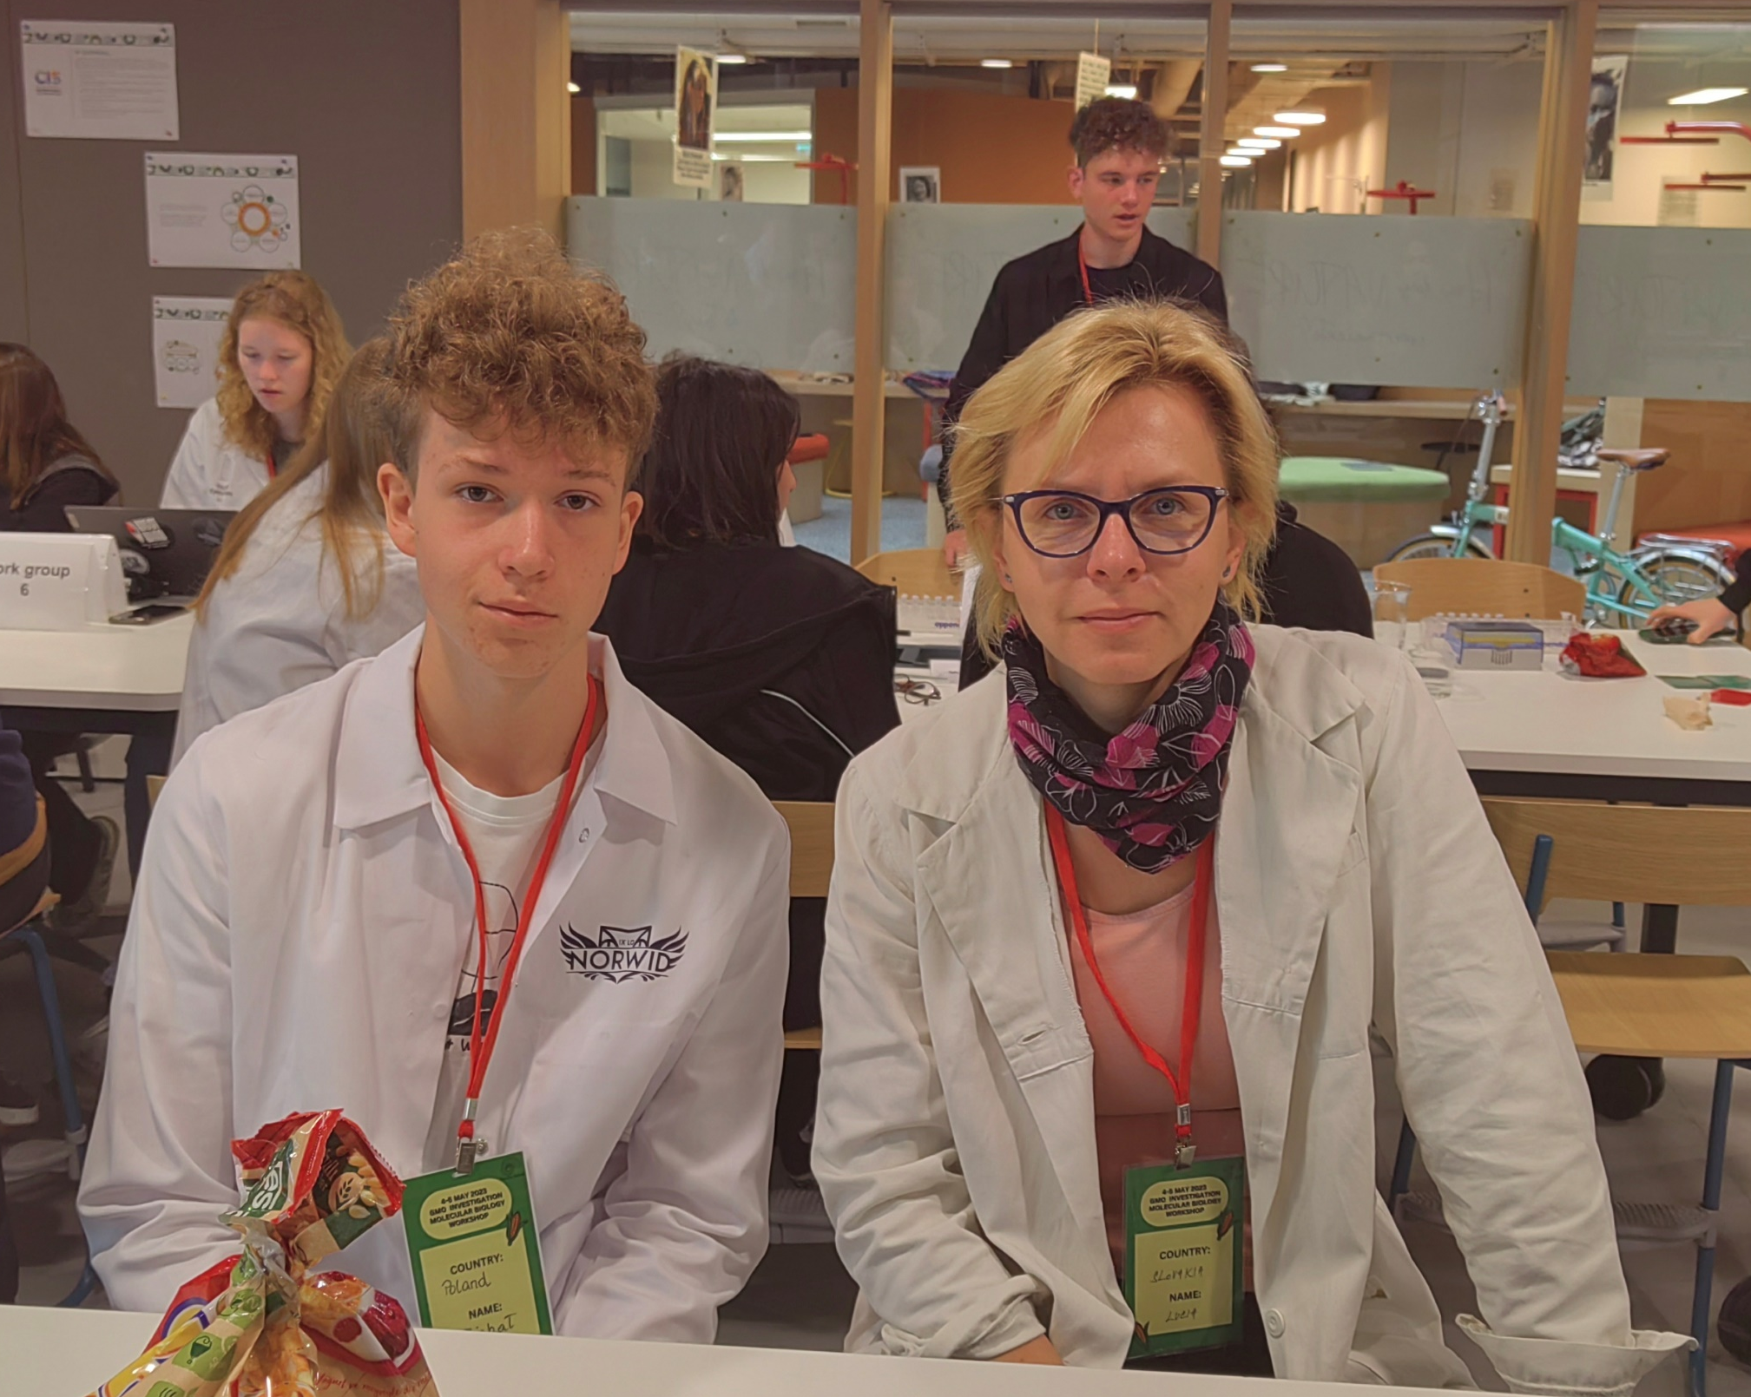

GROUP 11
Julia Candeo
United States
GSSM, Hartsville, SC
Hannah Loggie
United States
GSSM, Hartsville, SC
Rasa Rudzeviciene
Lithuania
Vilniaus jezuitu gimnazija

Slide 3
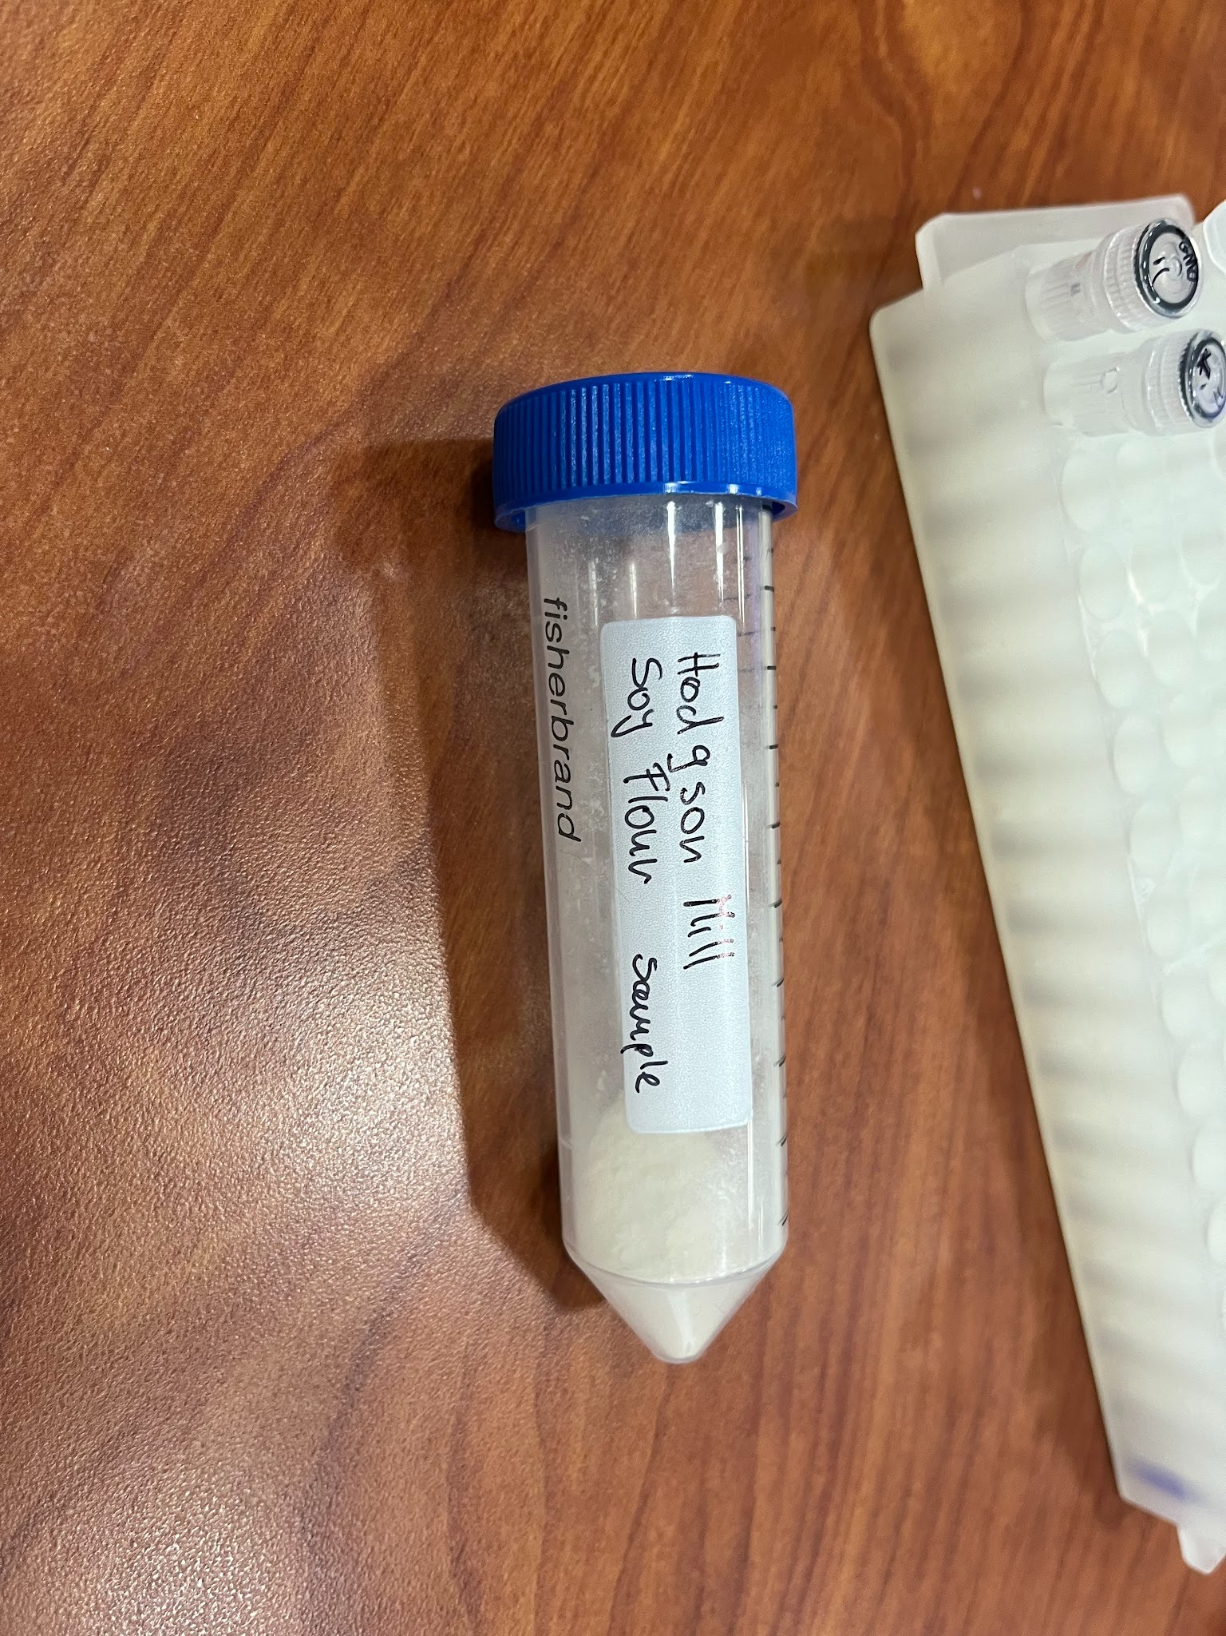
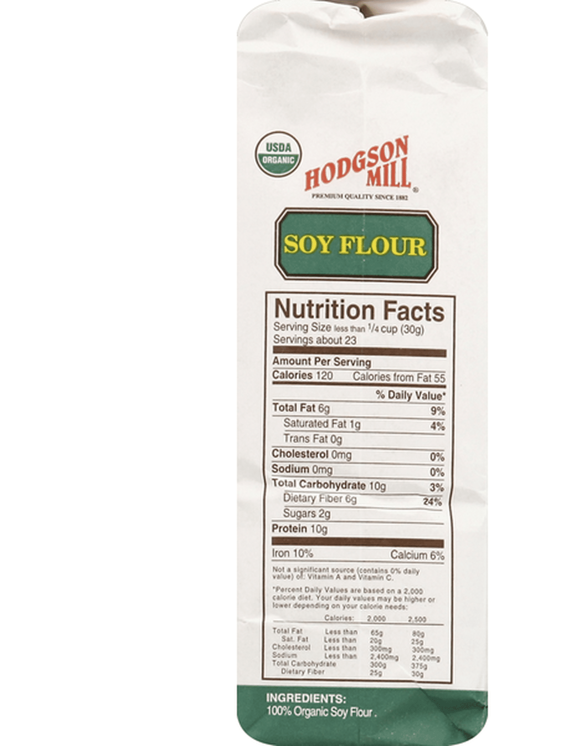
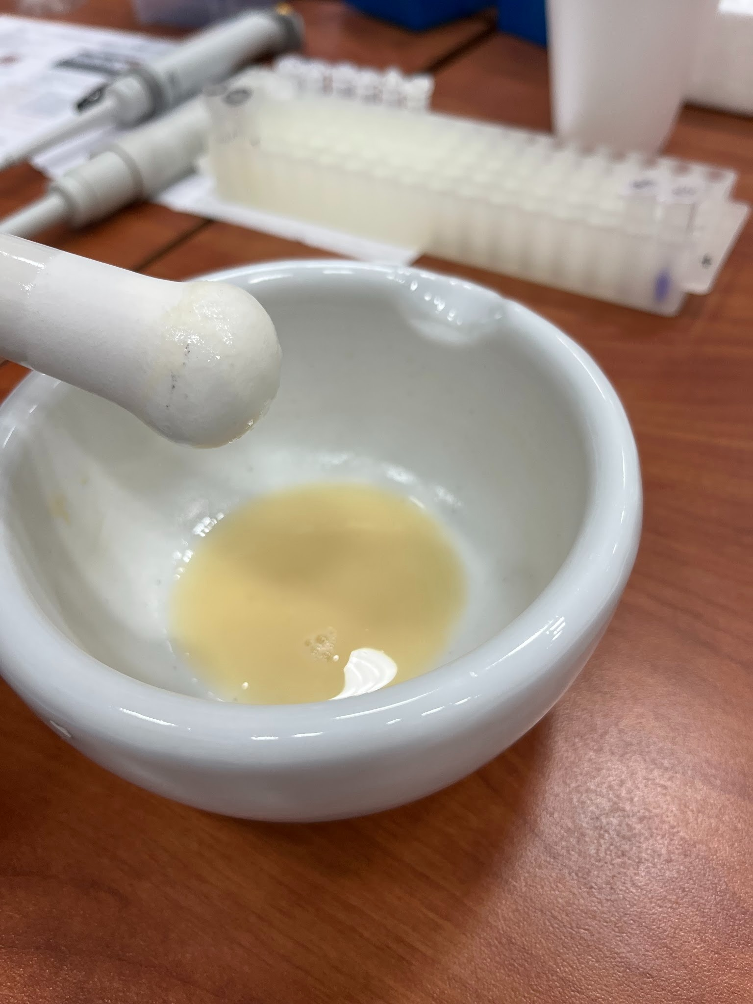
Tested food: SOY FLOUR
Grown: Illinois, U.S.
GMO signed: no (does not specify)
Country of origin: UNITED STATES
Brand: Hodgson Mill
Mass: 690g
Calorific value: 120 kcal per 30g

Slide 4
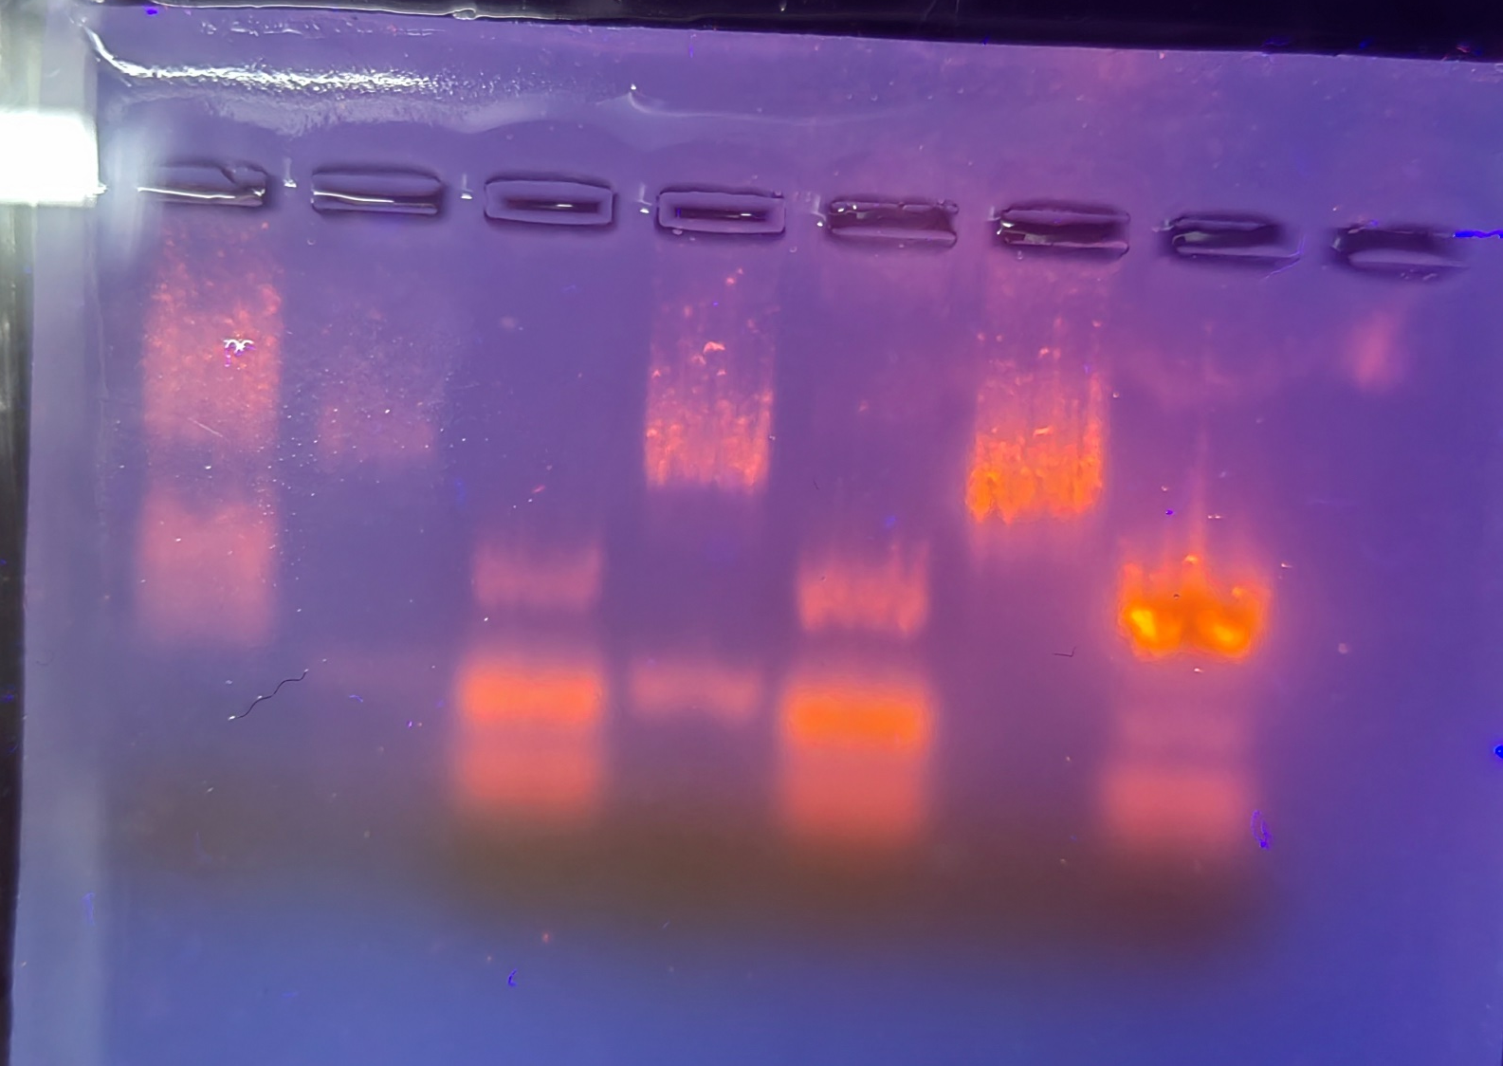
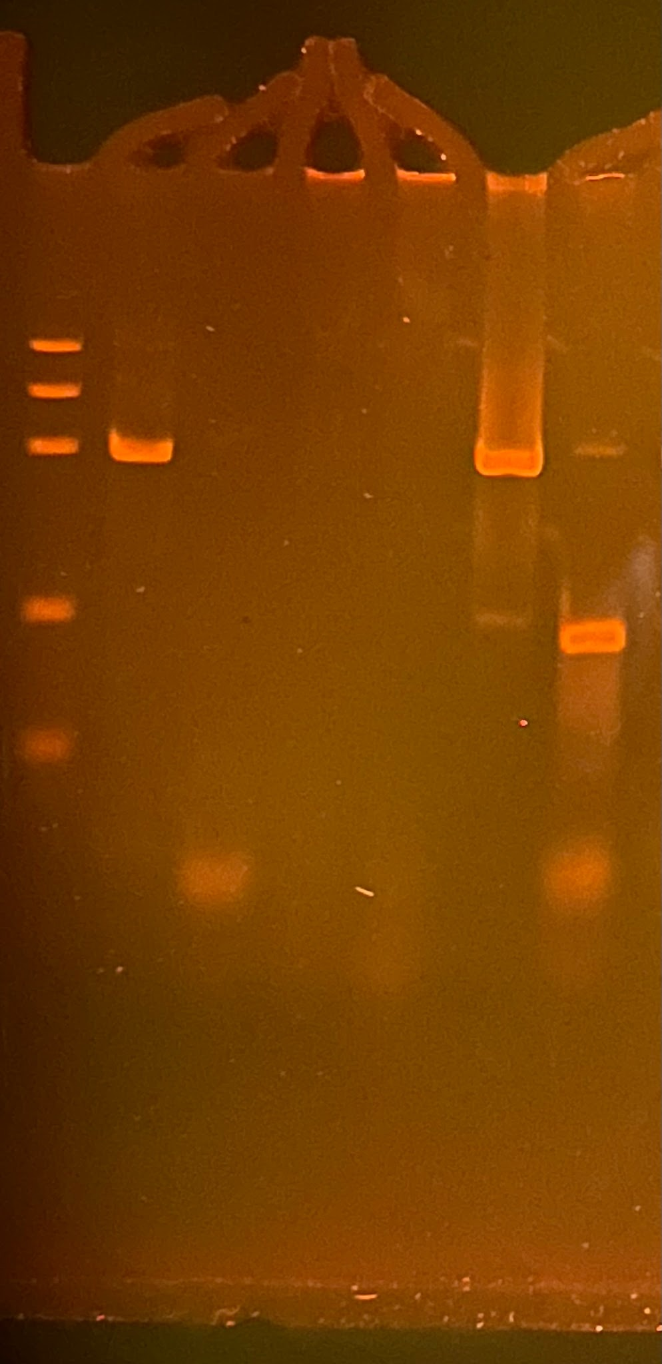
Observation: Gel Pattern of Electrophoresis
PAGE
1. -control PMM
2. –control GMM
3. Tested FOOD PMM
4. Tested FOOD GMM
5. +control PMM
6. +control GMM
M
1
2
3
4
5
6
PS II (455 bp)
CaMV or/and NOS
(220 bp)
Rest of primers
(25 bp)
Rest of dNTPs

Slide 5
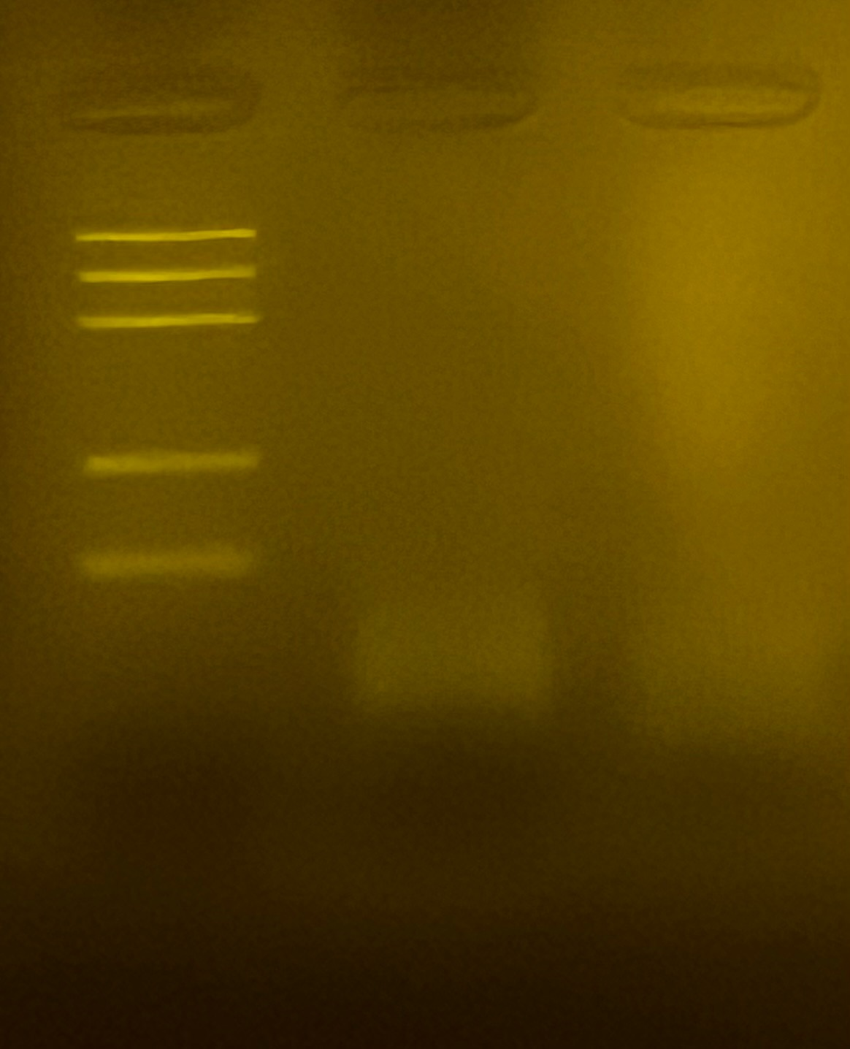
Observation: Gel Pattern of Electrophoresis
Agarose
M
1
2
1. Tested FOOD PMM
2. Tested FOOD GMM
Rest of primers
(25 bp)

Slide 6
Evaluation:
Oat flakes – plant origin
Oat flakes - genetic modified
TESTED FOOD – SOY FLOUR – plant origin
TESTED FOOD – SOY FLOUR – genetic modified
Positive control – plant origin
Positive control – genetic modified

Slide 7
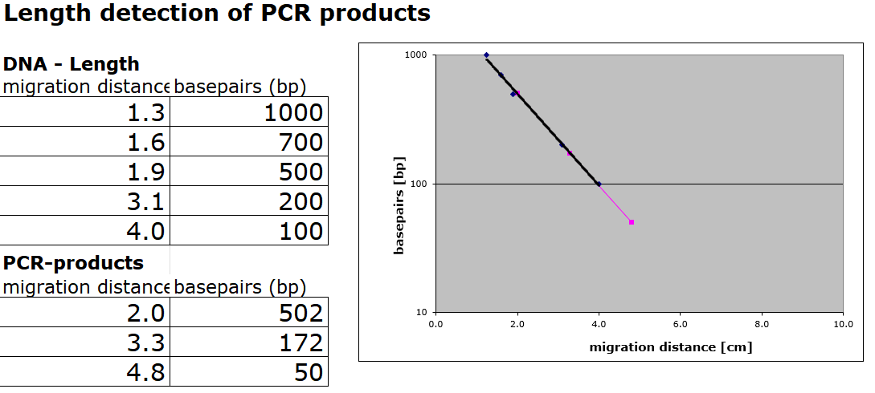
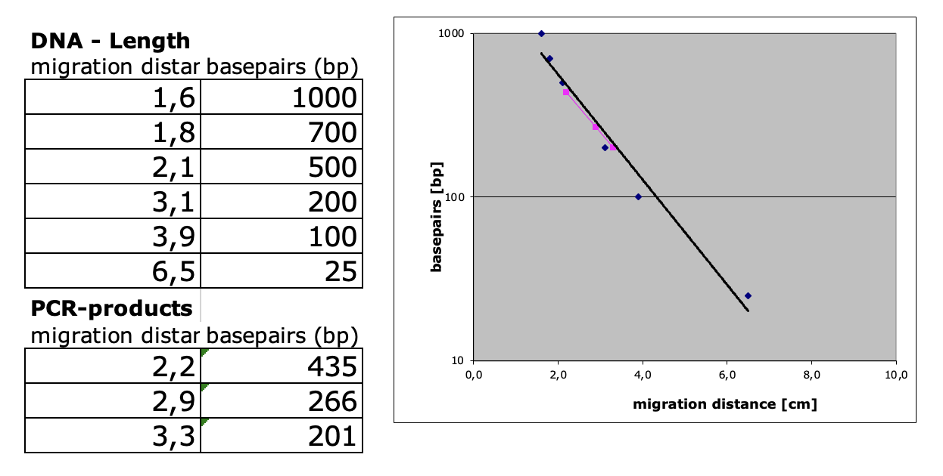
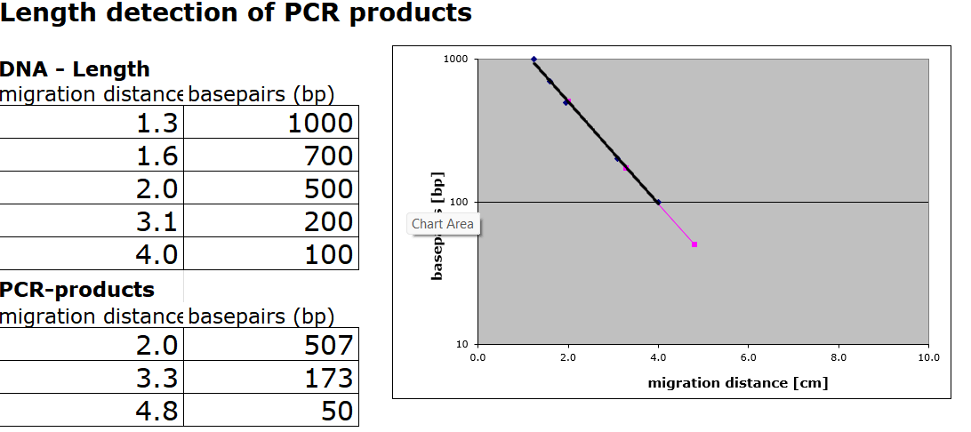
Evaluation:
Length Estimation of Bands in the Gel by Calibration Curve

Slide 8
Conclusion
Test food had no DNA to be detected.
We cannot determine if this soy flour had any GMOs. Just like the other groups with Hodgson Mill Soy Flour (groups 3 and 10), we had difficulties extracting DNA. We also had problems with the PAGE, as even with our positive control (test tube 5) we had odd bands at the top of the wells. This indicates that perhaps the flour was so overly processed there was no DNA to extract.

