Slide 1
Food Investigation about Genetically Modified Crops
Results from Group 1
Tested food: Cheerios
Hartsville (USA) June 1st – June 5th 2026

Slide 2


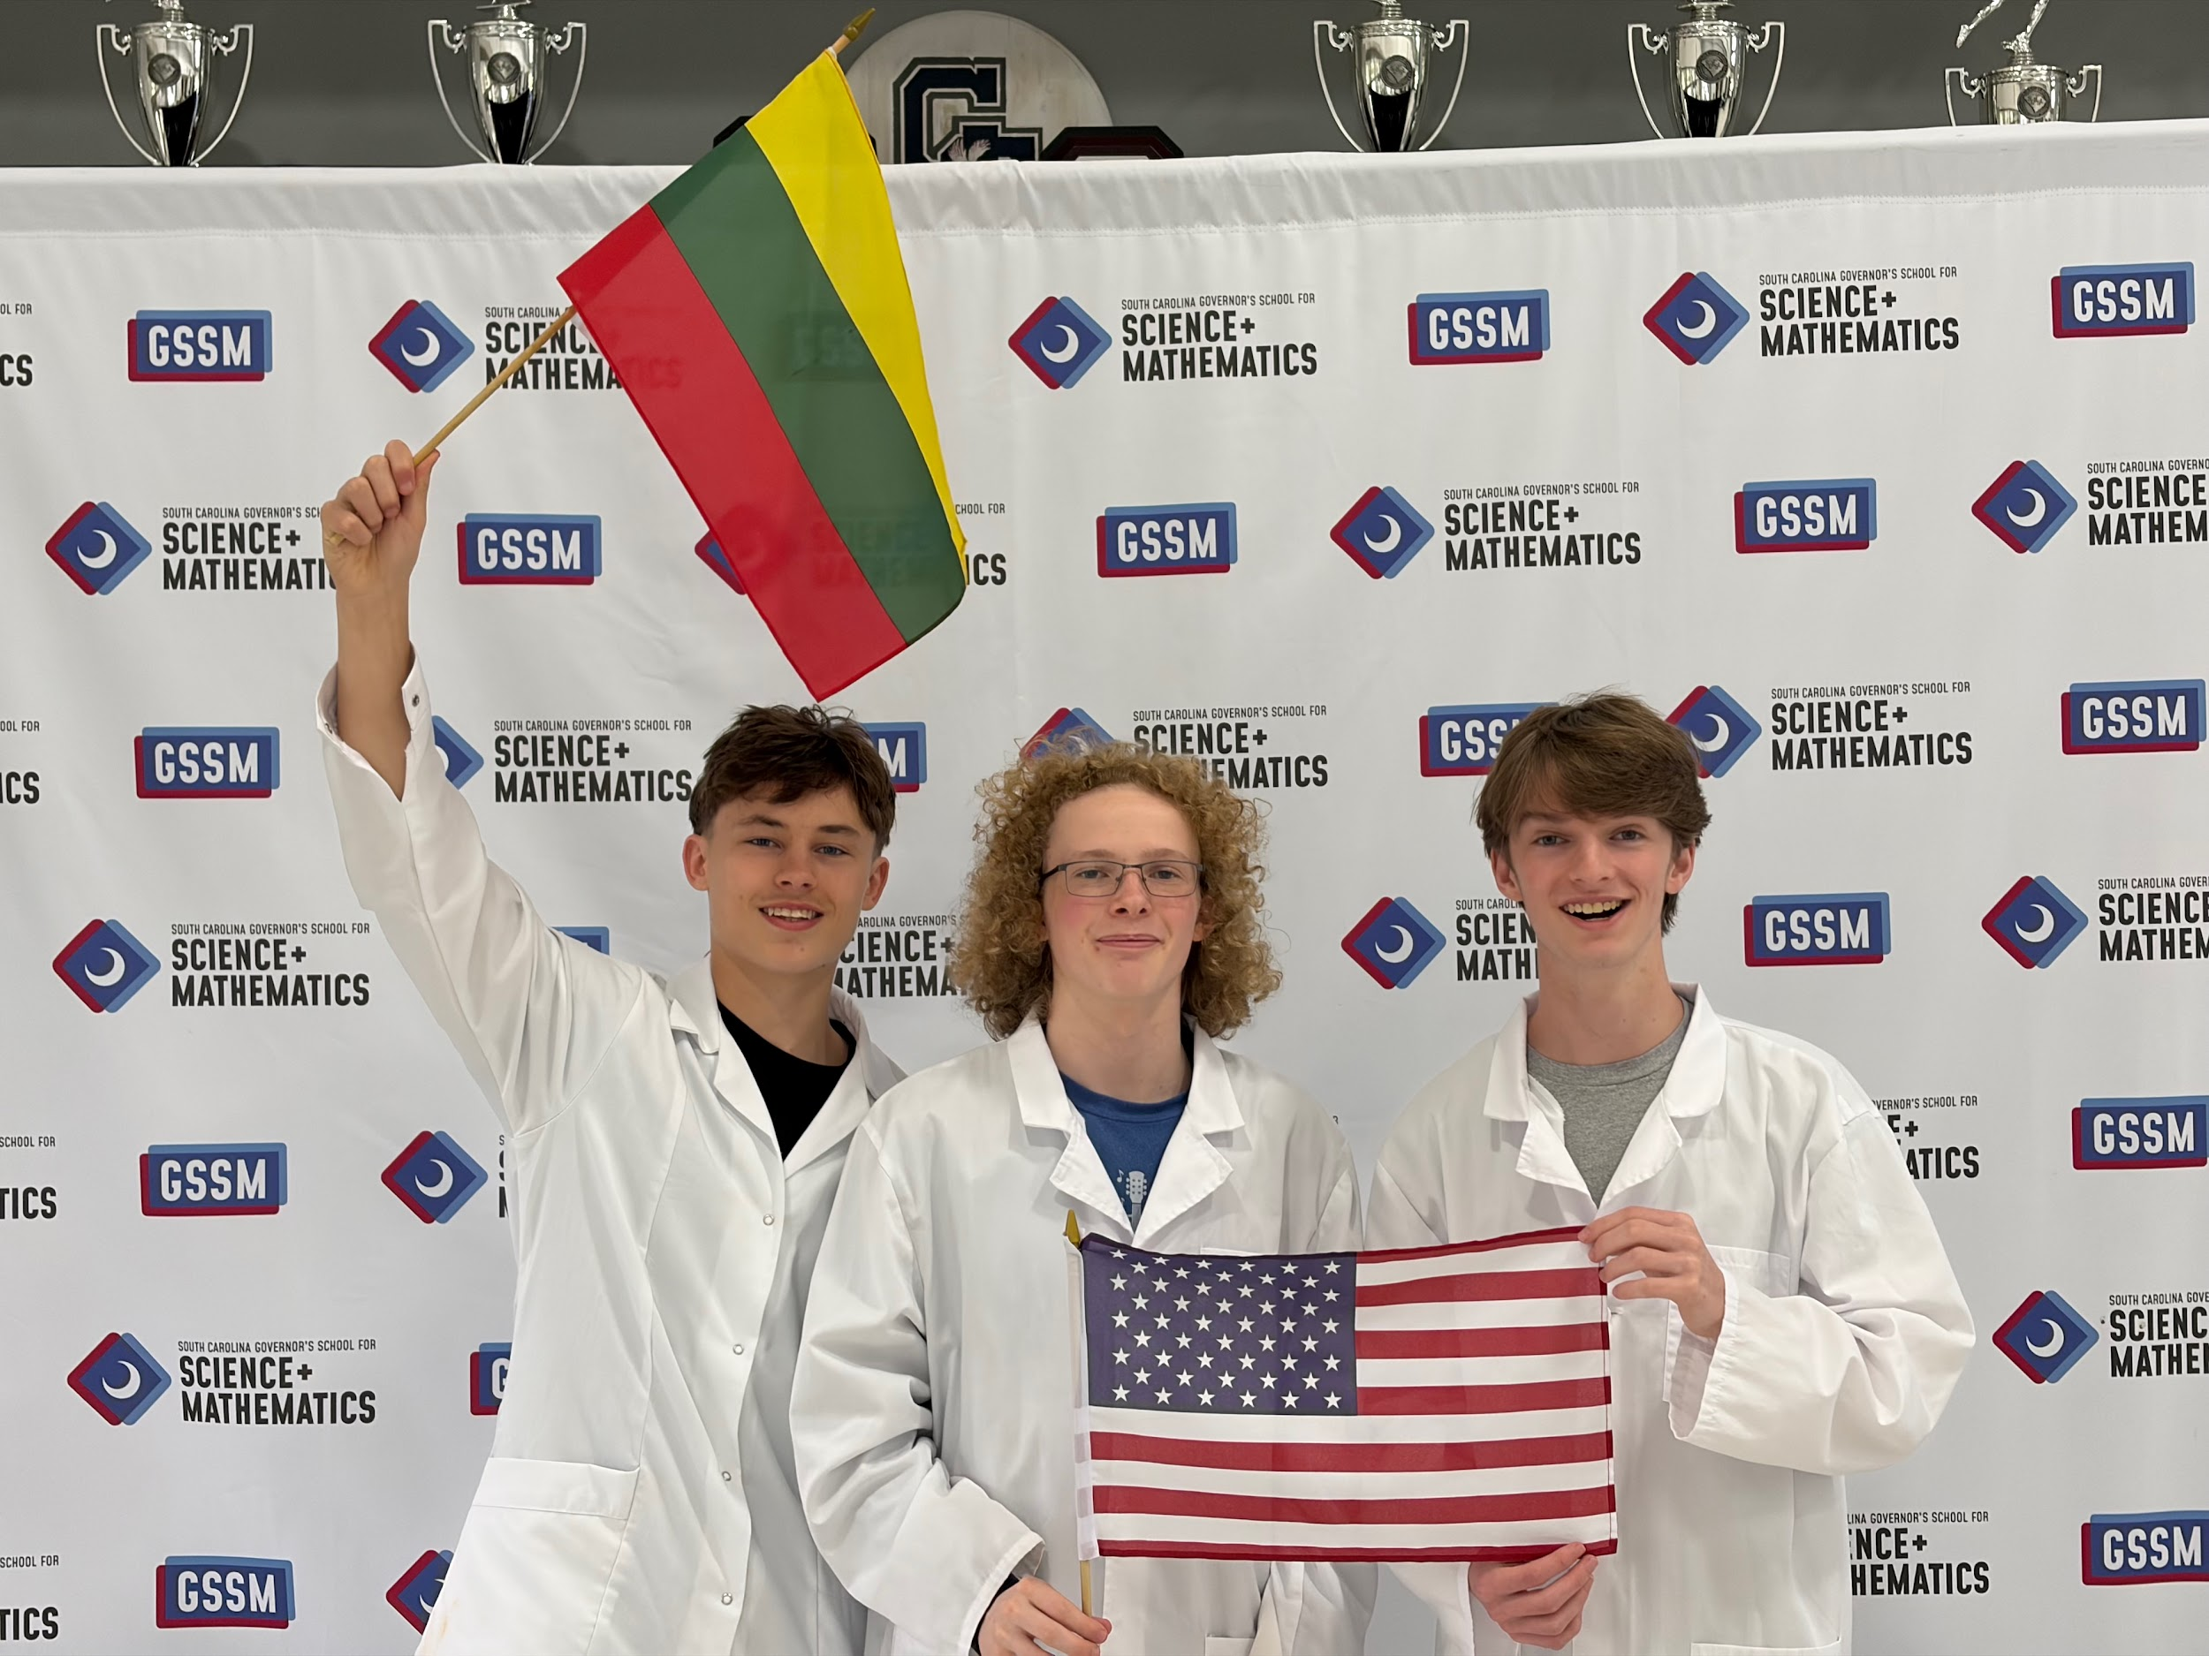
GROUP 1
Aidenas Antanevicius
Lithuania
Vilniaus jėzuitų gimnazija
Boone Hitch
United States
Governor’s School for Science and Mathematics
Ethan Engelhardt
United States
Governor’s School for Science and Mathematics

Slide 3

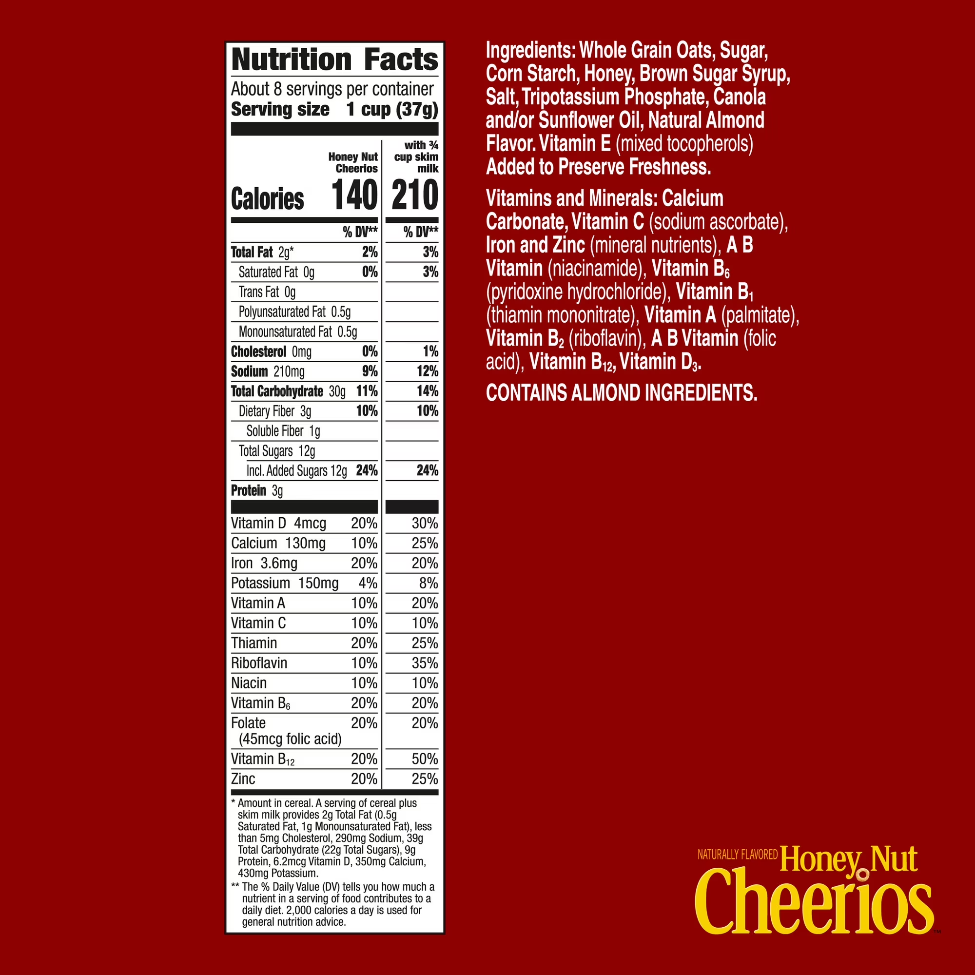
Tested food: Cheerios
Grown: not written
GMO signed: signed for GMO
Country of origin: United States
Brand: General Mills
Mass: 1 g
Calorific value: 140 cal per 39 g

Slide 4
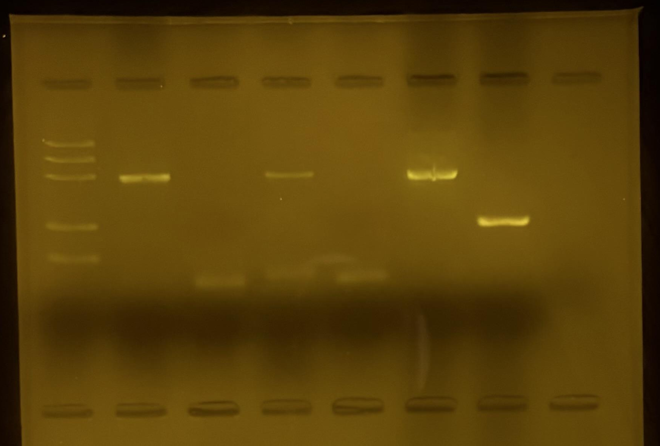
Observation: Gel Pattern of Electrophoresis
M
1
2
3
4
5
6
1. –control PMM
2. –control GMM
3. Tested FOOD PMM
4. Tested FOOD GMM
5. +control PMM
6. +control GMM
PS II (≈455 bp)
CaMV or/and NOS (≈220 bp)
Rest of primers (≈25 bp)
Rest of dNTPs

Slide 5
Evaluation:
Oats – plant origin
Oats – not genetically modified
TESTED FOOD – Cheerios – plant origin
TESTED FOOD – Cheerios – not genetically modified by CaMV or NOS
Positive control – plant origin
Positive control – genetically modified

Slide 6
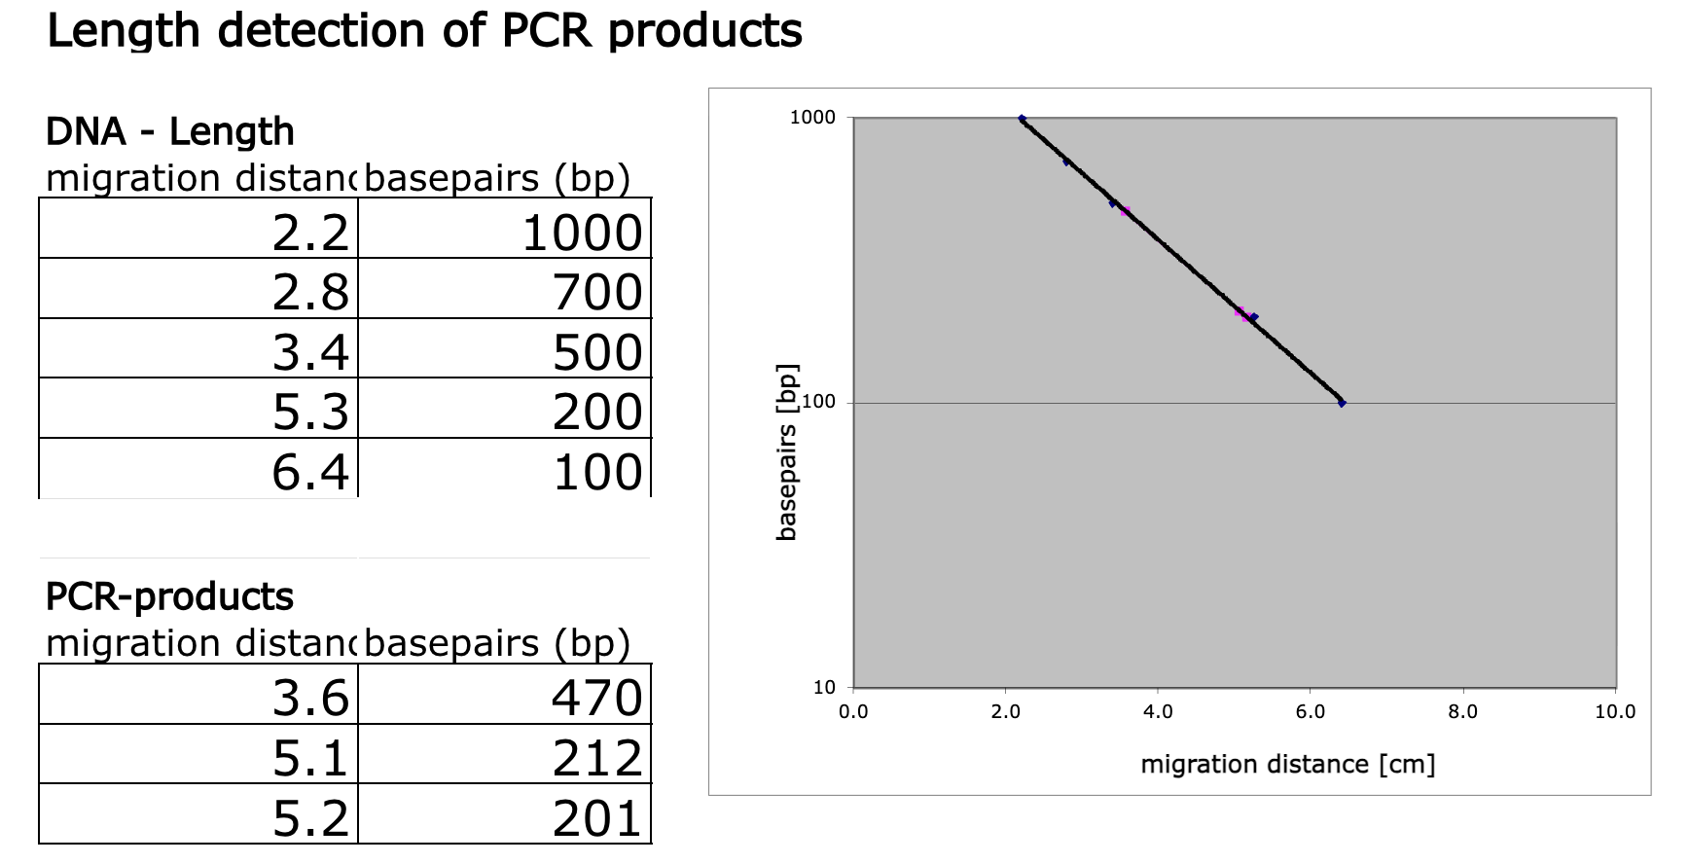
Evaluation:
Length Estimation of Bands in the Gel by Calibration Curve

Slide 7
Conclusion
Length of gene fragment PSII: 470 bp
It is not modified by the CaMV or NOS regulation sequences.

