Slide 1
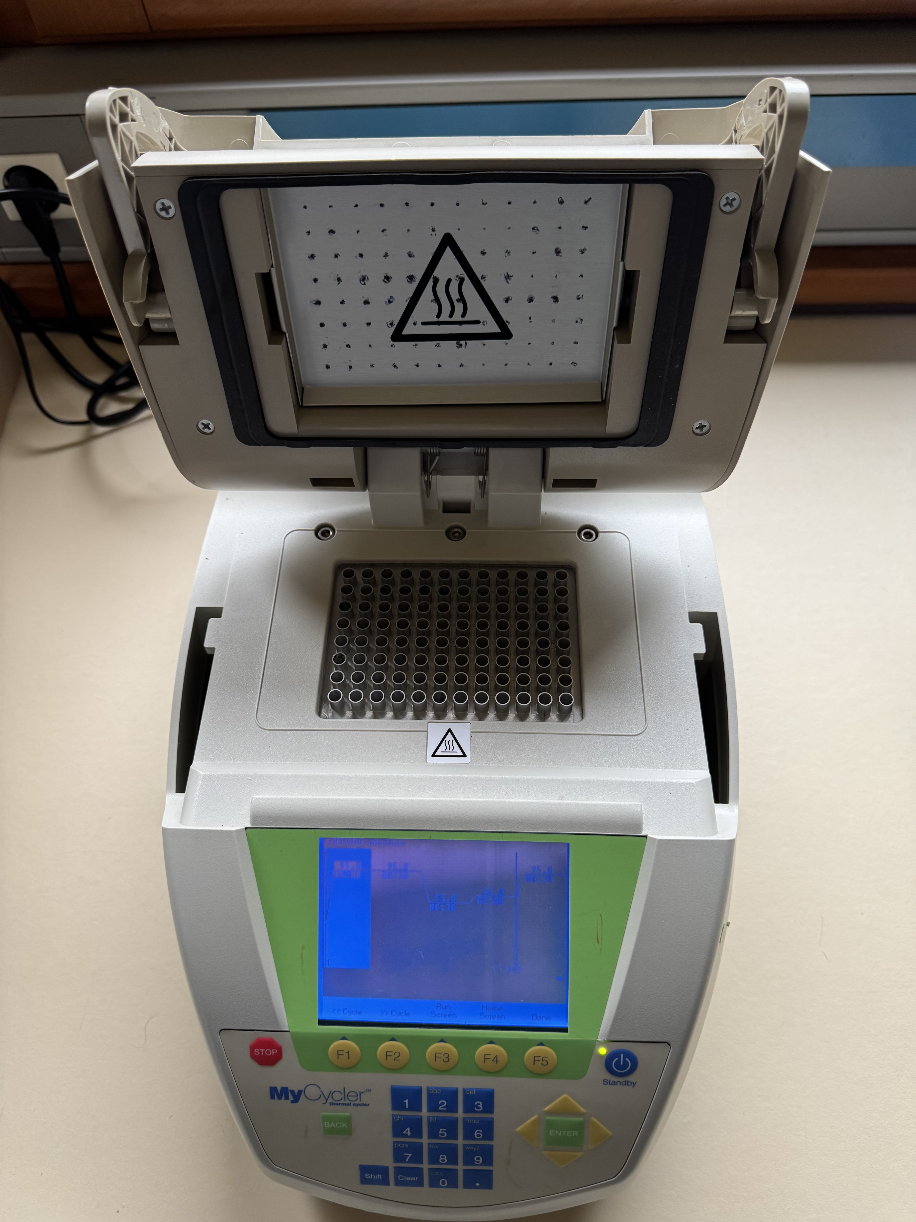

Introduction about Polymerase Chain Reaction (PCR)

Slide 2
Goal of PCR
One target gene in a complete genome could be amplified by new synthesis of DNA
to get a high number of DNA copies of a target gene, which - we can evaluate by gel-electrophoresis - we can sequence to detect bacteria species
The new synthesis of DNA is done similar like in semi conservative replication in nature (in vivo) catalized by the enzyme DNA-Polymerase
PCR is called DNA replication in vitro

Slide 3
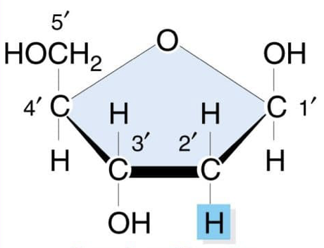
Abilities of DNA Polymerase
Enzyme is responsible for new synthesis of DNA
- Is working only from 5`to 3` end → means elongation with a new nucleotide is possible only at 3`OH-group of the sugar desoxyribose
- To work smouthly the polymerase needs a primer which is a short 15 – 25 nucleotides long single stranded DNA

Slide 4
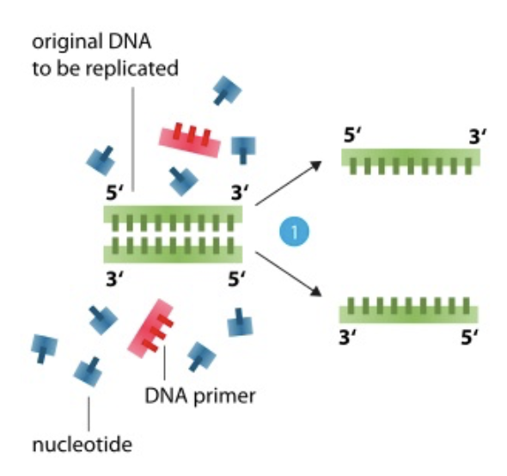
Meaning of the Primer
DNA Polymerase needs for starting DNA new synthesis a short piece of double stranded DNA with 15 till 25 nucleotides length
1. Phase: To make primer binding possible dsDNA must by denatured by heat into two single strands
DNA heated up to 95°C gets denatured → H-bridges will be distroyed → called denaturation

Slide 5
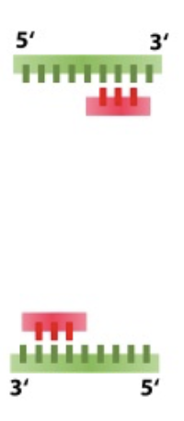
Meaning of the Primer
2. Phase:
A primer is a short piece of single stranded DNA
Primer must be able to bind complementary to denatured single stranded target DNA
Primers with a length of 15 – 25 nucleotides are specific binding at only one location in the human genome
Primer binding is called annealing
3´
5´
5´
3´

Slide 6
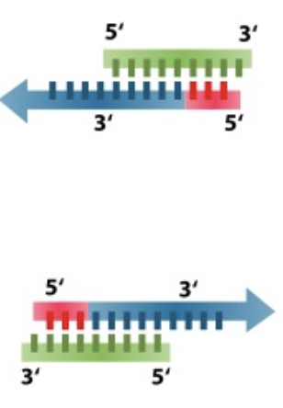
Meaning of the Primer
3. Phase:
DNA-polymerase has a small double stranded DNA and the primer is the adapter for elongation with new nucleotides → Primer elongation is called polymerisation

Slide 7
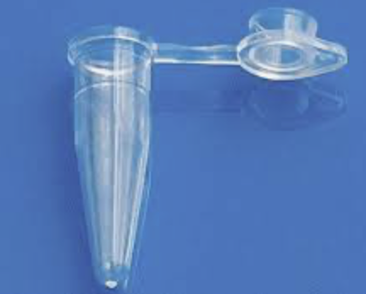
PCR Approach
What is neccessary to pipette in a PCR tube for running a successful PCR?
1. Template (target) DNA
2. DNA Polymerase (heat stable Taq-Polymerase)
3. Brickstones for DNA synthesis (deoxy-nucleoside triphosphate (dNTP: dATP, dTTP, dGTP, dCTP = energy rich nucleotides))
4. Buffer (for optimal environment conditions of DNA Polymerase e. g. pH. Mg²⁺
5. Primer pair (3 primer pairs = multiplex PCR: 455 bp gene sequence of PS II, NOS terminater sequence of 225 bp and CaMV promoter sequence of 203 bp)

Slide 8
Our PCR Approach
Reagent | Volume
Sample: -GMO, Test Food, +GMO | 10 µL
Master Mix 2x (MM) + Primer pairs | 10 µL
Total volume | 20 µL

Slide 9
Thermocycler Phases

Slide 10

Thermocycler Program
Step | Temp. | Time | Cycles
Denat. | 94 °C | 2 min. | 1
Denat. | 95 °C | 1 min. | 40
Anneal | 59 °C | 1 min. | 40
Polym. | 72 °C | 2 min. | 40
Polym. | 72 °C | 10 min. | Final
Hold | 4 °C

Slide 11
PCR Sumary
Amplification from 20 to 50 cycles
20 cycles → 2²⁰ copies of DNA = 10⁶-fold amplification
30 cycles → 2³⁰ copies of DNA = 10⁹-fold amplification
40 cycles → 2⁴⁰ copies of DNA = 10¹²-fold amplification
Formula: 2^{n} DNA copies, n = number of PCR cycles
Elaborated by K. Mullis in 1985, nobel price in 1993, use of DNA polymerase from E. coli, no automation possible
Automation was possible after introducing heat stabile DNA polymerases (e.g. Taq-Polymerase)
Automation of PCR by programmable thermal cycler
1st cycle yields DNA of undefined length, two length-defined DNA copies after the 3rd cycle

Slide 12
PCR - polymerase chain reaction
3‘
5‘
3‘
5‘
3‘
5‘
3‘
5‘
5‘
5‘
3‘
3‘
5‘
3‘
3‘
5‘
3‘
5‘
5‘
3‘
5‘
3‘
5‘
3‘

