Slide 1
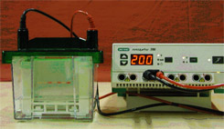
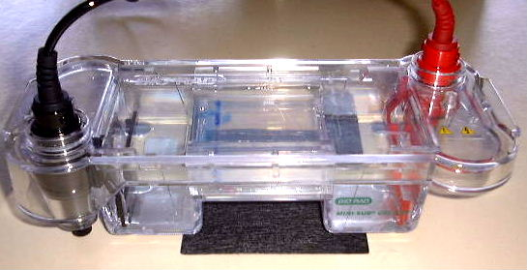


Verify PCR Products by Gel Electrophoresis (Vertical by PAGE and Horizontal with an Agarose Gel)

Slide 2
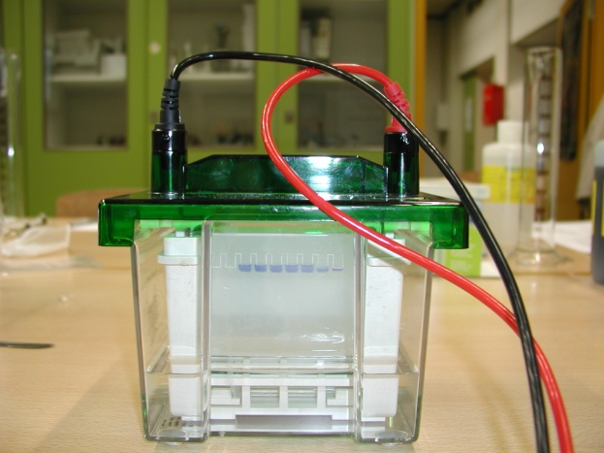
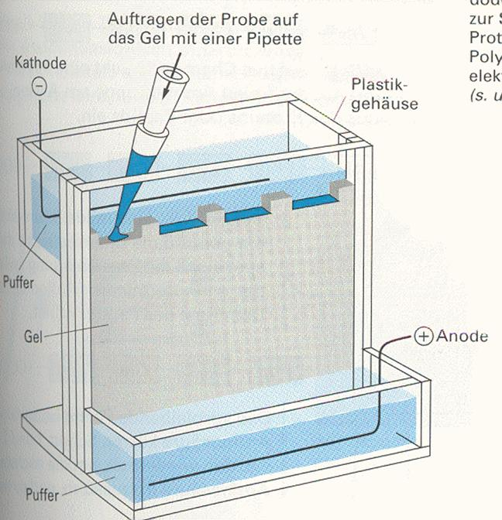
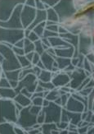
Vertical Gel Electrophoresis
DNA sample
cathode
the porous gel is made of crosslinked chemical chains of polyacrylamide
DNA fragments with negative charge move to the anode
buffer
anode
gel
buffer

Slide 3
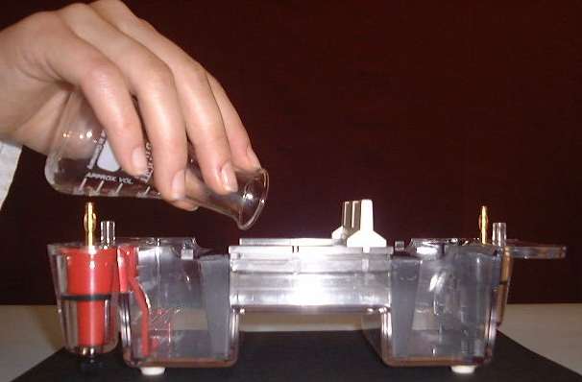
Horizontal Gel Electrophoresis
the porous gel is made of chemical chains of the polysaccharide agarose crosslinked by H-bridges.
Running the electrophoresis at higher voltages gel temperature is increasing and gel is melting because H-bridges are not stable enough.
To verify small fragments with round about 200 bp the pores should be very small.
We need a high concentration of agarose.
But solubility of agarose in buffer is limited to 3 % → pore size is also limited.

Slide 4
Model
Gel-Electrophoresis

Slide 5
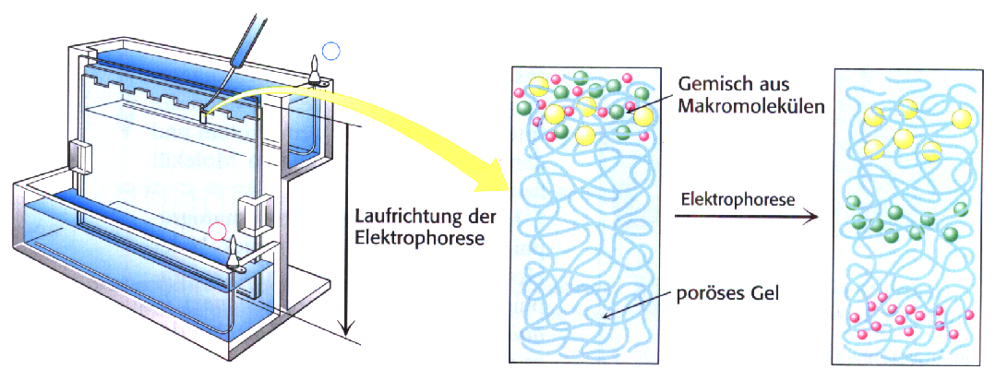
Separation of DNA Fragments by PAGE
load DNA fragments mixture onto gel
DNA mixture
-
electrophoresis
+
migration direction
Sodium-Dodecylsulfate (SDS)
CH₃-(CH₂)₁₀-CH₂-O-SO₂-O⁻ Na⁺
porous gel
negatively charged DNA fragments migrate to the anode
DNA fragments are separated by their size by the filtration principle of the gel
→ small fragments migrate faster than large fragments through the pores

Slide 6
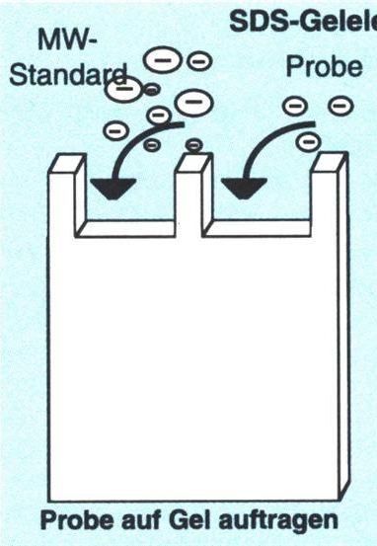

Length Determination of DNA Fragments by Calibration Curve
DNA marker
sample
- DNA fragment lengths of the marker are known (in bp).
- Migration distance of fragments (in cm) can be measured.
1000 bp
700 bp
500 bp
200 bp
100 bp

Slide 7
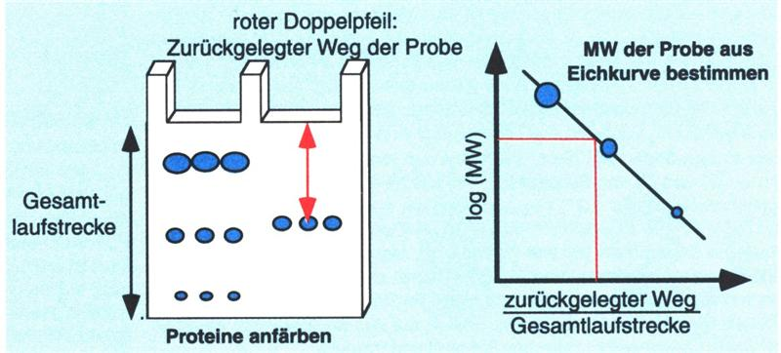

Determination of DNA Fragments Length (Bp) by PAGE
migration distance of sample
calibration curve
determine length of DNA fragments by calibration curve
migration distance of DNA standard
log bp
migration distance
stain DNA fragments

Slide 8
The End

