Slide 1
Experimental Practice Detection of genetically modified DNA-components in food by polymerase-chain-reaction (PCR)
Introduction

Slide 2
The Situation
As human population on earth passes 8 billion, the pressure intensifies on farmers:
Produce more food,
Food with more nutrients,
At reasonable prices,
And without using more energy.
Our understanding of the genetics of plants, insects, and plant diseases may help with this problem.

Slide 3
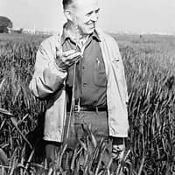
A Little History
Norman Borlaug
won the Nobel Prize in 1970 for developing disease resistant wheat plants.
It is estimated his invention saved over 1 billion people from starvation by increasing food yield dramatically.
He used traditional methods of controlled selection to enhance naturally occurring disease resistance.
Of course scientists wondered if new methods of direct gene manipulation could do even more.

Slide 4
A Little More History
In 1996, Monsanto introduced soybeans genetically engineered to produce plants tolerant of glyphosate weed killers.
Successful, BUT
Many people were and still are very suspicious of genetic modifications.
Unexpected consequences are feared, if the genes escaped to contaminate wild species, or even somehow transferred to animals or humans.
Genetic modifications of many plants and animals continue, but careful control is required.

Slide 5
The View Today & Our Experiment
Some countries have banned the use of genetically modified food crops, while others have embraced it.
The fear of unknown but possibly very serious consequences is balanced against the possibility of actual starvation.
This is a good ethical issue to discuss.
We think it will be interesting to analyze some foods and see if we can detect genetic modifications.

Slide 6
Aims of the experiment
Qualitative detection of a genetic modification in food.
Detection of modifications identified by the use of - the promoter of the cauliflower mosaic virus (CaMV)
- the terminator of nopaline synthesis (NOS) in Agrobacterium tumefaciens
Both sequences are often used for regulation of introduced genes in genetically engineered soybeans and corn.

Slide 7
Step by step procedure
Step 1: DNA-Extraction
A. Extraction of DNA from control soybeans without genetically modified components (-GMO)
B. Extraction of DNA from test food (T)

Slide 8
Meaning of InstaGene Matrix
During DNA extraction DNA could be destroyed by enzymes. Those enzymes need Mg²⁺ ions as cofactors for being active.
InstaGene beads are binding Mg²⁺ ions
Cofactors are missing → Enzymes are inactive
DNA could not be destroyed

Slide 9
Meaning of InstaGene Matrix
During PCR DNA polymerase also needs Mg²⁺ ions as cofactors for being active.
If InstaGene beads would be in the PCR approach beads would bind Mg²⁺ Ions
Cofactors are missing → DNA Polymerase is inactive
PCR would fail

Slide 10
Step by Step procedure
Step 2: PCR
A. As a control for non-GMO plant material in food, also demonstrating a successful PCR: → Amplification of a gene fragment encoding a photosystem II protein (455 bp)
B. Identifying two characteristic DNA-sequences for a genetic modification in food: → Amplification of DNA fragments from
a) CaMV-promoter with 203 bp
b) NOS-terminator with 225 bp

Slide 11
PCR
Cycler time/temperature program
60 sec, 94 °C Denaturation
120 sec, 94 °C Denaturation
60 sec, 59 °C
Annealing
40 Cycles
600 sec, 72 °C
Final Extension
120 sec, 72 °C
Elongation

Slide 12
Step by Step procedure
Step 3: Electrophoresis and evaluation
A. Detection of PCR products by agarose-gel electrophoresis
B. DNA staining and evaluation of the gel
Does your test food contain inserted DNA?

Slide 13
PCR Approaches
Tube | Template | Primers | Purpose
1 | non-GMO DNA | PMM | plant DNA control
2 | non-GMO DNA | GMM | negative GMO control
3 | test food | PMM | confirm plant DNA
4 | test food | GMM | detect GMO
5 | GMO positive control | PMM | positive control
6 | GMO positive control | GMM | positive control

Slide 14
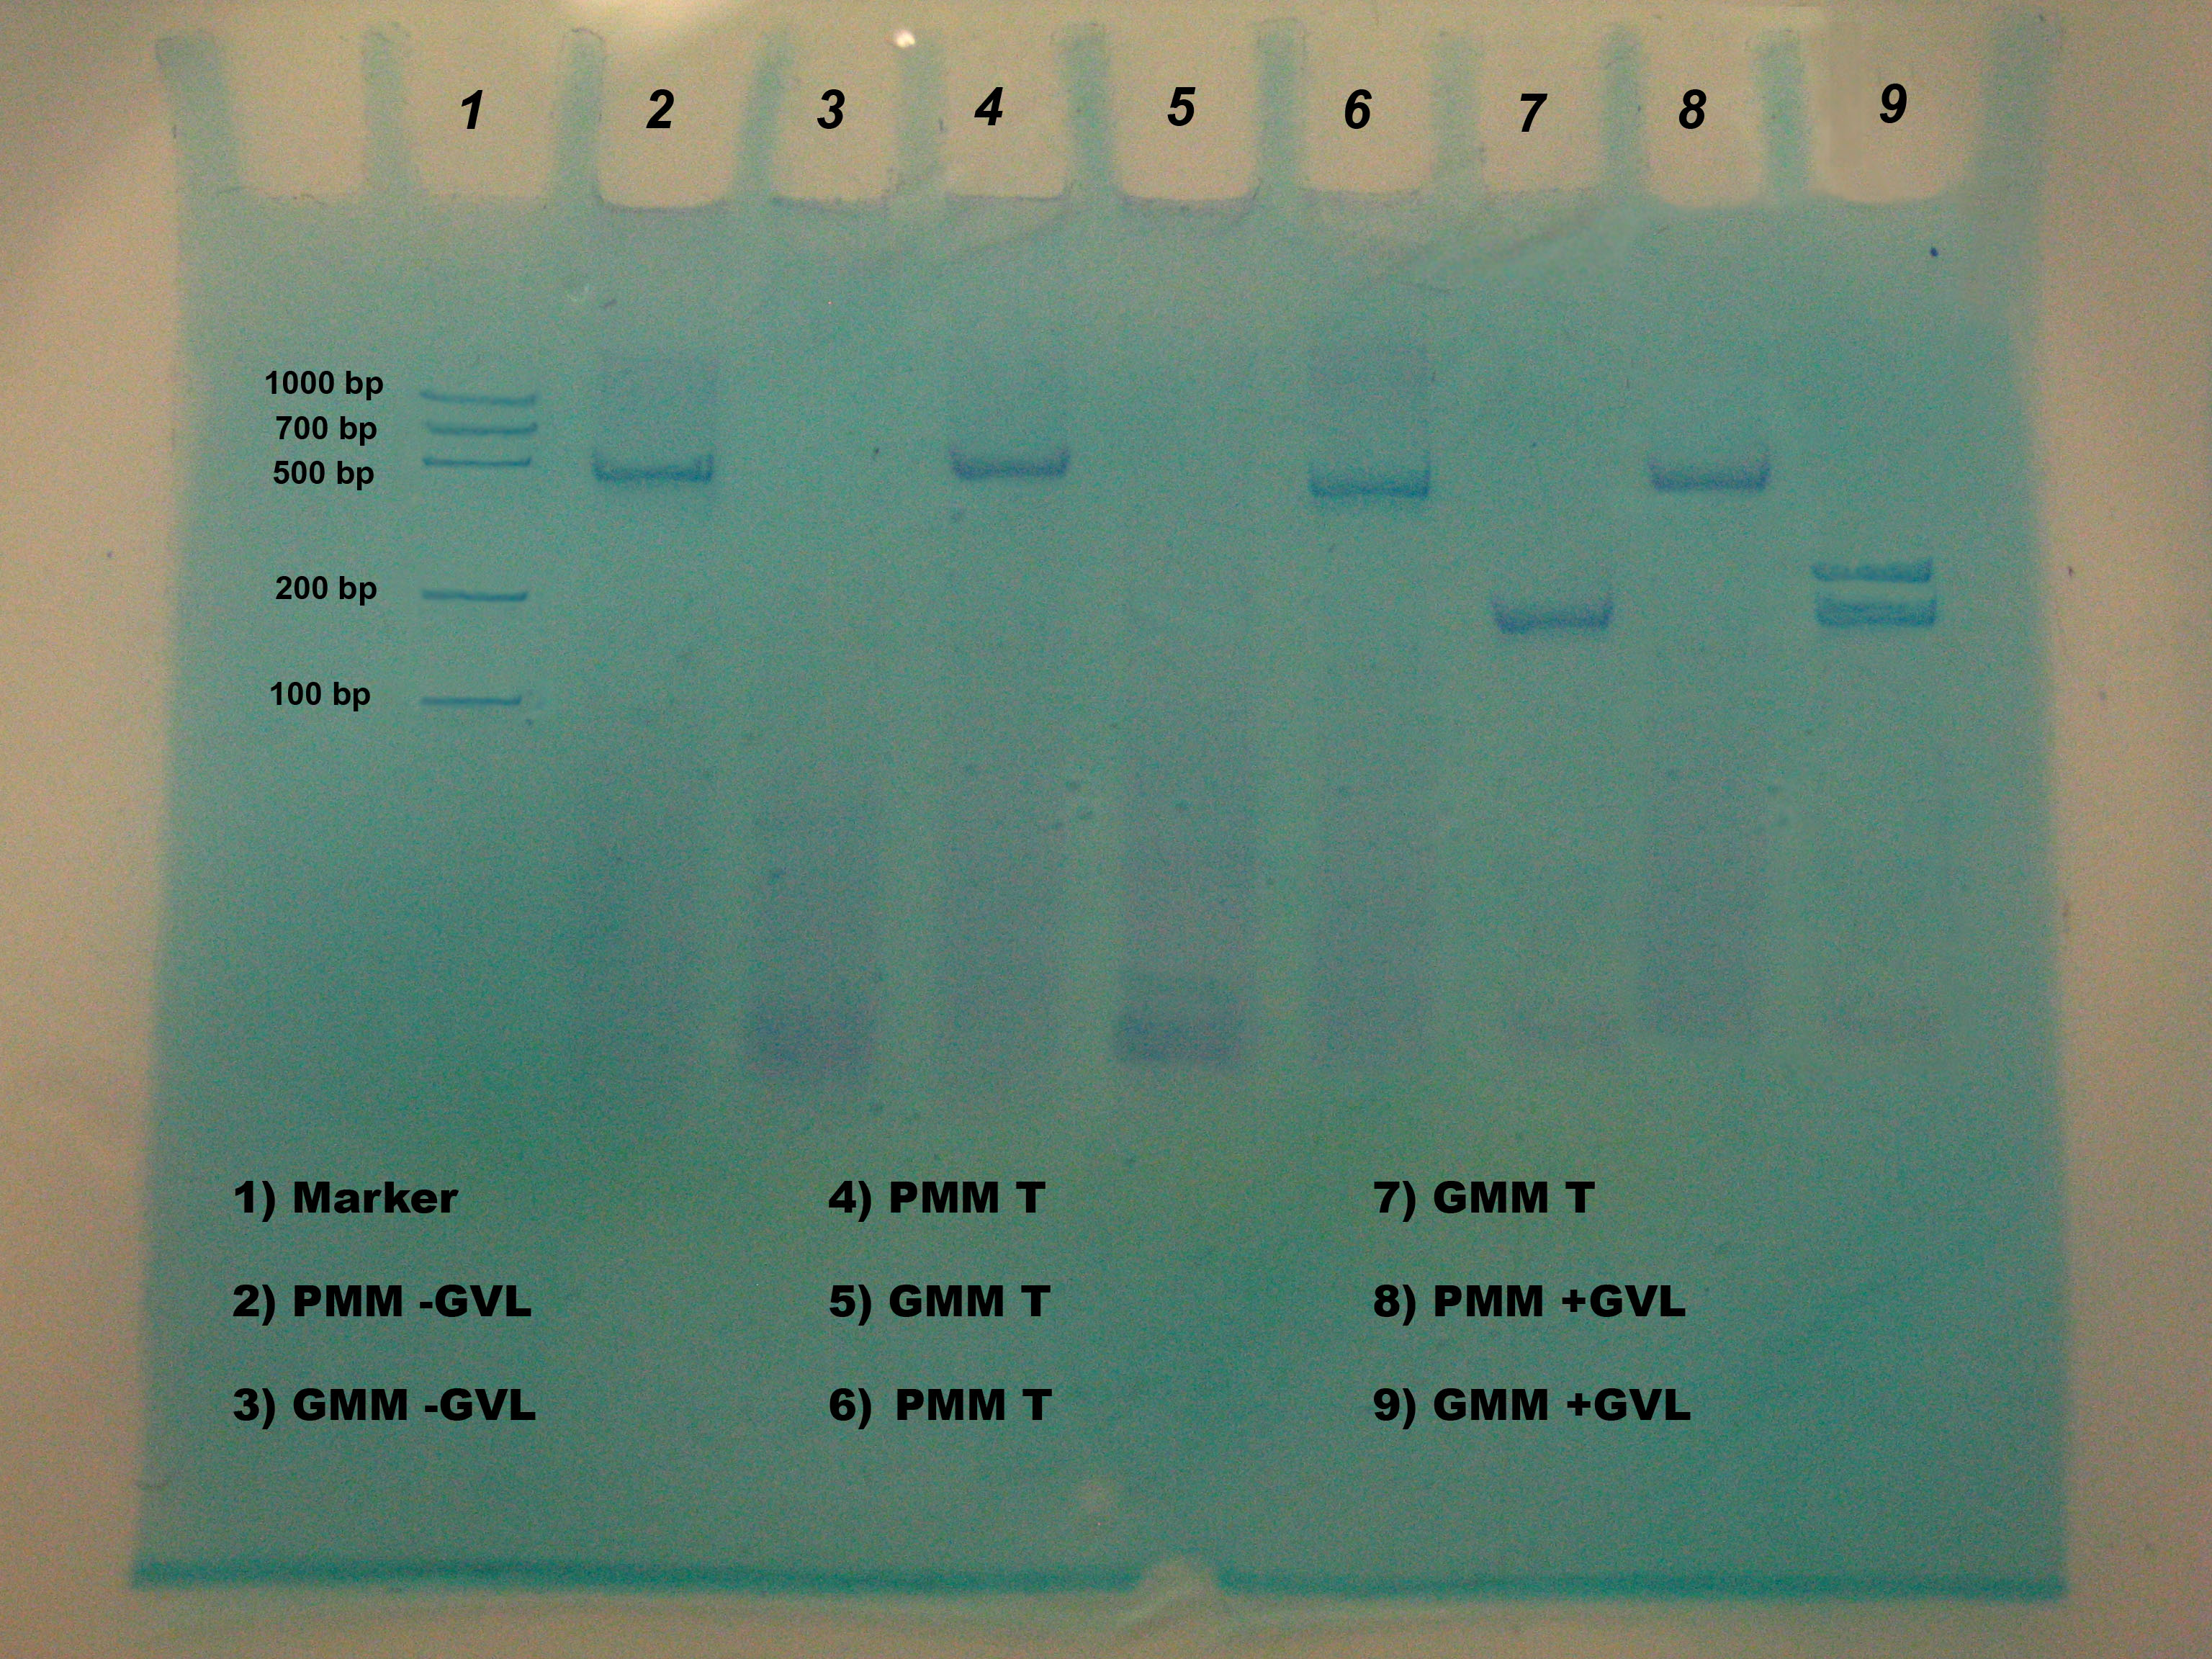
Expected results
PS II gene sequence (455 Bp)
NOs sequence (225 Bp)
CaMV sequence (203 Bp)
1
2
1
2

