Slide 1
Summary of Results from
Group 9
Lactase Downstream Processing
Evreux 23. – 27.03.2026

Slide 2
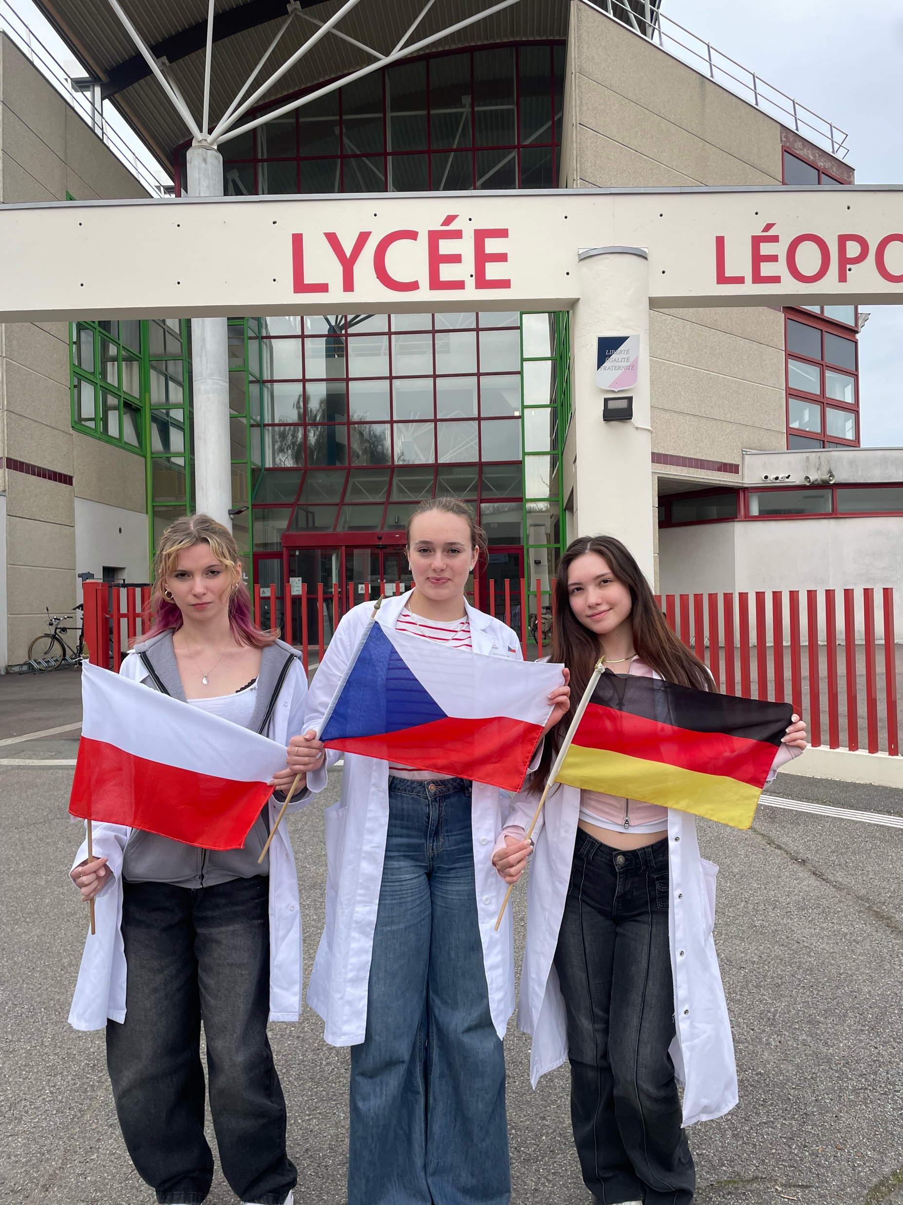



Group 9 + presentation of group members
Seda Sinem
German
Emilia Kabała
Polish
Agáta Korbelová
Czechia

Slide 3
Evaluation Steps of our Experiment
PARTICLE FREE LYSATE – o-NPG-test (enzymatic activity assay)
ANION EXCHANGE CHROMATOGRAPHY (AEXC) – o-NPG + photometer (enzymatic activity assay)
SDS – PAGE – gel + calibration line (purity, molecular weight – lactase)
RAW MILK TEST – colour change (conc. of glucose)
EVALUATION

Slide 4
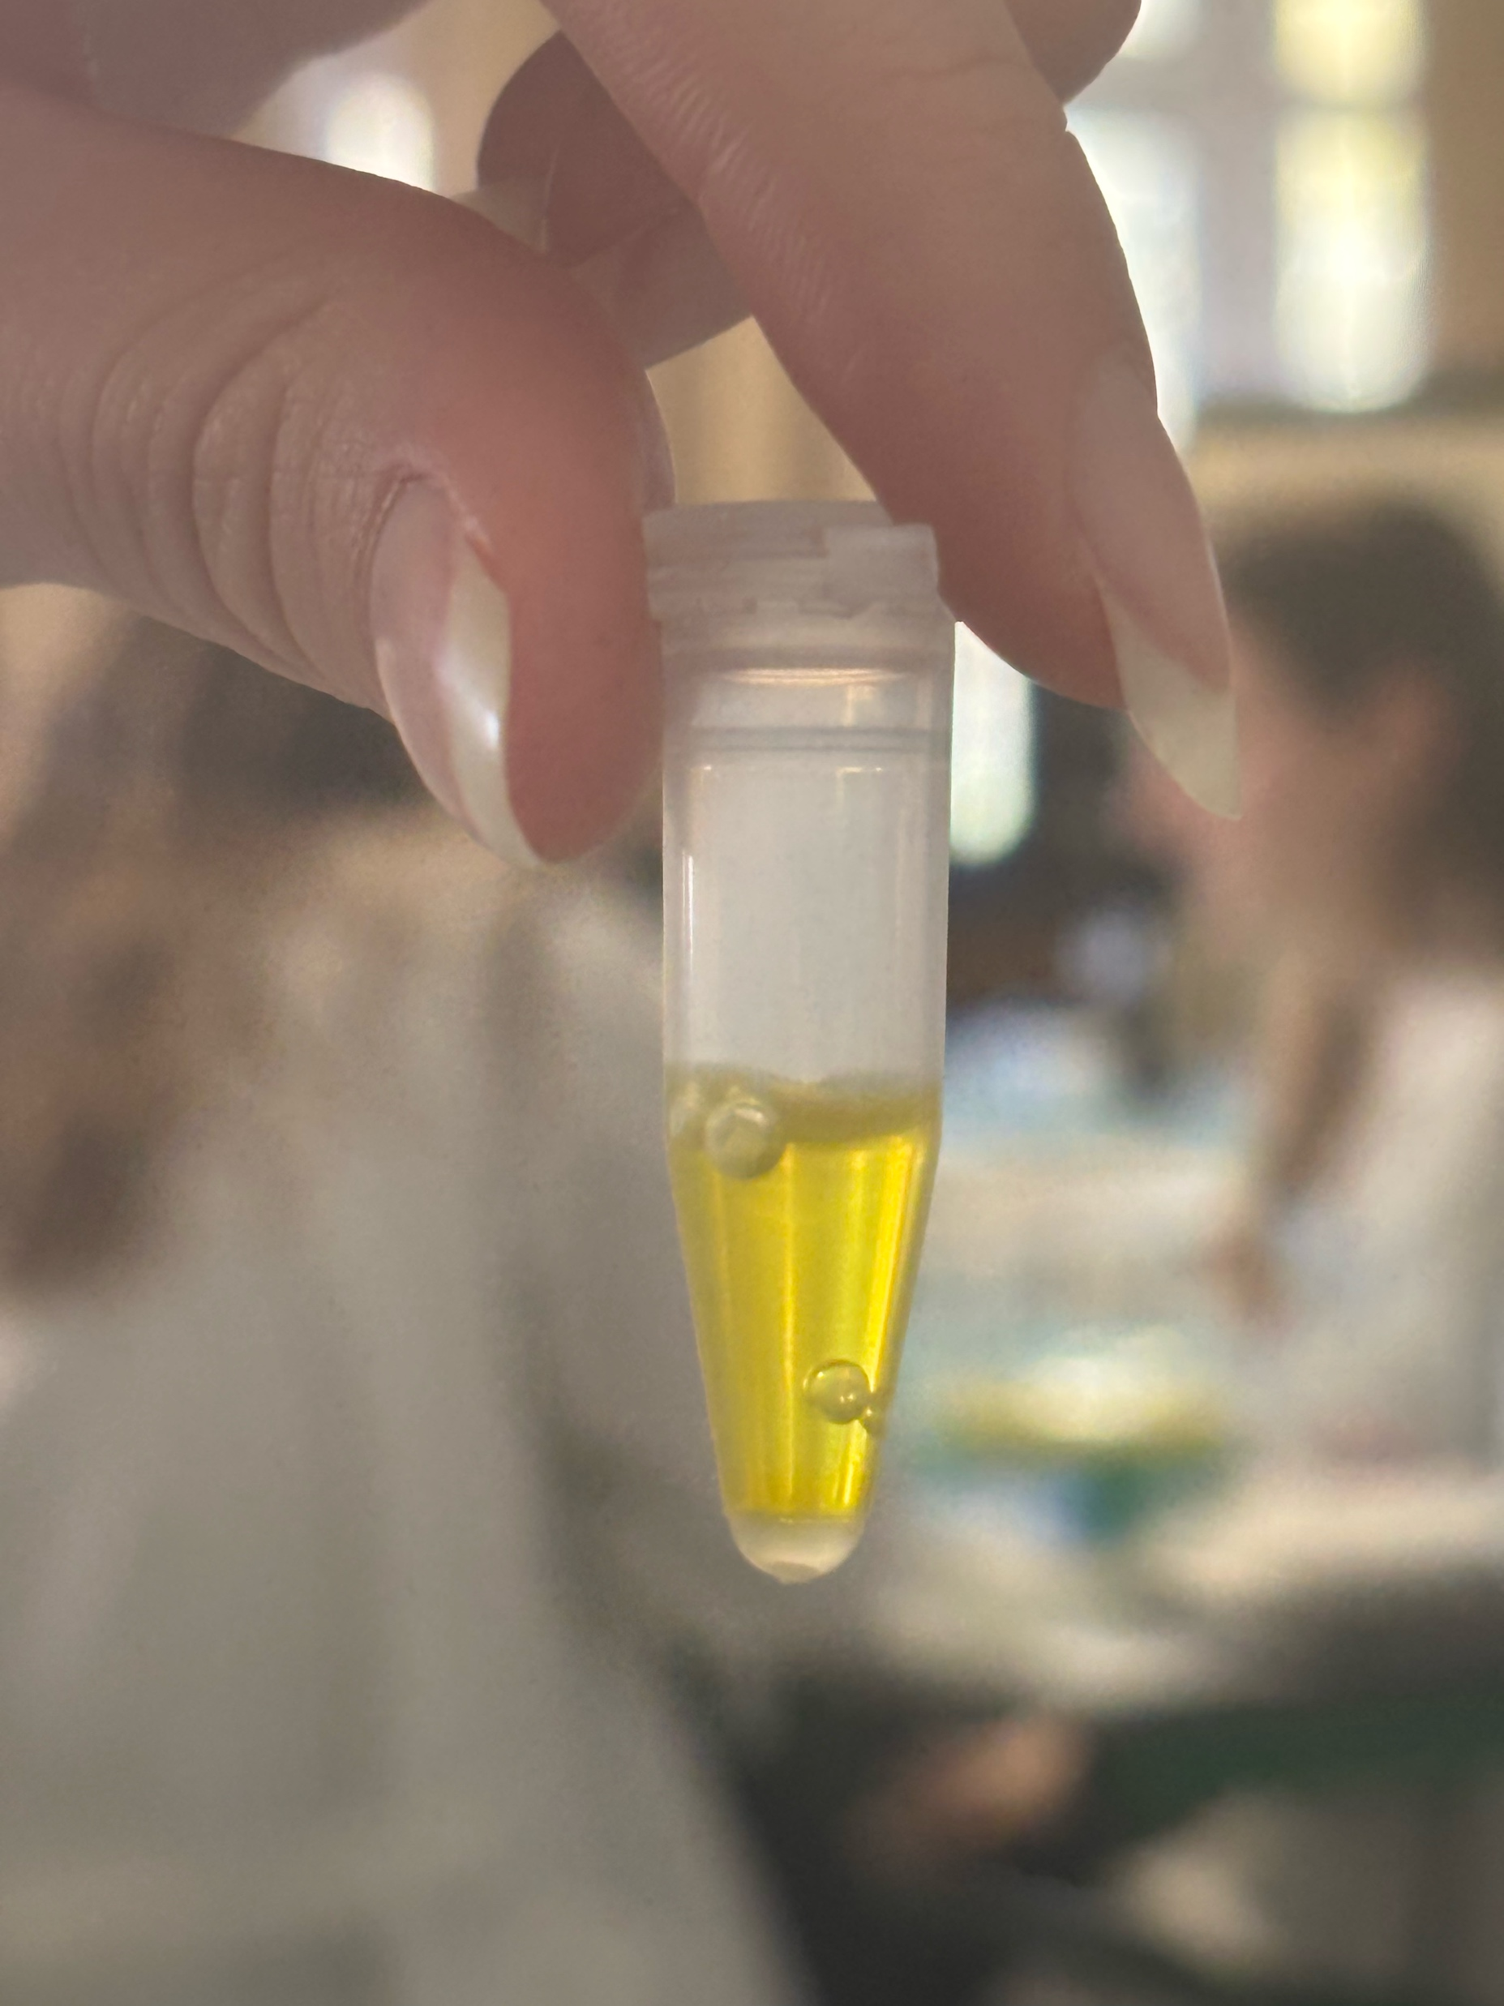
O-NPG-TEST of 1:10 diluted Particle Free Lysate
Test 50 μL supernatant + 500 μL o-NPG-solution.
Observation: yellow
Evaluation: β(1→4) bond was broken down
Conclusion: lactase is present.
→ We can start AEXC.
Picture of cuvette

Slide 5
Evaluation Steps of our Experiment
PARTICLE FREE LYSATE – o-NPG-test (enzymatic activity assay)
ANION EXCHANGE CHROMATOGRAPHY (AEXC) – o-NPG + photometer (enzymatic activity assay)
SDS – PAGE – gel + calibration line (purity, molecular weight – lactase)
RAW MILK TEST – colour change (conc. of glucose)
EVALUATION

Slide 6
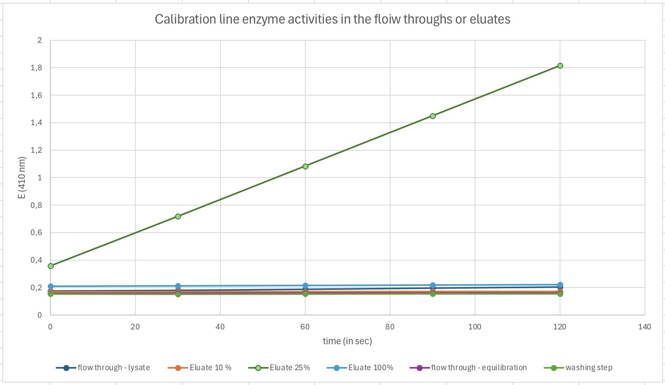
ANION EXCHANGE CHROMATOGRAPHY
O-NPG-test measured by photometer – enzymatic activity measurement
Test 50 μL eluate + 800 μL o-NPG-solution.

Slide 7
Evaluation Steps of our Experiment
PARTICLE FREE LYSATE – o-NPG-test (enzymatic activity assay)
ANION EXCHANGE CHROMATOGRAPHY (AEXC) – o-NPG + photometer (enzymatic activity assay)
SDS – PAGE – gel + calibration line (purity, molecular weight – lactase)
RAW MILK TEST – colour change (conc. of glucose)
EVALUATION

Slide 8
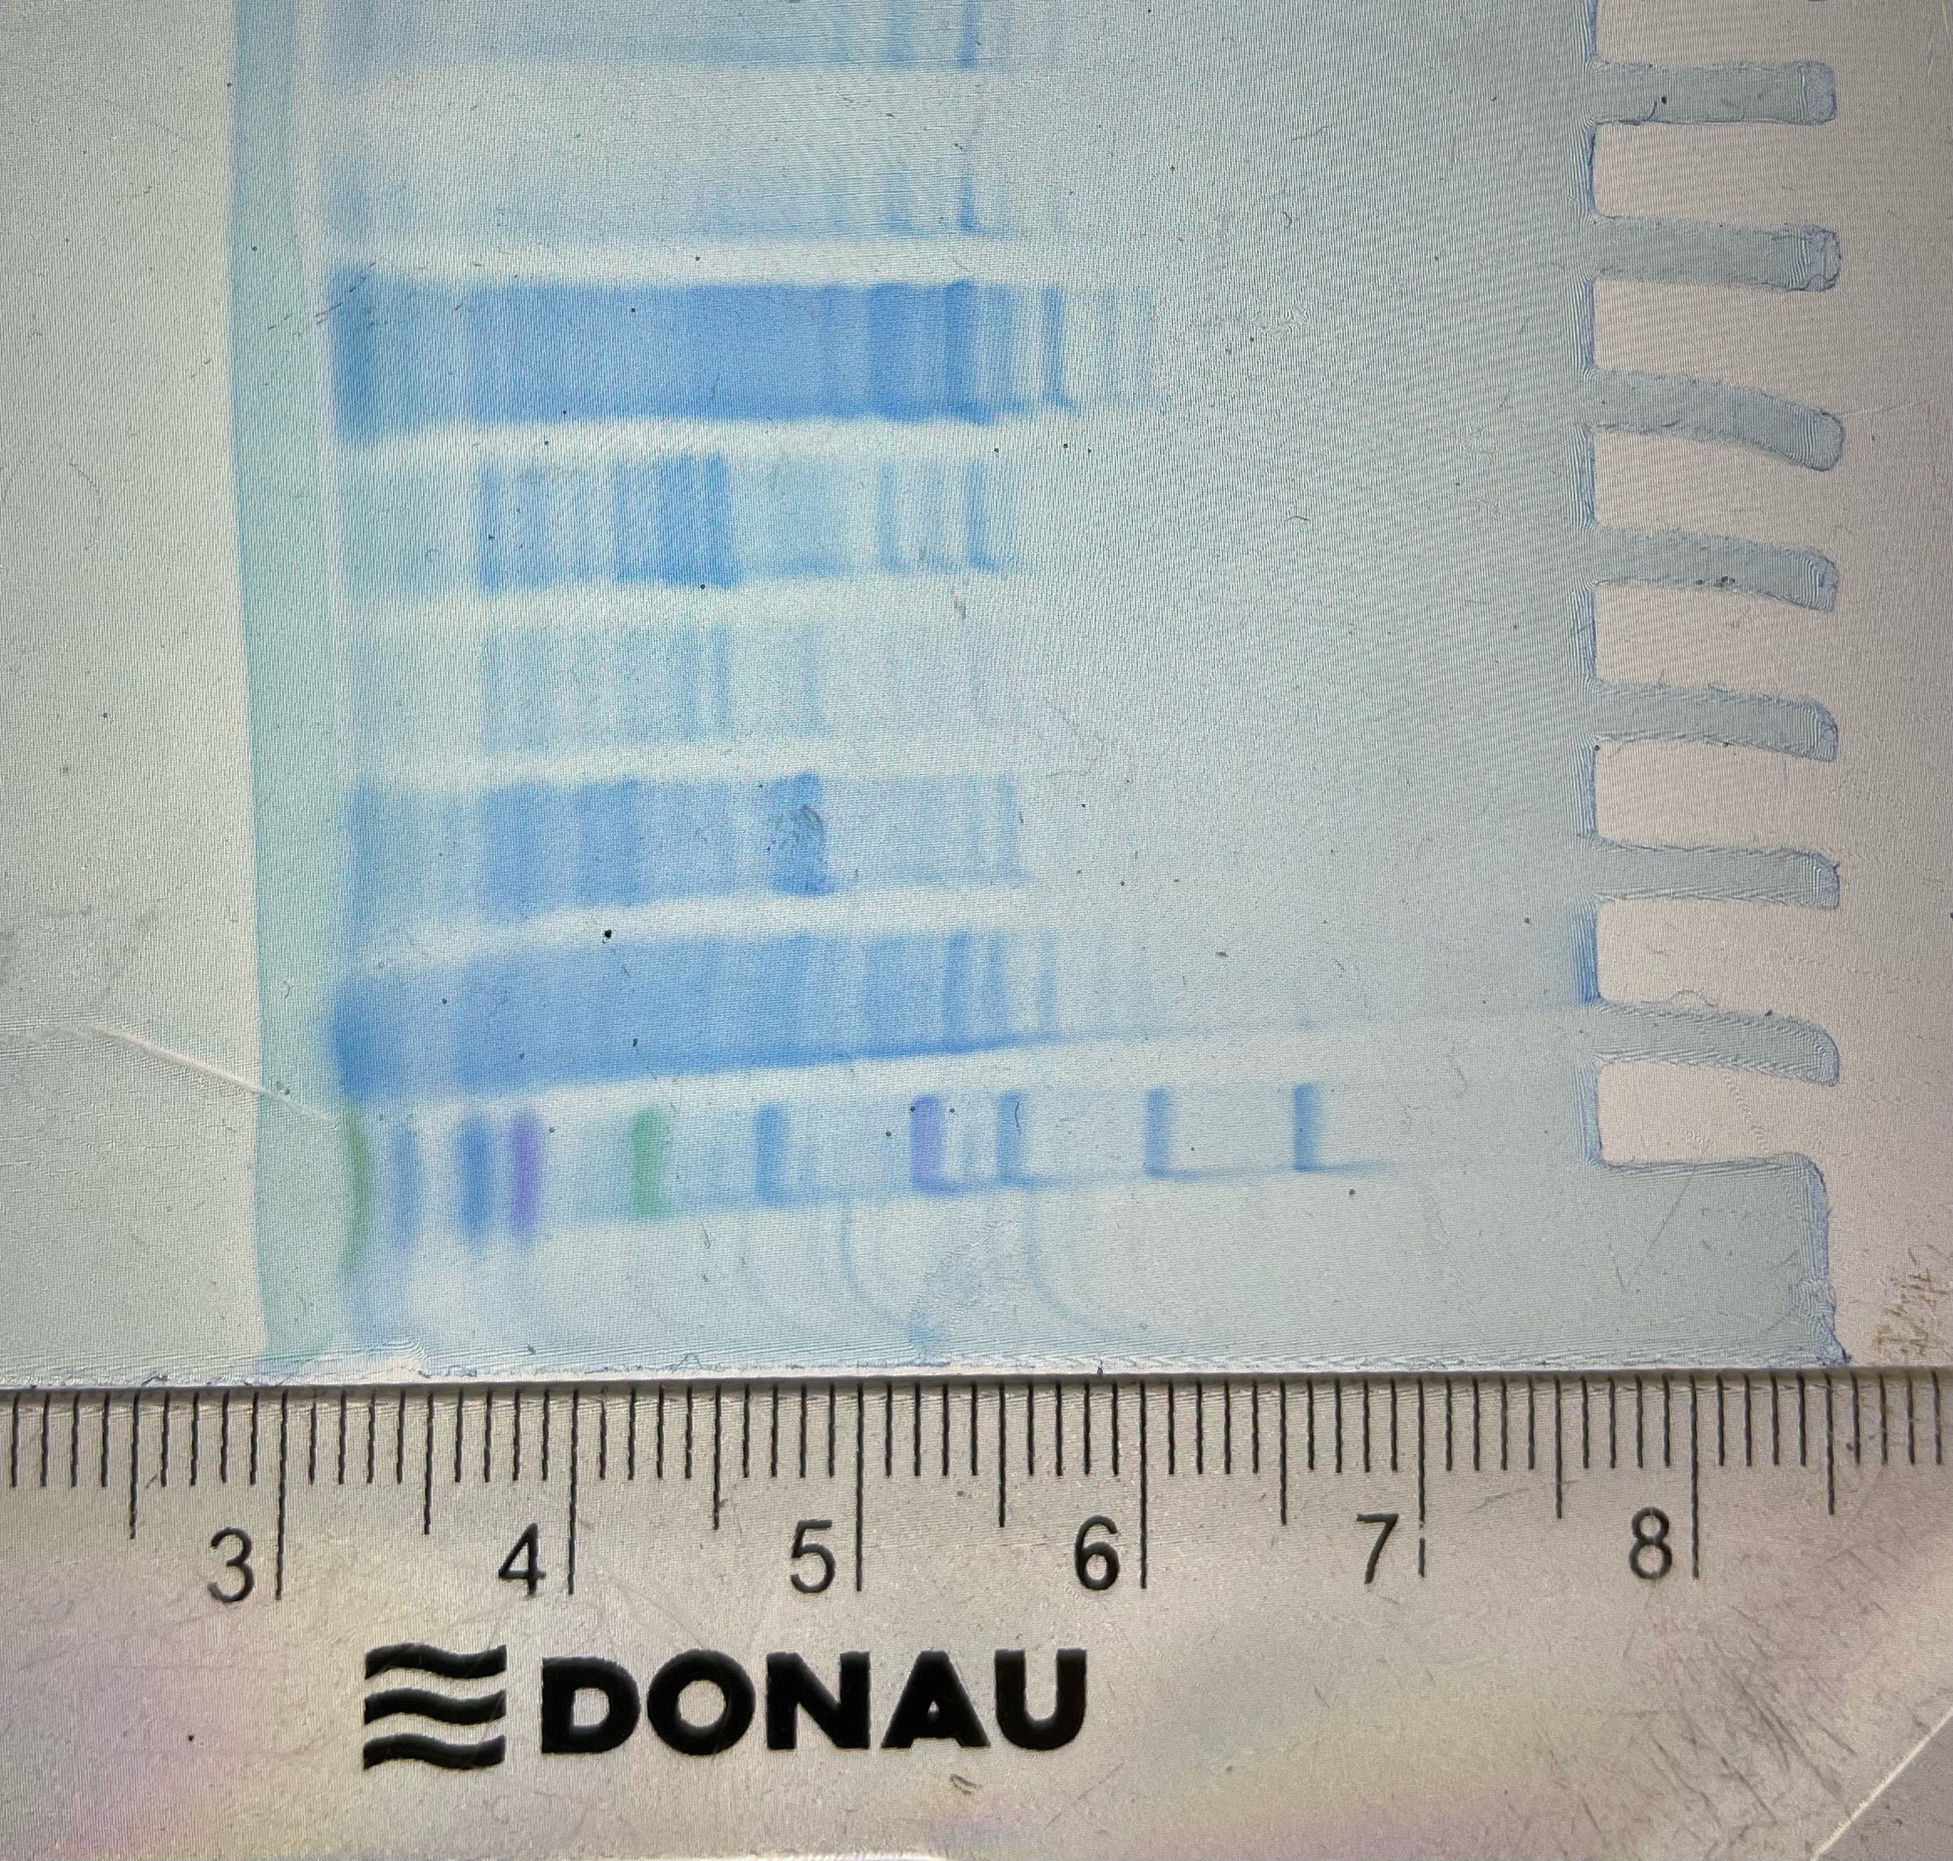
SDS - PAGE
100%
25%
10%
WS
FTL
LYS
M
MARKER
LYS: lysate (dilution factor 1:1)
FTL: flow through loading
WS: washing step
10%: eluate 10%
25%: eluate 25%
100%: eluate 100%
In the 25% eluate is lactase and another 15 proteins present
Conclusion: by AEXC we reduced the
number of proteins in our sample to
16 proteins (starting with 3000)

Slide 9
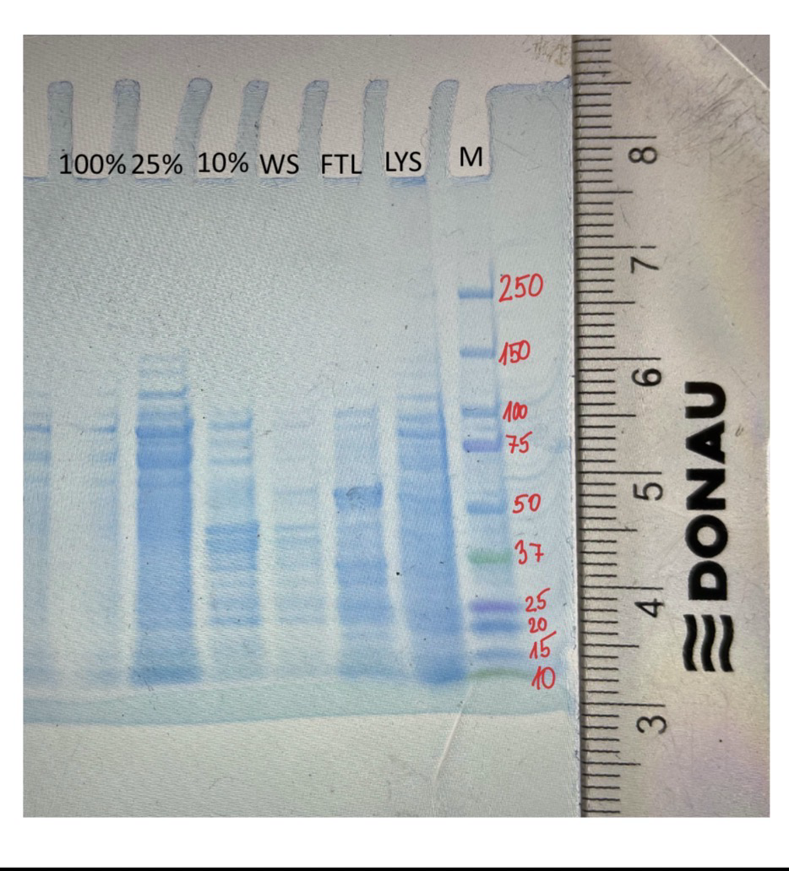
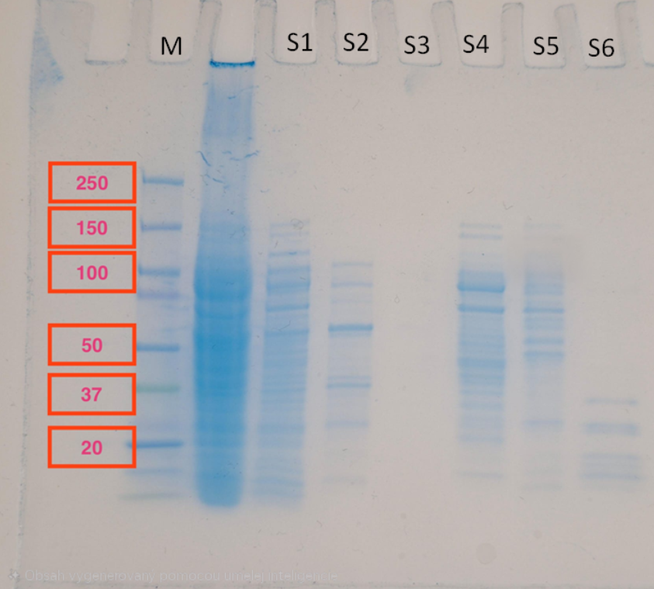
SDS - PAGE
Identification of the lactase subunit
in the gel with the marker
the molecular mass of lactase is 114kD
We can see the lactase right above the 100 marker on the lysate and 25% eluate

Slide 10
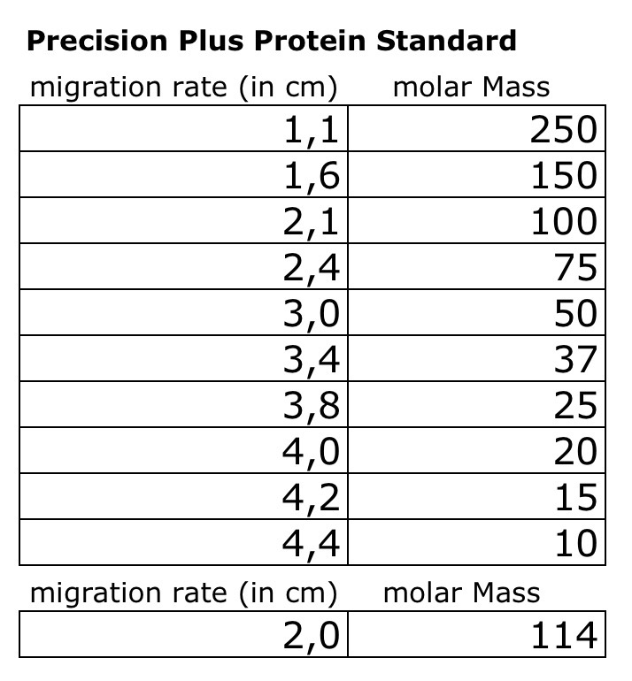
Evaluation of the SDS – PAGE
Identification of molecular weight of lactase subunit with your calibration line
Migration rate: 2 cm
Log (kDa) = 2
Molecular weight: 114 kDa
Log (kDa)
cm

Slide 11
Evaluation Steps of our Experiment
PARTICLE FREE LYSATE – o-NPG-test (enzymatic activity assay)
ANION EXCHANGE CHROMATOGRAPHY (AEXC) – o-NPG + photometer (enzymatic activity assay)
SDS – PAGE – gel + calibration line (purity, molecular weight – lactase)
RAW MILK TEST – colour change (conc. of glucose)
EVALUATION

Slide 12
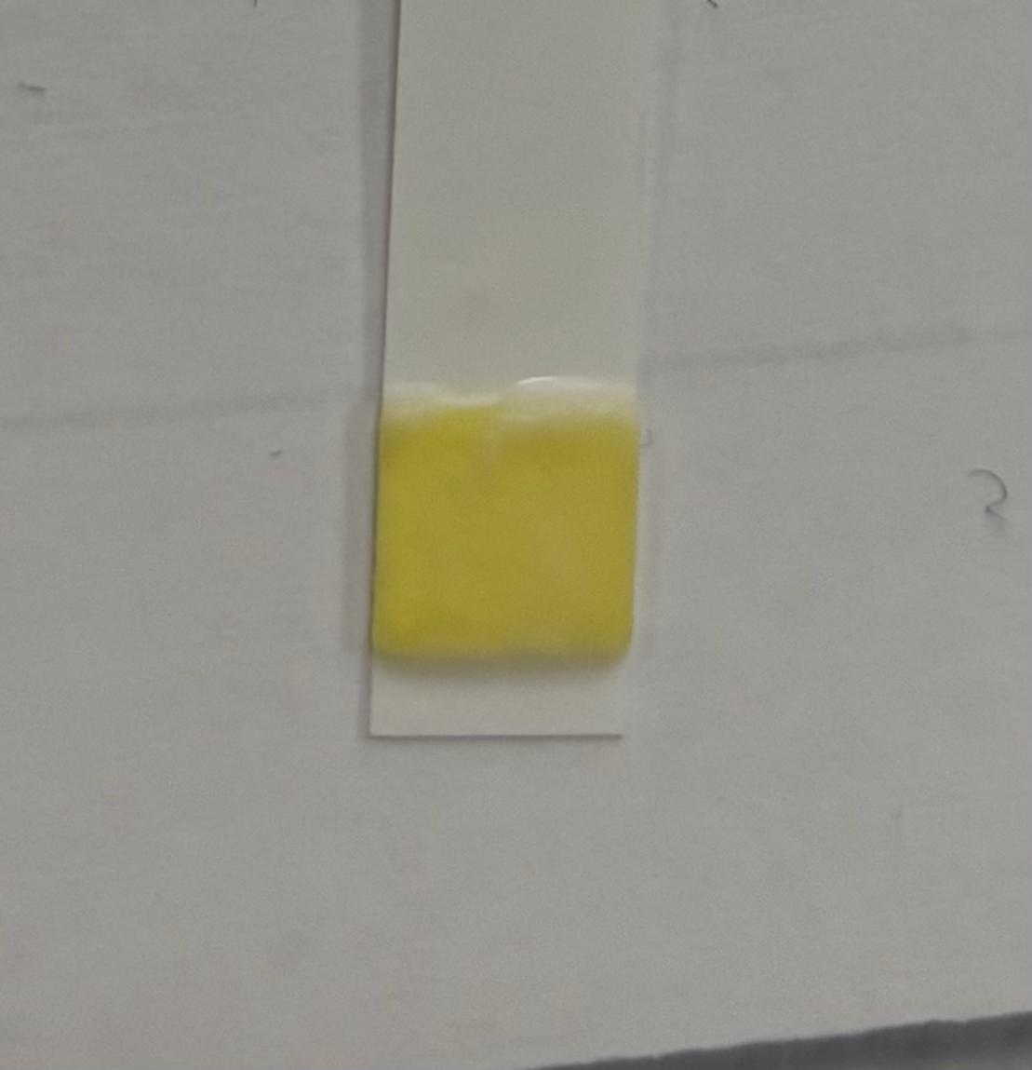
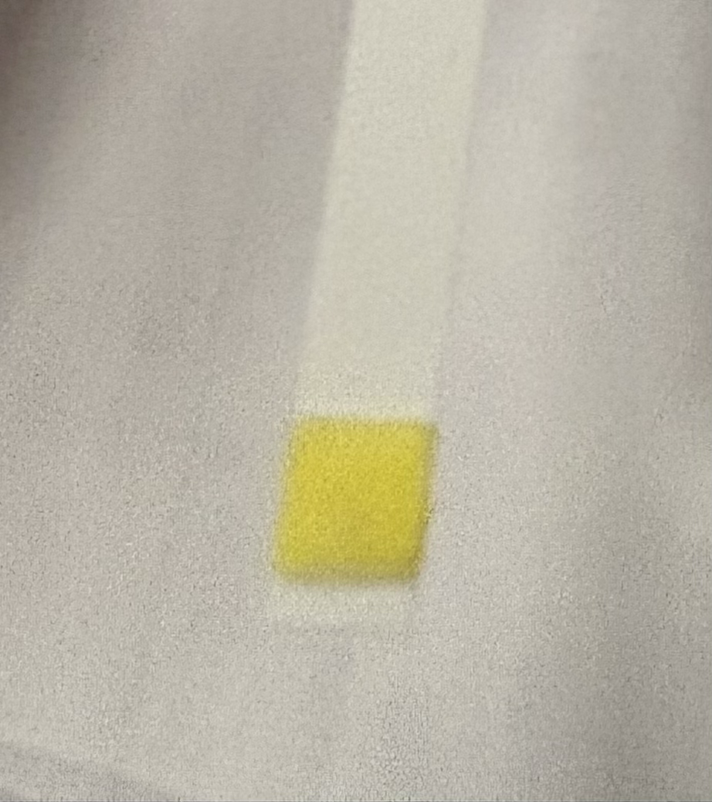
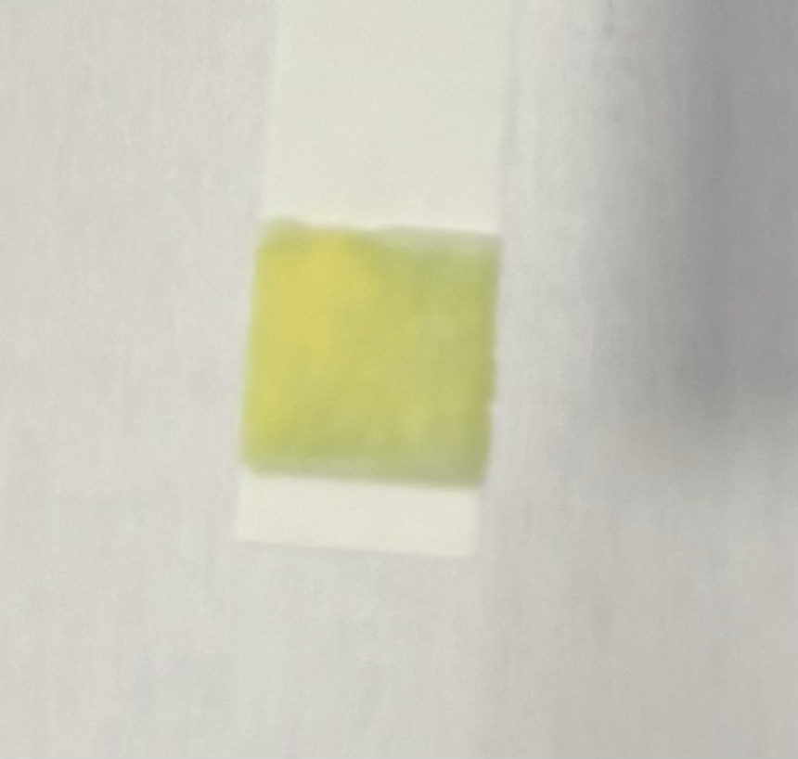
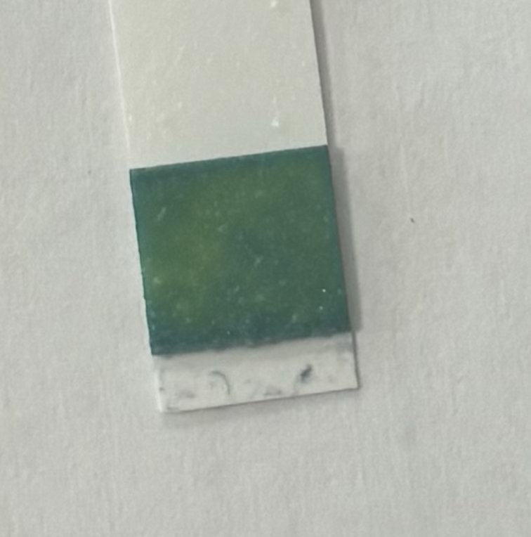
RAW MILK TEST
Observation: 0/20/40min: yellow
        70min: green
Evaluation: 2.8mmol/L
Conclusion: our isolated lactase could change raw milk
containing lactose into lactose-free raw milk
Control
0 min
20 min
40 min
60 min

Slide 13
Evaluation Steps of our Experiment
PARTICLE FREE LYSATE – o-NPG-test (enzymatic activity assay)
ANION EXCHANGE CHROMATOGRAPHY (AEXC) – o-NPG + photometer (enzymatic activity assay)
SDS – PAGE – gel + calibration line (purity, molecular weight – lactase)
RAW MILK TEST – colour change (conc. of glucose)
EVALUATION

Slide 14
EVALUATION
1. TASK: SDS-PAGE and AEXC both have the same results. 25% eluate had the highest enzymatic activity and showed the lactase subunit band.
2. TASK: we would use 25% eluate and have to further purify it by chromatography.

Slide 15
Thank you for your attention!

