Slide 1
Summary of Results from
Group 7
Lactase Downstream Processing
Evreux 23. – 27.03.2026

Slide 2




Group 7 presentation of group members
Michaela Labudová
Slovakia
Zuzana Zackova
Czech Republic
Agnes Sørensen
Denmark

Slide 3
Evaluation Steps of our Experiment
PARTICLE FREE LYSATE – o-NPG-test (enzymatic activity assay)
ANION EXCHANGE CHROMATOGRAPHY (AEXC) – o-NPG + photometer (enzymatic activity assay)
SDS – PAGE – gel + calibration line (purity, molecular weight – lactase)
RAW MILK TEST – colour change (conc. of glucose)
EVALUATION

Slide 4
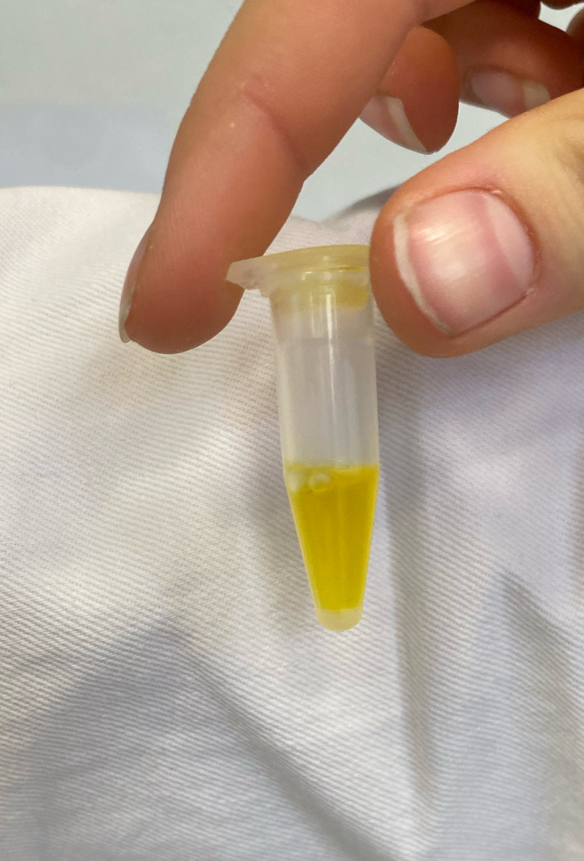
O-NPG-TEST of 1:10 diluted Particle Free Lysate
Test 50 μL supernatant + 500 μL o-NPG-solution.
Observation: We saw a dominant yellow color
Evaluation: The bond between D-galactose and Ortho-nitrophenol was broken down
Conclusion: The lactase was present I the lysate and we can start AEXC.

Slide 5
Evaluation Steps of our Experiment
PARTICLE FREE LYSATE – o-NPG-test (enzymatic activity assay)
ANION EXCHANGE CHROMATOGRAPHY (AEXC) – o-NPG + photometer (enzymatic activity assay)
SDS – PAGE – gel + calibration line (purity, molecular weight – lactase)
RAW MILK TEST – colour change (conc. of glucose)
EVALUATION

Slide 6
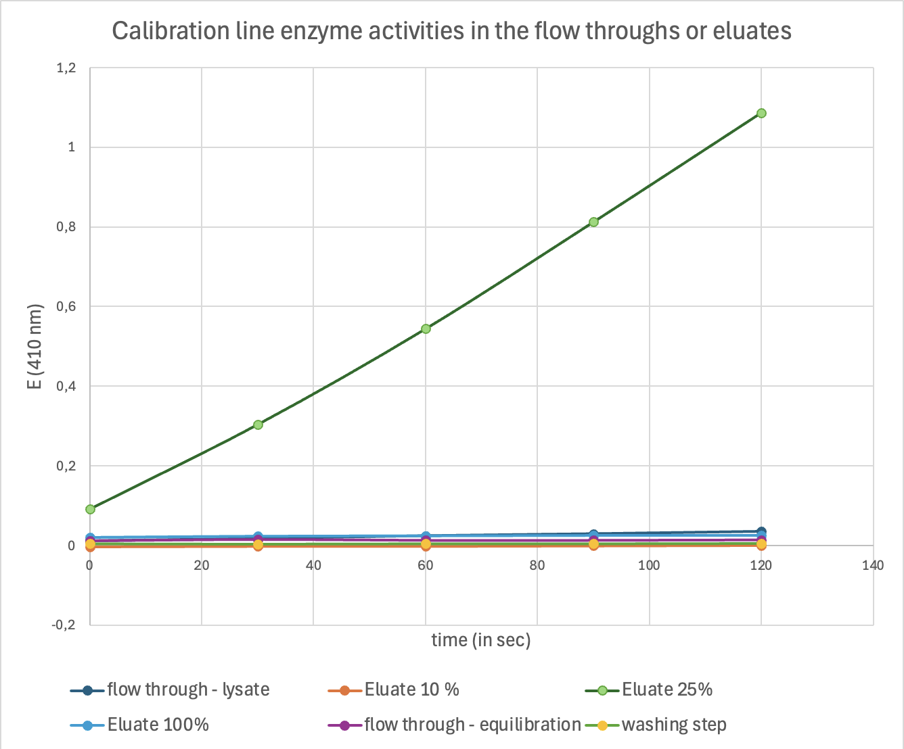
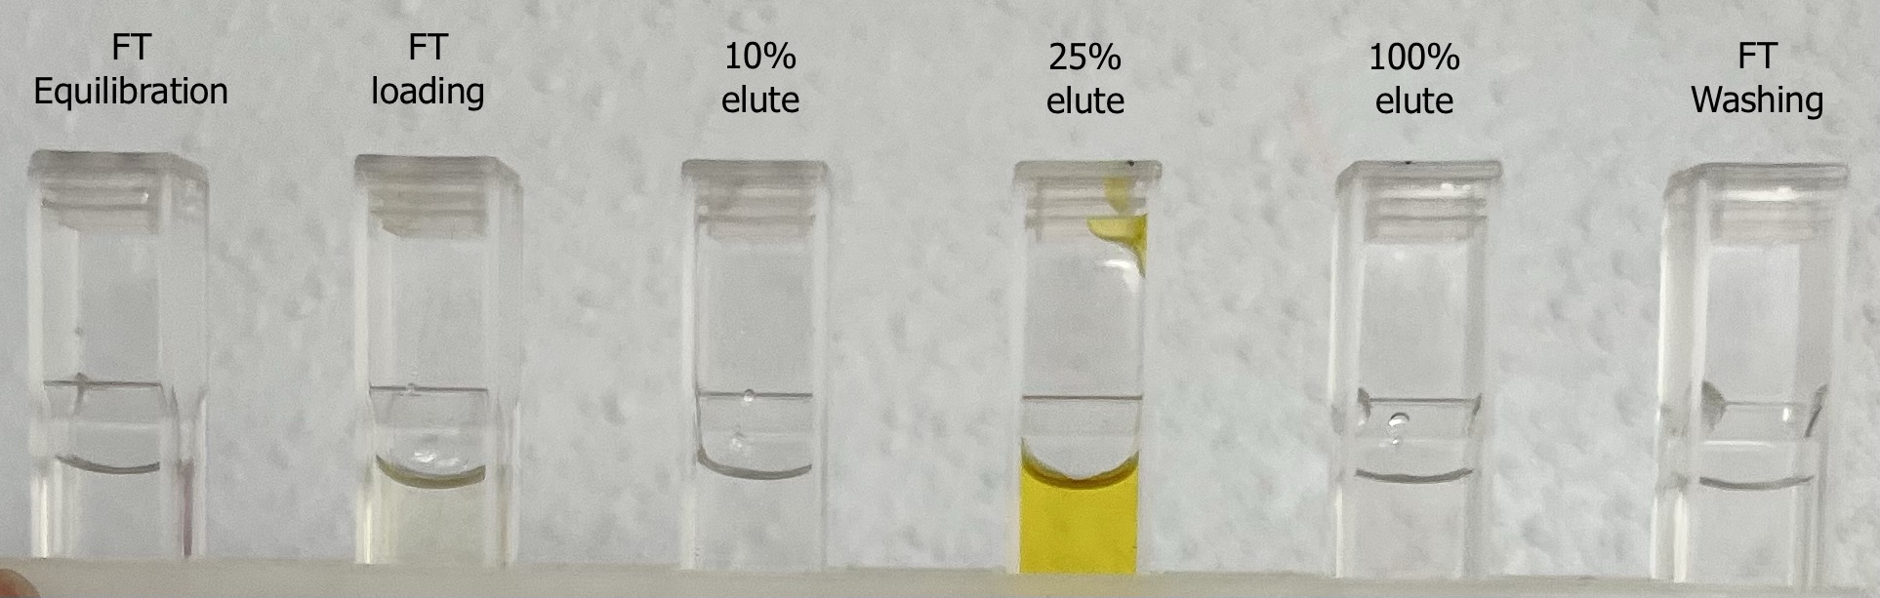
ANION EXCHANGE CHROMATOGRAPHY
O-NPG-test measured by photometer
– enzymatic activity measurement
Test 50 μL eluate + 800 μL o-NPG-solution.
Observation: We saw only an increase in the absorption in the 25% elute, which turned yellow
Evaluation: This means the enzymatic activity was highest in the 25% elute and there was little to no enzymatic activity in the others.
Conclusion: The highest lactase activity was in the 25% eluate

Slide 7
Evaluation Steps of our Experiment
PARTICLE FREE LYSATE – o-NPG-test (enzymatic activity assay)
ANION EXCHANGE CHROMATOGRAPHY (AEXC) – o-NPG + photometer (enzymatic activity assay)
SDS – PAGE – gel + calibration line (purity, molecular weight – lactase)
RAW MILK TEST – colour change (conc. of glucose)
EVALUATION

Slide 8
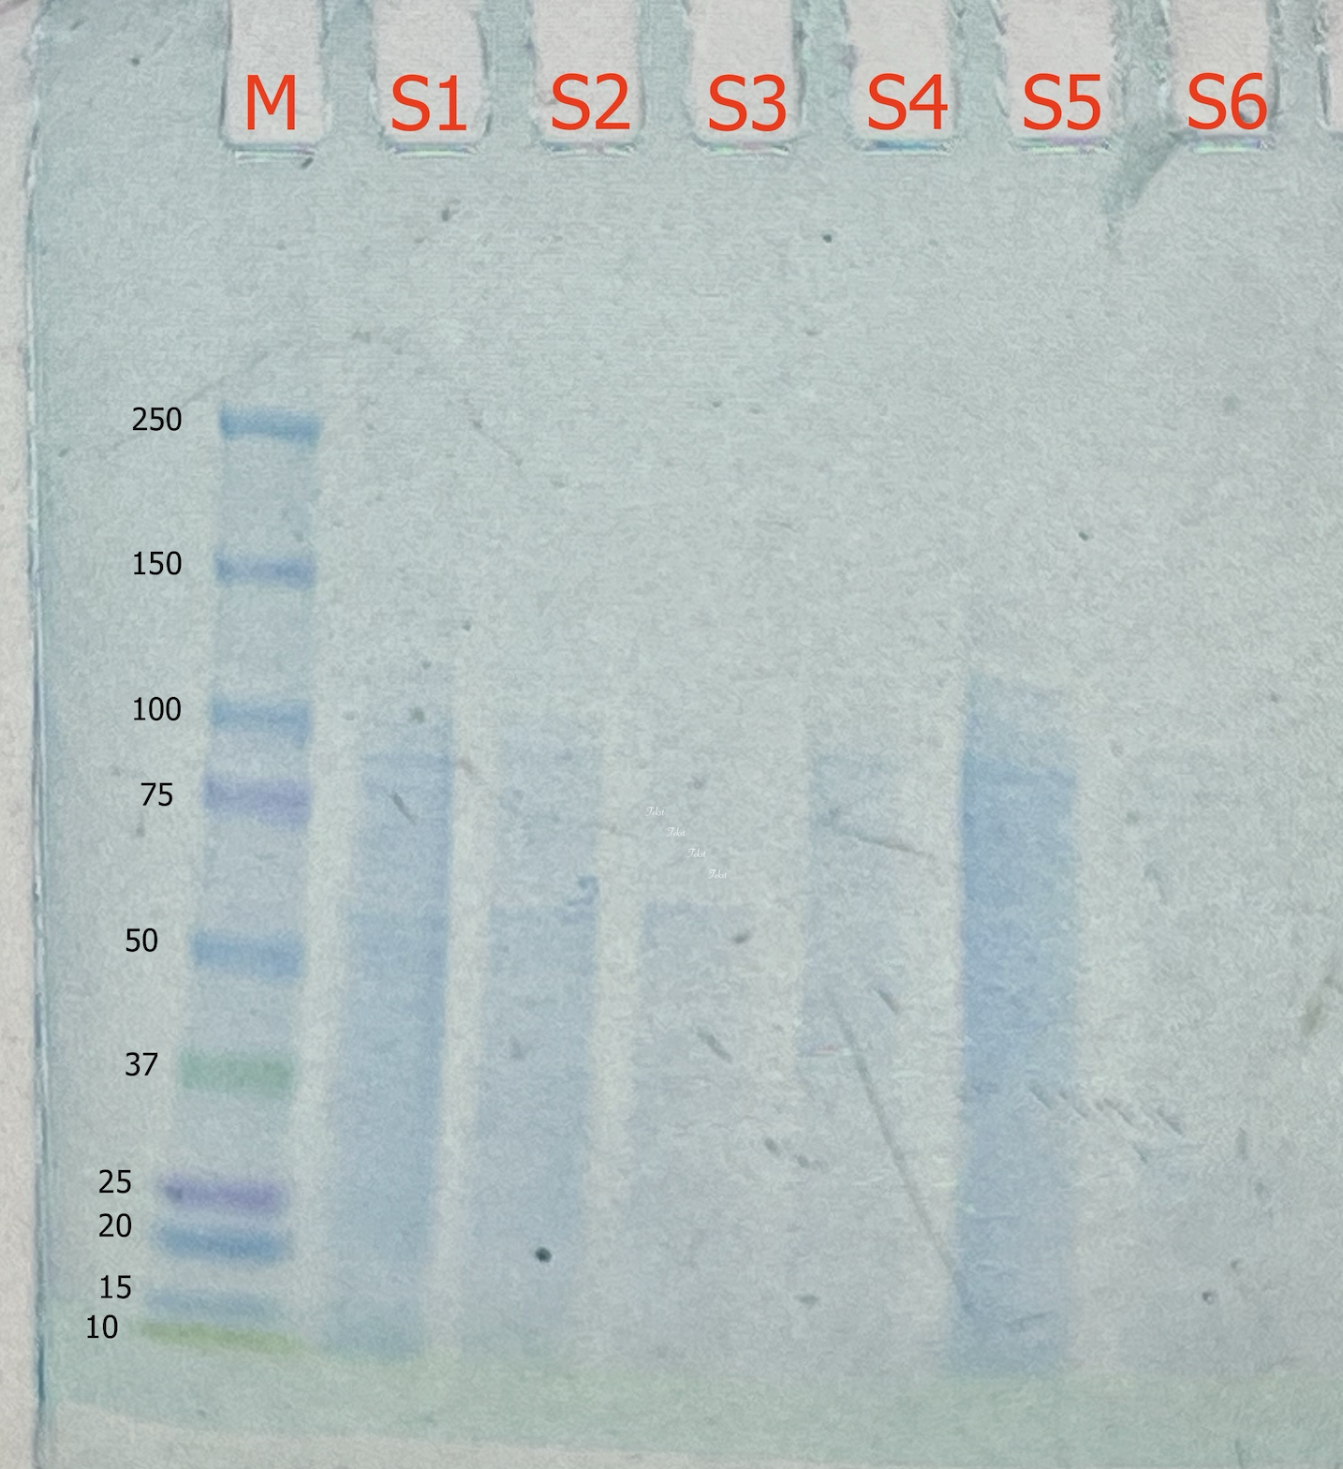
SDS - PAGE
M: MARKER
S1: lysate
S2: loading flow through
S3: washing step flow through
S4: eluate 10%
S5: eluate 25%
S6: eluate 100%
Observation: We saw a lot of proteins in the lysate and less in the others. Here we noticed a lot of smaller proteins in S2, S3 and S4 and larger proteins in S5 the 25% elute

Slide 9
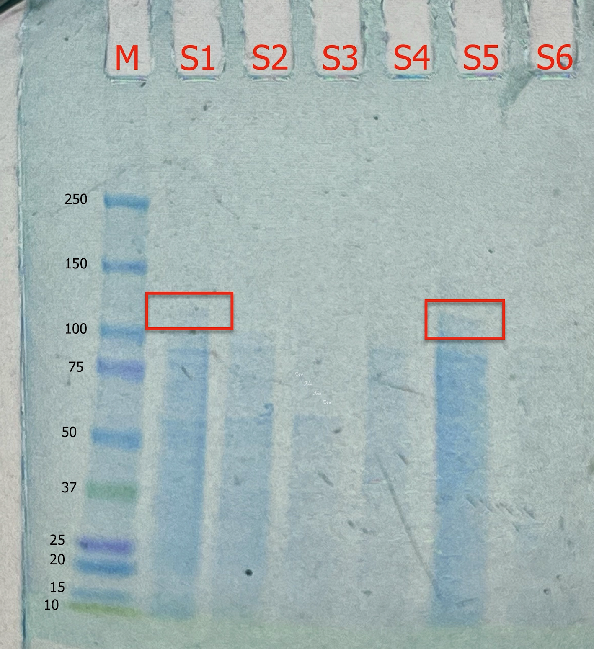
SDS - PAGE
Evaluation: We saw the lactase as a clear band in the 25% elute and the lysate and not in the others. Meaning we sucessfully purified the Lactase in the lysate.
Conclusion: By AEXC we reduced the
number of proteins starting with 3000.

Slide 10
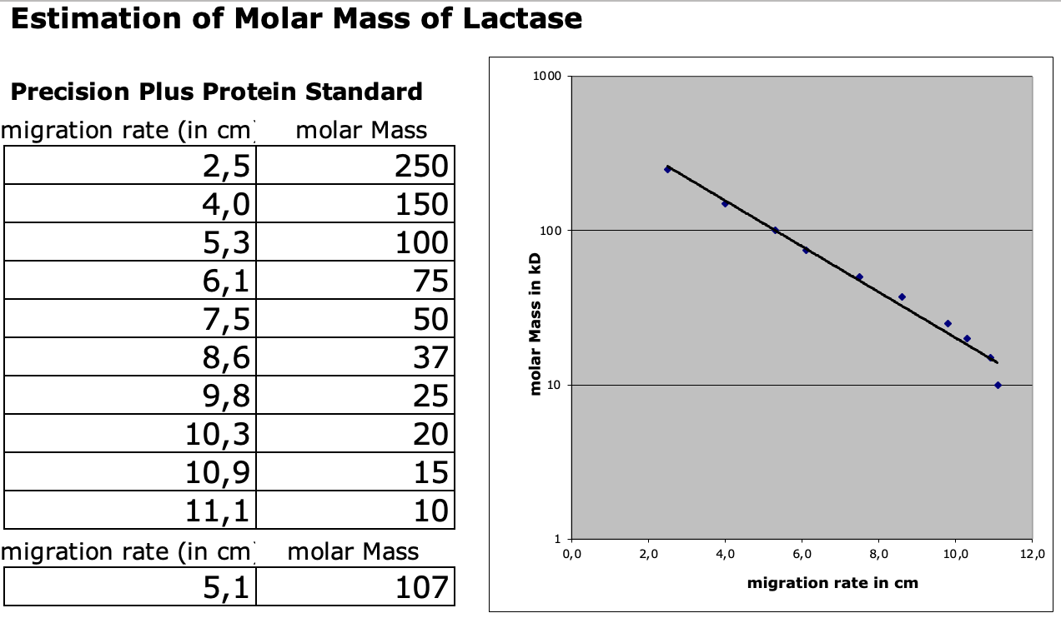
Evaluation of the SDS – PAGE
Identification of molecular weight of lactase subunit with our calibration line
Migration rate:
5,1 cm
Molecular weight: 107 kDa
Log (kDa)
cm

Slide 11
Evaluation Steps of our Experiment
PARTICLE FREE LYSATE – o-NPG-test (enzymatic activity assay)
ANION EXCHANGE CHROMATOGRAPHY (AEXC) – o-NPG + photometer (enzymatic activity assay)
SDS – PAGE – gel + calibration line (purity, molecular weight – lactase)
RAW MILK TEST – colour change (conc. of glucose)
EVALUATION

Slide 12
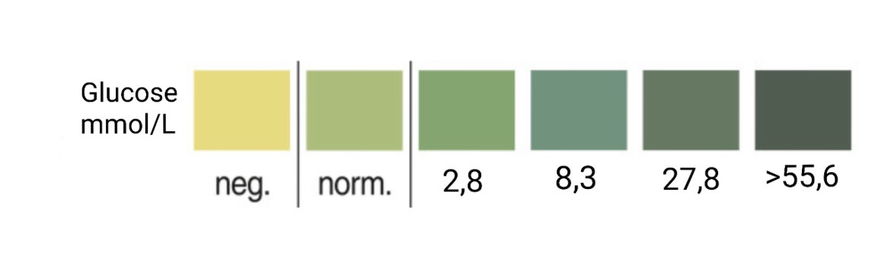

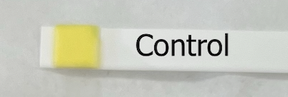
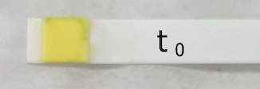
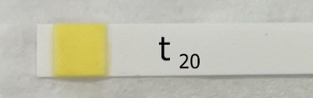
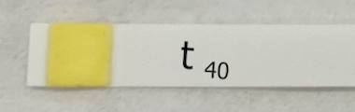
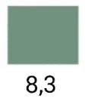
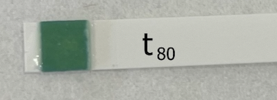
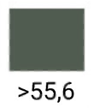
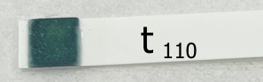
RAW MILK TEST
Test 100 μL 25% eluate + 1 mL raw milk.
Observation: We saw no color change in the control, t₀, t₂₀ & t₄₀. After that we added 200 μl we testet the t₈₀ that had a dark green color. We testet again at t₁₁₀ what gave an evan darker green color.
Evaluation: There was no glucose in the control, t₀, t₂₀ & t₄₀. In the t₈₀ there was 8,3 mmol/L glucose and in t₁₁₀ there was more than 55,6 mmol/L glucose.
Conclusion: our isolated lactase could change raw milk containing lactose into lactose-free raw milk after adding more.

Slide 13
Evaluation Steps of our Experiment
PARTICLE FREE LYSATE – o-NPG-test (enzymatic activity assay)
ANION EXCHANGE CHROMATOGRAPHY (AEXC) – o-NPG + photometer (enzymatic activity assay)
SDS – PAGE – gel + calibration line (purity, molecular weight – lactase)
RAW MILK TEST – colour change (conc. of glucose)
EVALUATION

Slide 14
EVALUATION
In comparison of our results of AEXC we saw the highest lactase activity in the 25% elute and the highest amount of lactase in SDS – PAGE in the 25% elute. Meaning we sucessfully purified the Lactase in the lysate.
The 25% elute is suitable for downstream process and further purification of lactase, because according to photometry and SDS – PAGE this is the sample that contains the most lactase.

Slide 15
Thank you for your attention!

