Slide 1
Summary of Results from
Group 5
Lactase Downstream Processing
Evreux 23. – 27.03.2026

Slide 2
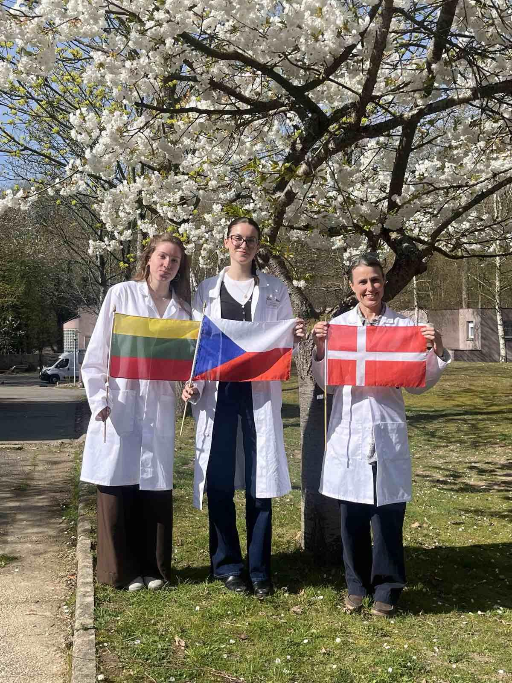



Group 5+ presentation of group members
1. Ieva Stundžytė
Lithuania
2. Natálie Růžová
Czech Republic
3. Pia Vigsø Lassen
Denmark

Slide 3
Evaluation Steps of our Experiment
PARTICLE FREE LYSATE – o-NPG-test (enzymatic activity assay)
ANION EXCHANGE CHROMATOGRAPHY (AEXC) – o-NPG + photometer (enzymatic activity assay)
SDS – PAGE – gel + calibration line (purity, molecular weight – lactase)
RAW MILK TEST – colour change (conc. of glucose)
EVALUATION

Slide 4
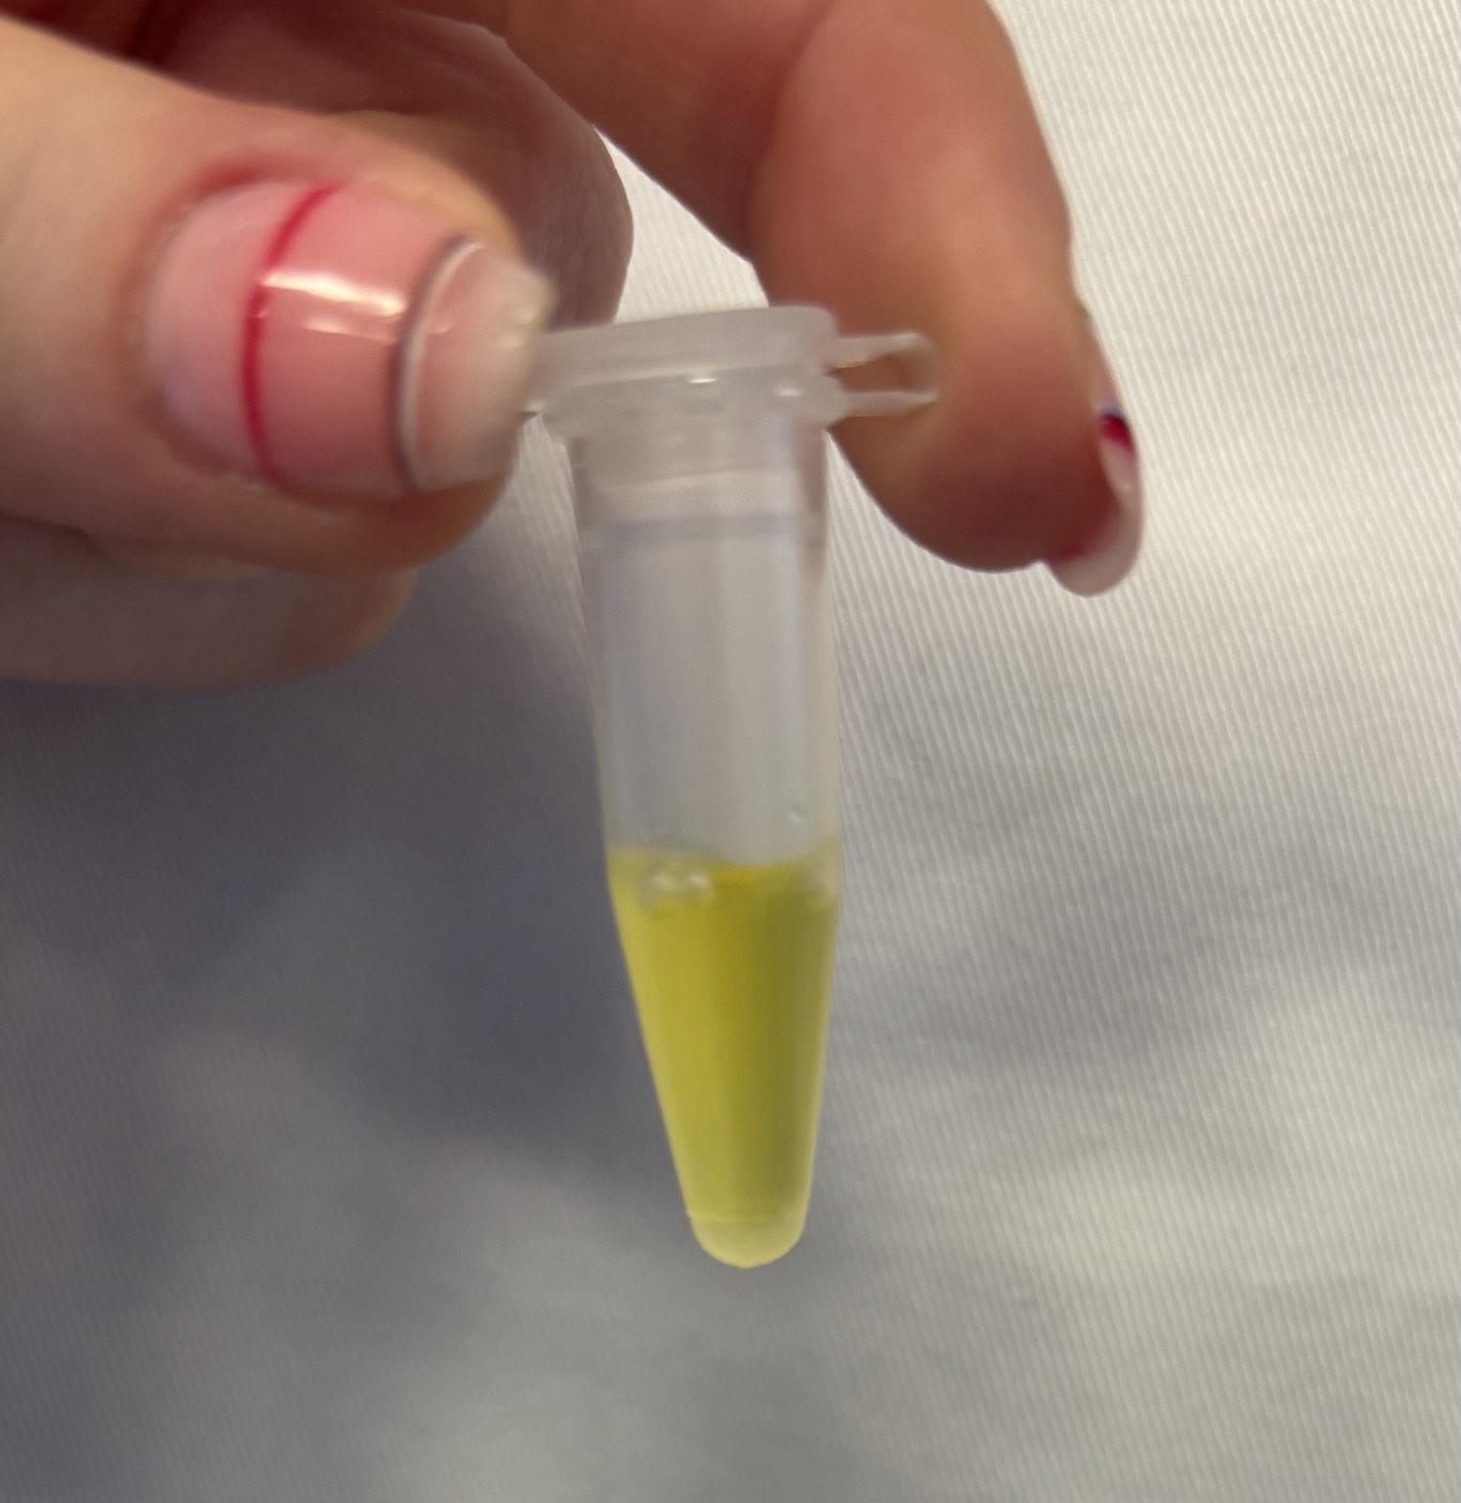
O-NPG-TEST of 1:10 diluted Particle Free Lysate
Test 50 μL supernatant + 500 μL o-NPG-solution.
Observation: The color changed from transparent to yellow.
Evaluation: β(1→4) bond was broken down.
Conclusion: lactase is present.
→ We can start AEXC.
Picture of cuvette

Slide 5
Evaluation Steps of our Experiment
PARTICLE FREE LYSATE – o-NPG-test (enzymatic activity assay)
ANION EXCHANGE CHROMATOGRAPHY (AEXC) – o-NPG + photometer (enzymatic activity assay)
SDS – PAGE – gel + calibration line (purity, molecular weight – lactase)
RAW MILK TEST – colour change (conc. of glucose)
EVALUATION

Slide 6
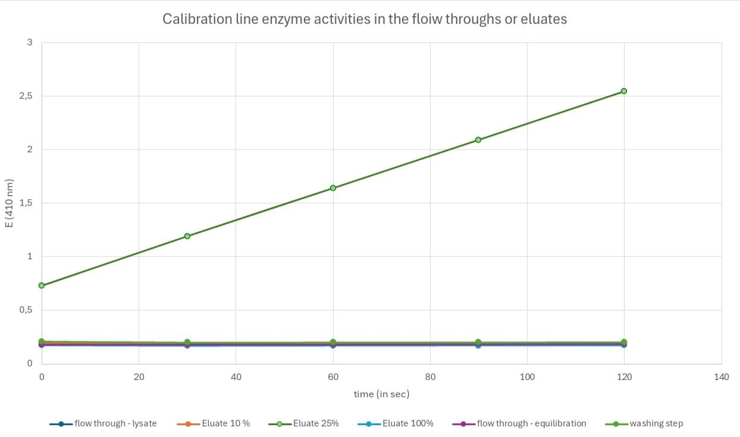
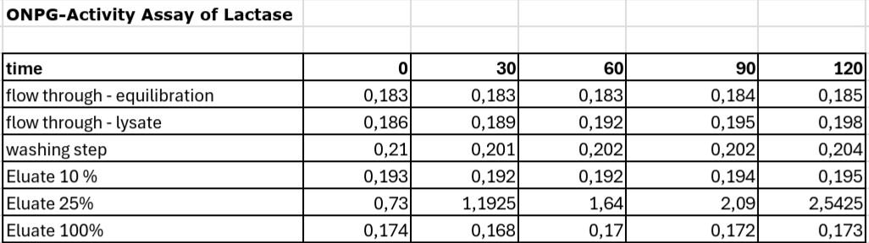
ANION EXCHANGE CHROMATOGRAPHY
O-NPG-test measured by photometer – enzymatic activity measurement
Test 50 μL eluate + 800 μL o-NPG-solution.
Observation: the curve of eluate 25% was increasing and other samples stayed close to zero.
Evaluation: our own Excel diagram
Conclusion: the highest
lactase activity was in 25% eluate.

Slide 7
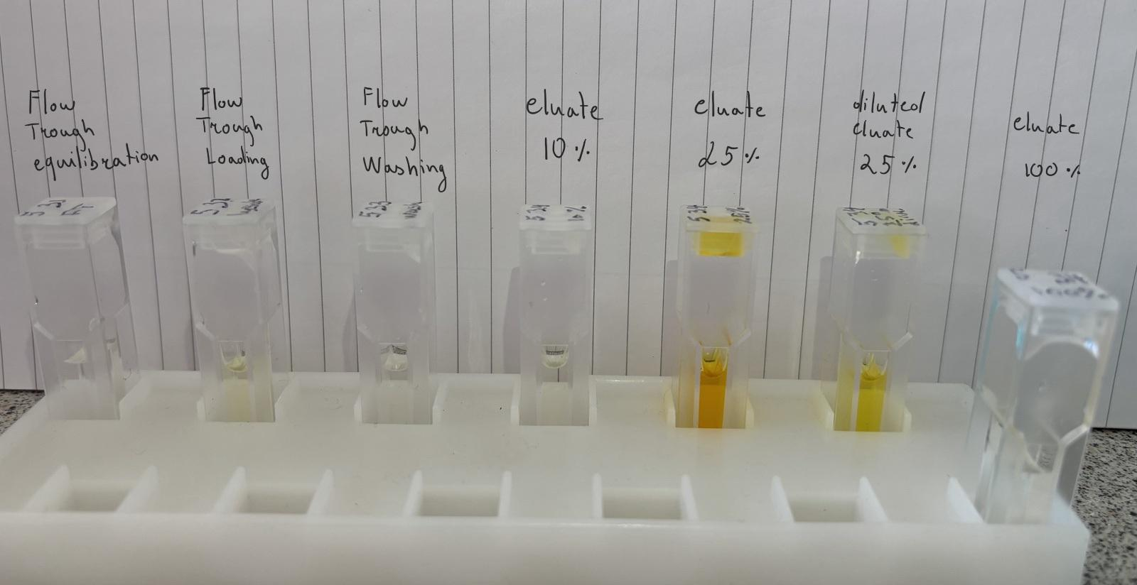
Photometry: ONPG-assay

Slide 8
Evaluation Steps of our Experiment
PARTICLE FREE LYSATE – o-NPG-test (enzymatic activity assay)
ANION EXCHANGE CHROMATOGRAPHY (AEXC) – o-NPG + photometer (enzymatic activity assay)
SDS – PAGE – gel + calibration line (purity, molecular weight – lactase)
RAW MILK TEST – colour change (conc. of glucose)
EVALUATION

Slide 9
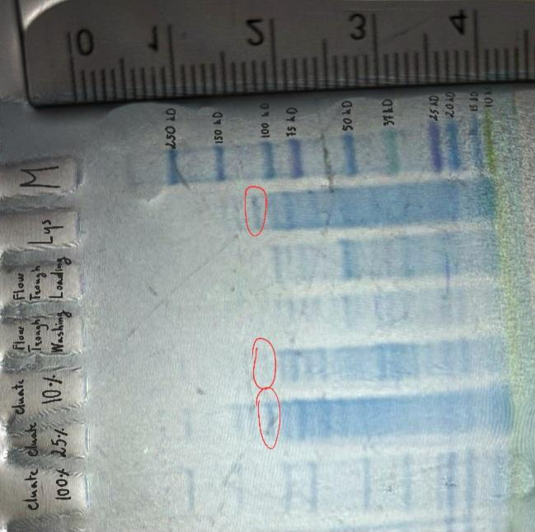
SDS - PAGE
MARKER
1: lysate (dilution factor 10)
2: loading flow through
3: washing step
4: eluate 10%
5: eluate 25%
6: eluate 100%
In the mixtures containing lactase there are: 1.Lys-15 bands,
2.e10%-17 bands,
3.e25%-13 bands.
Conclusion: by AEXC we reduced the
number of proteins in our sample from 15 protein bands (lysate) to 11 protein bands (eluate 100%) / (starting with 3000)

Slide 10
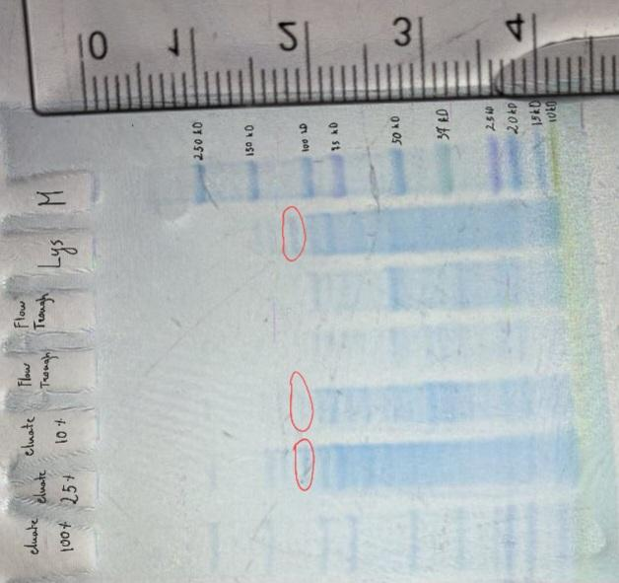
SDS - PAGE
Identification of the lactase subunits in the gel with the marker

Slide 11
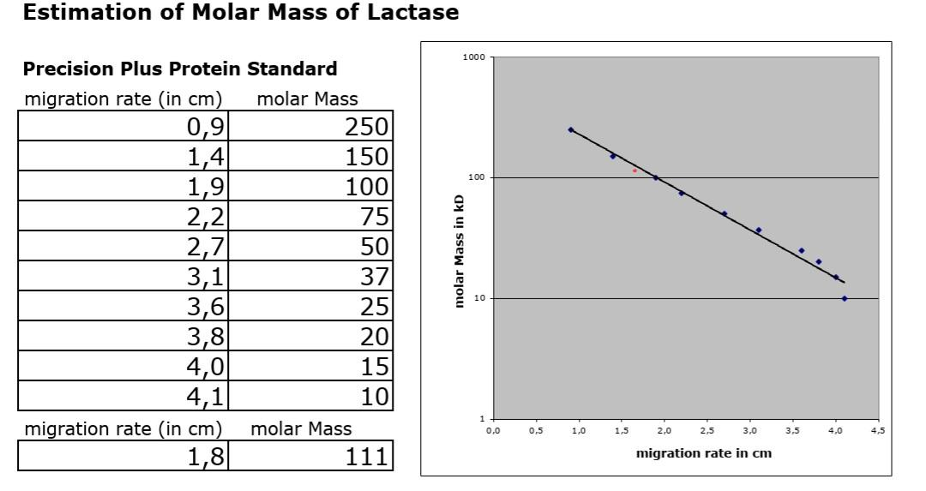
Evaluation of the SDS – PAGE
Migration rate: 1,8 cm
Molecular weight: 111 kDa
Log (kDa)
cm

Slide 12
Evaluation Steps of our Experiment
PARTICLE FREE LYSATE – o-NPG-test (enzymatic activity assay)
ANION EXCHANGE CHROMATOGRAPHY (AEXC) – o-NPG + photometer (enzymatic activity assay)
SDS – PAGE – gel + calibration line (purity, molecular weight – lactase)
RAW MILK TEST – colour change (conc. of glucose)
EVALUATION

Slide 13
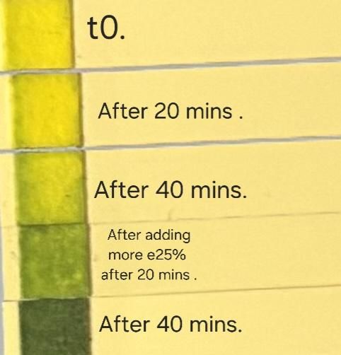
RAW MILK TEST
Observation:
t0-yellow,
after 20 mins-yellow/a little green.
after 40 mins-green/a little yellow.
after adding more e25%:
after 20 mins-green.
after 40 mins-dark green.
Control
0 min
20 min
40 min
60 min

Slide 14
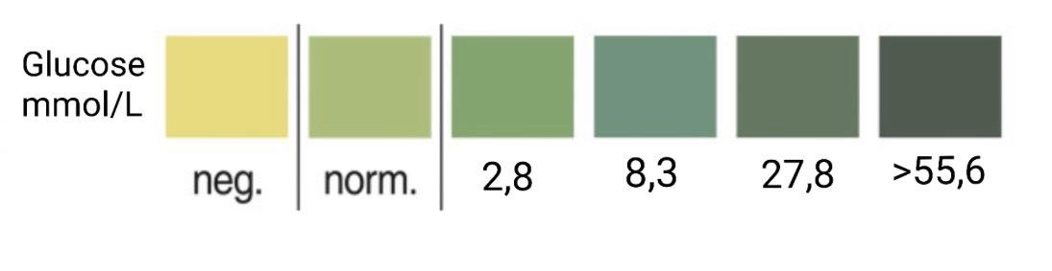
Raw Milk Test
Evaluation: value of glucose:
t0- neg
after 20 mins-neg
after 40 mins-norm
after adding more e25%:
after 20 mins-2,8 mmol/L
after 40 mins-27,8 mmol/L
Conclusion: our isolated lactase could change raw milk containing lactose into lactose-free raw milk

Slide 15
Evaluation Steps of our Experiment
PARTICLE FREE LYSATE – o-NPG-test (enzymatic activity assay)
ANION EXCHANGE CHROMATOGRAPHY (AEXC) – o-NPG + photometer (enzymatic activity assay)
SDS – PAGE – gel + calibration line (purity, molecular weight – lactase)
RAW MILK TEST – colour change (conc. of glucose)
EVALUATION

Slide 16
EVALUATION
TASK:
From AEXC (and photometry) and SDS Page, we can see that the most lactase was in eluate 25%.
Conclusion of task 1 is that our AEXC was successful and the biggest concentration of lactase was in eluate 25%, that was proven by photometry (ONPG-assay) and SDS Page.
2. TASK: For a further purification of lactase we would choose eluate 25% sample, because there was the biggest amount of lactase.

Slide 17
Thank you for your attention!

