Slide 1
Summary of Results from
Group 3
Lactase Downstream Processing
Evreux 23. – 27.03.2026

Slide 2
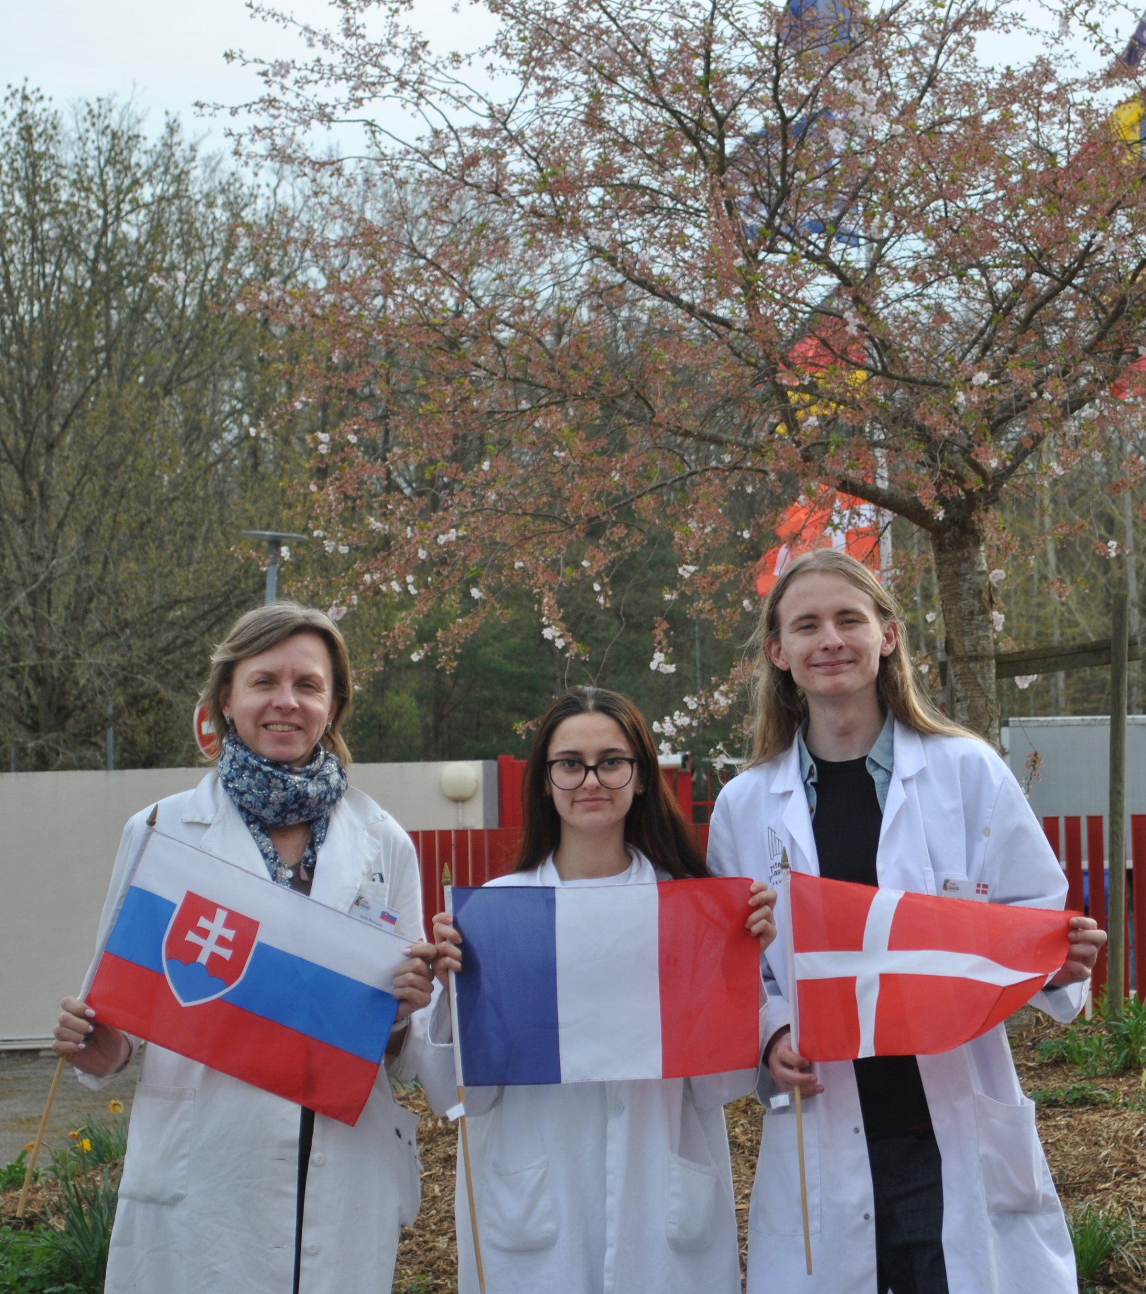



Group 3 + presentation of group members
Severin A Andersen (s)
Denmark
Azra Cengia (m)
France
Lucia Bizoňová (t)
Slovakia

Slide 3
Evaluation Steps of our Experiment
PARTICLE FREE LYSATE – o-NPG-test (enzymatic activity assay)
ANION EXCHANGE CHROMATOGRAPHY (AEXC) – o-NPG + photometer (enzymatic activity assay)
SDS – PAGE – gel + calibration line (purity, molecular weight – lactase)
RAW MILK TEST – colour change (conc. of glucose)
EVALUATION

Slide 4
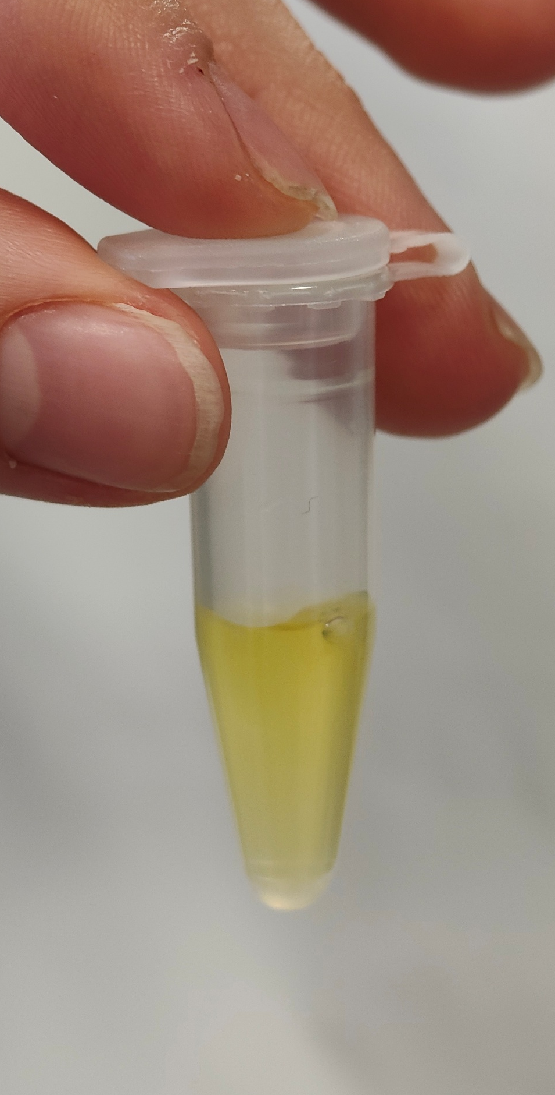
O-NPG-TEST of 1:10 diluted Particle Free Lysate
Test 50 μL supernatant + 500 μL o-NPG-solution.
Observation: The color of the solution has changed to yellow
Evaluation: β(1→4) bond was broken down
Conclusion: lactase is present.
→ We can start AEXC.
Picture of cuvette

Slide 5
Evaluation Steps of our Experiment
PARTICLE FREE LYSATE – o-NPG-test (enzymatic activity assay)
ANION EXCHANGE CHROMATOGRAPHY (AEXC) – o-NPG + photometer (enzymatic activity assay)
SDS – PAGE – gel + calibration line (purity, molecular weight – lactase)
RAW MILK TEST – colour change (conc. of glucose)
EVALUATION

Slide 6
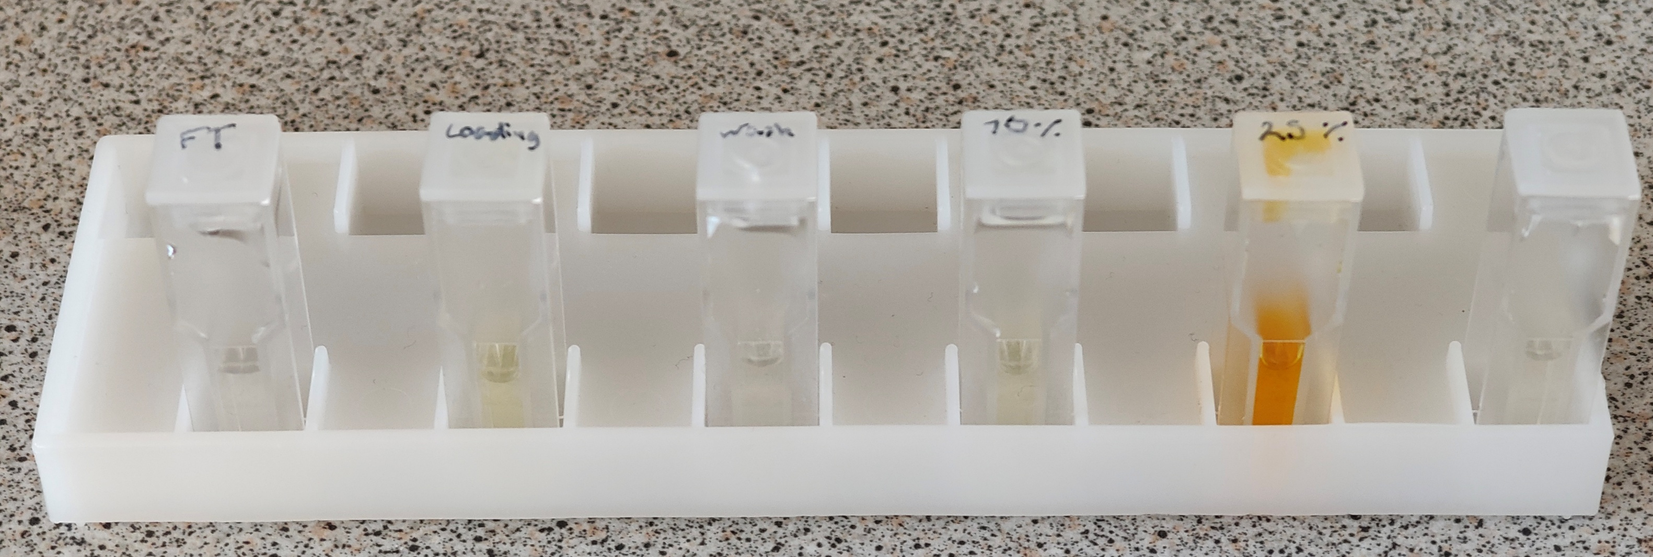
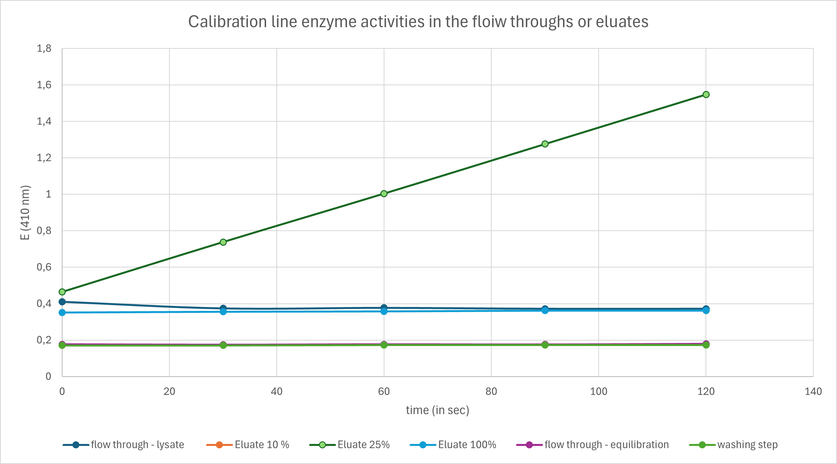
ANION EXCHANGE CHROMATOGRAPHY
O-NPG-test measured by photometer – enzymatic activity measurement
Test 50 μL eluate + 800 μL o-NPG-solution, yellow o-nitrophenol
Observation: difference in growth rates across samples, all eluates show some growth.
Evaluation: difference in growth rates indicates a difference in lactase activity
Conclusion: the highest lactase activity was in 25% eluate/flow through

Slide 7
Evaluation Steps of our Experiment
PARTICLE FREE LYSATE – o-NPG-test (enzymatic activity assay)
ANION EXCHANGE CHROMATOGRAPHY (AEXC) – o-NPG + photometer (enzymatic activity assay)
SDS – PAGE – gel + calibration line (purity, molecular weight – lactase)
RAW MILK TEST – colour change (conc. of glucose)
EVALUATION

Slide 8
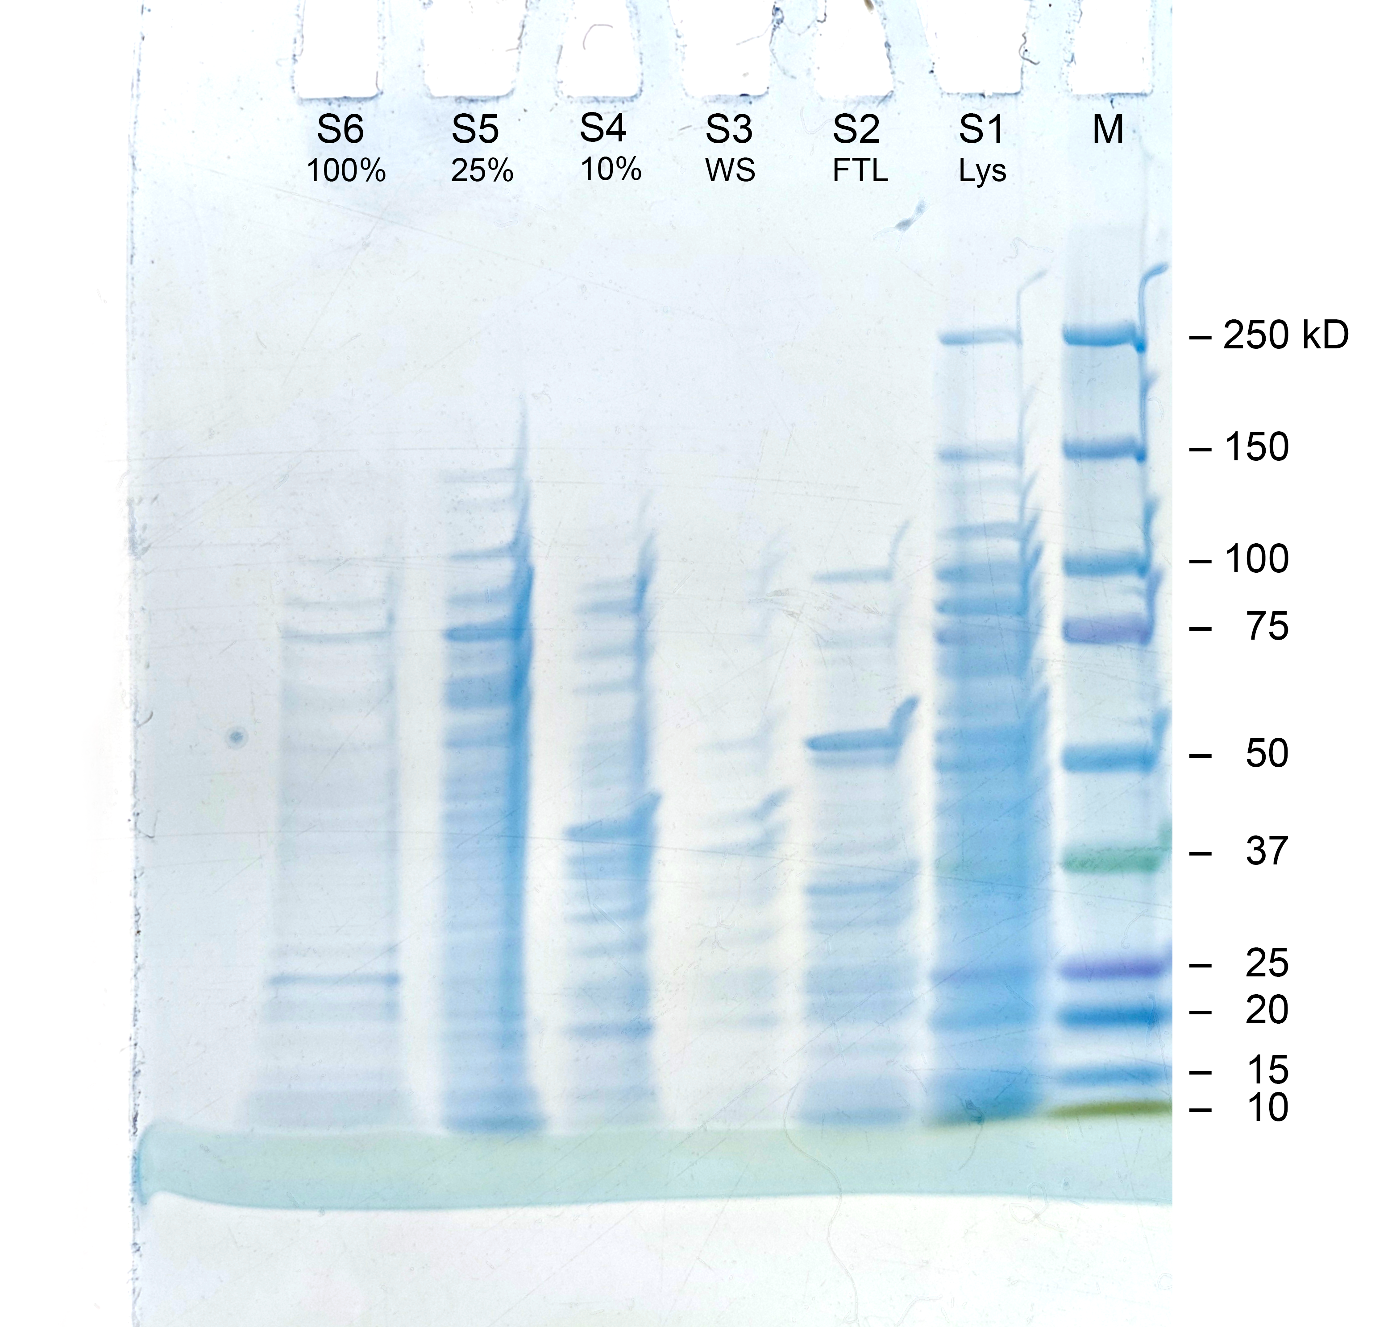
SDS - PAGE
MARKER
S1: lysate (dilution factor 10)
S2: loading flow through
S3: washing step
S4: eluate 10%
S5: eluate 25%
S6: eluate 100%
By counting the bands in the mixture containing the most lactase, an estimate of 29 bands, and therefore proteins in the mixture can be made. There could be more overlapping proteins unaccounted for.
Conclusion: by AEXC we reduced the
number of proteins in our sample to
29 proteins (starting with 3000)

Slide 9
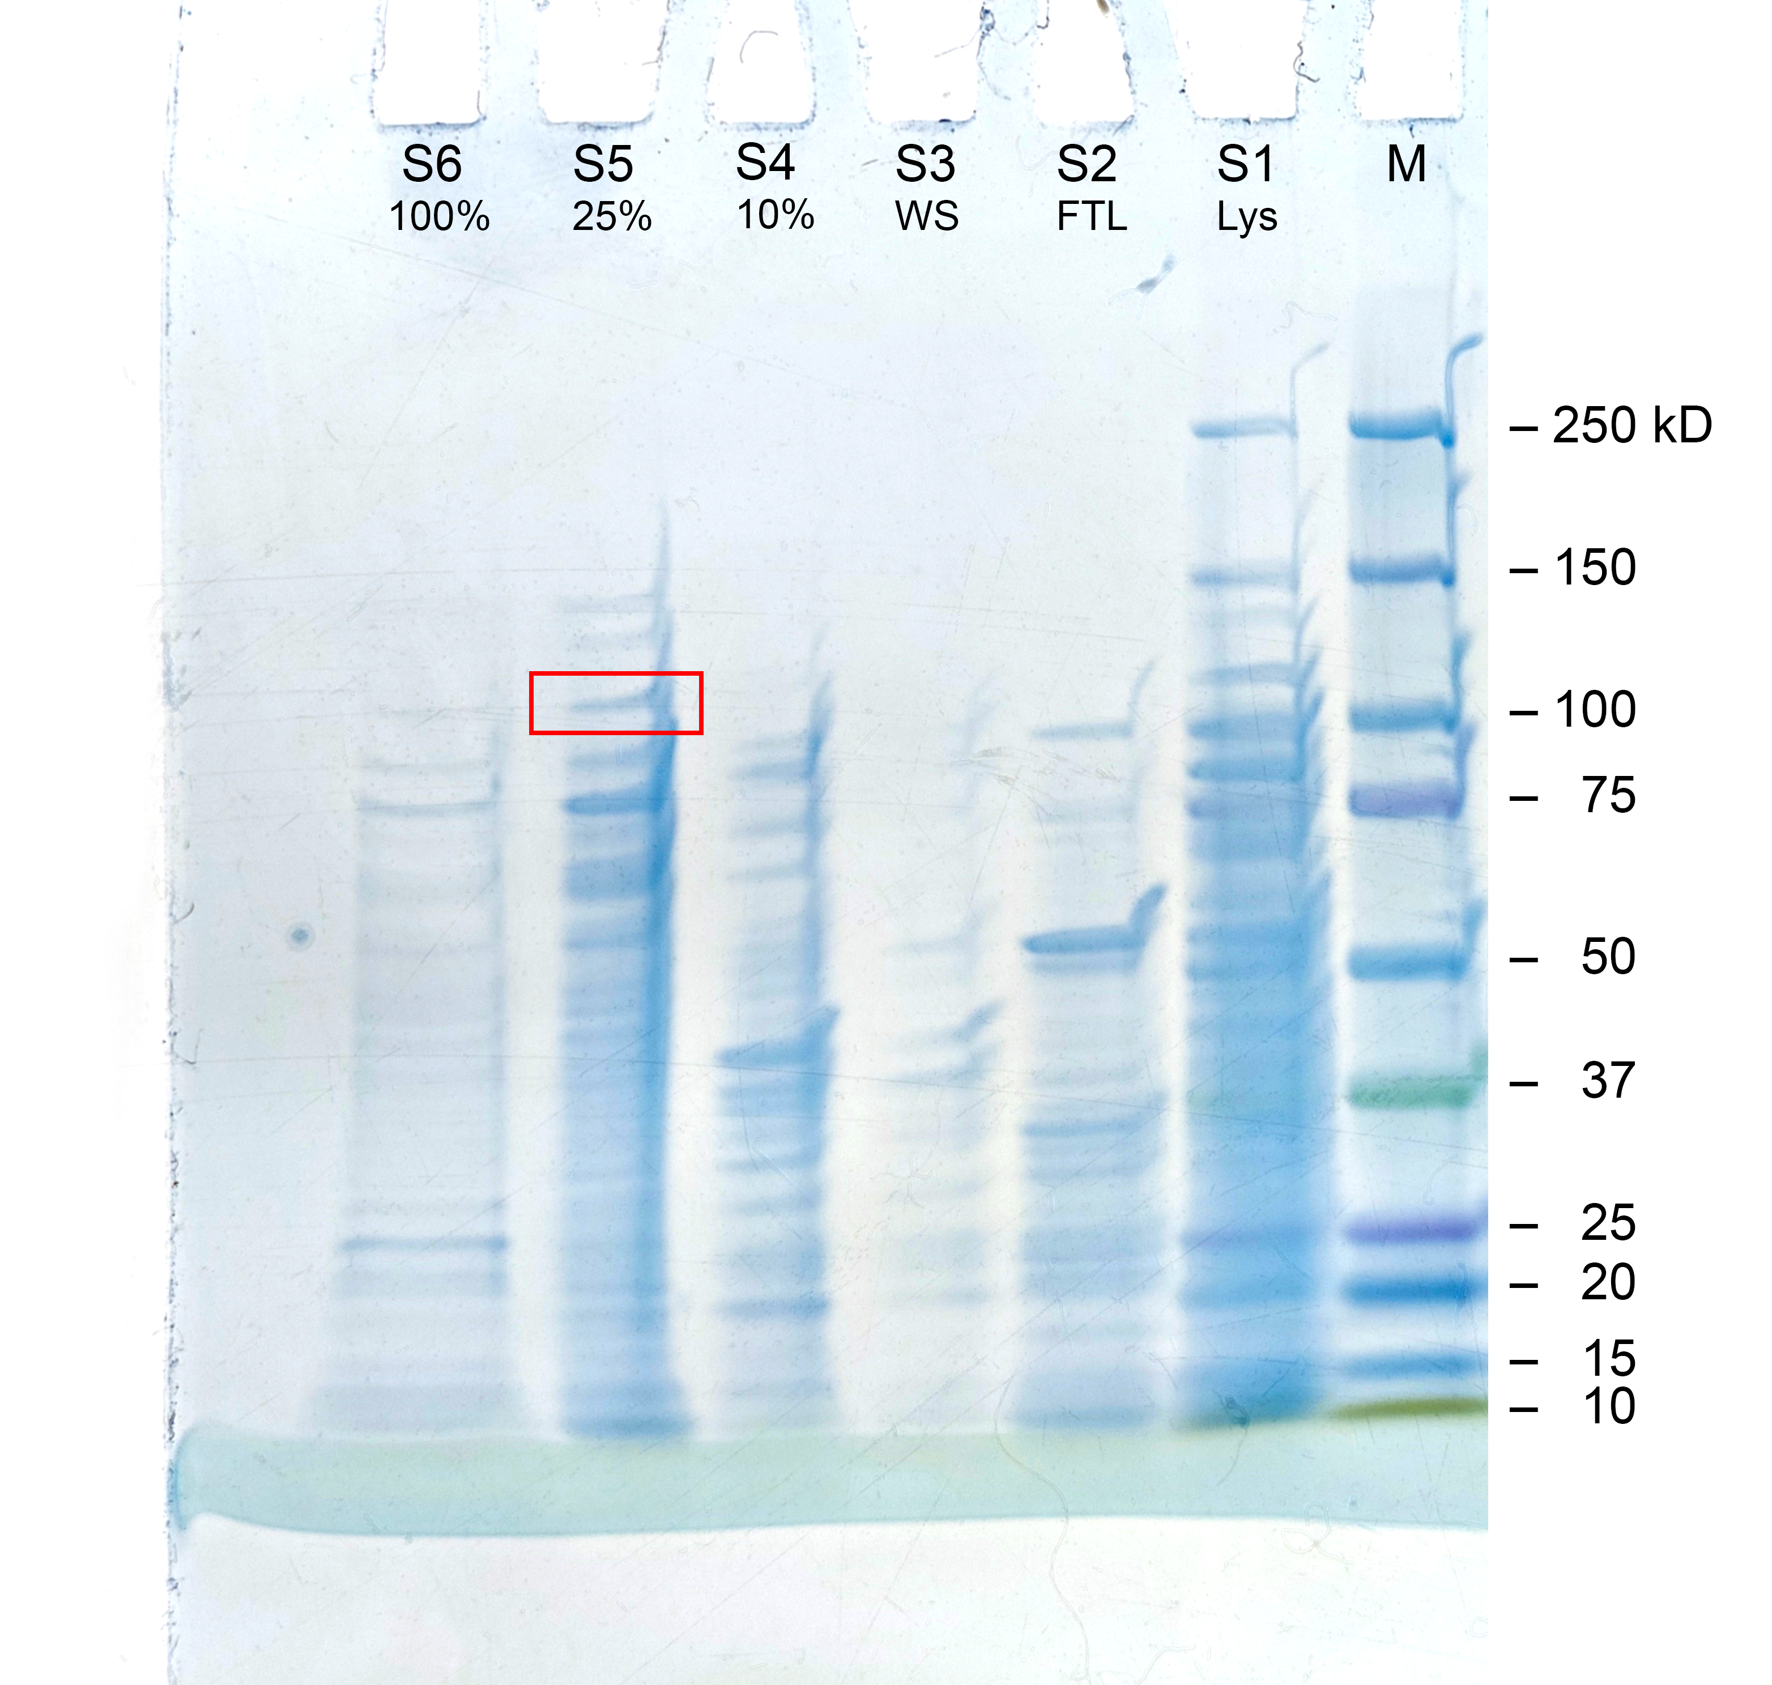
SDS - PAGE
The lactase subunit in the gel can be identified by using the marker (M)
Lactase subunit band marked with a square

Slide 10
Evaluation of the SDS – PAGE
Identification of molecular weight of lactase subunit with your calibration line
Migration rate: 1,86 cm
Log (kDa) = x
Molecular weight: 114 kDa
Log (kDa)
cm

Slide 11
Evaluation Steps of our Experiment
PARTICLE FREE LYSATE – o-NPG-test (enzymatic activity assay)
ANION EXCHANGE CHROMATOGRAPHY (AEXC) – o-NPG + photometer (enzymatic activity assay)
SDS – PAGE – gel + calibration line (purity, molecular weight – lactase)
RAW MILK TEST – colour change (conc. of glucose)
EVALUATION

Slide 12
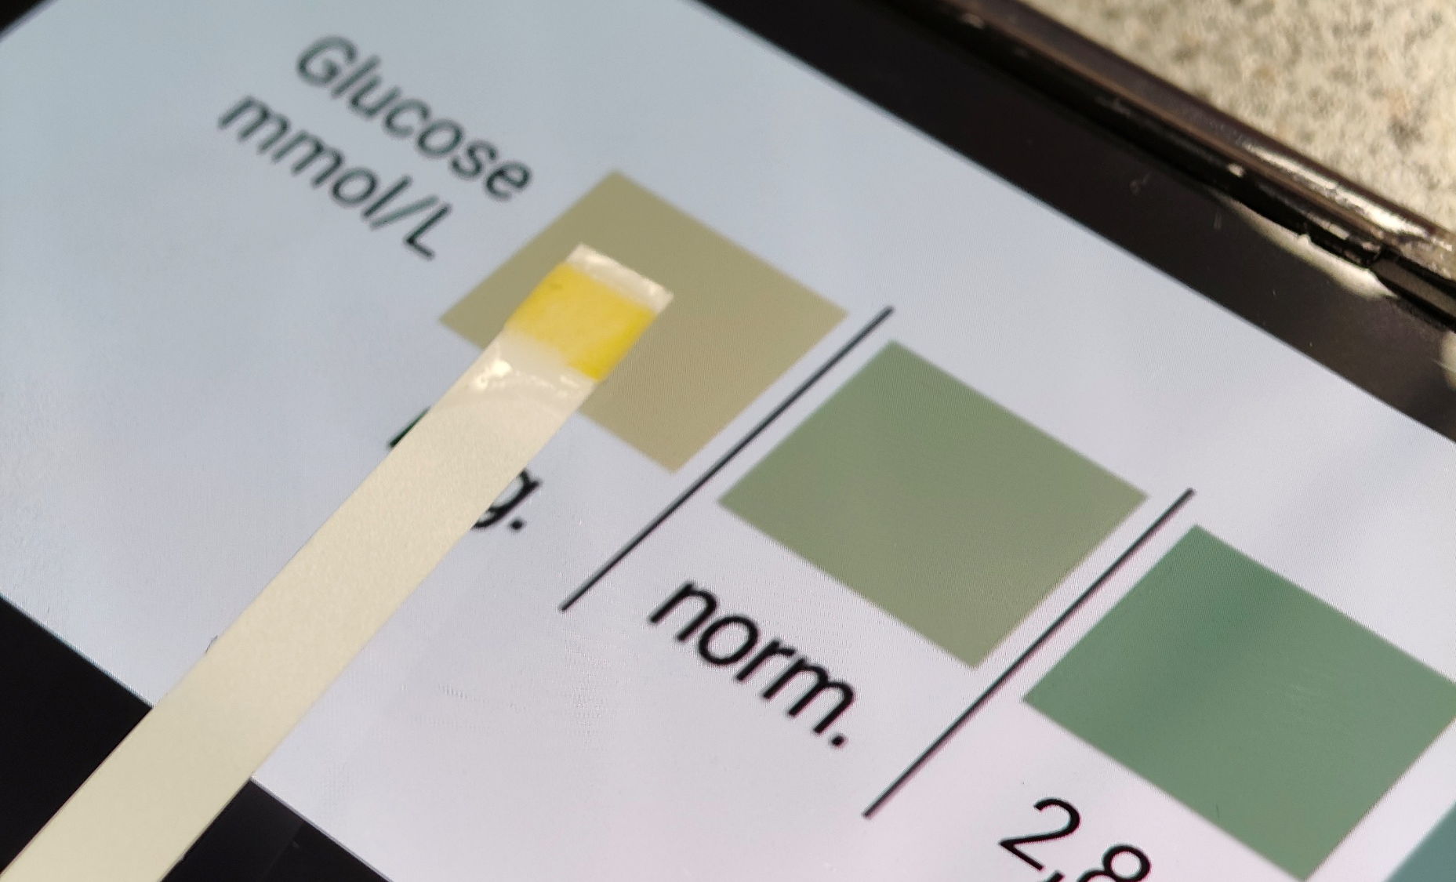
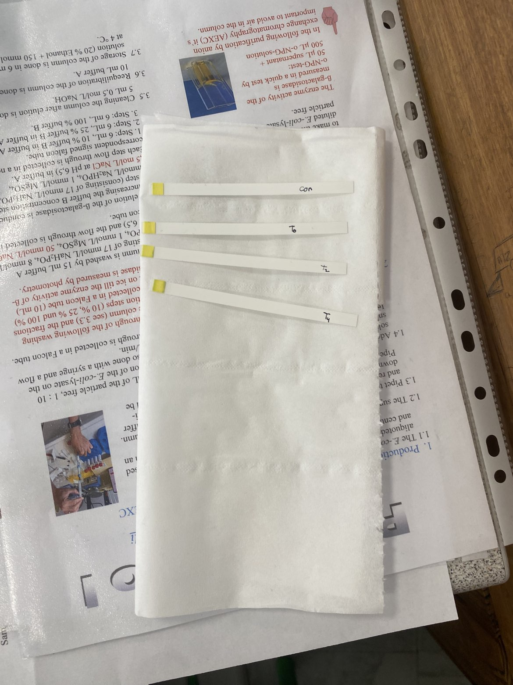
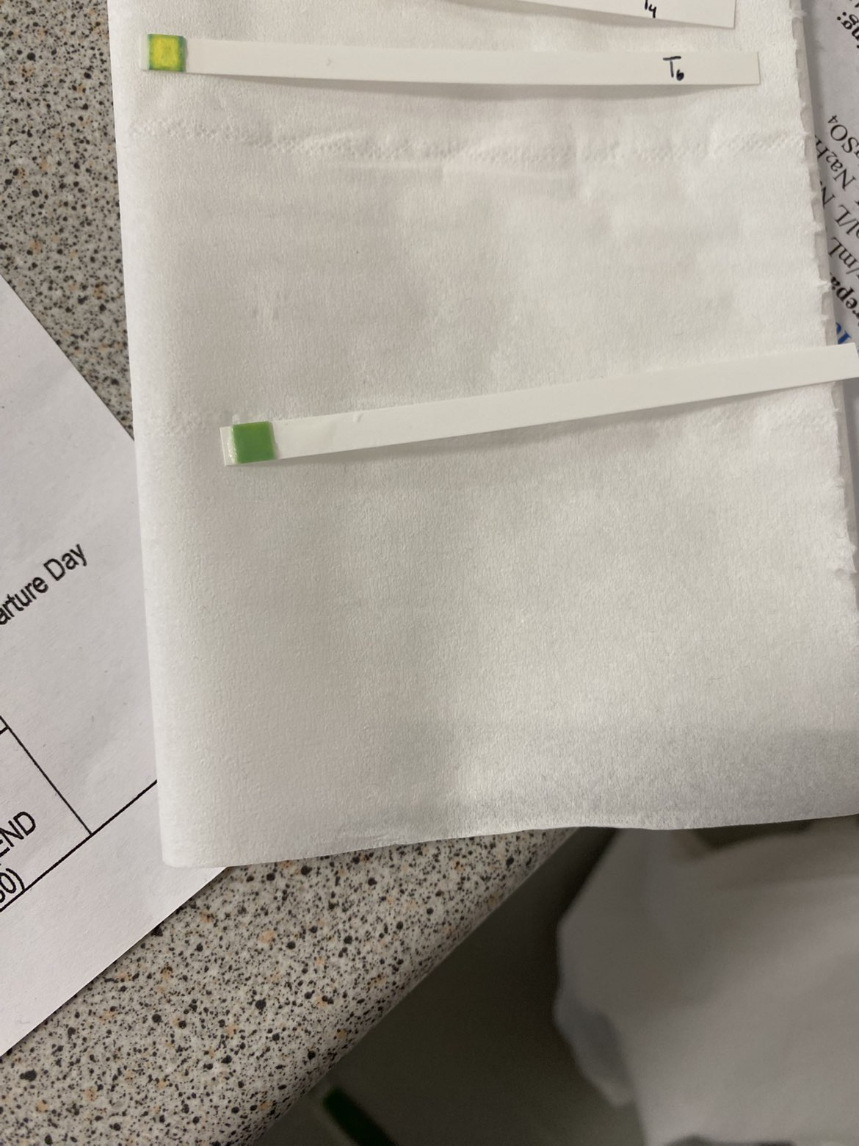
RAW MILK TEST
Control
0 min
20 min
Observation: when the lactase solution has been added, the color changes slightly over measurements 0/20/40/60 min, initially (control), no color change.
Modified test observation: the color change on a strip becomes more intense if left for a while. More added solution, plus added heat, results in the most intense color.
Evaluation: Measured glucose (mmol/L) across samples:
neg., neg., neg., norm., 2.8 mmol/L, 27.8 mmol/L
Conclusion: our isolated lactase could change raw milk containing lactose into lactose-free raw milk
40 min
60 min
Sitting test
Amplified

Slide 13
Evaluation Steps of our Experiment
PARTICLE FREE LYSATE – o-NPG-test (enzymatic activity assay)
ANION EXCHANGE CHROMATOGRAPHY (AEXC) – o-NPG + photometer (enzymatic activity assay)
SDS – PAGE – gel + calibration line (purity, molecular weight – lactase)
RAW MILK TEST – colour change (conc. of glucose)
EVALUATION

Slide 14
EVALUATION
1. TASK: The results of the AEXC show that the highest amount of lactase is expected to be found in the 25% eluate flow through solution. The activity is clear with the raw milk test, and in the SDS-PAGE gel, the subunit in the gel expected to be lactase is also clearest in the 25% eluate flow through solution.
It can be concluded that purification by Anion Exchange Chromatography can significantly reduce the number of proteins in a solution, to effectively concentrate lactase.
2. TASK: The 25% eluate flow through solution would be suitable for downstream processing, and further purification of lactase.

Slide 15
Thank you for your attention!

