Slide 1
Summary of Results from
Group 2
Lactase Downstream Processing
Evreux 23. – 27.03.2026

Slide 2
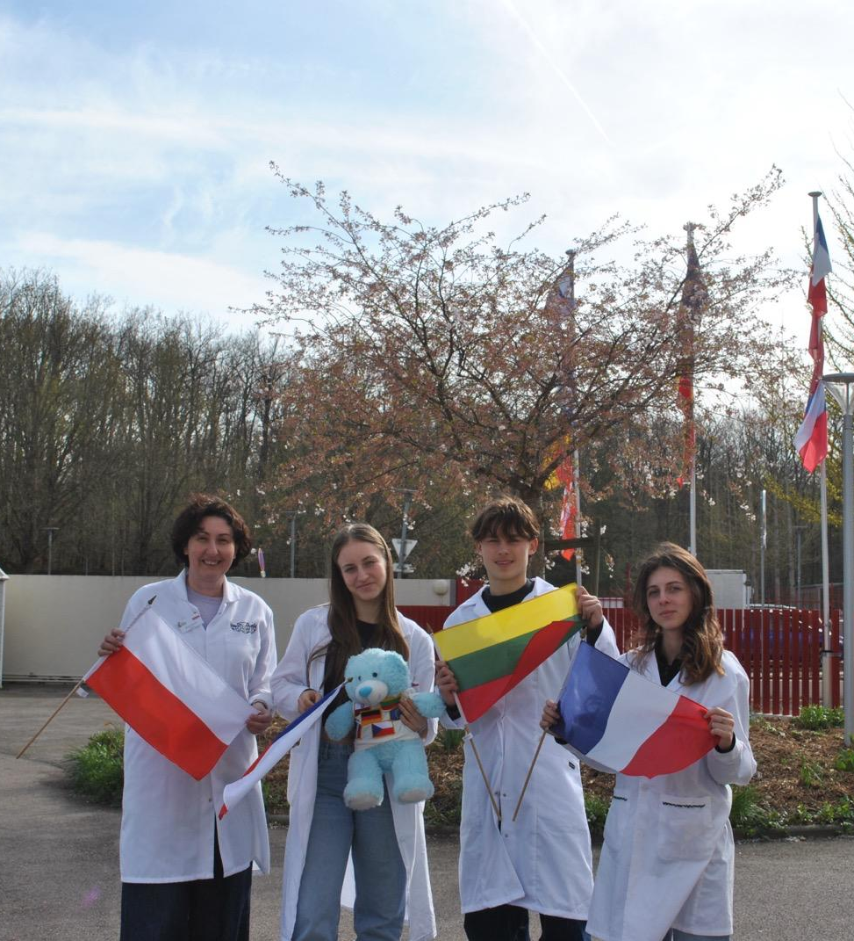




Group 2 + presentation of group members
Nela Horňáčková (m)
Czech Republic
Elyna Friley (m)
France
Aidenas Antanevičius (s)
Lithuania
Renata Stencel (t)
Poland

Slide 3
Evaluation Steps of our Experiment
PARTICLE FREE LYSATE – o-NPG-test (enzymatic activity assay)
ANION EXCHANGE CHROMATOGRAPHY (AEXC) – o-NPG + photometer (enzymatic activity assay)
SDS – PAGE – gel + calibration line (purity, molecular weight – lactase)
RAW MILK TEST – colour change (conc. of glucose)
EVALUATION

Slide 4
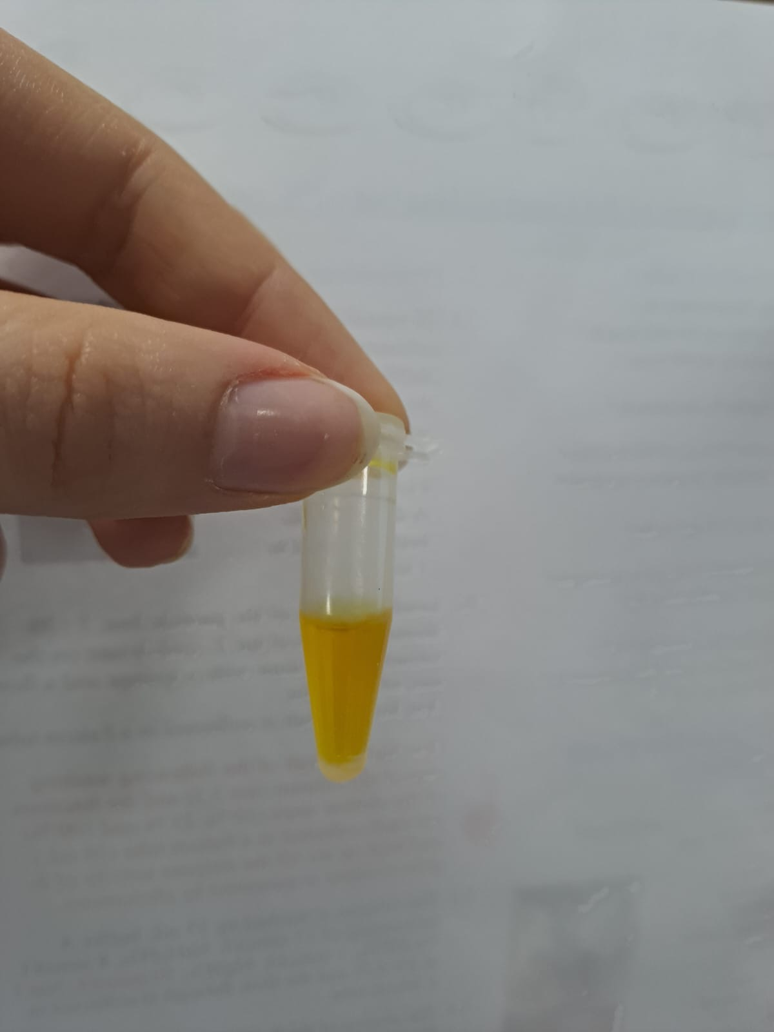
O-NPG-TEST of 1:10 diluted Particle Free Lysate
Test 50 μL supernatant + 500 μL o-NPG-solution.
Observation: yellow color in the cuvette
Evaluation: β(1→4) bond was broken down
Conclusion: lactase is present.
→ We can start AEXC.
Picture of cuvette

Slide 5
Evaluation Steps of our Experiment
PARTICLE FREE LYSATE – o-NPG-test (enzymatic activity assay)
ANION EXCHANGE CHROMATOGRAPHY (AEXC) – o-NPG + photometer (enzymatic activity assay)
SDS – PAGE – gel + calibration line (purity, molecular weight – lactase)
RAW MILK TEST – colour change (conc. of glucose)
EVALUATION

Slide 6
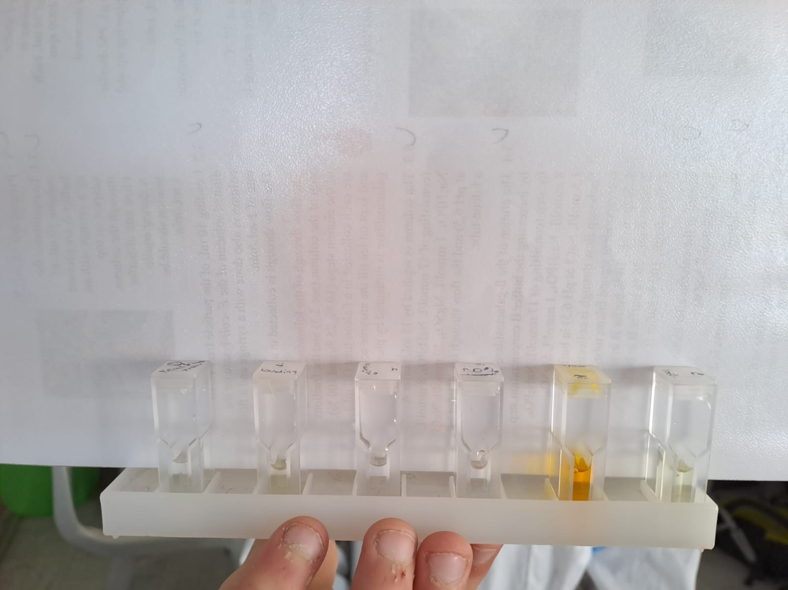
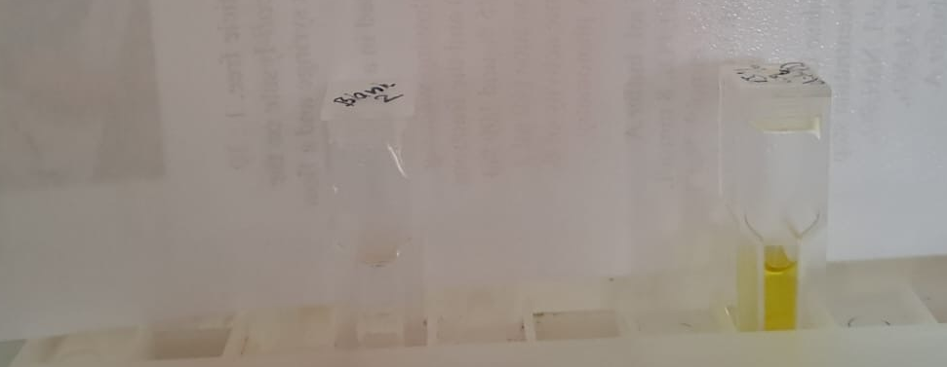
ANION EXCHANGE CHROMATOGRAPHY
O-NPG-test measured by photometer – enzymatic activity measurement
Test 50 μL eluate + 800 μL o-NPG-solution.
Observation: we can see yellow in the FtL, 10%, 25%, 100% Eluate

Slide 7
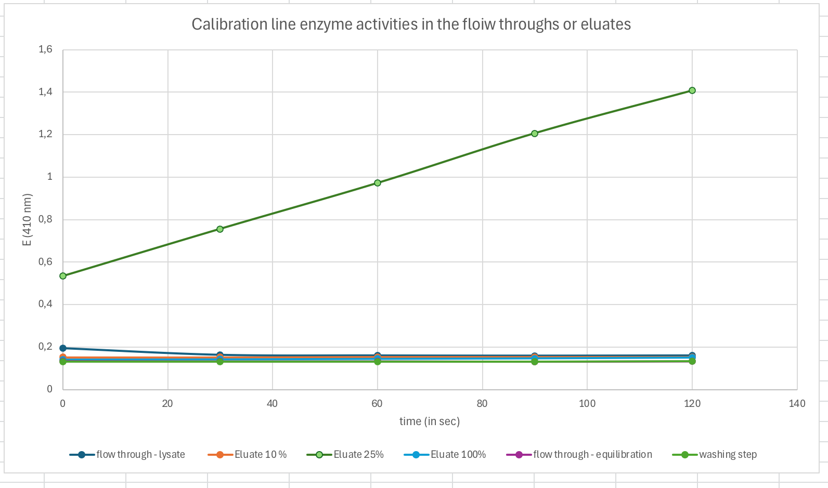
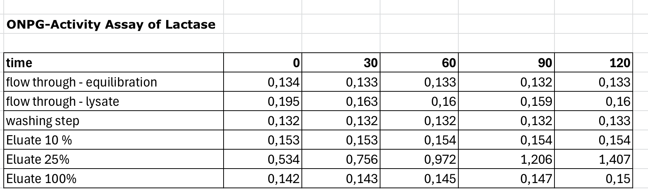
ANION EXCHANGE CHROMATOGRAPHY
O-NPG-test measured by photometer – enzymatic activity measurement
Test 50 μL eluate + 800 μL o-NPG-solution.
Evaluation: lactase was present in FtL, 10%, 25%, 100% Eluate
Conclusion: the highest
lactase activity was in 25% eluate

Slide 8
Evaluation Steps of our Experiment
PARTICLE FREE LYSATE – o-NPG-test (enzymatic activity assay)
ANION EXCHANGE CHROMATOGRAPHY (AEXC) – o-NPG + photometer (enzymatic activity assay)
SDS – PAGE – gel + calibration line (purity, molecular weight – lactase)
RAW MILK TEST – colour change (conc. of glucose)
EVALUATION

Slide 9
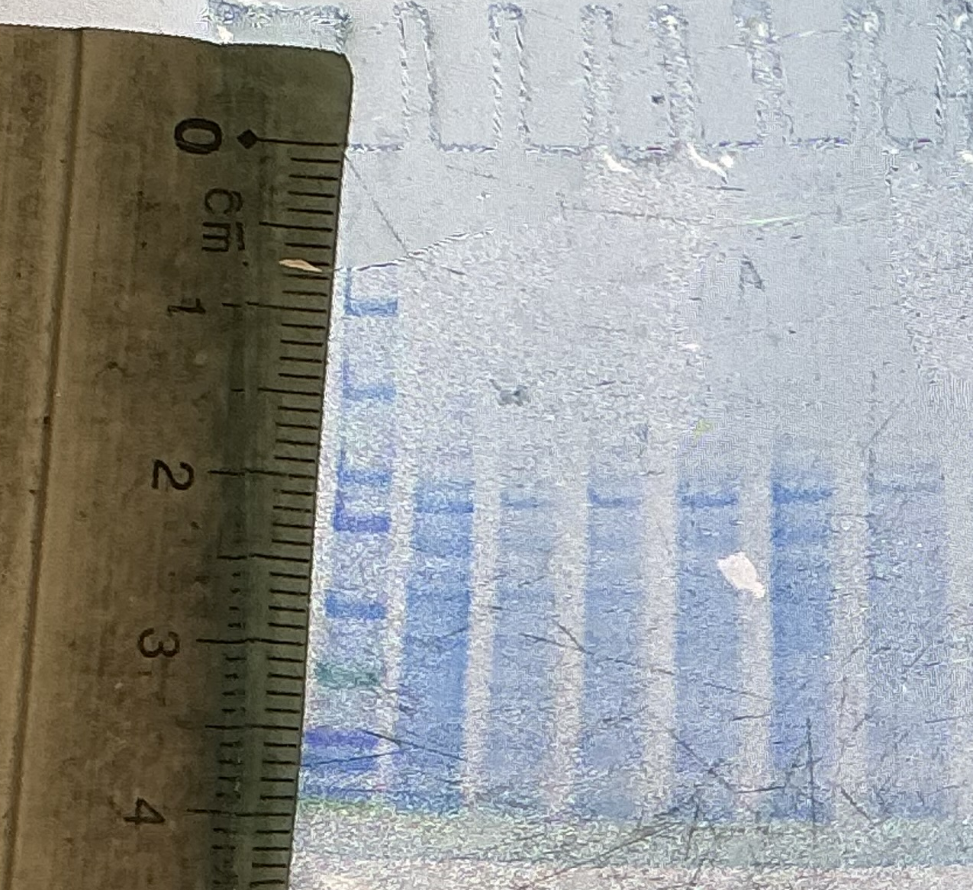
SDS - PAGE
MARKER
S1: lysate (dilution factor 10)
S2: loading flow through
S3: washing step
S4: eluate 10%
S5: eluate 25%
S6: eluate 100%
There were 14 bands in the mixture
containing the most concentration
of lactase (25% Eluate).
Conclusion: by AEXC we reduced the
number of proteins in our sample to
14 proteins (starting with 3000)

Slide 10
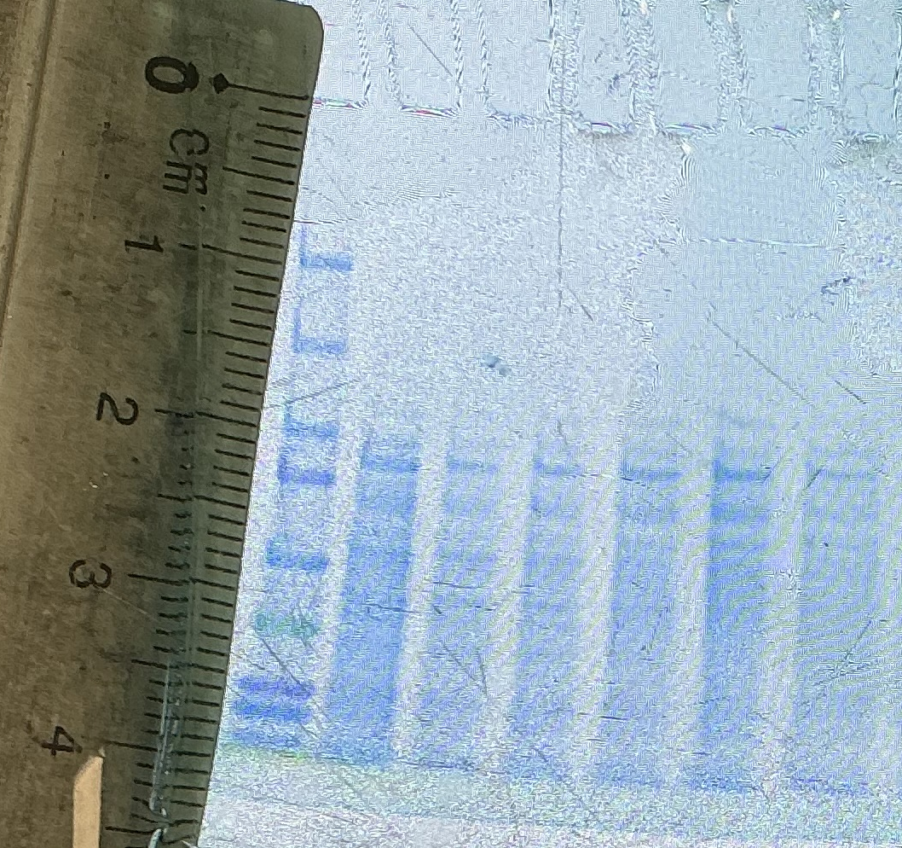
SDS - PAGE
Identification of the lactase subunit
in the gel with the marker
Please mark the lactase subunit band

Slide 11
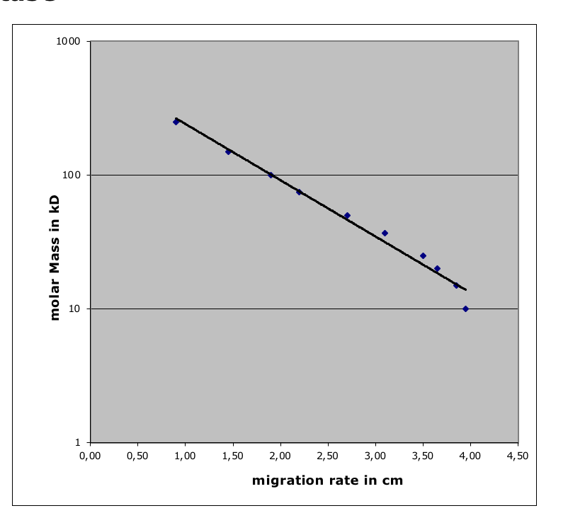
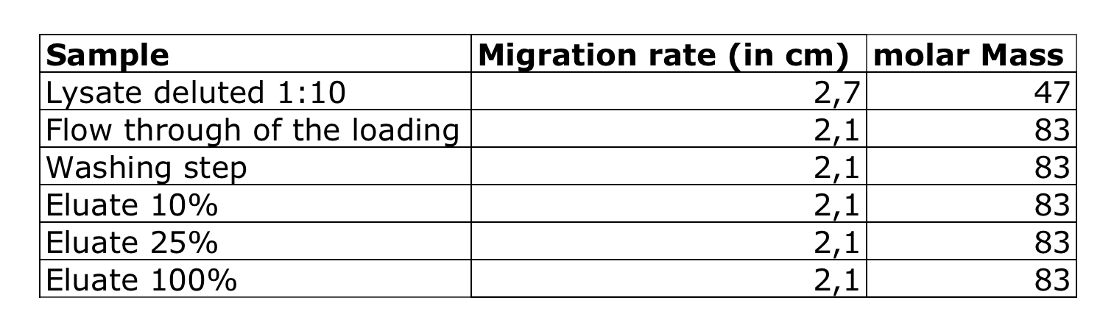
Evaluation of the SDS – PAGE
Identification of molecular weight of lactase subunit with your calibration line
Migration rate: 1,8 cm
Molecular weight: 111 kDa
cm

Slide 12
Evaluation Steps of our Experiment
PARTICLE FREE LYSATE – o-NPG-test (enzymatic activity assay)
ANION EXCHANGE CHROMATOGRAPHY (AEXC) – o-NPG + photometer (enzymatic activity assay)
SDS – PAGE – gel + calibration line (purity, molecular weight – lactase)
RAW MILK TEST – colour change (conc. of glucose)
EVALUATION

Slide 13
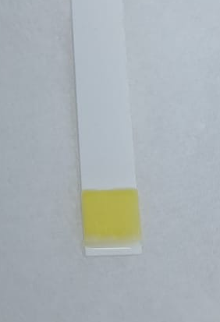
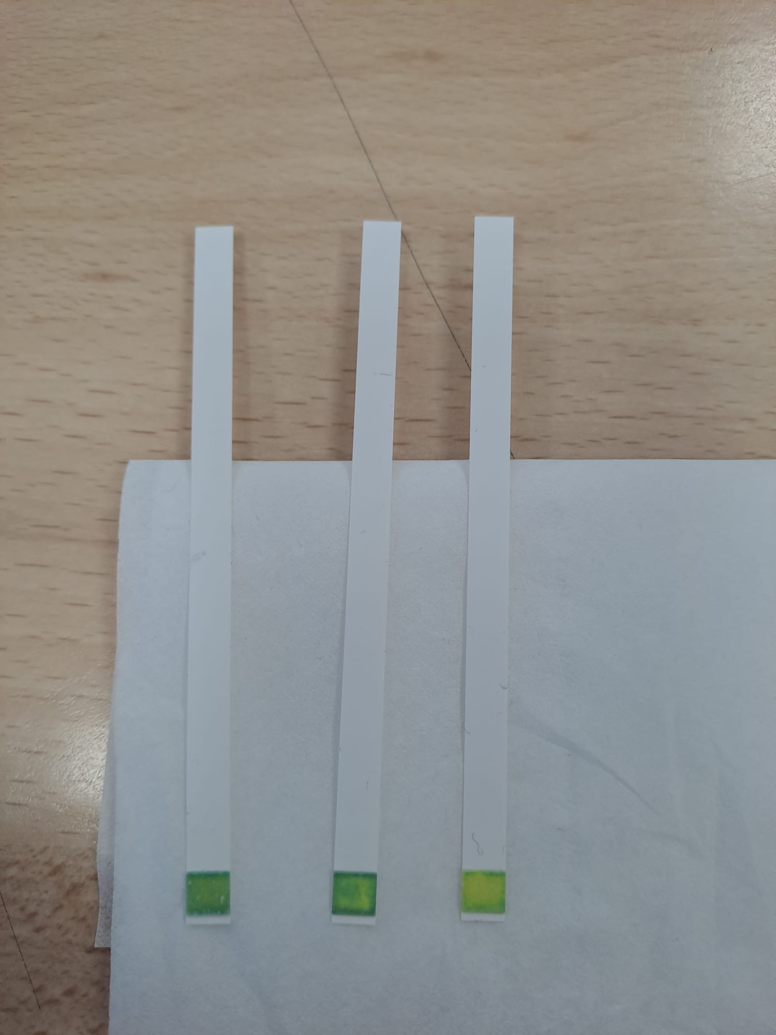
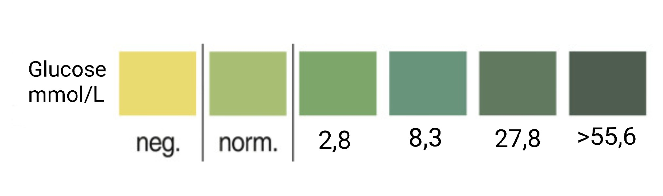
RAW MILK TEST
Observation: colour of the stripe after 0/20/40/70 min
Evaluation: after 70 minutes of enzyme activity the
glucose test showed approximately a concentration
of 5 mmol/L of glucose.
Conclusion: our isolated lactase could change raw milk
containing lactose into lactose-free raw milk
Control
0 min
20 min
40 min
60 min

Slide 14
Evaluation Steps of our Experiment
PARTICLE FREE LYSATE – o-NPG-test (enzymatic activity assay)
ANION EXCHANGE CHROMATOGRAPHY (AEXC) – o-NPG + photometer (enzymatic activity assay)
SDS – PAGE – gel + calibration line (purity, molecular weight – lactase)
RAW MILK TEST – colour change (conc. of glucose)
EVALUATION

Slide 15
EVALUATION
1. TASK: Compare your results of AEXC according to the highest lactase activity and the highest amount of lactase in SDS – PAGE.
Conclusion: we could see the highest enzyme activity after photometry and highest concentration of lactase (SDS-PAGE) in the 25% Eluate.
2. TASK: Choose a sample suitable for downstream process and further purification of lactase.
Answer: 25% Eluate.

Slide 16
Thank you for your attention!

