Slide 1
Summary of Results from
Group 18
Lactase Downstream Processing
Evreux 23. – 27.03.2026

Slide 2

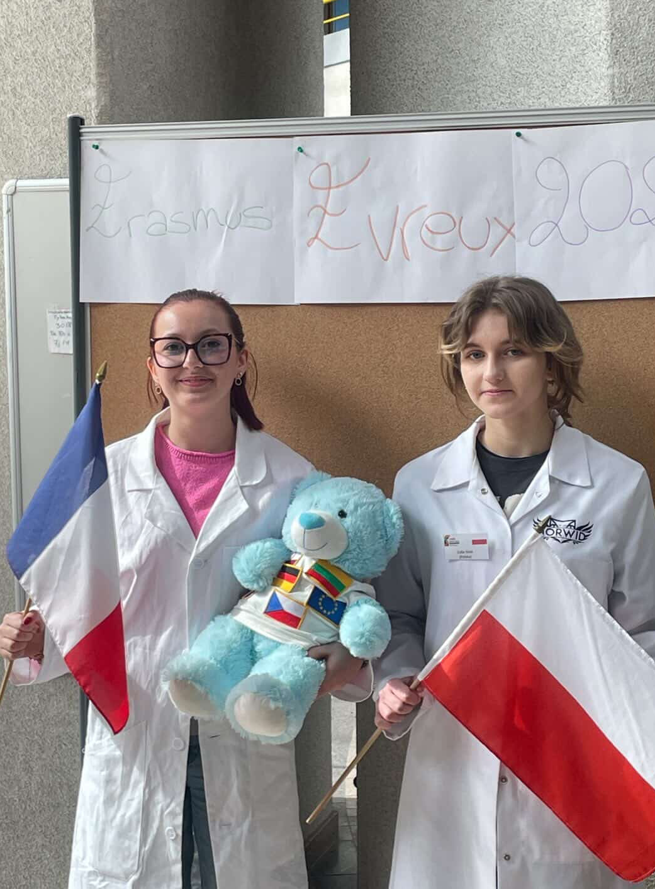



Group 18 + presentation of group members
Zofia Sitek (S)
Poland
Melissa Legouez (S)
France
Evangelia Petrou (T)
Greece
Timotej Gonda (M)
Slovakia

Slide 3
Evaluation Steps of our Experiment
PARTICLE FREE LYSATE – o-NPG-test (enzymatic activity assay)
ANION EXCHANGE CHROMATOGRAPHY (AEXC) – o-NPG + photometer (enzymatic activity assay)
SDS – PAGE – gel + calibration line (purity, molecular weight – lactase)
RAW MILK TEST – colour change (conc. of glucose)
EVALUATION

Slide 4
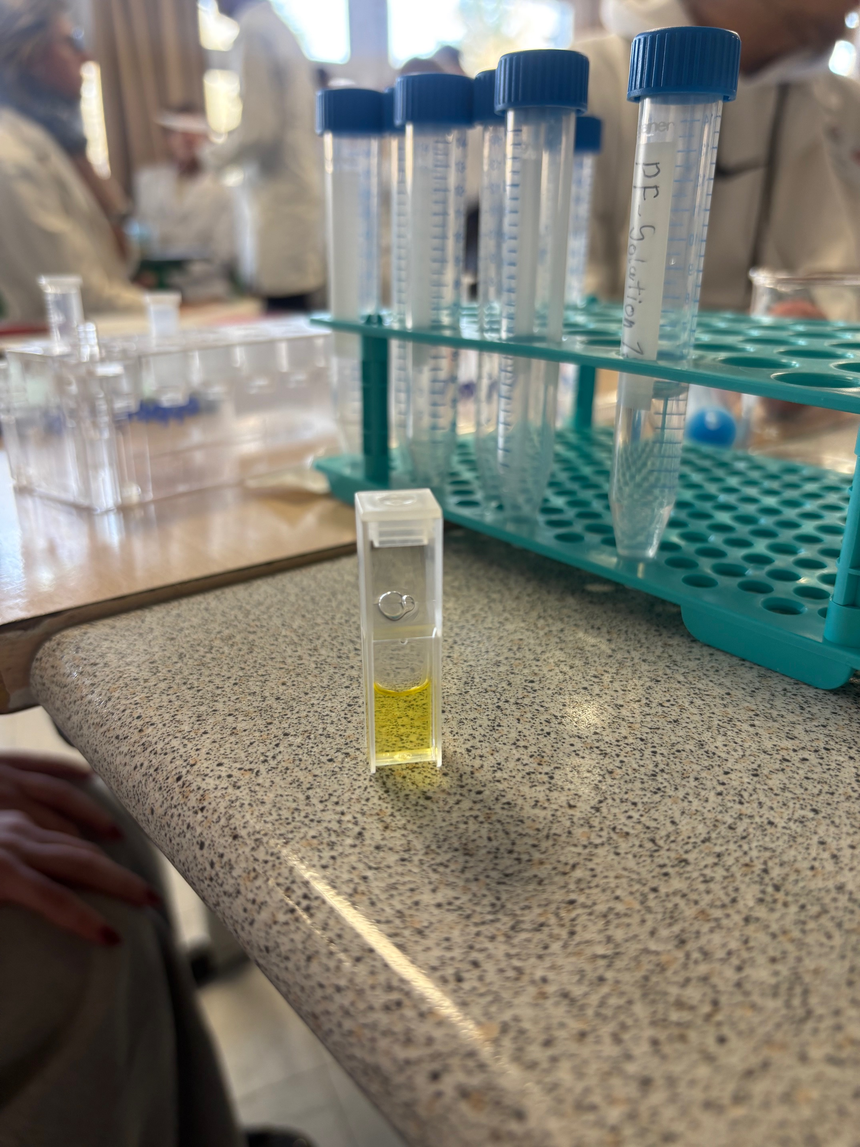
O-NPG-TEST of 1:10 diluted Particle Free Lysate
Test 50 μL supernatant + 500 μL o-NPG-solution.
Observation: yellow colour of the solution
Evaluation: β(1→4) bond was broken down
Conclusion: lactase is present.
→ We can start AEXC.

Slide 5
Evaluation Steps of our Experiment
PARTICLE FREE LYSATE – o-NPG-test (enzymatic activity assay)
ANION EXCHANGE CHROMATOGRAPHY (AEXC) – o-NPG + photometer (enzymatic activity assay)
SDS – PAGE – gel + calibration line (purity, molecular weight – lactase)
RAW MILK TEST – colour change (conc. of glucose)
EVALUATION

Slide 6
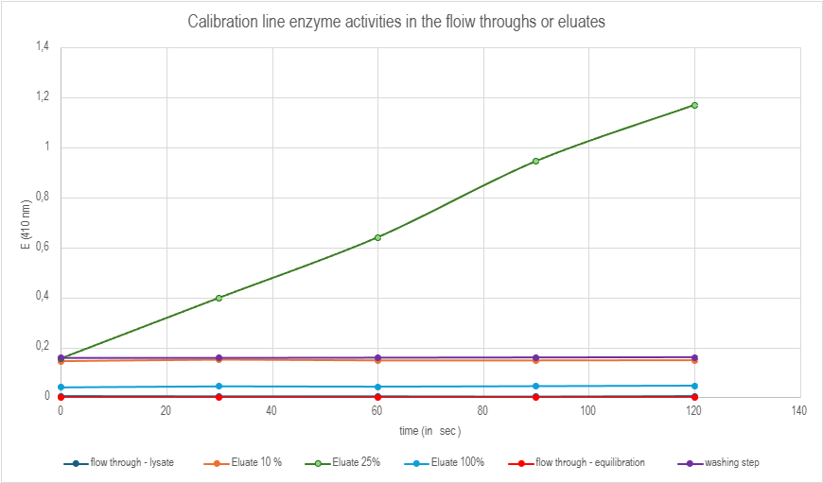
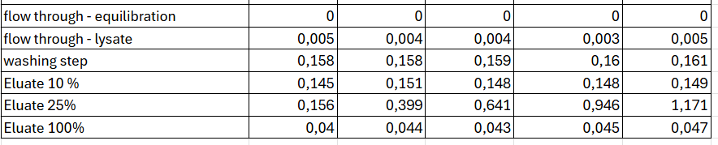
ANION EXCHANGE CHROMATOGRAPHY
O-NPG-test measured by photometer – enzymatic activity measurement
Test 50 L eluate + 800 L o-NPG-solution.
Observation: photometric results
Evaluation: Excel diagram
Conclusion: the highest
lactase activity was in the 25% eluate

Slide 7
Evaluation Steps of our Experiment
PARTICLE FREE LYSATE – o-NPG-test (enzymatic activity assay)
ANION EXCHANGE CHROMATOGRAPHY (AEXC) – o-NPG + photometer (enzymatic activity assay)
SDS – PAGE – gel + calibration line (purity, molecular weight – lactase)
RAW MILK TEST – colour change (conc. of glucose)
EVALUATION

Slide 8
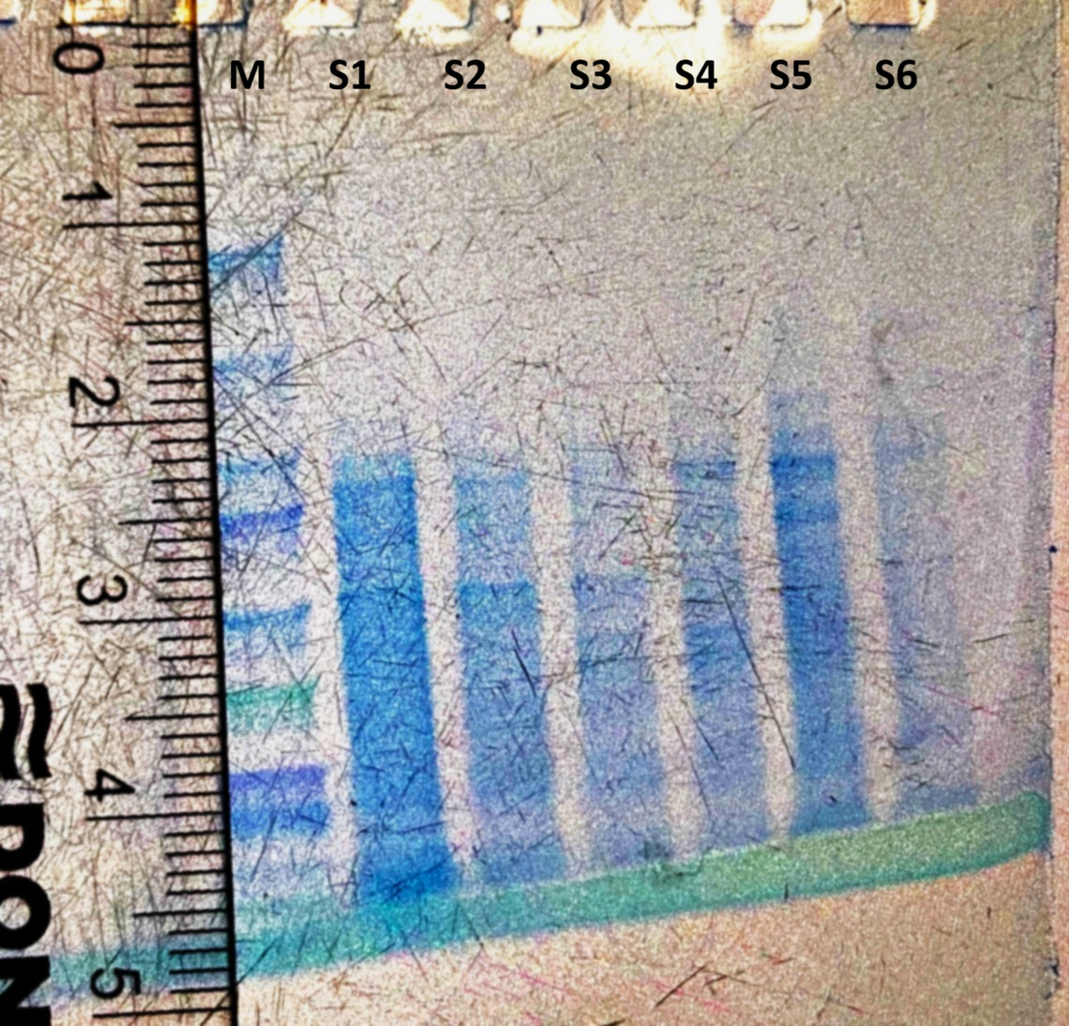
SDS - PAGE
MARKER
S1: lysate (dilution factor 10)
S2: loading flow through
S3: washing step
S4: eluate 10%
S5: eluate 25%
S6: eluate 100%
There are 8 bands in the mixture
containing lactase
Conclusion: by AEXC we reduced the
number of proteins in our sample to
8 no. of proteins (starting with 3000)

Slide 9
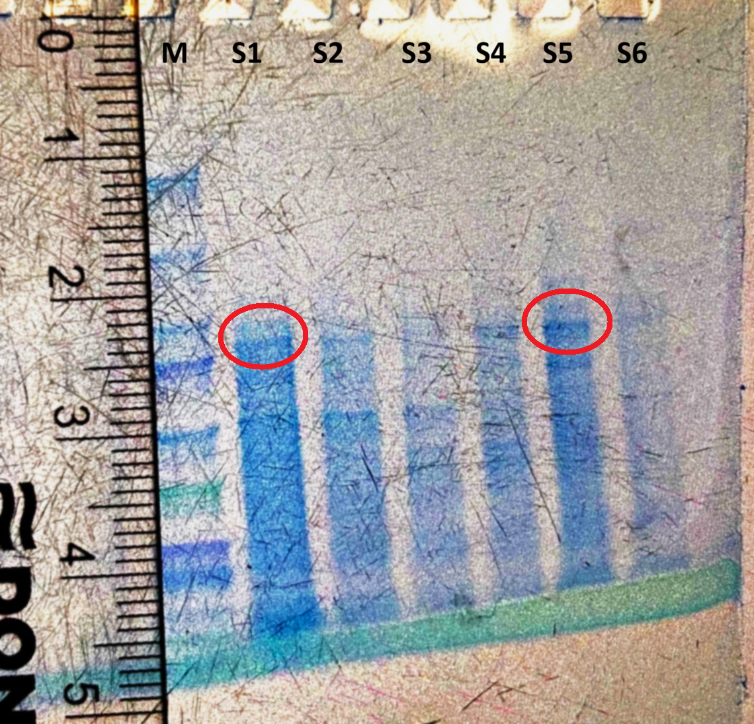
SDS - PAGE
Lactase is marked with red circles.

Slide 10
Evaluation of the SDS – PAGE
Lactase:
Migration rate: 2,2 cm
Molecular weight: 106 kDa
Log (kDa)
cm

Slide 11
Evaluation Steps of our Experiment
PARTICLE FREE LYSATE – o-NPG-test (enzymatic activity assay)
ANION EXCHANGE CHROMATOGRAPHY (AEXC) – o-NPG + photometer (enzymatic activity assay)
SDS – PAGE – gel + calibration line (purity, molecular weight – lactase)
RAW MILK TEST – colour change (conc. of glucose)
EVALUATION

Slide 12
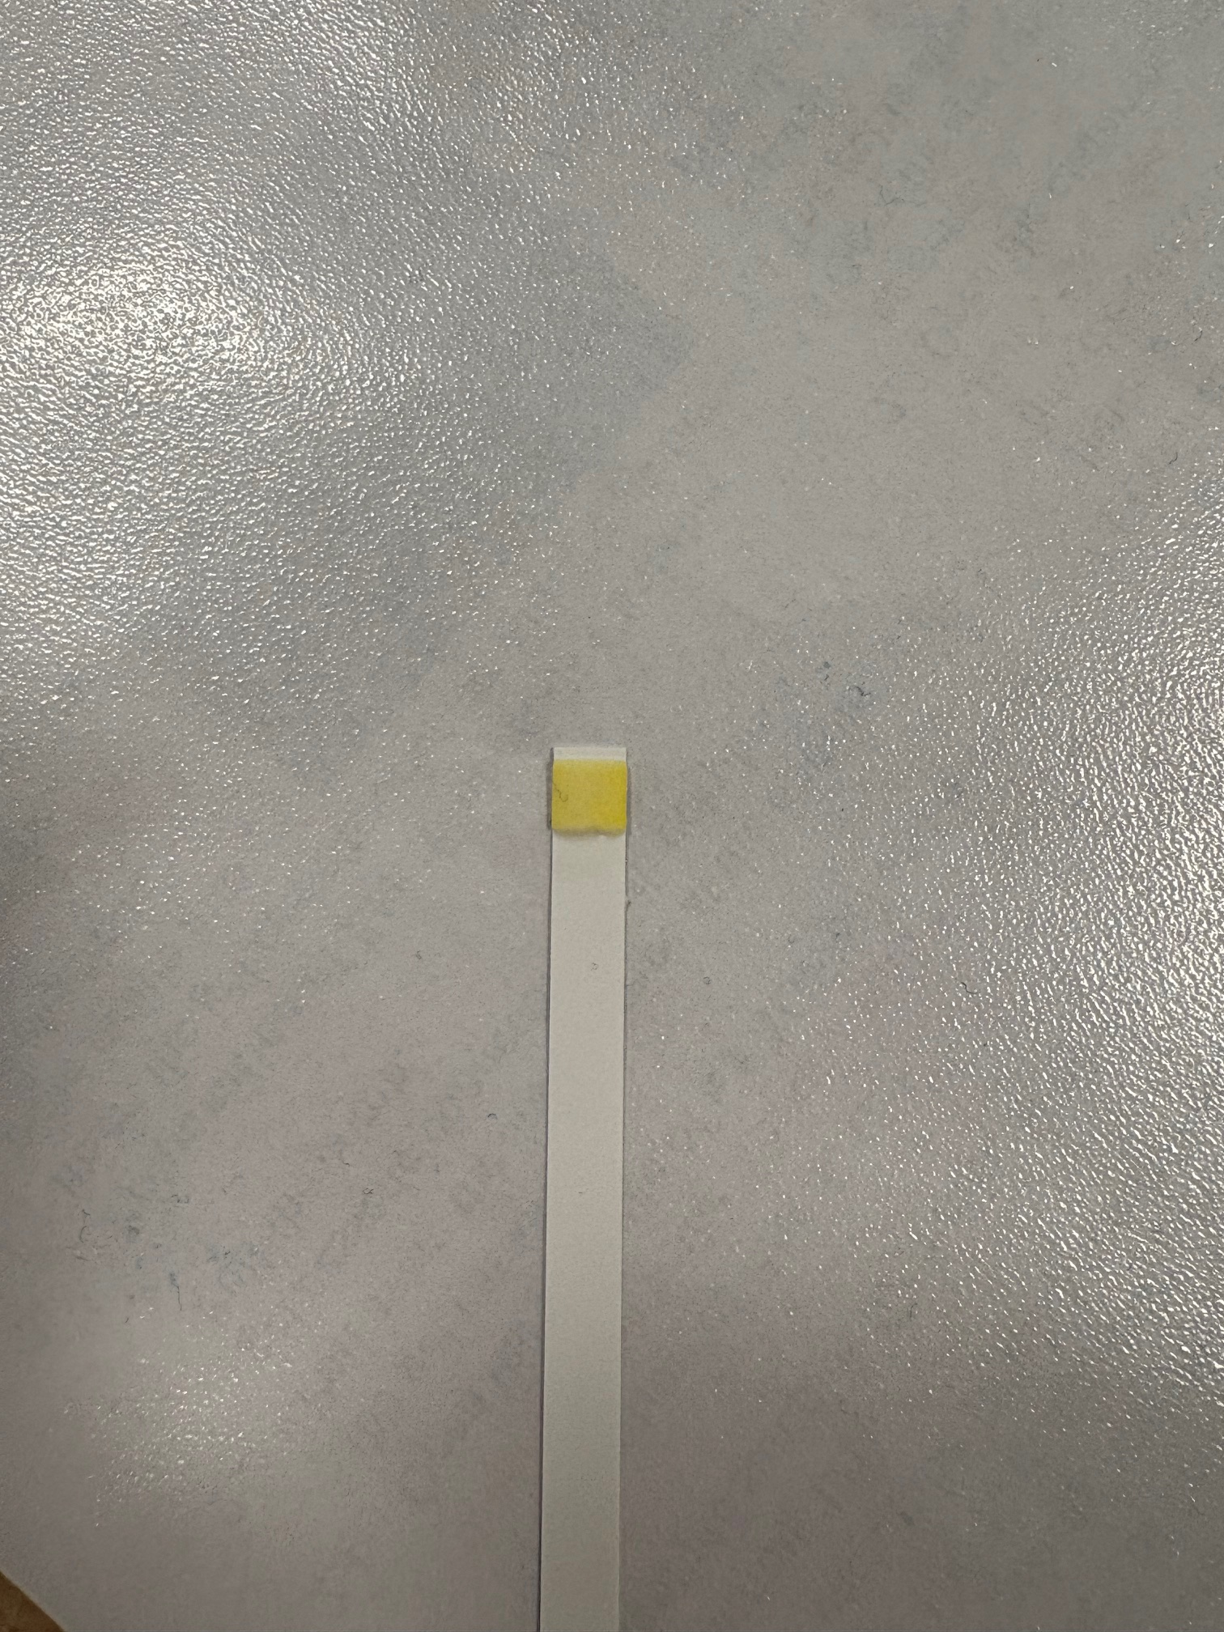
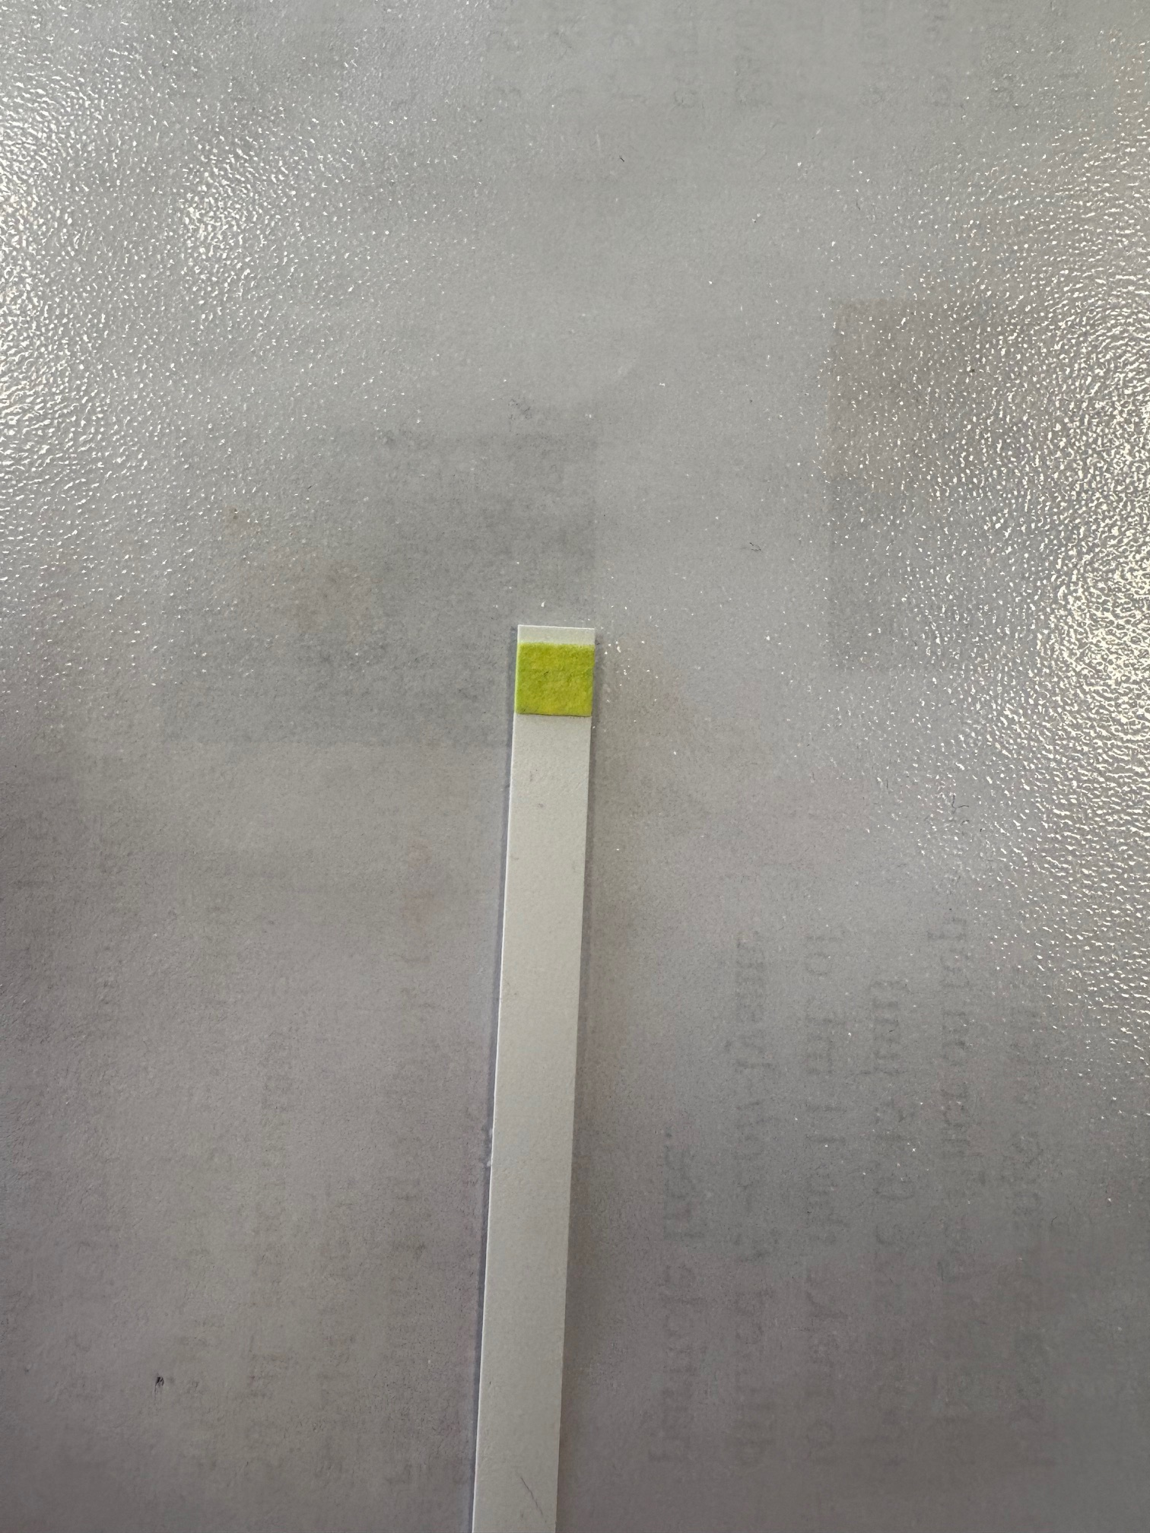
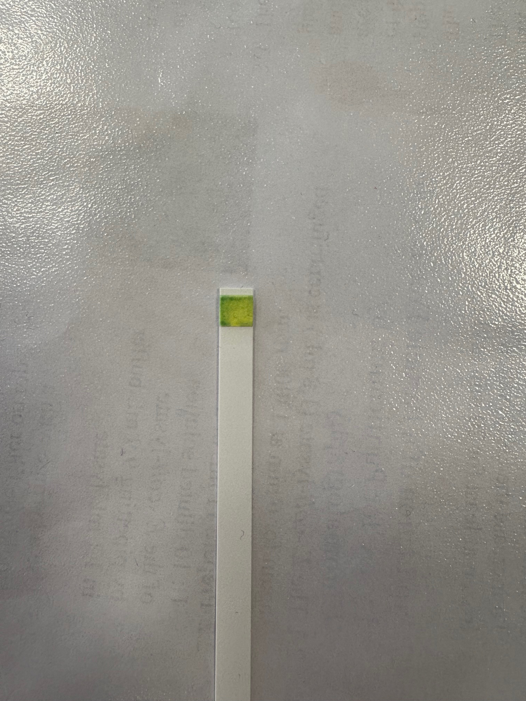
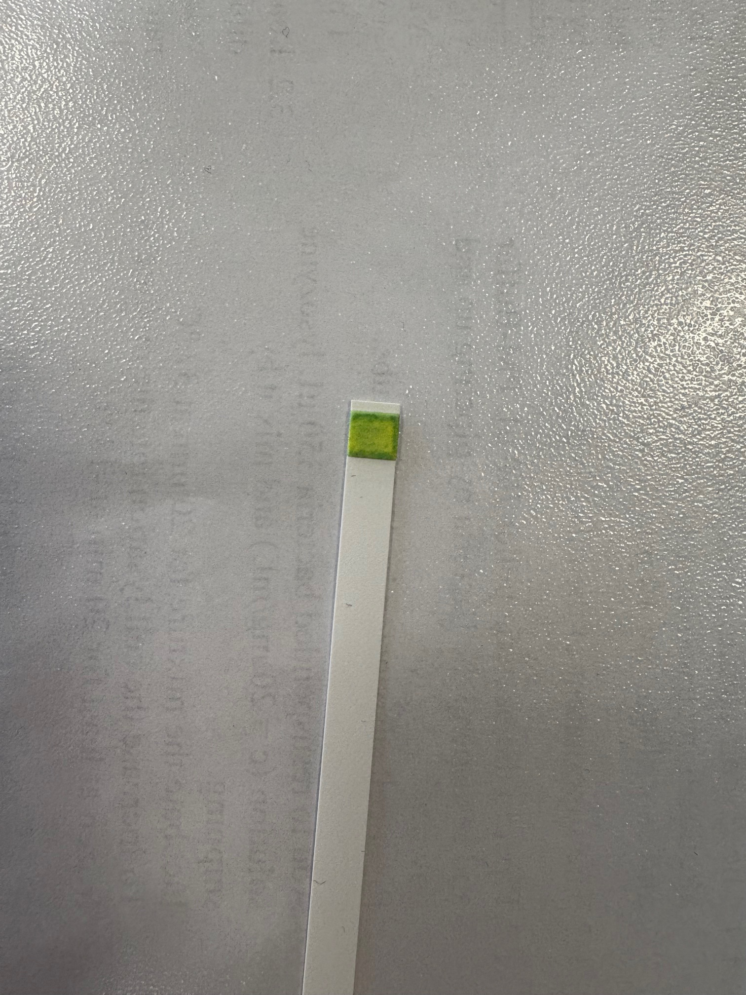
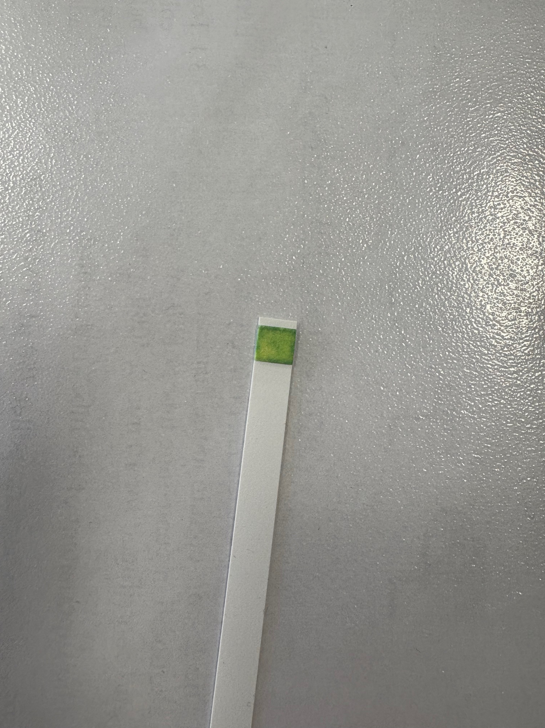
RAW MILK TEST
Observation: colour of the stripe after
0/20/40/60/90 min
Evaluation: value of glucose (mmol/L)
0 min- neg.
20 min- norm.
40 min- 2,8
60 min- 8,3
90 min- 27,8
Conclusion: our isolated lactase could change raw
milk containing lactose into lactose-free raw milk
Control
0 min
20 min
40 min
60 min
90 min

Slide 13
Evaluation Steps of our Experiment
PARTICLE FREE LYSATE – o-NPG-test (enzymatic activity assay)
ANION EXCHANGE CHROMATOGRAPHY (AEXC) – o-NPG + photometer (enzymatic activity assay)
SDS – PAGE – gel + calibration line (purity, molecular weight – lactase)
RAW MILK TEST – colour change (conc. of glucose)
EVALUATION

Slide 14
EVALUATION
The results of AEXC according to the highest lactase activity showed that the highest activity of lactase was in the 25% eluate. In the results of SDS – PAGE, the highest amount of lactase was in the 25% eluate.
From this, we can conclude that the most lactase is in the 25% eluate.
A sample suitable for downstream process and further purification of lactase is the 25% eluate.

Slide 15
Thank you for your attention!

