Slide 1
Summary of Results from
Group 17
Lactase Downstream Processing
Evreux 23. – 27.03.2026

Slide 2
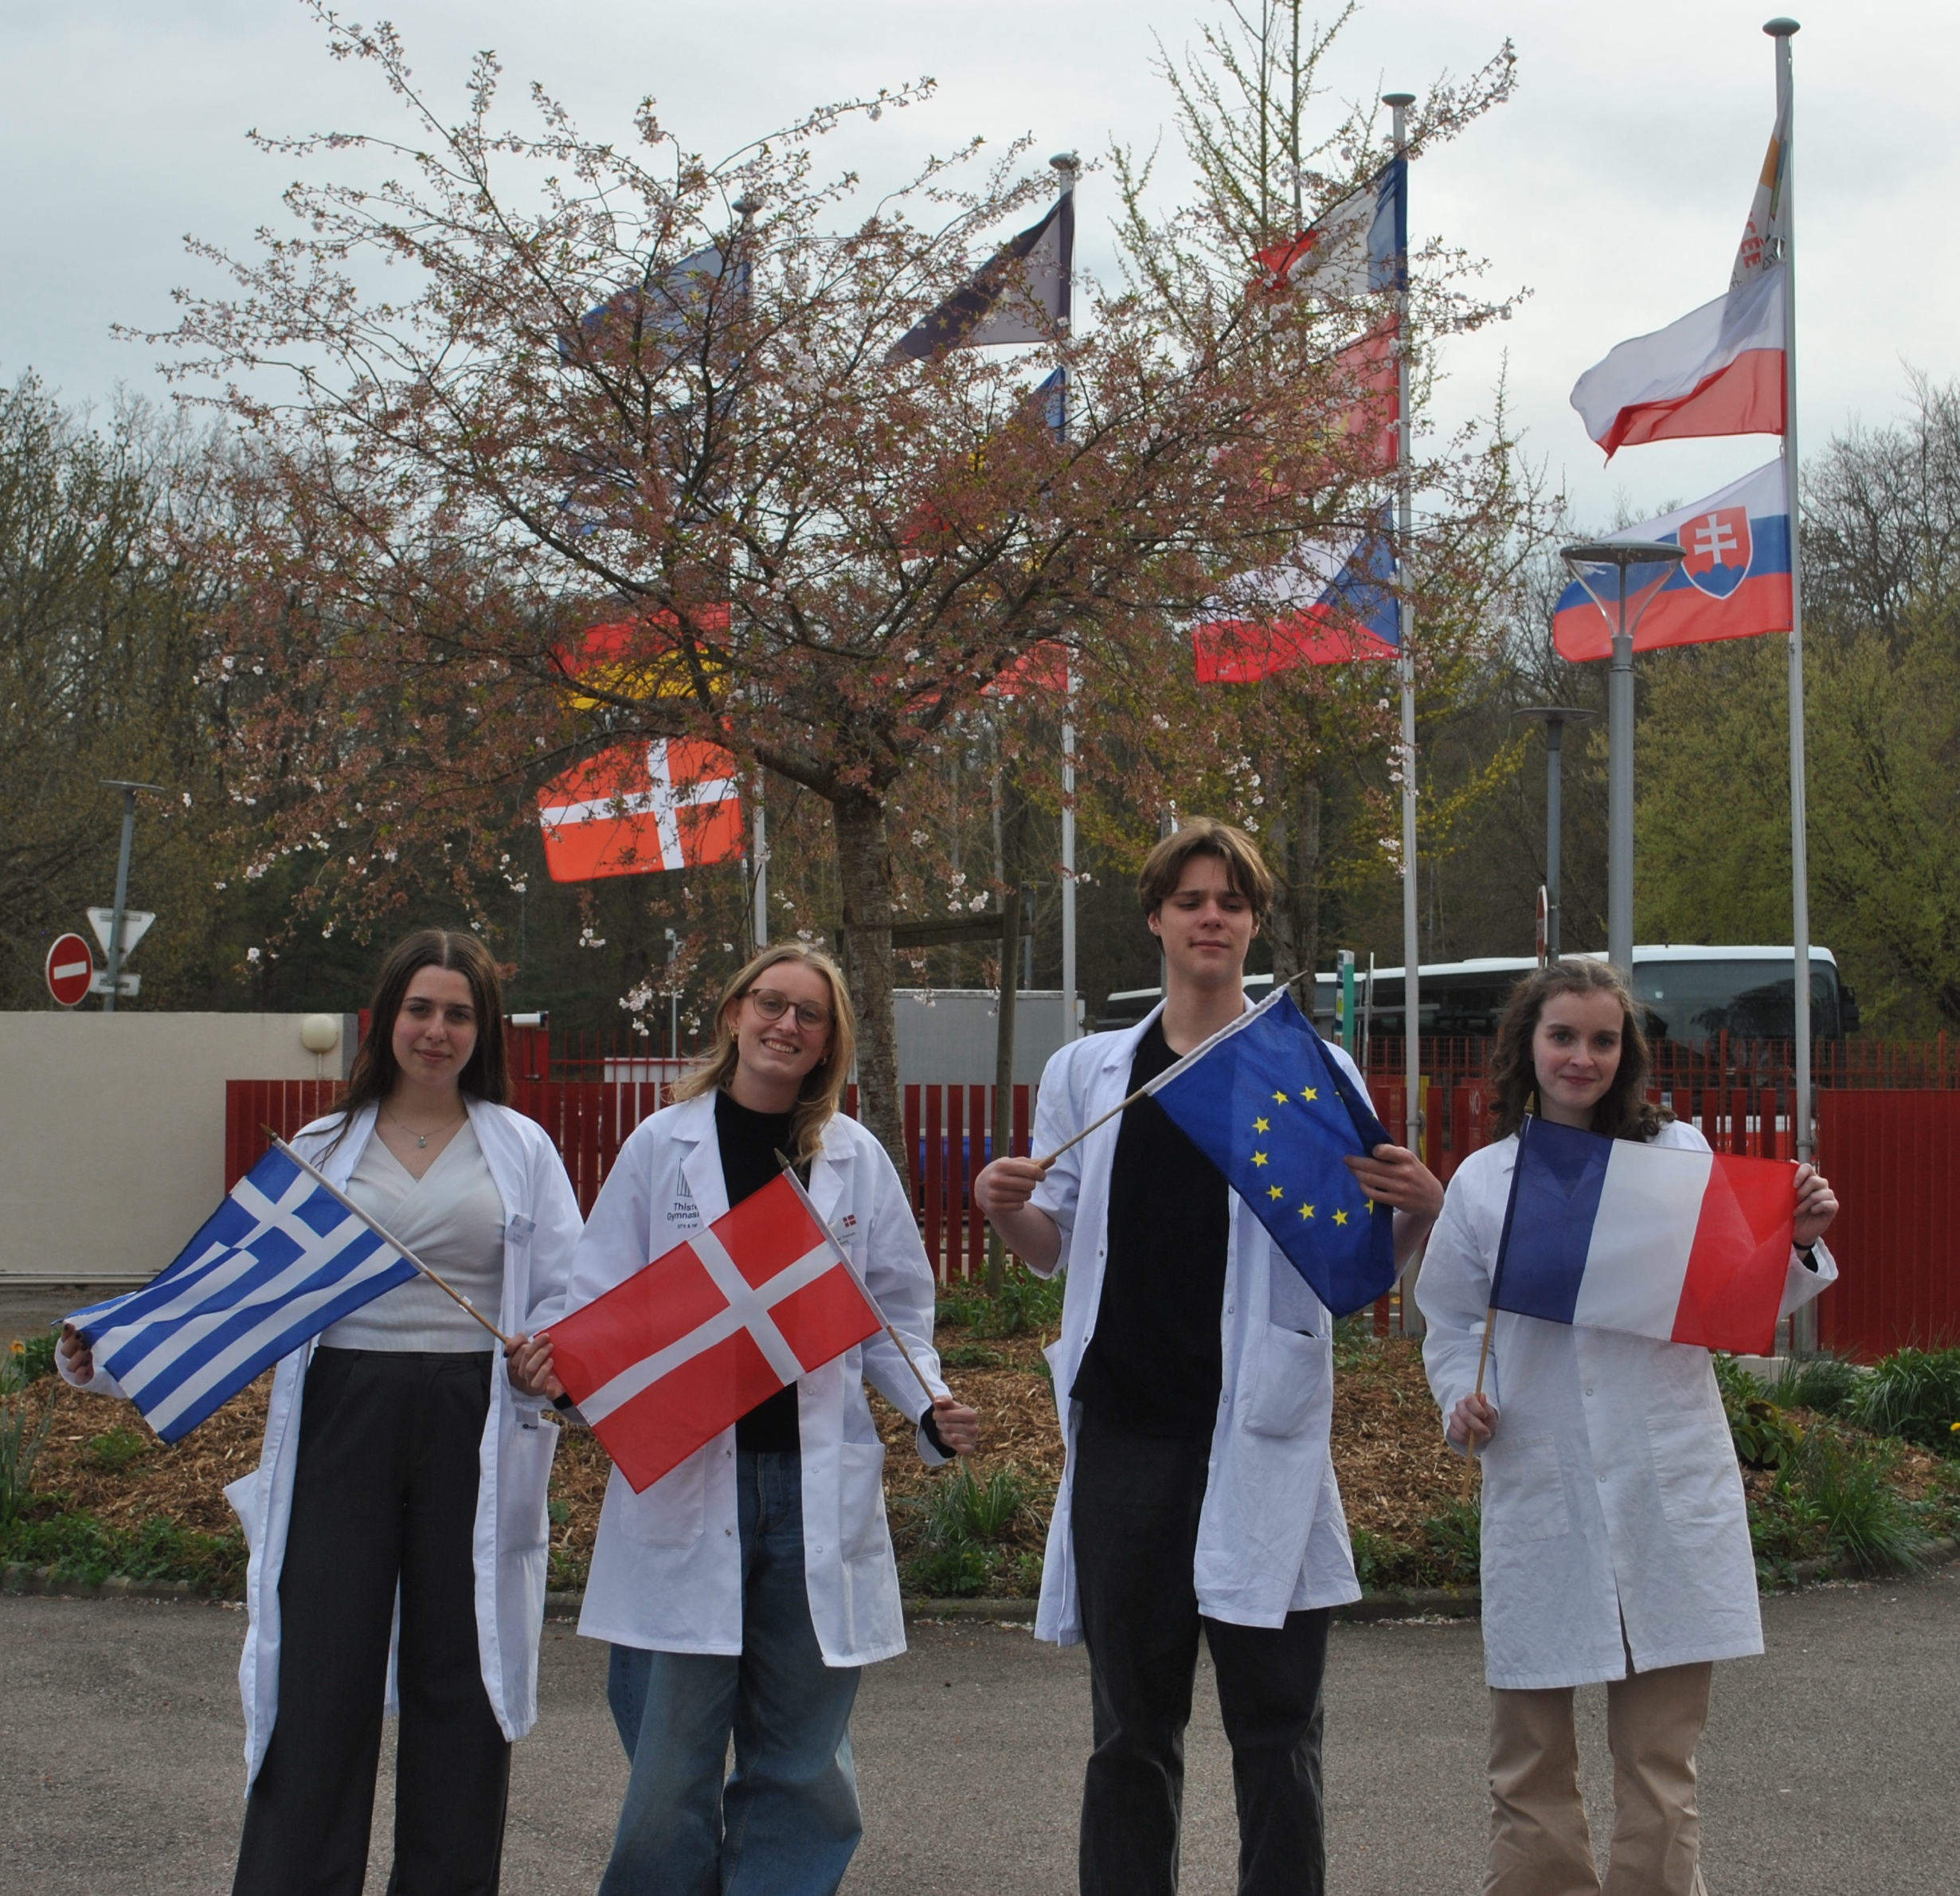



Group 17 + presentation of group members
Sara Grønkjær Thomsen
Denmark (S)
Maïwenn Guilleux
France (M)
Isaac Boutry
France (M)
Olga Kaplanis
Greece (S)

Slide 3
Evaluation Steps of our Experiment
PARTICLE FREE LYSATE – o-NPG-test (enzymatic activity assay)
ANION EXCHANGE CHROMATOGRAPHY (AEXC) – o-NPG + photometer (enzymatic activity assay)
SDS – PAGE – gel + calibration line (purity, molecular weight – lactase)
RAW MILK TEST – colour change (conc. of glucose)
EVALUATION

Slide 4
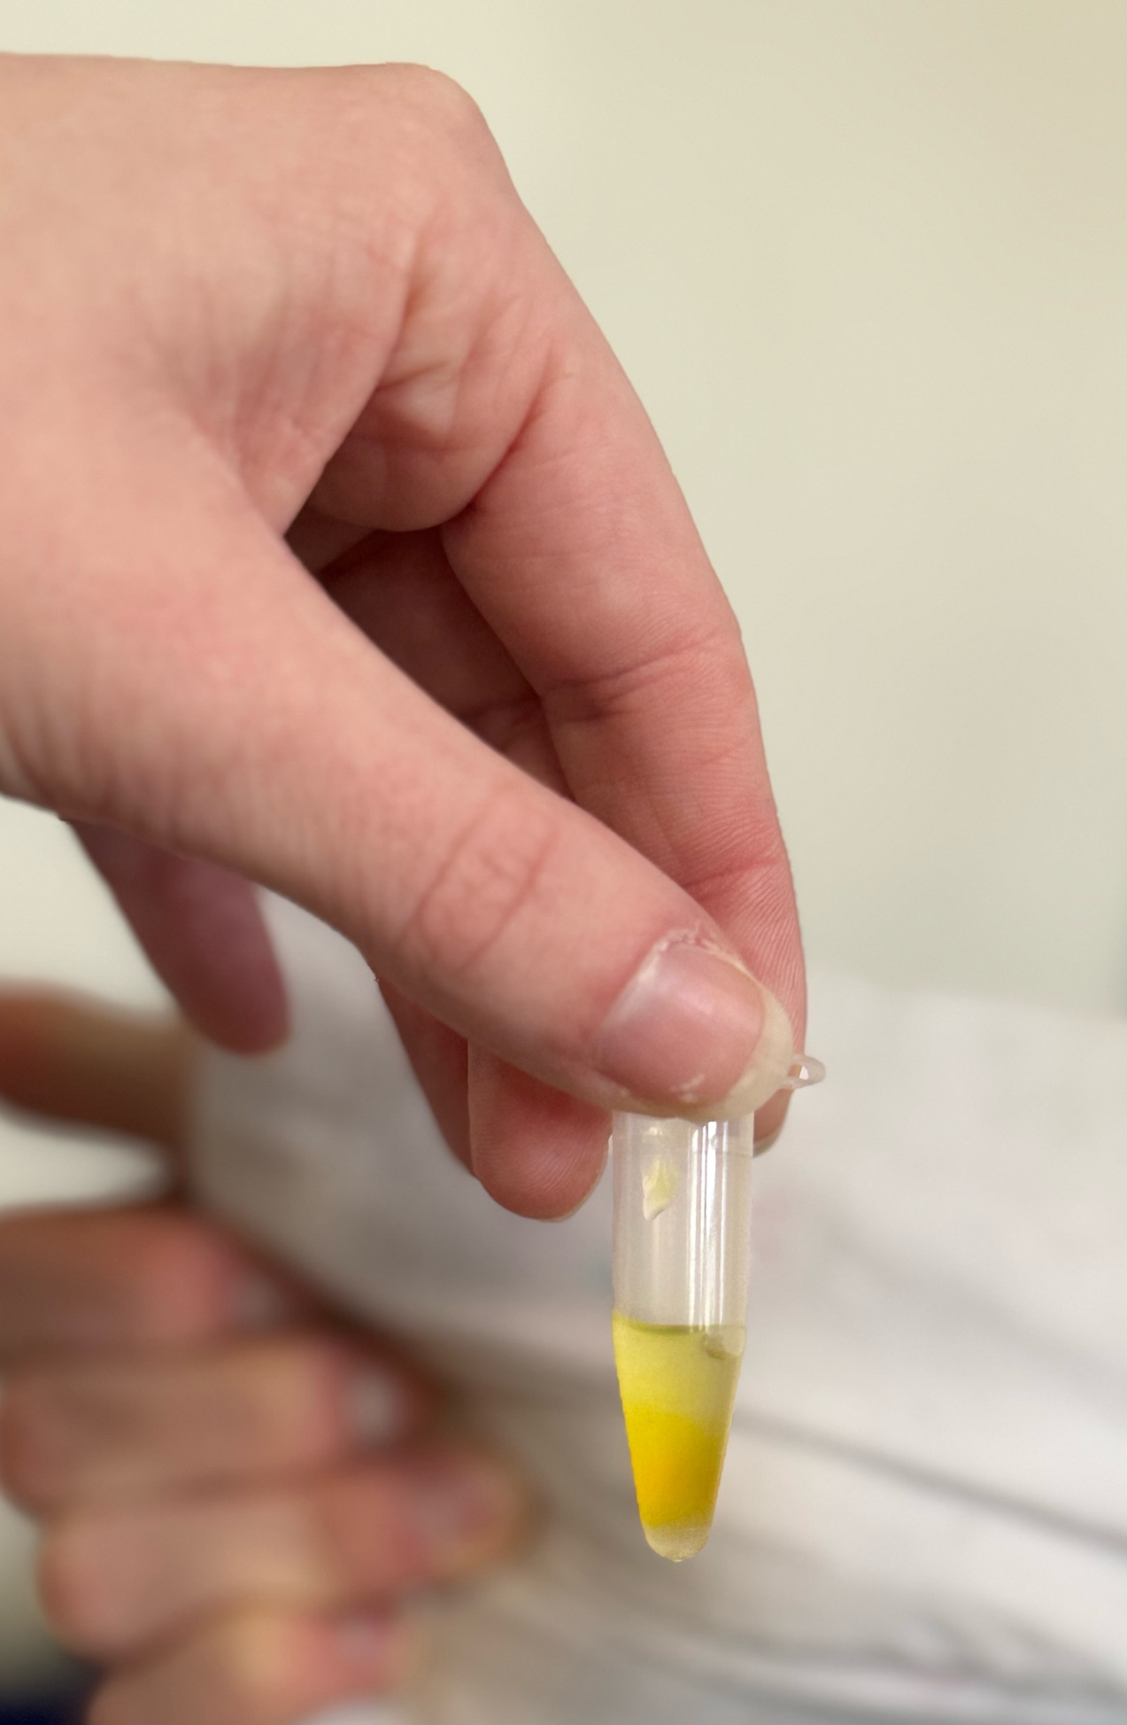
O-NPG-TEST of 1:10 diluted Particle Free Lysate
Test 50 μL supernatant + 500 μL o-NPG-solution.
Observation: The color of the particle free lysate was yellow
Evaluation: β(1→4) bond was broken down
Conclusion: lactase is present.
→ We can start AEXC.

Slide 5
Evaluation Steps of our Experiment
PARTICLE FREE LYSATE – o-NPG-test (enzymatic activity assay)
ANION EXCHANGE CHROMATOGRAPHY (AEXC) – o-NPG + photometer (enzymatic activity assay)
SDS – PAGE – gel + calibration line (purity, molecular weight – lactase)
RAW MILK TEST – colour change (conc. of glucose)
EVALUATION

Slide 6
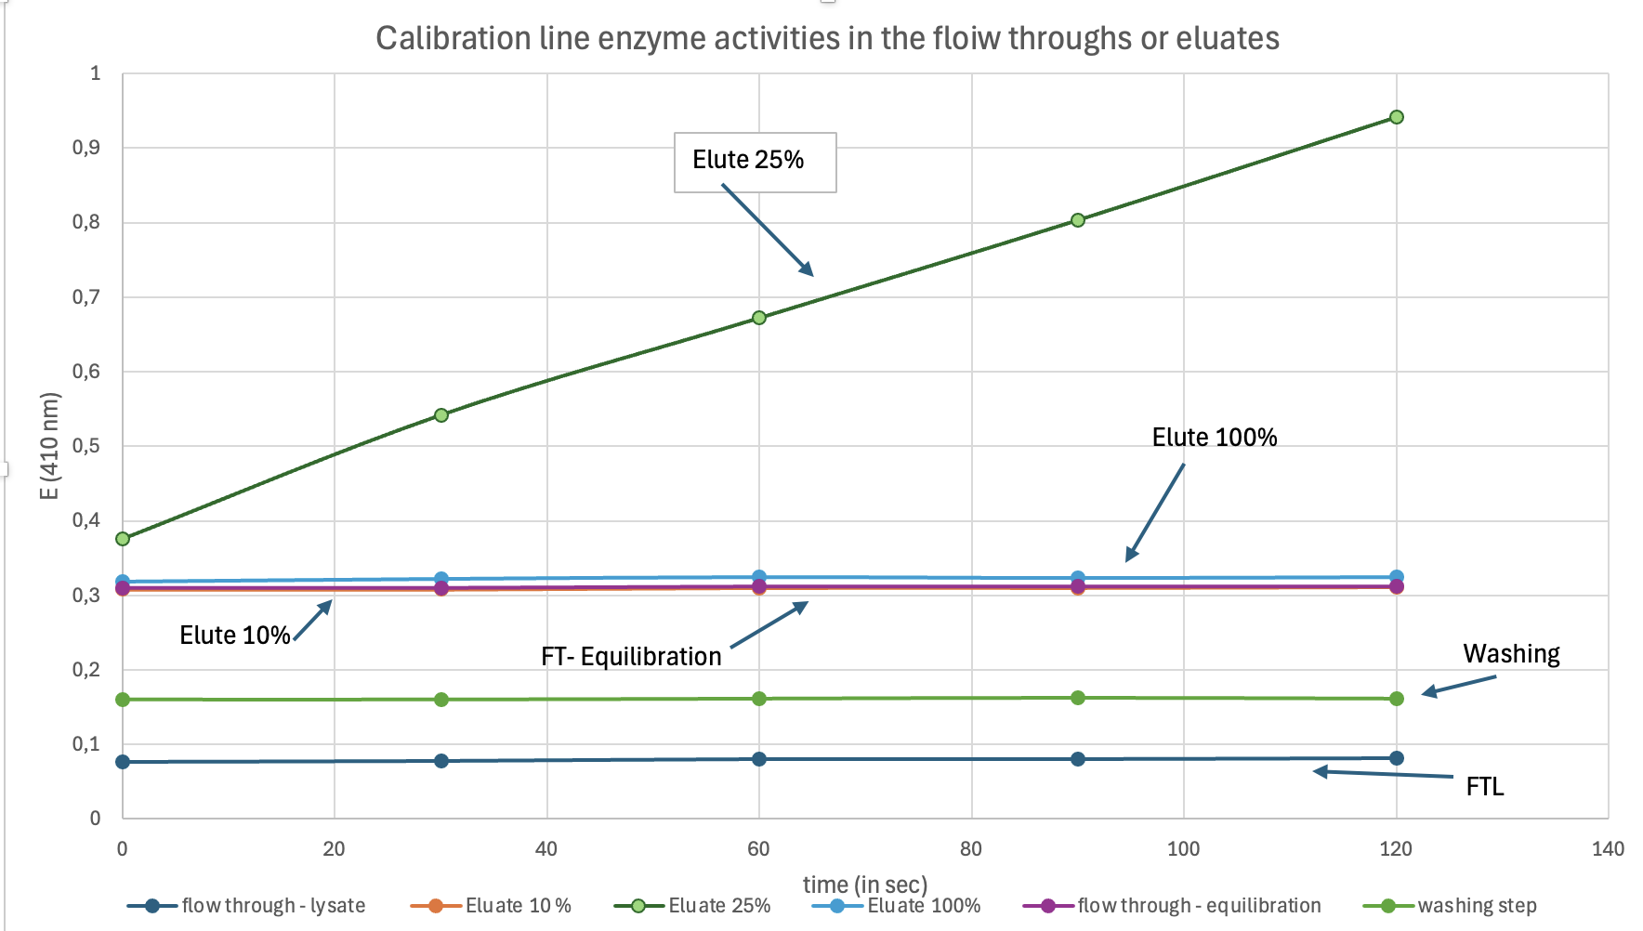
ANION EXCHANGE CHROMATOGRAPHY
O-NPG-test measured by photometer – enzymatic activity measurement
Test 50 μL eluate + 800 μL o-NPG-solution.
Observation: We can observe that 25% elute has the highest absorbance and is the most increasing
Evaluation: The evaluation tells us that the elute 25% is the on that contains the most enzymatic activity because it has the highest absorbance because we get more ortho-nitrophenol.
Conclusion: The highest lactase activity was found in eluate 25% therefore is the highest lactase concentration and has the most enzymatic activity

Slide 7
Evaluation Steps of our Experiment
PARTICLE FREE LYSATE – o-NPG-test (enzymatic activity assay)
ANION EXCHANGE CHROMATOGRAPHY (AEXC) – o-NPG + photometer (enzymatic activity assay)
SDS – PAGE – gel + calibration line (purity, molecular weight – lactase)
RAW MILK TEST – colour change (conc. of glucose)
EVALUATION

Slide 8
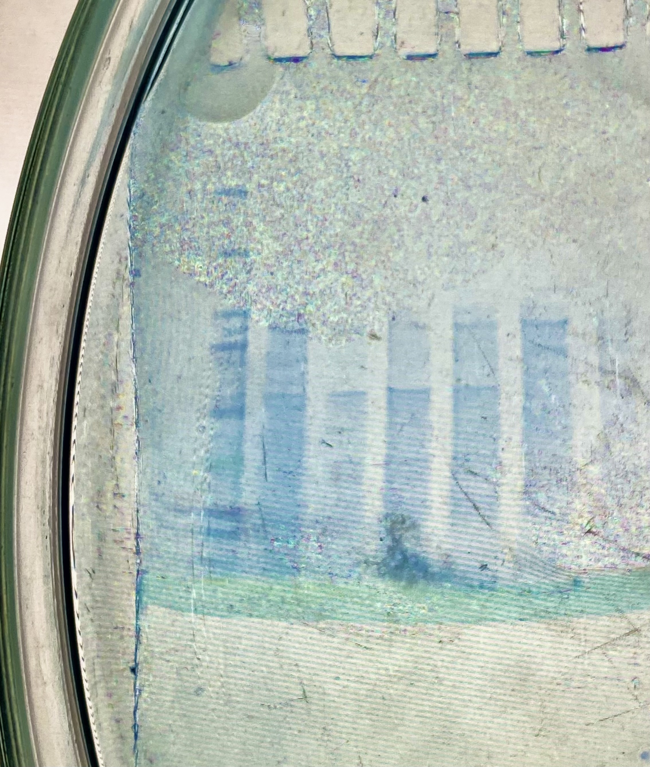
SDS - PAGE
M
S1
S2
S3
S4
S5
S6
MARKER
S1: lysate (dilution factor 10)
S2: loading flow through
S3: washing step
S4: eluate 10%
S5: eluate 25%
S6: eluate 100%
Observation: The lysate contains a lot of proteins, whereas the other samples contain less proteins. The bands are faint and smeared and therefore a little hard to see

Slide 9
SDS - PAGE
M
S1
S2
S3
S4
S5
S6
Evaluation: In the wells with the 25% eluate we can see a band with lactase. We can also see a band in the well with lysate. Meaning that we successfully purified the lactase from the lysate.
Conclusion: by AEXC we reduced the number of proteins in our sample starting with 3000 proteins

Slide 10
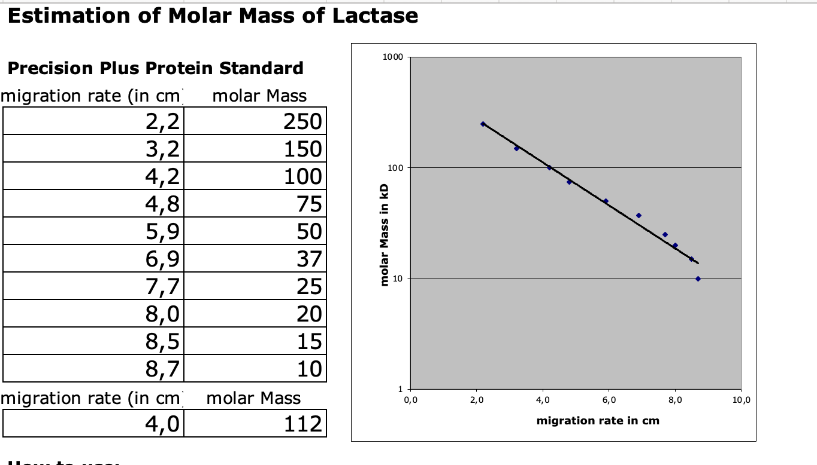
Evaluation of the SDS – PAGE
Identification of molecular weight of lactase subunit with our calibration line
Migration rate: 4,0 cm
Molecular weight: 112 kDa
Log (kDa)
cm

Slide 11
Evaluation Steps of our Experiment
PARTICLE FREE LYSATE – o-NPG-test (enzymatic activity assay)
ANION EXCHANGE CHROMATOGRAPHY (AEXC) – o-NPG + photometer (enzymatic activity assay)
SDS – PAGE – gel + calibration line (purity, molecular weight – lactase)
RAW MILK TEST – colour change (conc. of glucose)
EVALUATION

Slide 12
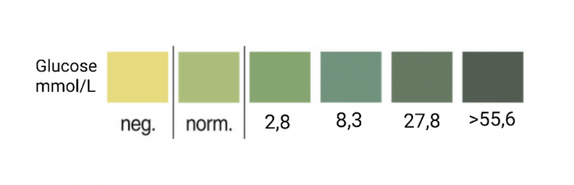

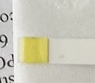
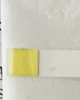

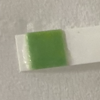
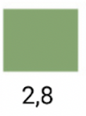
RAW MILK TEST
Observation: Color of stripe after:
0 minutes – yellow negative of glucose
20 minutes – yellow negative of glucose
40 minutes – yellow negative of glucose
30 minutes after adding more lactase – green
Evaluation: after 90 minutes the amount of glucose is 2,8 mmol/L
Conclusion: our isolated lactase could change raw milk
containing lactose into lactose-free raw milk after adding heat and 200𝜇𝑙 of the 25% eluate
T₀
T₂₀
T₄₀
30 min after adding 100 𝜇𝑙 more of lactase

Slide 13
Evaluation Steps of our Experiment
PARTICLE FREE LYSATE – o-NPG-test (enzymatic activity assay)
ANION EXCHANGE CHROMATOGRAPHY (AEXC) – o-NPG + photometer (enzymatic activity assay)
SDS – PAGE – gel + calibration line (purity, molecular weight – lactase)
RAW MILK TEST – colour change (conc. of glucose)
EVALUATION

Slide 14
EVALUATION
1. TASK: According to AEXC the highest amount of lactase was found in the 25% eluate because it had the highest absorbance and most enzymatic activity. Likewise, the SDS-PAGE showed us that it contained lactase. We can conclude that the 25% eluate is the one that had the most lactase in both experiments.
2 . TASK: The most suitable sample for downstream purification and further purification of lactase is the 25% eluate because it contained the most lactase and had the most enzymatic activity. And therefore, is the most suitable.

Slide 15
Thank you for your attention!

