Slide 1
Summary of Results from
Group 16
Lactase Downstream Processing
Evreux 23. – 27.03.2026

Slide 2

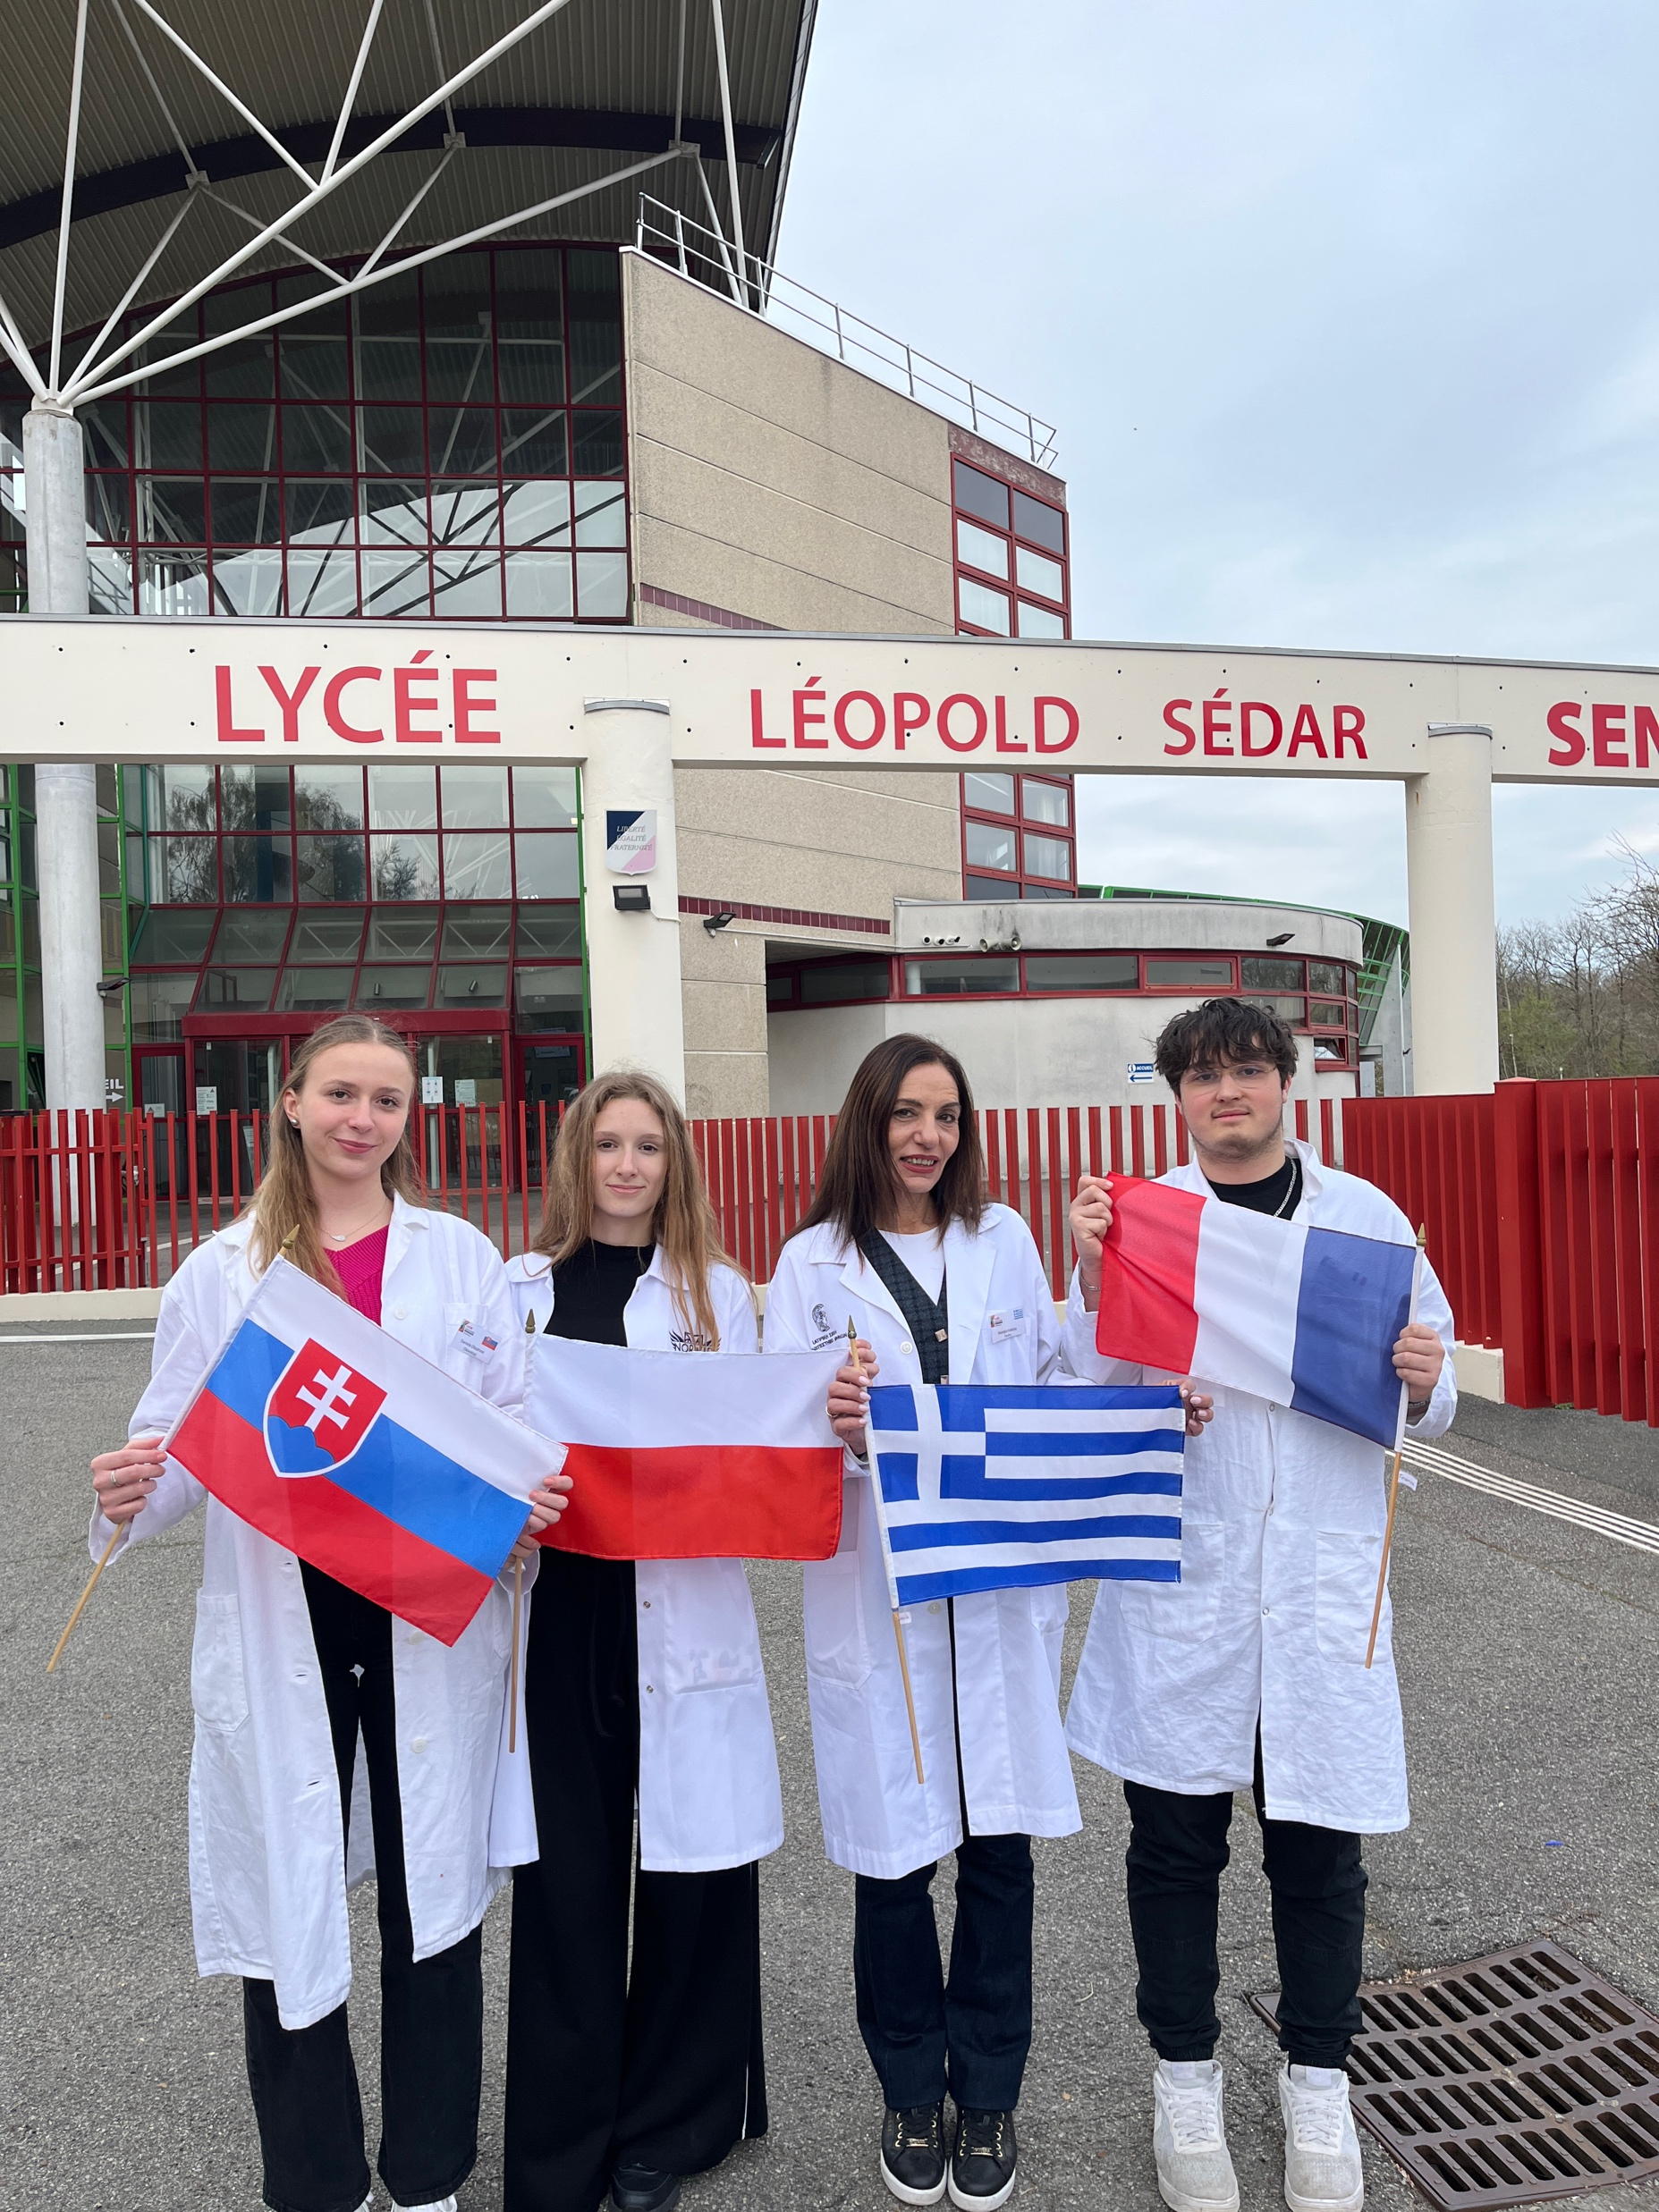



Group X + presentation of group members
Daniela Olejárová
Slovakia (Mentor)
Emilia Stolarczyk
Poland (Student)
Georgia Kokkiza
Greece (Teacher)
Quentin Vaissié
France (Mentor)

Slide 3
Evaluation Steps of our Experiment
PARTICLE FREE LYSATE – o-NPG-test (enzymatic activity assay)
ANION EXCHANGE CHROMATOGRAPHY (AEXC) – o-NPG + photometer (enzymatic activity assay)
SDS – PAGE - gel + calibration line (purity, molecular weight – lactase)
RAW MILK TEST – colour change (conc. of glucose)
EVALUATION

Slide 4
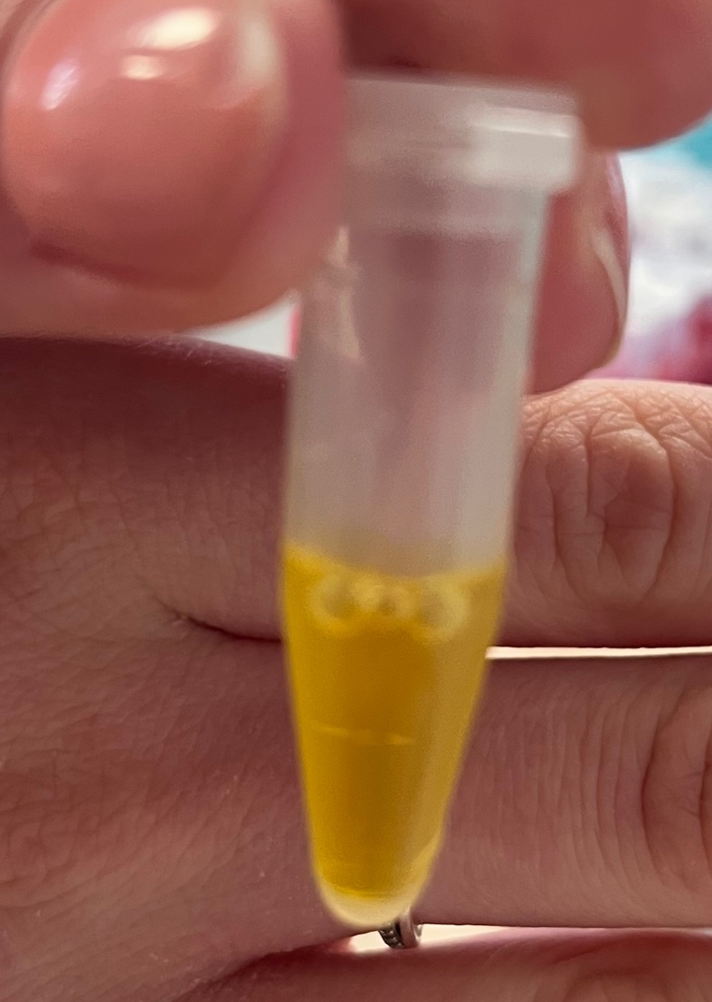
O-NPG-TEST of 1:10 diluted Particle Free Lysate
Test 50 μL supernatant + 500 μL o-NPG-solution.
Observation: yellow color
Evaluation: β(1→4) bond was broken down
Conclusion: lactase is present.
→ We can start AEXC.
Picture of cuvette

Slide 5
Evaluation Steps of our Experiment
PARTICLE FREE LYSATE – o-NPG-test (enzymatic activity assay)
ANION EXCHANGE CHROMATOGRAPHY (AEXC) – o-NPG + photometer (enzymatic activity assay)
SDS – PAGE – gel + calibration line (purity, molecular weight – lactase)
RAW MILK TEST – colour change (conc. of glucose)
EVALUATION

Slide 6
ANION EXCHANGE CHROMATOGRAPHY
O-NPG-test measured by photometer – enzymatic activity measurement
Test 50 μL eluate + 800 μL o-NPG-solution.
Observation: we only saw an increase
in the 25% eluate, which turned yellow
Evaluation: enzymatic activity was
the highest in the 25% eluate
Conclusion: the highest lactase
activity was in 25% eluate

Slide 7
Evaluation Steps of our Experiment
PARTICLE FREE LYSATE – o-NPG-test (enzymatic activity assay)
ANION EXCHANGE CHROMATOGRAPHY (AEXC) – o-NPG + photometer (enzymatic activity assay)
SDS – PAGE – gel + calibration line (purity, molecular weight – lactase)
RAW MILK TEST – colour change (conc. of glucose)
EVALUATION

Slide 8
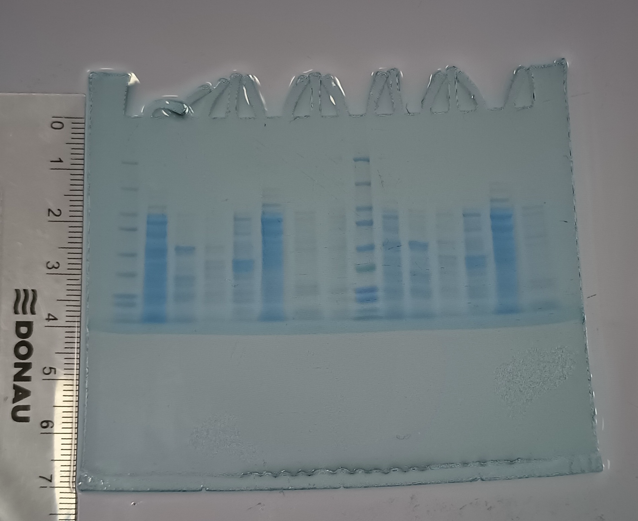
SDS - PAGE
MARKER
S1: lysate (dilution factor 10)
S2: loading flow through
S3: washing step
S4: eluate 10%
S5: eluate 25%
S6: eluate 100%
Conclusion: by AEXC we reduced many proteins but it is hard to tell the exact number (starting with 3000)

Slide 9
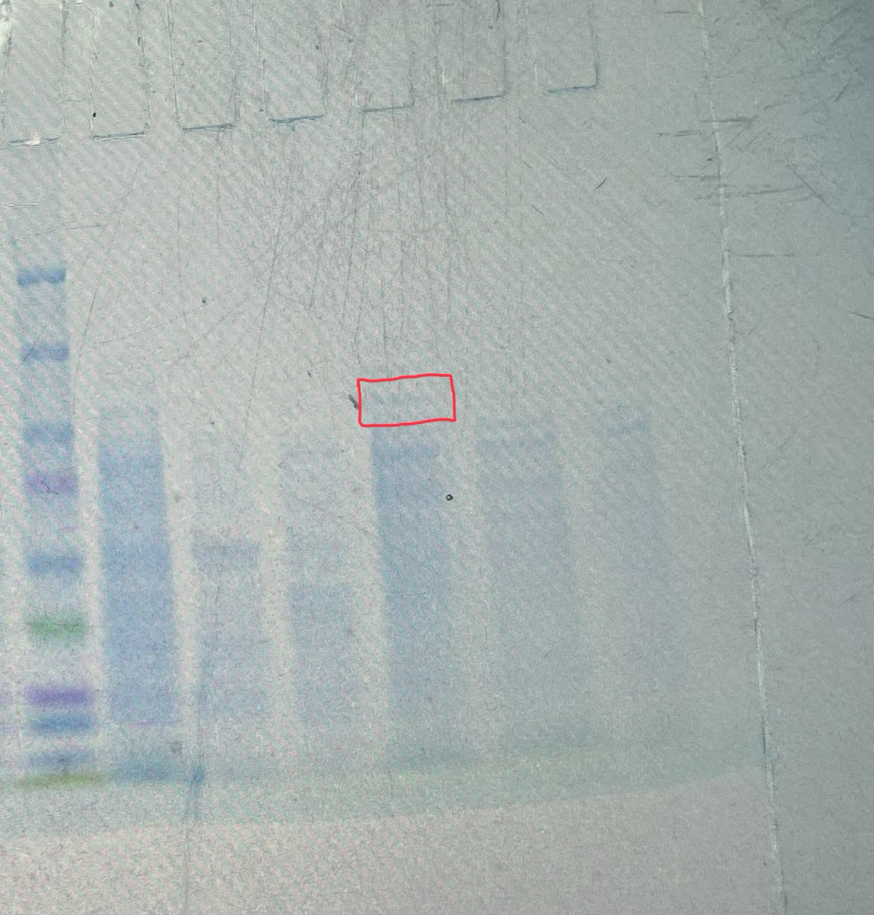
SDS - PAGE
We identified the lactase subunit
(116 kDa) in our gel with the marker
The lactase band is little above
100 marker
250
150
100
75
50
37
25
20
15
10

Slide 10
Evaluation of the SDS – PAGE
Identification of molecular weight of lactase subunit with your calibration line
Migration rate: 1,6 cm
Molecular weight: 112 kDa
Log (kDa)
cm

Slide 11
Evaluation Steps of our Experiment
PARTICLE FREE LYSATE – o-NPG-test (enzymatic activity assay)
ANION EXCHANGE CHROMATOGRAPHY (AEXC) – o-NPG + photometer (enzymatic activity assay)
SDS – PAGE – gel + calibration line (purity, molecular weight – lactase)
RAW MILK TEST – colour change (conc. of glucose)
EVALUATION

Slide 12
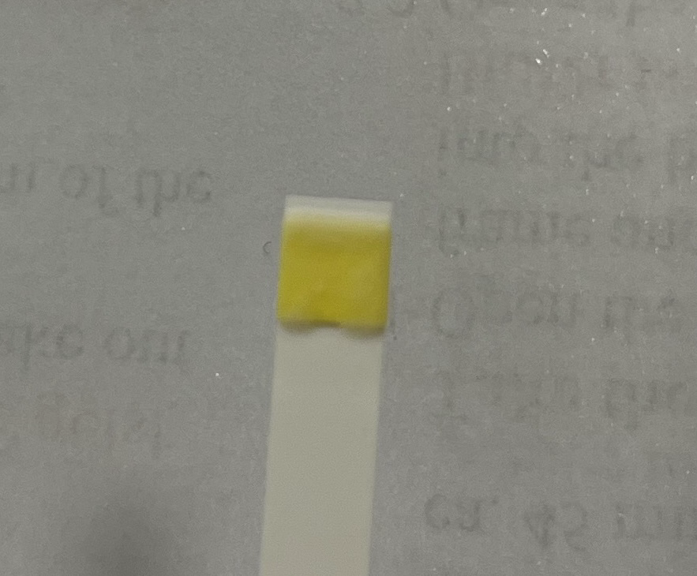
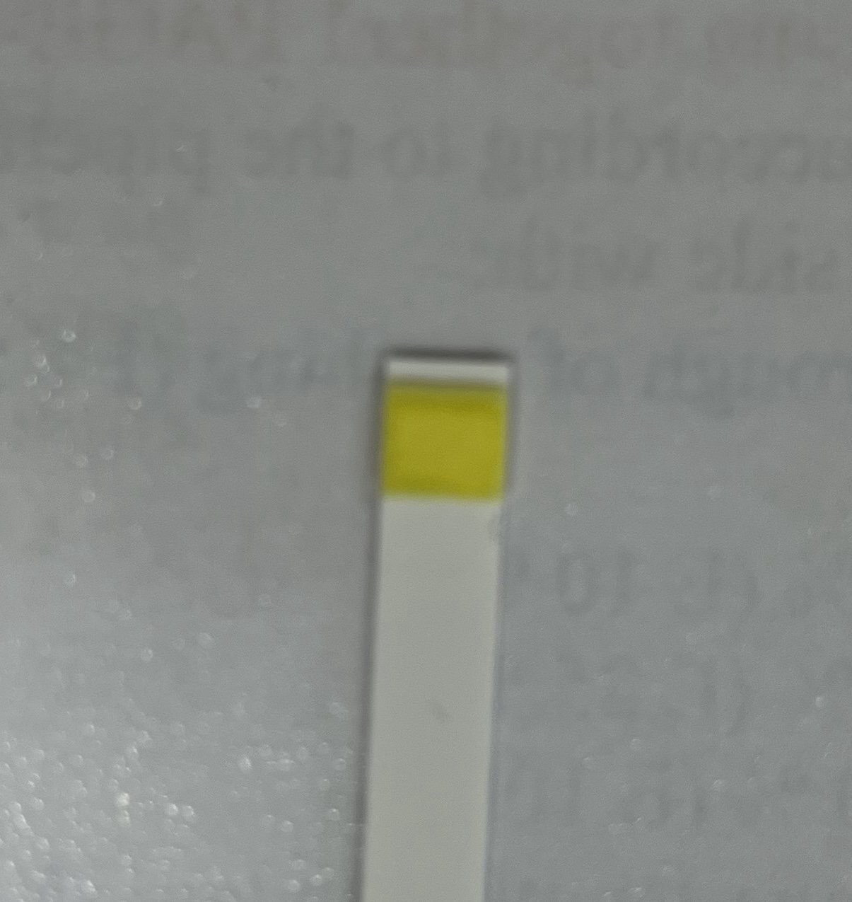
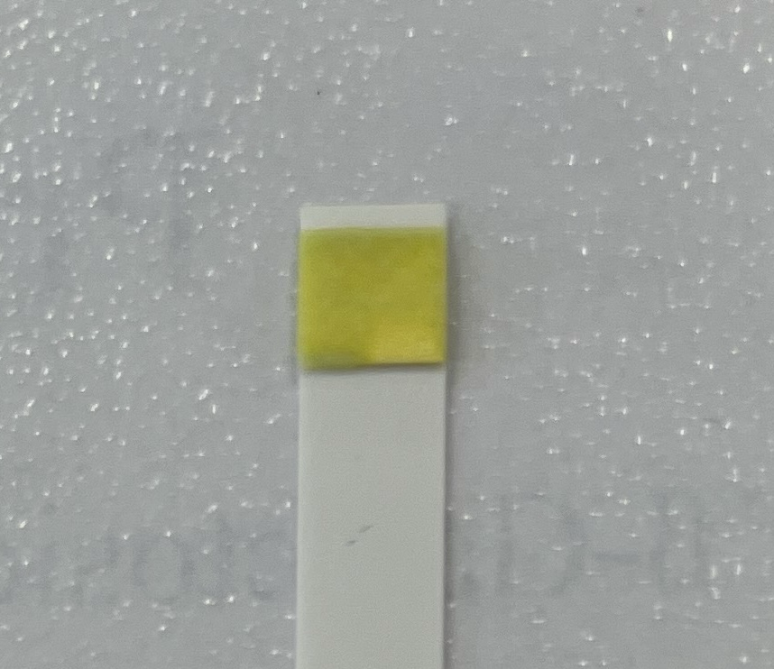
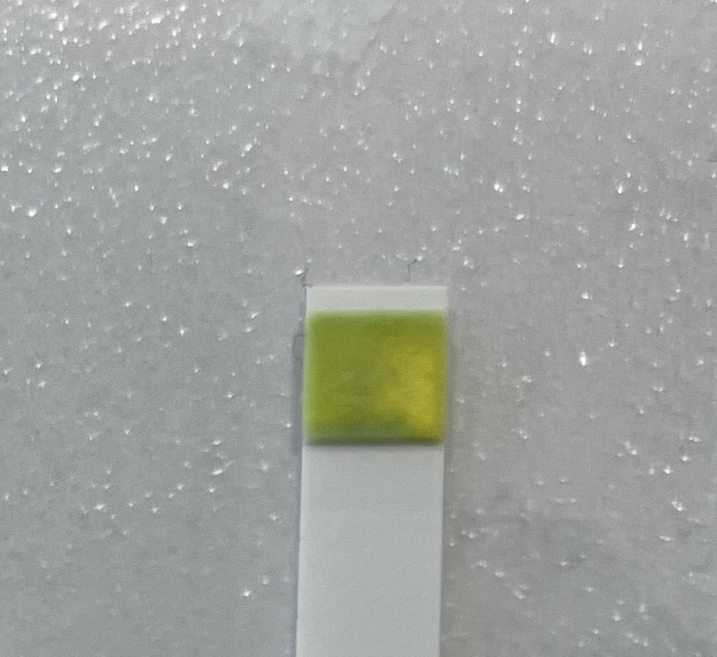
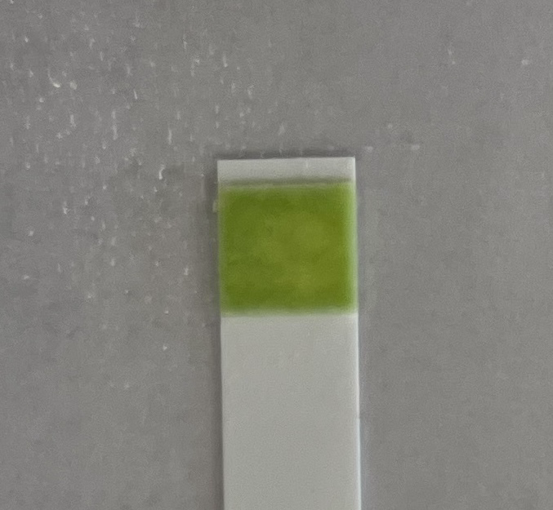
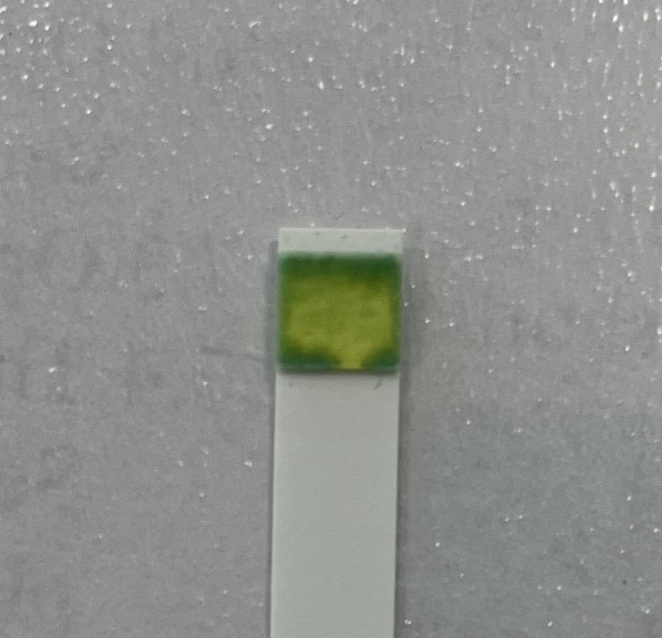
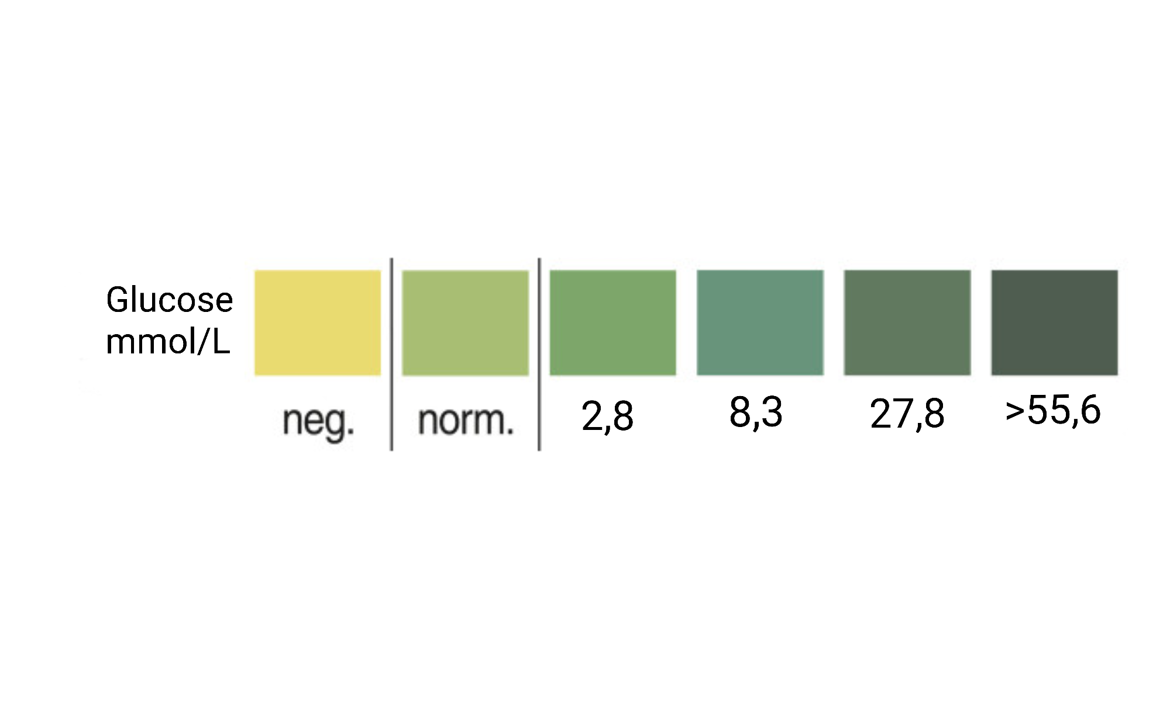
RAW MILK TEST
Observation: we could barely see any change of colour after 0/20/40min. After 70 min we applied heat and another
100 μl of 25% eluate. Green colour after 100/130 min
Evaluation: value of glucose was 8,3 (mmol/L)
Conclusion: our isolated lactase could change raw milk
containing lactose into lactose-free raw milk
Neg.
Neg.
Norm.
2,8
2,8
8,3

Slide 13
Evaluation Steps of our Experiment
PARTICLE FREE LYSATE – o-NPG-test (enzymatic activity assay)
ANION EXCHANGE CHROMATOGRAPHY (AEXC) – o-NPG + photometer (enzymatic activity assay)
SDS – PAGE – gel + calibration line (purity, molecular weight – lactase)
RAW MILK TEST – colour change (conc. of glucose)
EVALUATION

Slide 14
EVALUATION
1. TASK: In comparison of our results of AEXC we saw the highest lactase activity in the eluate 25% and the highest amount of lactase in SDS – PAGE in the eluate 25%. Meaning we succesfully purified the lactase in the lysate.
2. TASK: The eluate 25% is suitable for downstream process and further purification of lactase, because according to photometry and SDS – PAGE this is the sample that contains the most lactase.

Slide 15
Thank you for your attention!

