Slide 1
Summary of Results from
Group 15
Lactase Downstream Processing
Evreux 23. – 27.03.2026

Slide 2

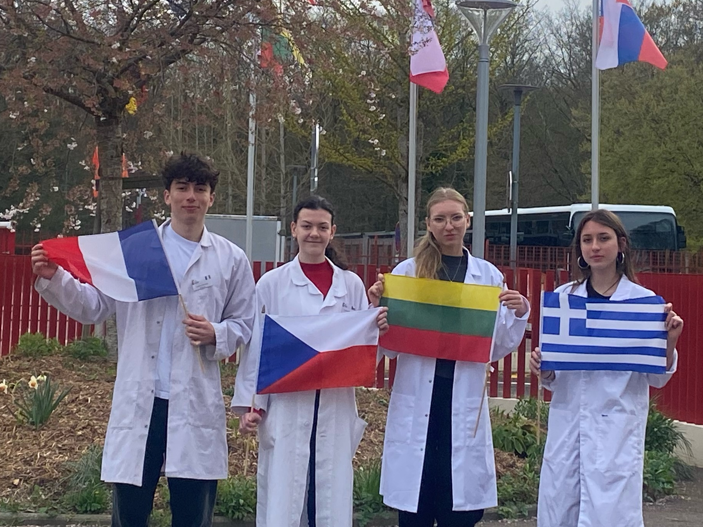



Group 15 + presentation of group members
Angeliki Chalepli
Greece
Stanislava Piňosová
The Czech Republic
(Mentor)
Antoine Sciarretta
France (Mentor)
Ainė Rimavičiūtė
Lithuania

Slide 3
Evaluation Steps of our Experiment
PARTICLE FREE LYSATE – o-NPG-test (enzymatic activity assay)
ANION EXCHANGE CHROMATOGRAPHY (AEXC) – o-NPG + photometer (enzymatic activity assay)
SDS – PAGE – gel + calibration line (purity, molecular weight – lactase)
RAW MILK TEST – colour change (conc. of glucose)
EVALUATION

Slide 4
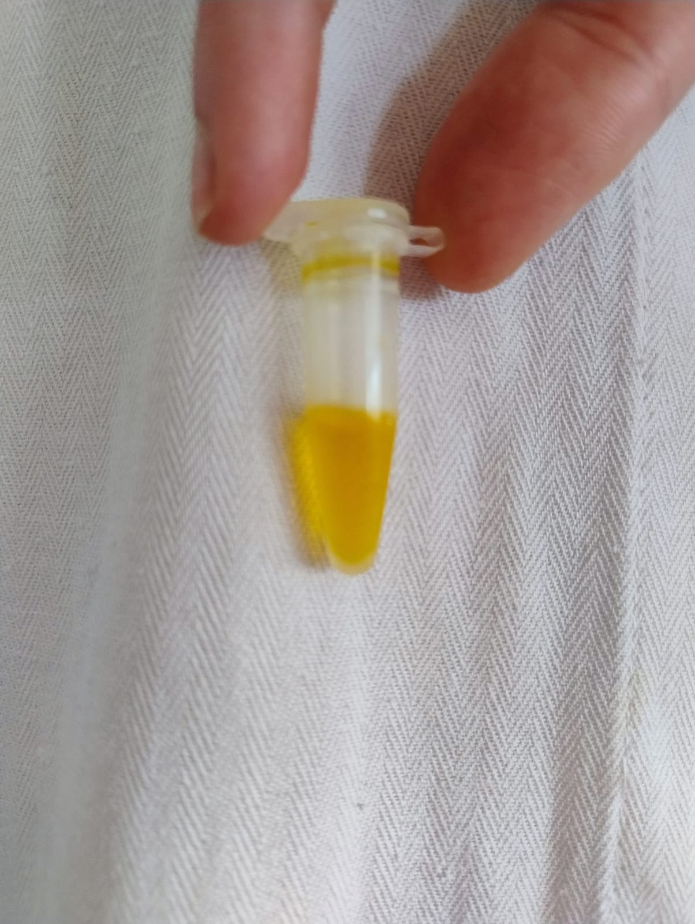
O-NPG-TEST of 1:10 diluted Particle Free Lysate
Test 50 μL supernatant + 500 μL o-NPG-solution.
Observation: bright yellow
Evaluation: β(1→4) bond was broken down
Conclusion: lactase is present.
→ We can start AEXC.
Picture of cuvette
Caption

Slide 5
Evaluation Steps of our Experiment
PARTICLE FREE LYSATE – o-NPG-test (enzymatic activity assay)
ANION EXCHANGE CHROMATOGRAPHY (AEXC) – o-NPG + photometer (enzymatic activity assay)
SDS – PAGE – gel + calibration line (purity, molecular weight – lactase)
RAW MILK TEST – colour change (conc. of glucose)
EVALUATION

Slide 6
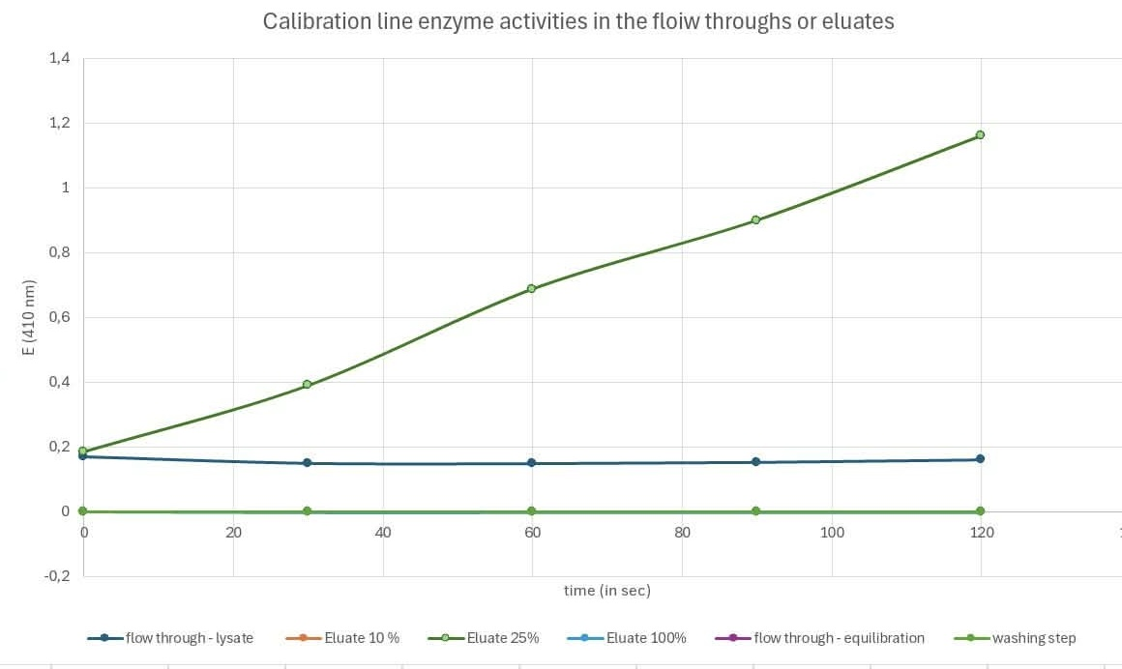
ANION EXCHANGE CHROMATOGRAPHY
O-NPG-test measured by photometer – enzymatic activity measurement
Test 50 μL eluate + 800 μL o-NPG-solution.
Observation: with photometric results we saw that the curve of eluate 25% was increasing, the loading had some really small changes and other curves were straight.
Evaluation: our own Excel diagram
Conclusion: the highest
lactase activity was in eluate 25%

Slide 7
Evaluation Steps of our Experiment
PARTICLE FREE LYSATE – o-NPG-test (enzymatic activity assay)
ANION EXCHANGE CHROMATOGRAPHY (AEXC) – o-NPG + photometer (enzymatic activity assay)
SDS – PAGE – gel + calibration line (purity, molecular weight – lactase)
RAW MILK TEST – colour change (conc. of glucose)
EVALUATION

Slide 8
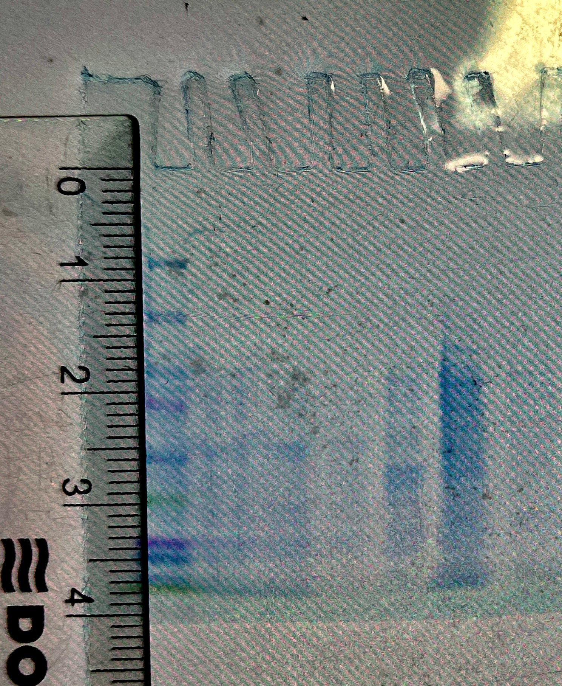
SDS - PAGE
M
MARKER
S1: lysate (dilution factor 10)
S2: loading flow through
S3: washing step
S4: eluate 10%
S5: eluate 25%
S6: eluate 100%
In eluate 25% there were about 6 solid bands and too many overlapping bands so we couldn’t count it accurately.
Conclusion: by AEXC we should have reduced the number of proteins in our sample, but we couldn’t compare it to our lysate (technical problems: the cassette was screwed tightly). We couldn’t count the proteins in eluate 25% properly because we only could see 6 solid bands.
S1
S2
S3
S4
S5
S6
Caption

Slide 9
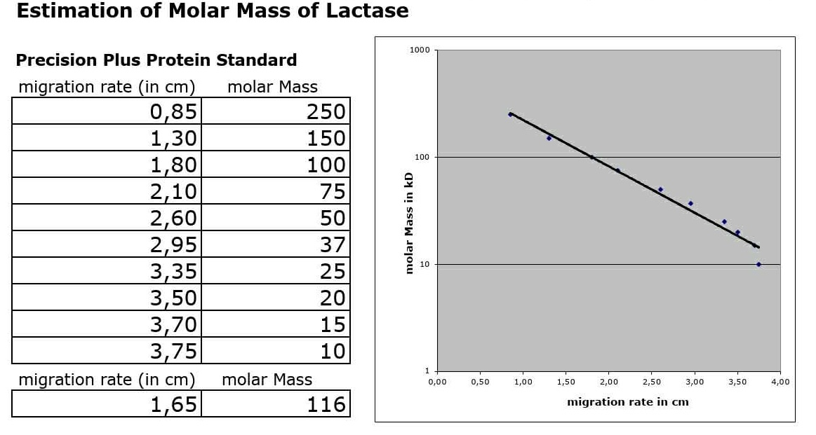
Evaluation of the SDS – PAGE
Identification of molecular weight of lactase subunit with your calibration line
Migration rate: 1,65 cm
Log (kDa) = x
Molecular weight: 116 kDa
Log (kDa)
cm

Slide 10
Evaluation Steps of our Experiment
PARTICLE FREE LYSATE – o-NPG-test (enzymatic activity assay)
ANION EXCHANGE CHROMATOGRAPHY (AEXC) – o-NPG + photometer (enzymatic activity assay)
SDS – PAGE – gel + calibration line (purity, molecular weight – lactase)
RAW MILK TEST – colour change (conc. of glucose)
EVALUATION

Slide 11
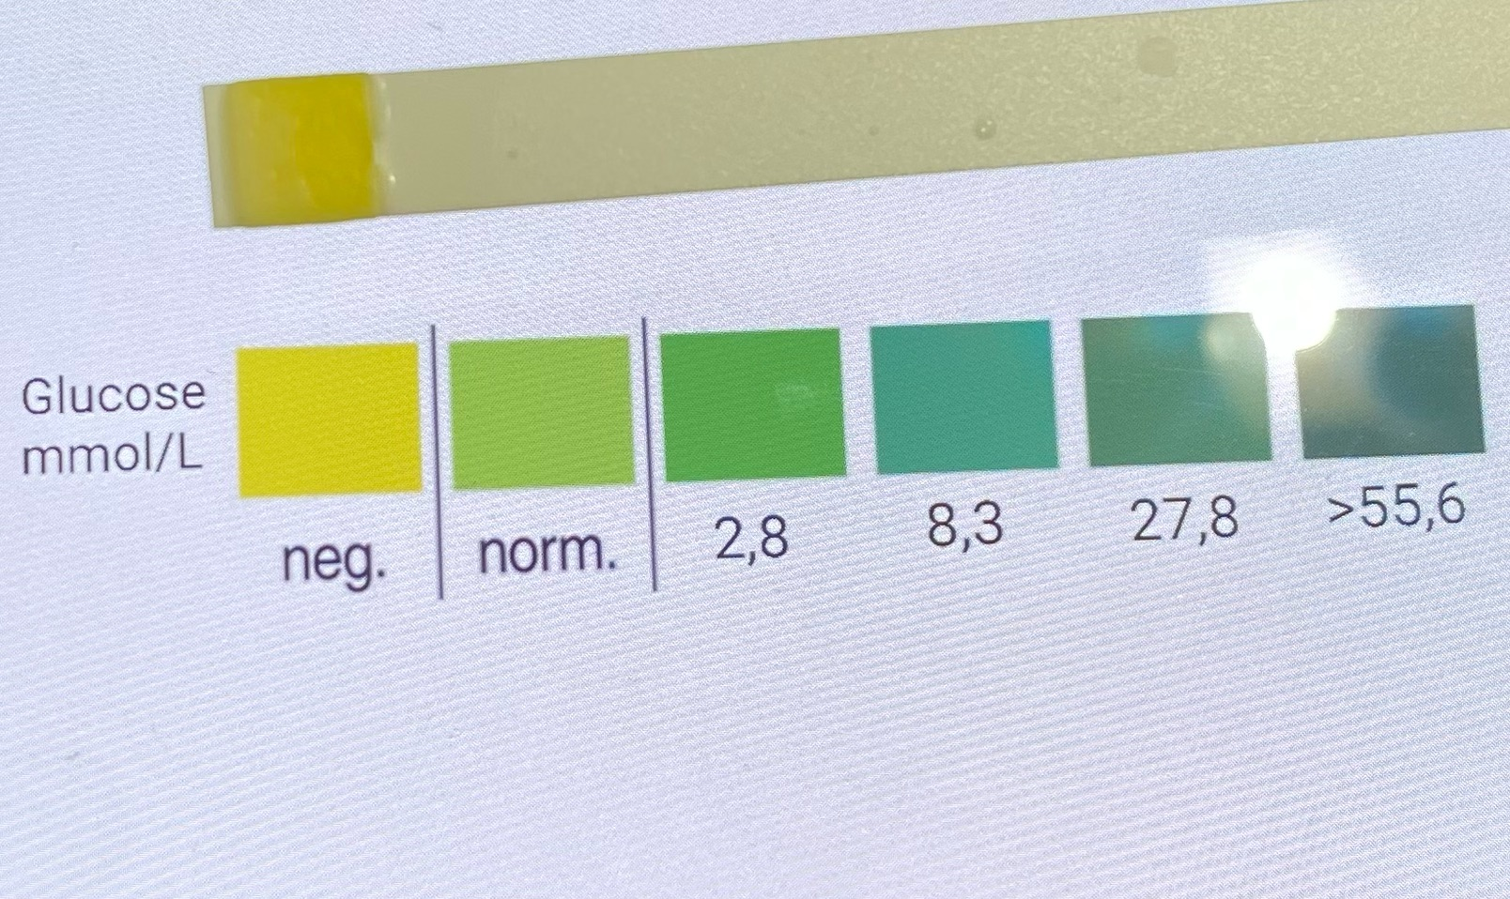
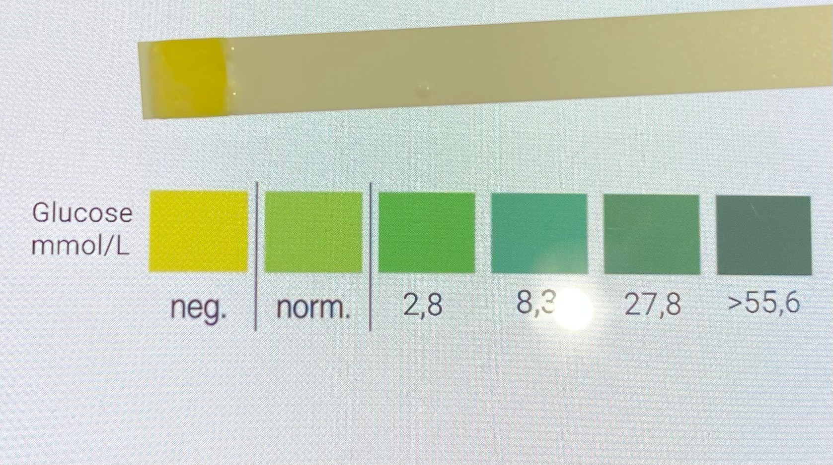
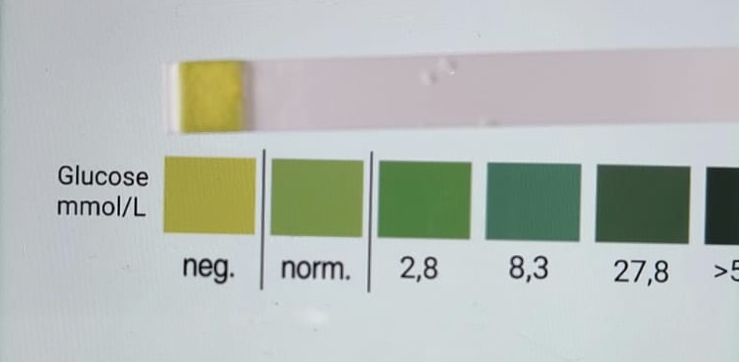
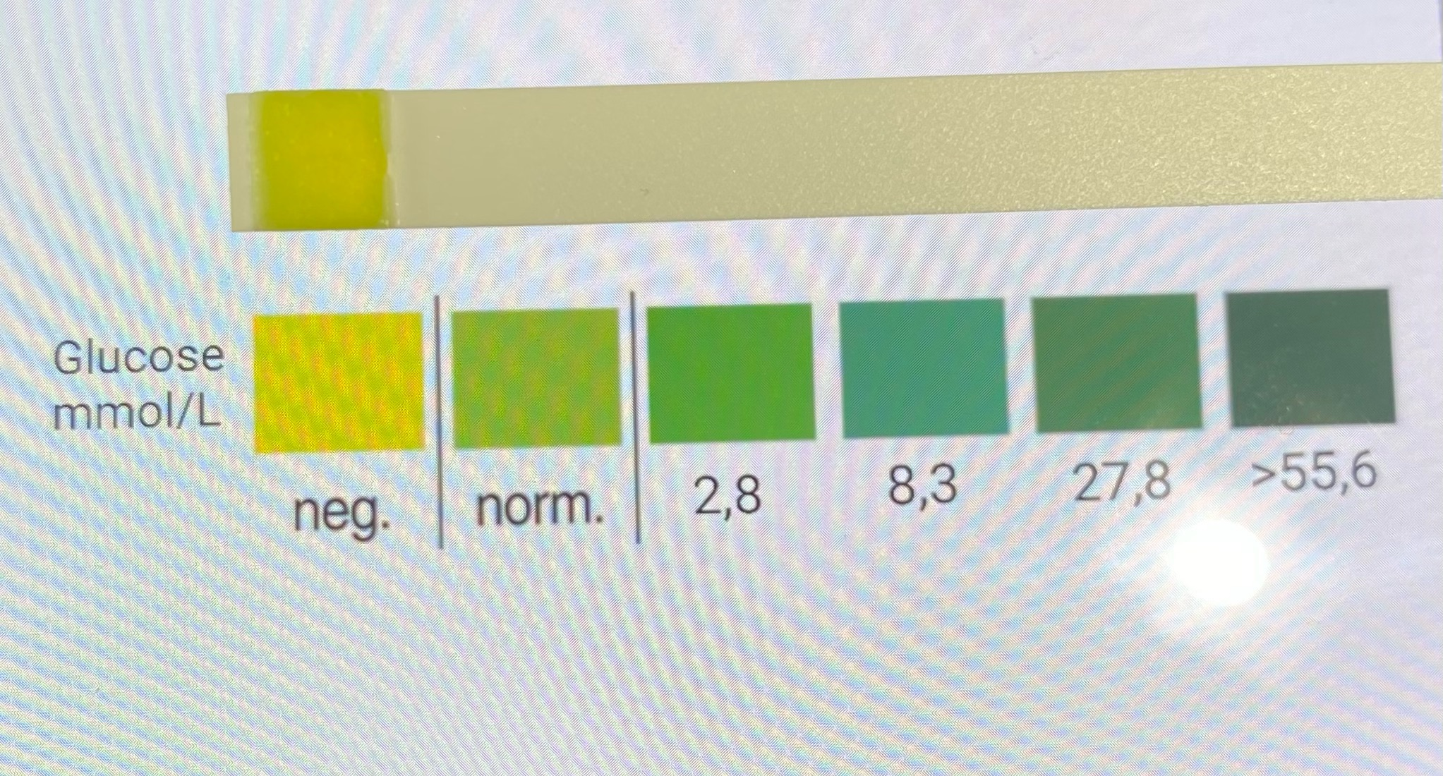
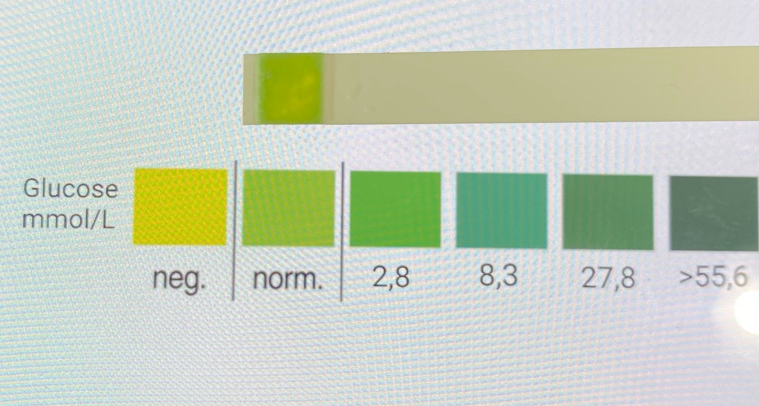
RAW MILK TEST
Observation: colour of the stripe after 0/20/40/70 was yellow, and after 110 min it was light green.
We were heating our sample after 40 minutes of checking the glucose concentration.
Evaluation: value of glucose (mmol/L) is norm. after 110 min (After 0/20/40/70 min it was negative)
Conclusion: our isolated lactase could change raw milk containing lactose into lactose-free raw milk

Slide 12
Evaluation Steps of our Experiment
PARTICLE FREE LYSATE – o-NPG-test (enzymatic activity assay)
ANION EXCHANGE CHROMATOGRAPHY (AEXC) – o-NPG + photometer (enzymatic activity assay)
SDS – PAGE – gel + calibration line (purity, molecular weight – lactase)
RAW MILK TEST – colour change (conc. of glucose)
EVALUATION

Slide 13
EVALUATION
1. TASK: Compare your results of AEXC according to the highest lactase activity and the highest amount of lactase in SDS – PAGE.
What can we conclude from the TASK 1?
We saw the highest lactase activity (o-NPG + photometer) in the eluate 25% and SDS-PAGE proved that the lactase band was in the eluate 25%.
2. TASK: Choose a sample suitable for downstream process and further purification of lactase.
The sample we can actually use is eluate 25%.

Slide 14
Thank you for your attention!

