Slide 1
Summary of Results from
Group 13
Lactase Downstream Processing
Evreux 23. – 27.03.2026

Slide 2




Group 13 presentation of group members
Zoi Chioni
Greek
Tessa J. Ramskov
Danish
Lucie Zoubkava
Czech Republic

Slide 3
Evaluation Steps of our Experiment
PARTICLE FREE LYSATE – o-NPG-test (enzymatic activity assay)
ANION EXCHANGE CHROMATOGRAPHY (AEXC) – o-NPG + photometer (enzymatic activity assay)
SDS – PAGE – gel + calibration line (purity, molecular weight – lactase)
RAW MILK TEST – colour change (conc. of glucose)
EVALUATION

Slide 4
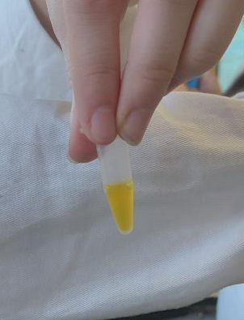
O-NPG-TEST of 1:10 diluted Particle Free Lysate
Test 50 μL supernatant + 500 μL o-NPG-solution.
Observation: We saw a dominant yellow colour
Evaluation: The bond between D-galactose and Ortho-nitrophenol was broken down
Conclusion: The lactase was present in the lysate and we can start AEXC.
Picture of cuvette

Slide 5
Evaluation Steps of our Experiment
PARTICLE FREE LYSATE – o-NPG-test (enzymatic activity assay)
ANION EXCHANGE CHROMATOGRAPHY (AEXC) – o-NPG + photometer (enzymatic activity assay)
SDS – PAGE – gel + calibration line (purity, molecular weight – lactase)
RAW MILK TEST – colour change (conc. of glucose)
EVALUATION

Slide 6
ANION EXCHANGE CHROMATOGRAPHY
O-NPG-test measured by photometer – enzymatic activity measurement
Test 50 μL eluate + 800 μL o-NPG-solution.
Observation: we saw an increase in the absorbtion in the 25% eluate and a high absorbtion in the loading flow through, but no increase.
Evaluation: this means the enzymatic activity was highest in the 25% eluate and there was little to no activity in the others. We believe the loading flow trough might be too high because we blanked it.
Conclusion: the highest lactase activity was in eluate 25%

Slide 7
Evaluation Steps of our Experiment
PARTICLE FREE LYSATE – o-NPG-test (enzymatic activity assay)
ANION EXCHANGE CHROMATOGRAPHY (AEXC) – o-NPG + photometer (enzymatic activity assay)
SDS – PAGE – gel + calibration line (purity, molecular weight – lactase)
RAW MILK TEST – colour change (conc. of glucose)
EVALUATION

Slide 8
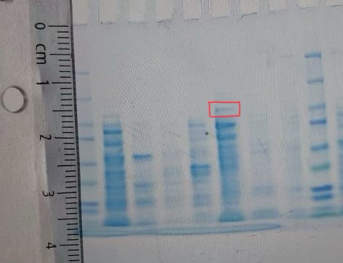
SDS - PAGE
MARKER
S1: lysate (dilution factor 10)
S2: loading flow through
S3: washing step
S4: eluate 10%
S5: eluate 25%
S6: eluate 100%
We saw a lot of proteins in S1. We saw a lot of smaller proteins in S2, S3 and S4, and a lot bigger proteins in S5. in S6 there were not that many proteins.

Slide 9
SDS - PAGE
Evaluation:
We can see that in the 25% elute, there is a clear line just above the 100 kDa line in the marker, which we can only asume is our lactace, because we know that one subunit of the lactace is 116 kDa.
We can also see that we have a weak line in the lysate, which also means that the lactase was present.
Conclusion: by AEXC we reduced the
number of proteins in our sample starting with 3000

Slide 10
Evaluation of the SDS – PAGE
Identification of molecular weight of lactase subunit with our calibration line
Migration rate: 1,6 cm
Molecular weight: 113 kDa
Log (kDa)
cm

Slide 11
Evaluation Steps of our Experiment
PARTICLE FREE LYSATE – o-NPG-test (enzymatic activity assay)
ANION EXCHANGE CHROMATOGRAPHY (AEXC) – o-NPG + photometer (enzymatic activity assay)
SDS – PAGE – gel + calibration line (purity, molecular weight – lactase)
RAW MILK TEST – colour change (conc. of glucose)
EVALUATION

Slide 12
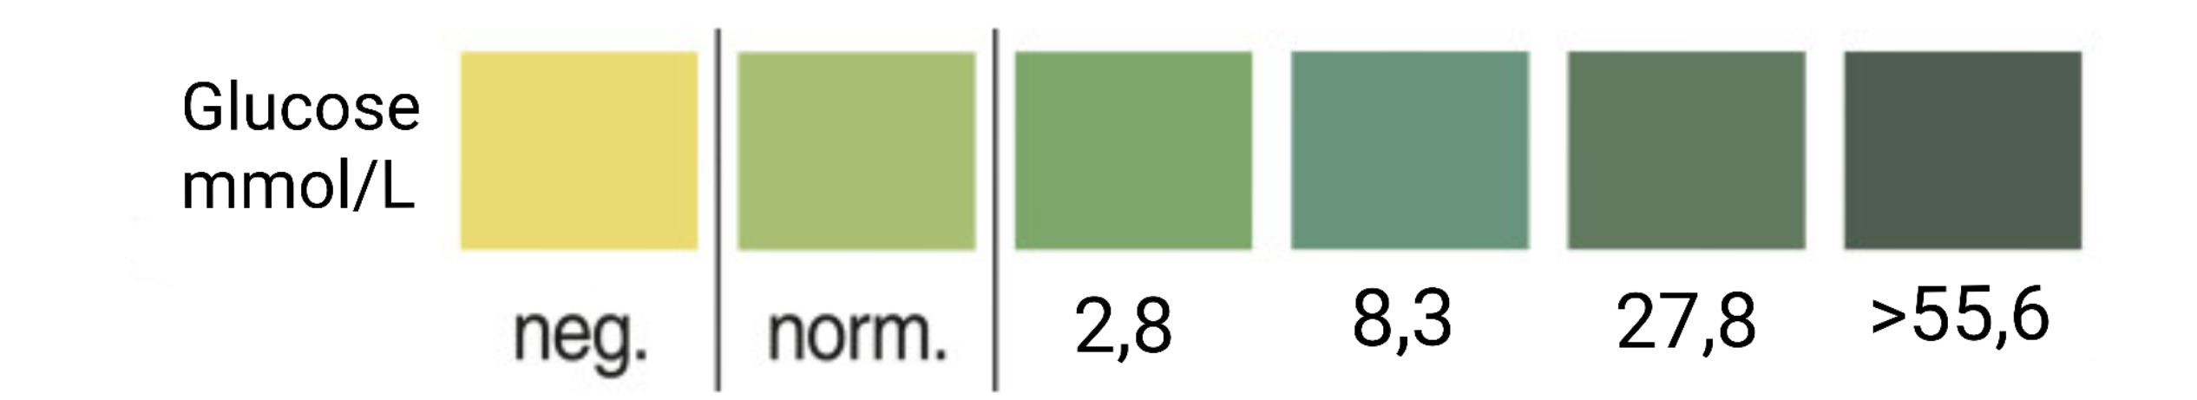
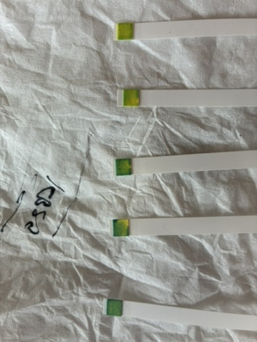
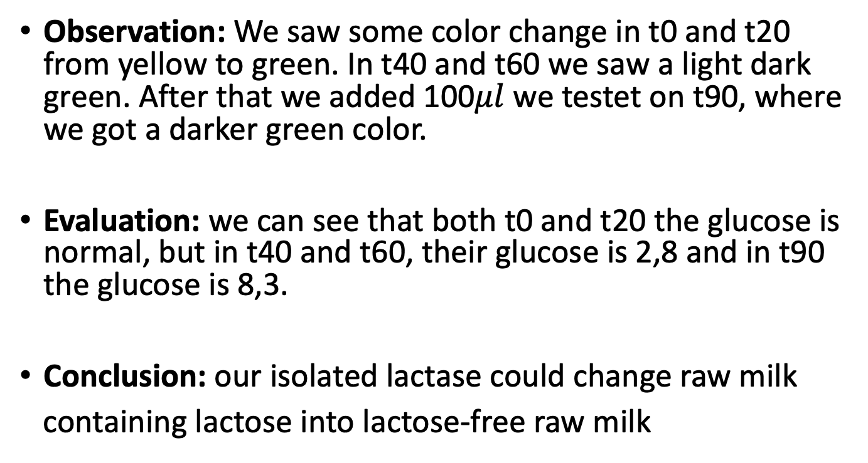
RAW MILK TEST
Observation: We saw some color change in t0 and t20 from yellow to green. In t40 and t60 we saw a light dark green. After that we added 100$μl$ we testet on t90, where we got a darker green color.
Evaluation: we can see that both t0 and t20 the glucose is normal, but in t40 and t60, their glucose is 2,8 and in t90 the glucose is 8,3.
Conclusion: our isolated lactase could change raw milk
containing lactose into lactose-free raw milk

Slide 13
Evaluation Steps of our Experiment
PARTICLE FREE LYSATE – o-NPG-test (enzymatic activity assay)
ANION EXCHANGE CHROMATOGRAPHY (AEXC) – o-NPG + photometer (enzymatic activity assay)
SDS – PAGE – gel + calibration line (purity, molecular weight – lactase)
RAW MILK TEST – colour change (conc. of glucose)
EVALUATION

Slide 14
EVALUATION
In comparison of our results of AEXC we saw the highest lactase activity in the eluate 25% and the highest amount of lactase in SDS – PAGE in the eluate 25%. Meaning we succesfully purified the lactase in the lysate.
The eluate 25% is suitable for downstream process and further purificataion of lactase, because according to photometry and SDS – PAGE this is the sample that contains the most lactase.

Slide 15
Thank you for your attention!

