Slide 1
Summary of Results from
Group 11
Lactase Downstream Processing
Evreux 23. – 27.03.2026

Slide 2

Group 11 + presentation of group members
Adriána Nemcová
Slovak
Sara yen Vy Nguyen
German
Agnieszka Nowak
Polish

Slide 3
Evaluation Steps of our Experiment
PARTICLE FREE LYSATE – o-NPG-test (enzymatic activity assay)
ANION EXCHANGE CHROMATOGRAPHY (AEXC) – o-NPG + photometer (enzymatic activity assay)
SDS – PAGE – gel + calibration line (purity, molecular weight – lactase)
RAW MILK TEST – colour change (conc. of glucose)
EVALUATION

Slide 4
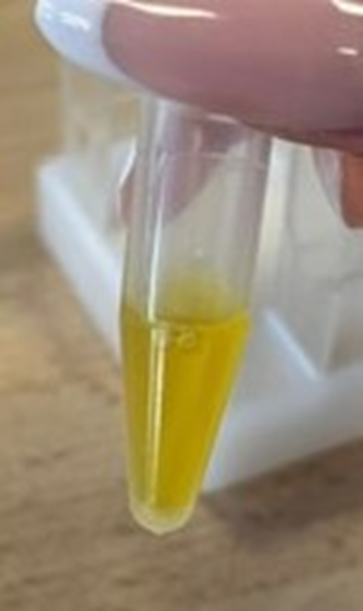
O-NPG-TEST of 1:10 diluted Particle Free Lysate
Test 50 μL supernatant + 500 μL o-NPG-solution.
Observation: yellow
Evaluation: β(1→4) bond was broken down
Conclusion: lactase is present.
→ We can start AEXC.

Slide 5
Evaluation Steps of our Experiment
PARTICLE FREE LYSATE – o-NPG-test (enzymatic activity assay)
ANION EXCHANGE CHROMATOGRAPHY (AEXC) – o-NPG + photometer (enzymatic activity assay)
SDS – PAGE – gel + calibration line (purity, molecular weight – lactase)
RAW MILK TEST – colour change (conc. of glucose)
EVALUATION

Slide 6
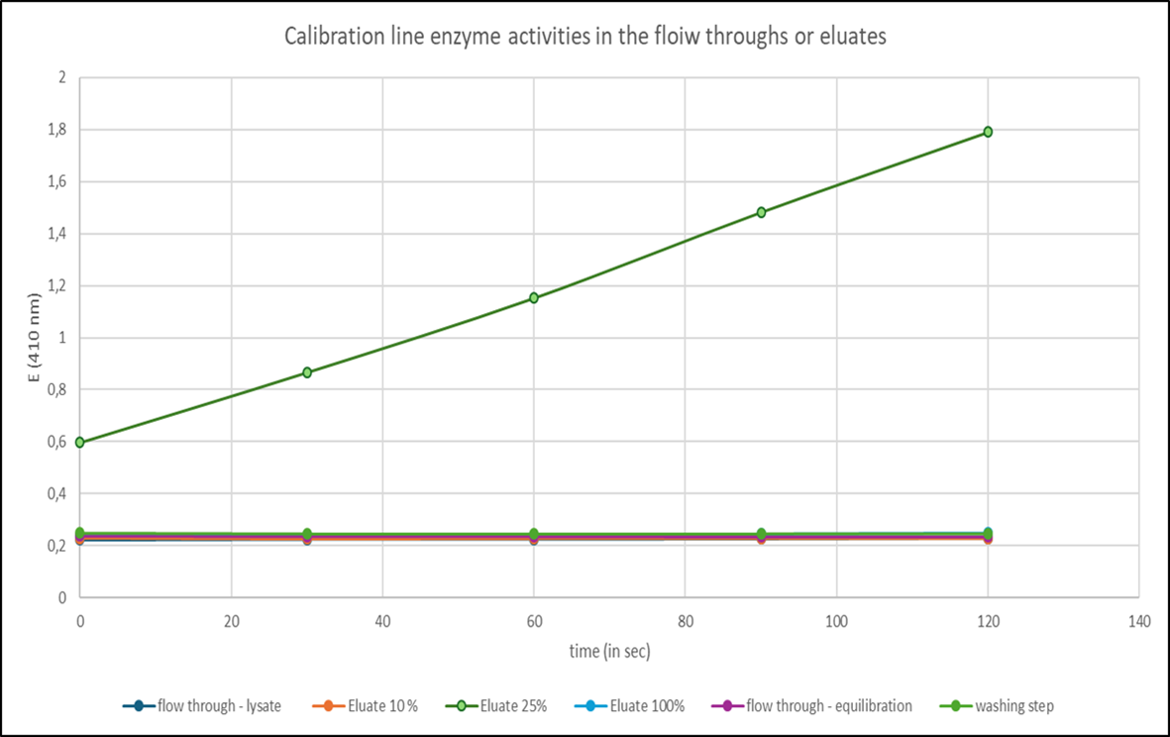
ANION EXCHANGE CHROMATOGRAPHY
O-NPG-test measured by photometer – enzymatic activity measurement
Test 50 μL eluate + 800 μL o-NPG-solution.
Observation: with photometric results we saw that the highest increasing of curve was in 25% elulate, and the other curves were almost straight lines
Evaluation: our own Excel diagram
Conclusion: the highest
lactase activity was in 25% eluate

Slide 7
Evaluation Steps of our Experiment
PARTICLE FREE LYSATE – o-NPG-test (enzymatic activity assay)
ANION EXCHANGE CHROMATOGRAPHY (AEXC) – o-NPG + photometer (enzymatic activity assay)
SDS – PAGE – gel + calibration line (purity, molecular weight – lactase)
RAW MILK TEST – colour change (conc. of glucose)
EVALUATION

Slide 8
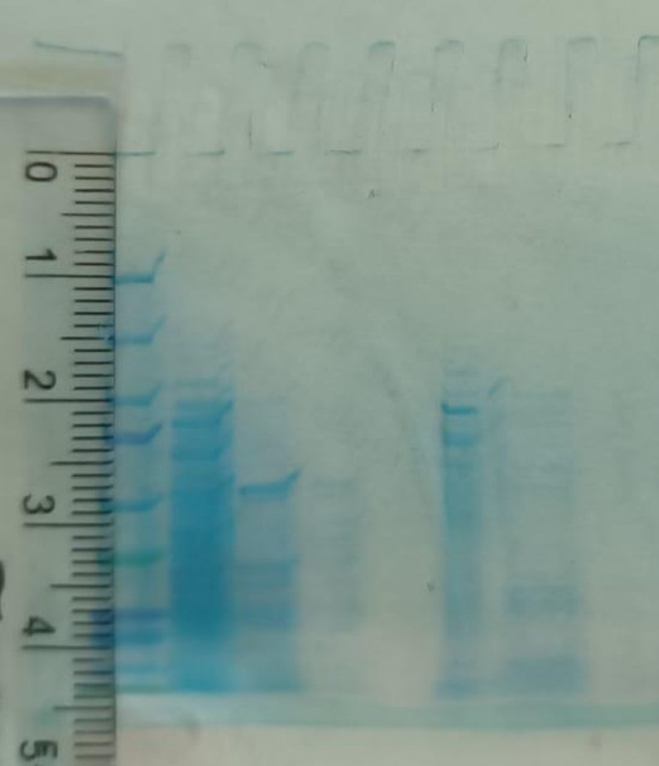
SDS - PAGE
M S1 S2 S3 S4 S5 S6
MARKER
S1: lysate (dilution factor 10)
S2: loading flow through
S3: washing step
S4: eluate 10%
S5: eluate 25%
S6: eluate 100%
In 25% elulate were many bands, but we can not see all of them properly, so we could not count it accurately.
Conclusion: by AEXC we should reduced the number of proteins, but we can not judge it because of the bad quality of photo we could see all bands.

Slide 9
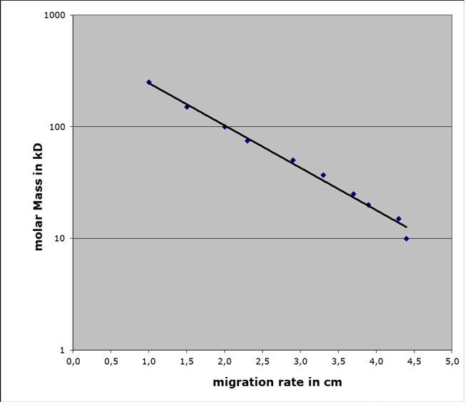
Evaluation of the SDS – PAGE
Identification of molecular weight of lactase subunit with your calibration line
Migration rate: 2 cm
Molecular weight: 103 kDa
Log (kDa)
cm

Slide 10
Evaluation Steps of our Experiment
PARTICLE FREE LYSATE – o-NPG-test (enzymatic activity assay)
ANION EXCHANGE CHROMATOGRAPHY (AEXC) – o-NPG + photometer (enzymatic activity assay)
SDS – PAGE – gel + calibration line (purity, molecular weight – lactase)
RAW MILK TEST – colour change (conc. of glucose)
EVALUATION

Slide 11
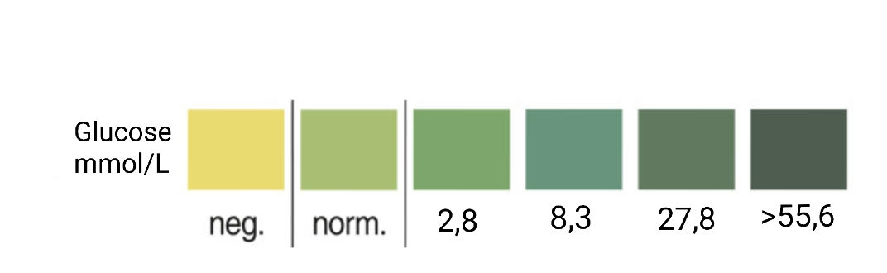
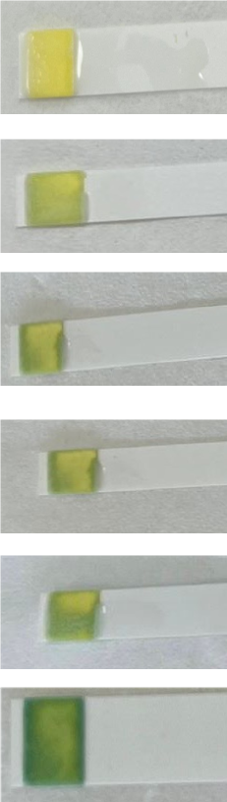
RAW MILK TEST
Observation: colour of the stripe after 0/20/40/60 min was yellow, after 90 minutes it started turning green and after 120 it was green
Evaluation: value of glucose was first 60 minutes negative, after 90 minutes it was norm. and after 120 it had 2,8 (mmol/L) of glucose in it.
Conclusion: our isolated lactase could change raw milk
containing lactose into lactose-free raw milk

Slide 12
Evaluation Steps of our Experiment
PARTICLE FREE LYSATE – o-NPG-test (enzymatic activity assay)
ANION EXCHANGE CHROMATOGRAPHY (AEXC) – o-NPG + photometer (enzymatic activity assay)
SDS – PAGE – gel + calibration line (purity, molecular weight – lactase)
RAW MILK TEST – colour change (conc. of glucose)
EVALUATION

Slide 13
EVALUATION
1. TASK: Compare your results of AEXC according to the highest lactase activity and the highest amount of lactase in SDS – PAGE.
What can we conclude from the TASK 1?
The highest lactase activity in AEXC was observed in the 25% elulate, while SDS-PAGE showed the highest amount of lactase in E.coli lysate.
2. TASK: Choose a sample suitable for downstream process and further purification of lactase.
The most suitable sample for downstream process and further purification of lactase is 25% elulate.

Slide 14
Thank you for your attention!

