Slide 1
Summary of Results from
Group 10
Lactase Downstream Processing
Evreux 23. – 27.03.2026

Slide 2
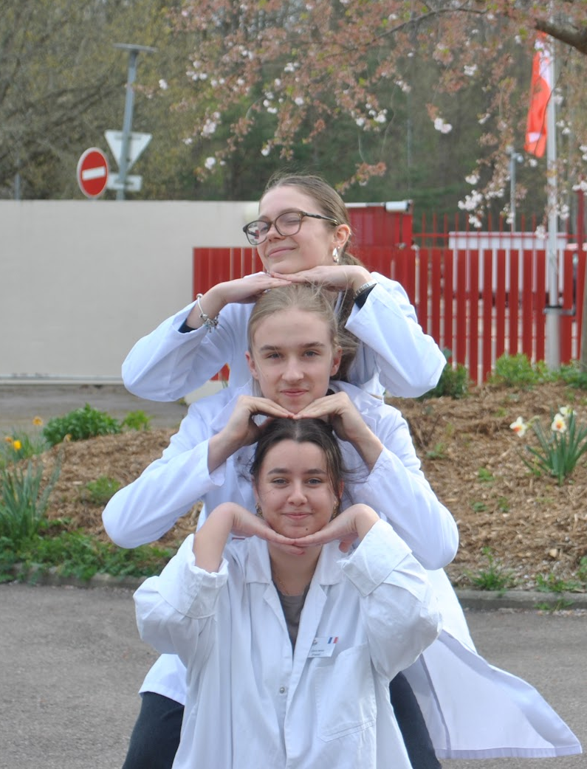



Group 10 + presentation of group members
Gloria Hervé
French
Liam Nocoń
Polish
Izabelė Prieskienytė
Lithuanian

Slide 3
Evaluation Steps of our Experiment
PARTICLE FREE LYSATE – o-NPG-test (enzymatic activity assay)
ANION EXCHANGE CHROMATOGRAPHY (AEXC) – o-NPG + photometer (enzymatic activity assay)
SDS – PAGE – gel + calibration line (purity, molecular weight – lactase)
RAW MILK TEST – colour change (conc. of glucose)
EVALUATION

Slide 4
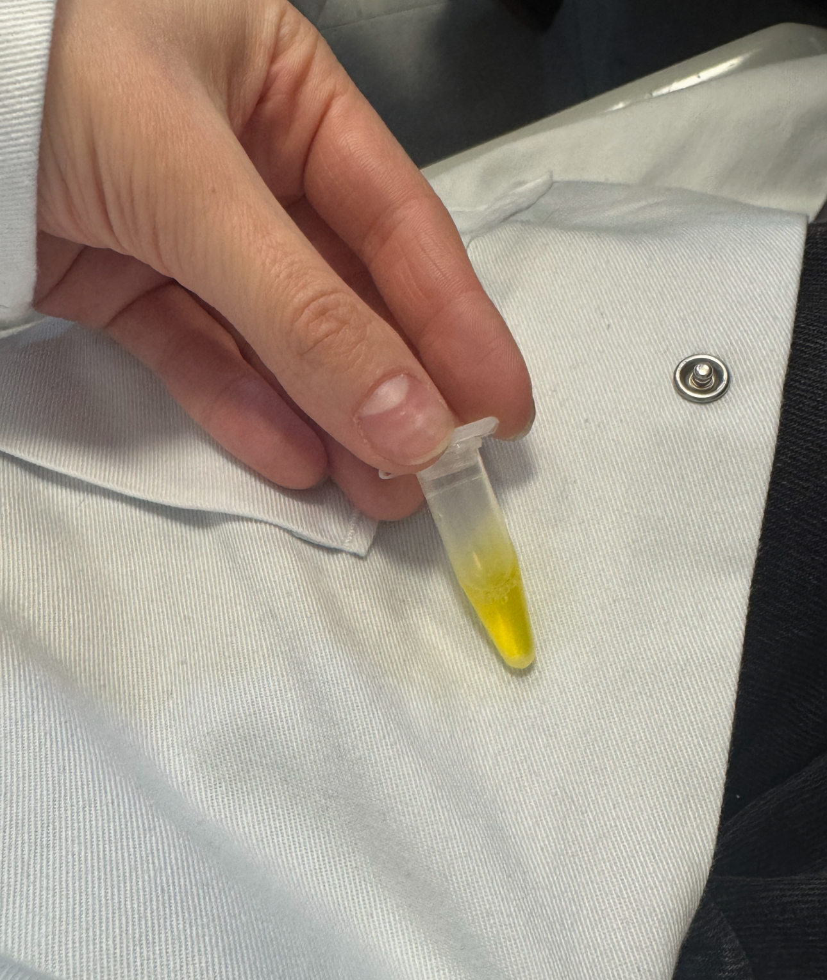
O-NPG-TEST of 1:10 diluted Particle Free Lysate
Test 50 µL supernatant + 500 µL o-NPG-solution.
Observation: change of colour (clear->yellow)
Evaluation: β(1->4) bond was broken down
Conclusion: lactase is present.
-We can start AEXC.
Picture of cuvette

Slide 5
Evaluation Steps of our Experiment
PARTICLE FREE LYSATE – o-NPG-test (enzymatic activity assay)
ANION EXCHANGE CHROMATOGRAPHY (AEXC) – o-NPG + photometer (enzymatic activity assay)
SDS – PAGE – gel + calibration line (purity, molecular weight – lactase)
RAW MILK TEST – colour change (conc. of glucose)
EVALUATION

Slide 6
ANION EXCHANGE CHROMATOGRAPHY
O-NPG-test measured by photometer – enzymatic activity measurement
Test 50 µL eluate + 800 µL o-NPG-solution.
Observation: photometric results
Evaluation: your own Excel diagram
Conclusion: the highest
lactase activity was in 25% eluate

Slide 7
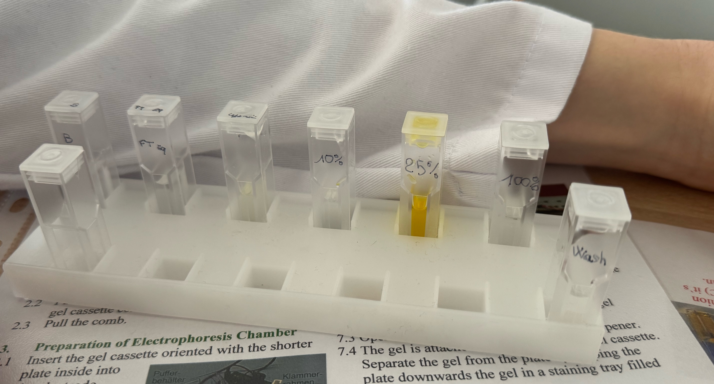

Slide 8
ONPG – Activity Assay of Lactase
time | 0 | 30 | 60 | 90 | 120
flow through - equilibration | 0,179 | 0,181 | 0,183 | 0,181 | 0,181
flow through - lysate | 0,347 | 0,323 | 0,319 | 0,318 | 0,318
washing step | 0,159 | 0,159 | 0,16 | 0,16 | 0,16
Eluate 10 % | 0,178 | 0,177 | 0,178 | 0,177 | 0,179
Eluate 25% | 0,305 | 0,427 | 0,578 | 0,746 | 0,917
Eluate 100% | 0,164 | 0,166 | 0,166 | 0,167 | 0,168

Slide 9
Evaluation Steps of our Experiment
PARTICLE FREE LYSATE – o-NPG-test (enzymatic activity assay)
ANION EXCHANGE CHROMATOGRAPHY (AEXC) – o-NPG + photometer (enzymatic activity assay)
SDS – PAGE – gel + calibration line (purity, molecular weight – lactase)
RAW MILK TEST – colour change (conc. of glucose)
EVALUATION

Slide 10
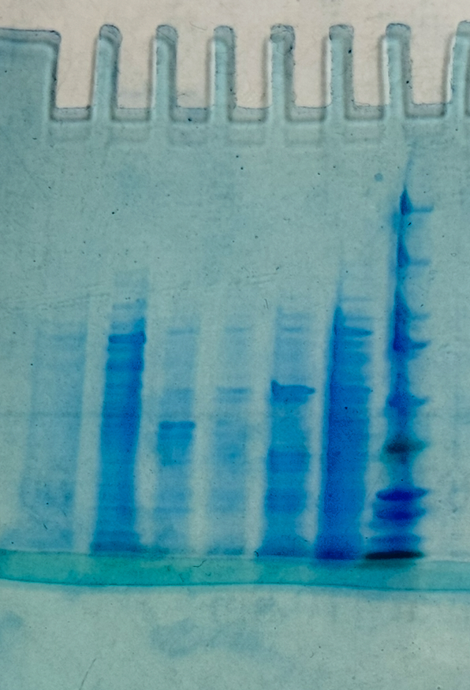
SDS - PAGE
MARKER
S1: lysate (dilution factor 10)
S2: loading flow through
S3: washing step
S4: eluate 10%
S5: eluate 25%
S6: eluate 100%
11 bands are in the mixture
containing lactase (S5)
Conclusion: by AEXC we reduced the
number of proteins in our sample to
11 no. of proteins (starting with 3000)
250 kD
150
100
75
50
37
20
10
S6
S5
S4
S3
S2
S1
M

Slide 11
SDS - PAGE
Identification of the lactase subunit
in the gel with the marker
The lactase subunit band is marked with a bright red circle
250 kD
150
100
75
50
37
20
10
S6
S5
S4
S3
S2
S1
M

Slide 12
Evaluation of the SDS – PAGE
Identification of molecular weight of lactase subunit with your calibration line
Migration rate: 1,9 cm
Log (kDa) = 2,06
Molecular weight: 115 kDa
Log (kDa)
cm

Slide 13
Evaluation Steps of our Experiment
PARTICLE FREE LYSATE – o-NPG-test (enzymatic activity assay)
ANION EXCHANGE CHROMATOGRAPHY (AEXC) – o-NPG + photometer (enzymatic activity assay)
SDS – PAGE – gel + calibration line (purity, molecular weight – lactase)
RAW MILK TEST – colour change (conc. of glucose)
EVALUATION

Slide 14
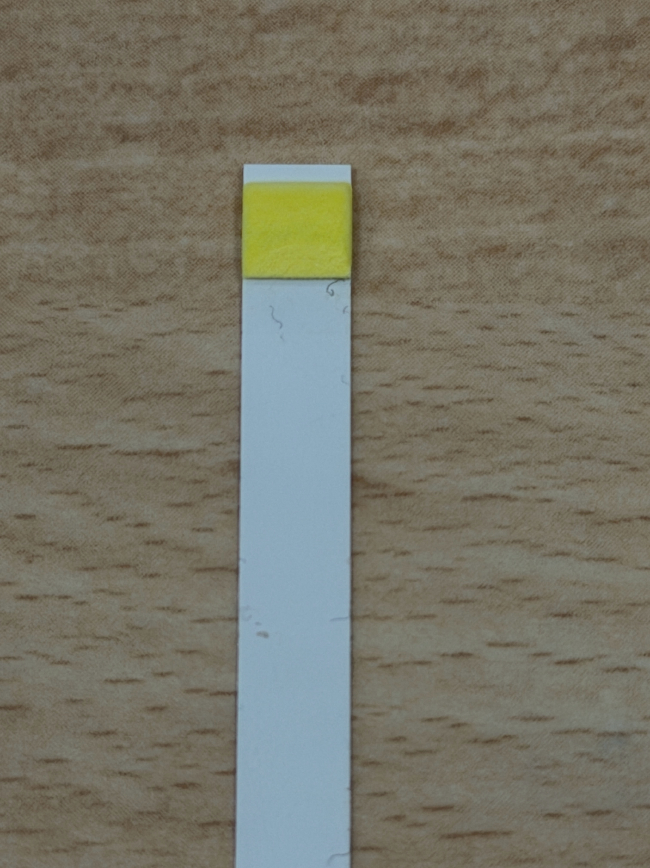
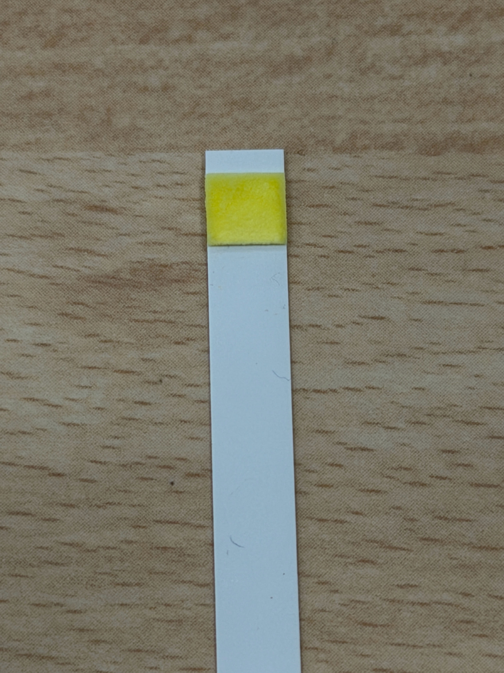
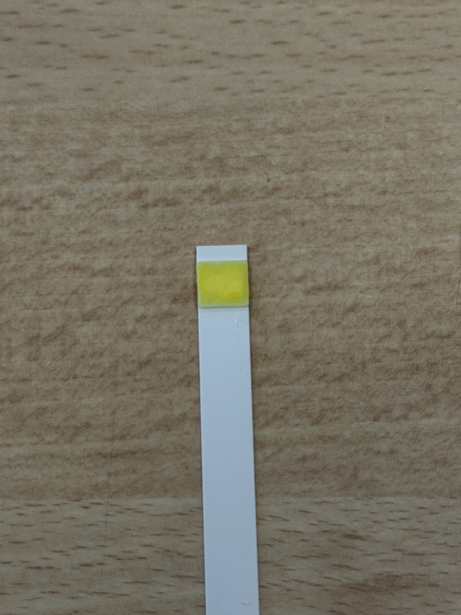
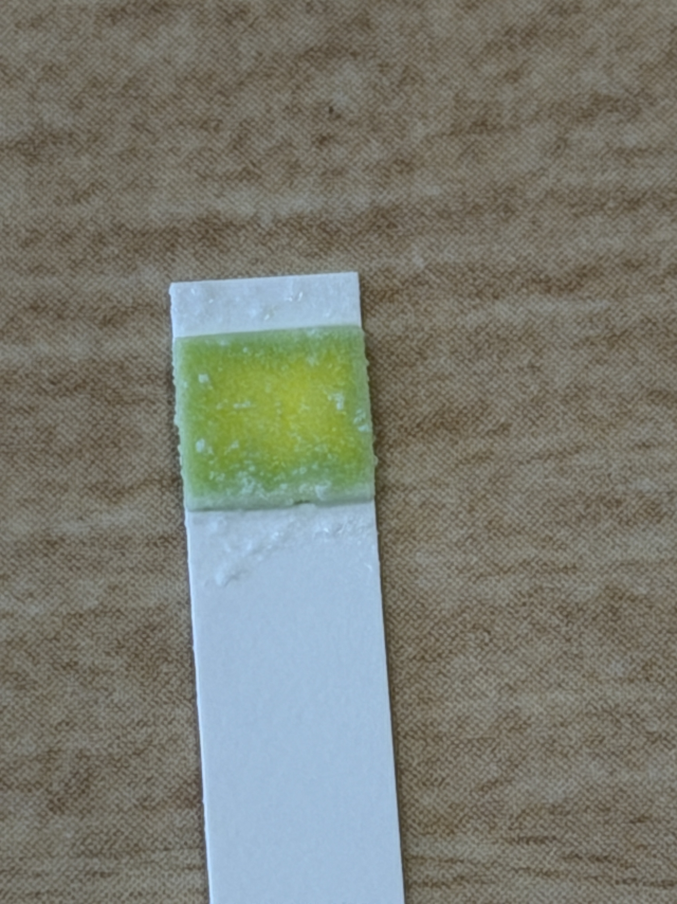
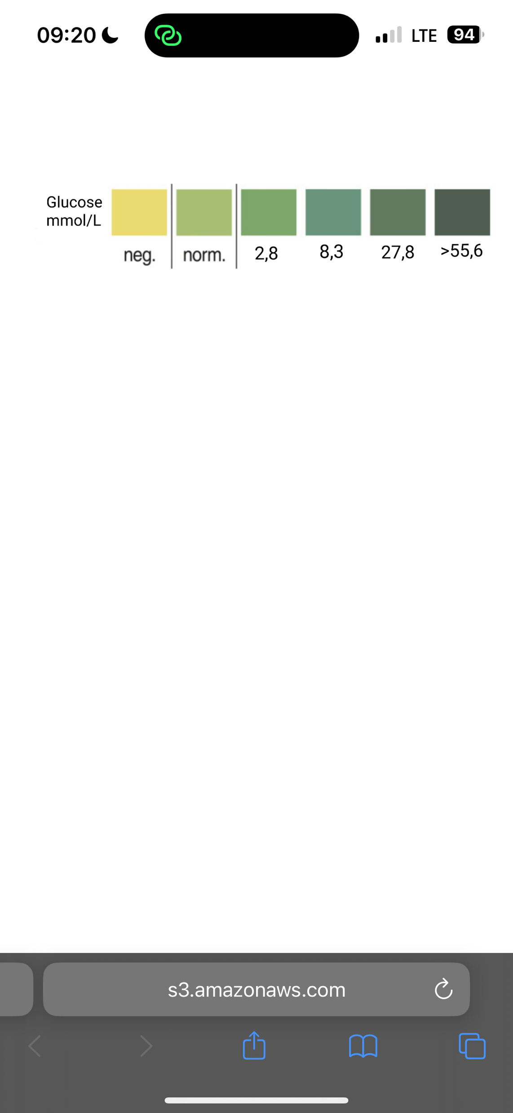
RAW MILK TEST
0 min
20 min
Observation: colour of the stripe after
0 min – yellow
20 min – slightly darker yellow
40 min – slight green
70 min – green (200 µl of elute 25% added)
Evaluation: value of glucose (mmol/L)
0 min – negative
20 min – negative
40 min – normal
70 min – 2,8 mmol/L
Conclusion: our isolated lactase could change
raw milk containing lactose into lactose-free raw milk
Control
0 min
20 min
40 min
60 min
40 min
70 min

Slide 15
Evaluation Steps of our Experiment
PARTICLE FREE LYSATE – o-NPG-test (enzymatic activity assay)
ANION EXCHANGE CHROMATOGRAPHY (AEXC) – o-NPG + photometer (enzymatic activity assay)
SDS – PAGE – gel + calibration line (purity, molecular weight – lactase)
RAW MILK TEST – colour change (conc. of glucose)
EVALUATION

Slide 16
EVALUATION
1. TASK: Compare your results of AEXC according to the highest lactase activity and the highest amount of lactase in SDS – PAGE.
What can we conclude from the TASK 1?
The results from the AEXC point to the fact that the eluate 25% contains the highest enzymatic activity (the most lactase/ the most active lactase). The presence of lactase in the sample in proven by the SDS - PAGE.

Slide 17
EVALUATION
2. TASK: Choose a sample suitable for downstream process and further purification of lactase.
The sample containing the most lactase is the eluate 25% hence it is the most suitable for further purification and downstream process.

Slide 18
Thank you for your attention!

