Slide 1
Summary of Results from
Group 1
Lactase Downstream Processing
Evreux 23. – 27.03.2026

Slide 2

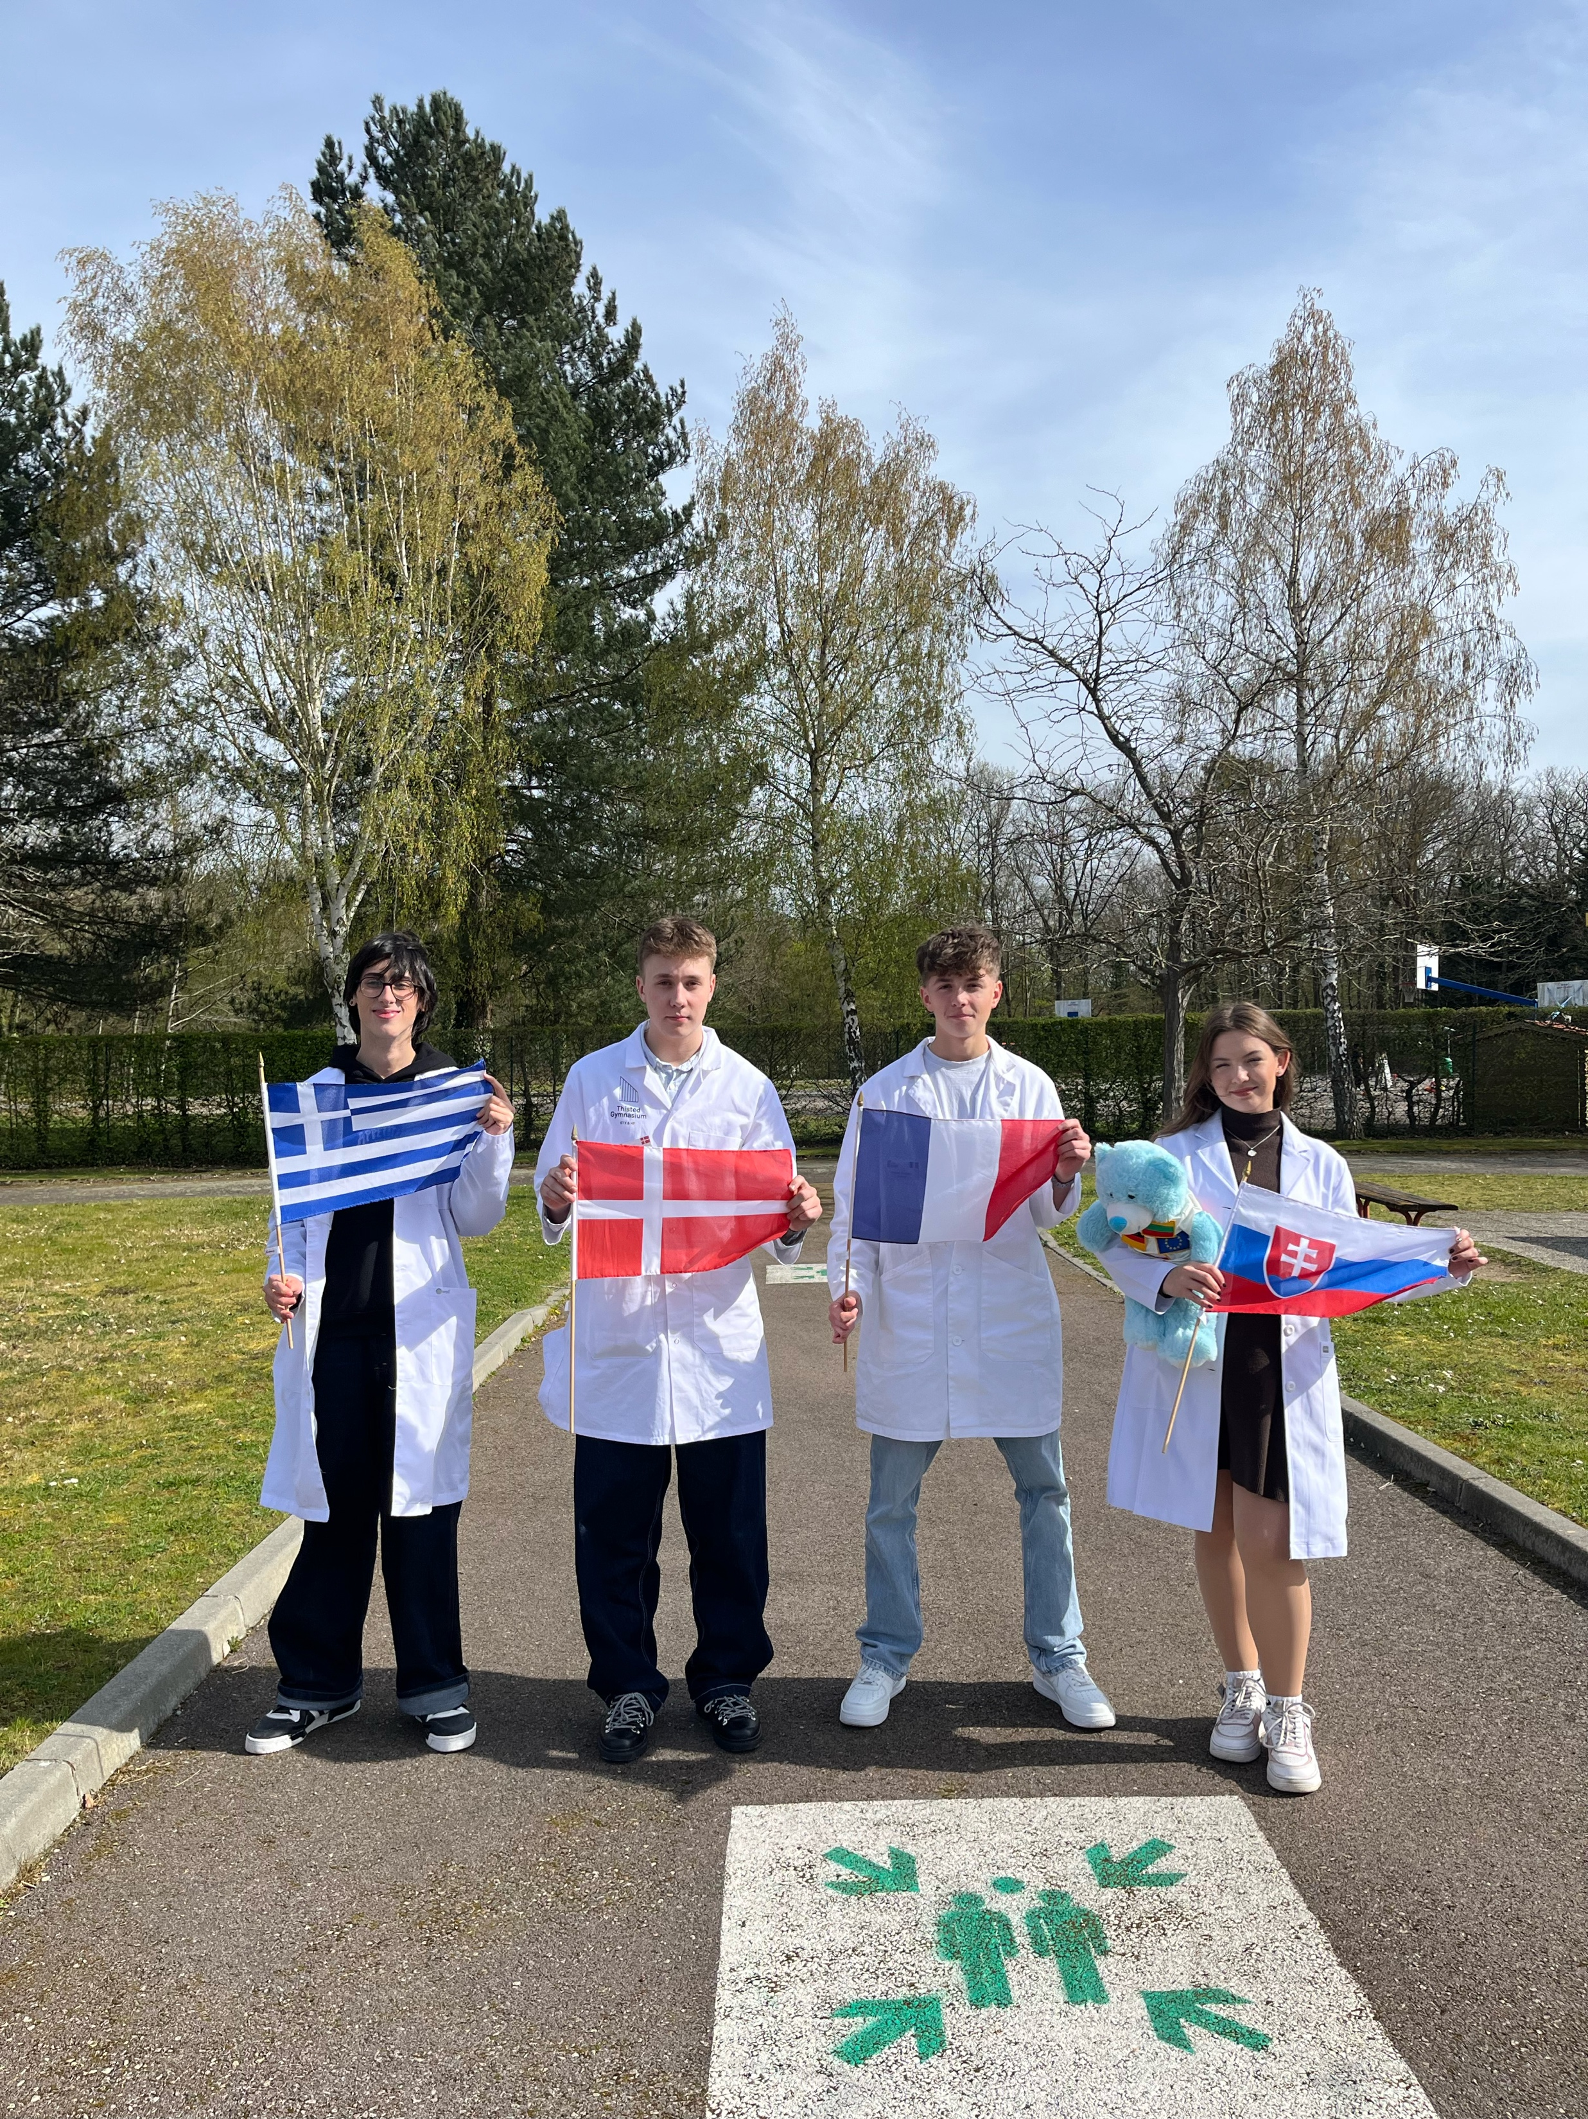



Group 1 + presentation of group members
Stavros Politakis
Greece (Student)
Ivan Bannov Pedersen
Denmark (Student)
Raphaël Desforges
France (Mentor)
Júlia Halcinová
Slovakia (Mentor)

Slide 3
Evaluation Steps of our Experiment
PARTICLE FREE LYSATE – o-NPG-test (enzymatic activity assay)
ANION EXCHANGE CHROMATOGRAPHY (AEXC) – o-NPG + photometer (enzymatic activity assay)
SDS – PAGE – gel + calibration line (purity, molecular weight – lactase)
RAW MILK TEST – colour change (conc. of glucose)
EVALUATION

Slide 4
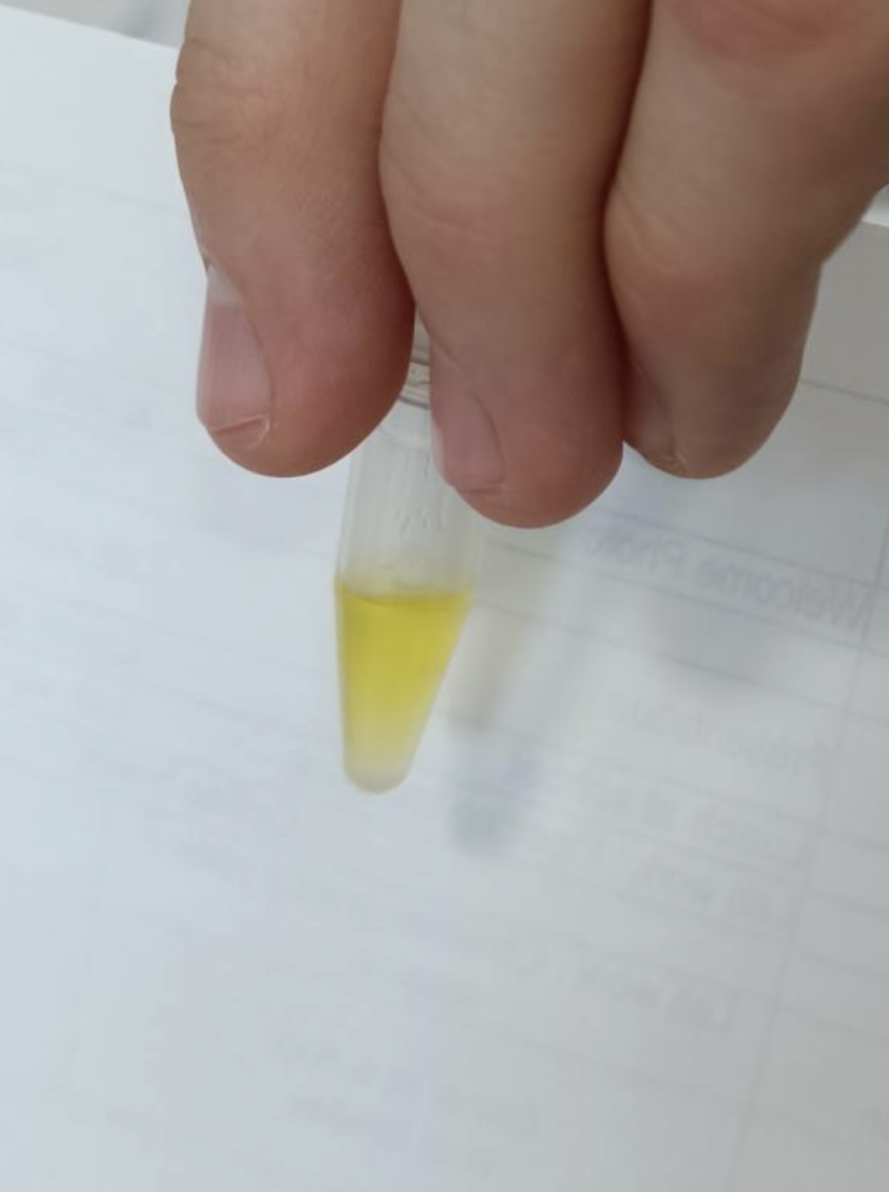
O-NPG-TEST of 1:10 diluted Particle Free Lysate
Test 50 μL supernatant + 500 μL o-NPG-solution.
Observation: It turned yellow.
Evaluation: The bond between D-galactose and Ortho-nitrophenol was broken down.
Conclusion: We can start the AEXC, because the lactase was present in the lysate.
Picture of cuvette

Slide 5
Evaluation Steps of our Experiment
PARTICLE FREE LYSATE – o-NPG-test (enzymatic activity assay)
ANION EXCHANGE CHROMATOGRAPHY (AEXC) – o-NPG + photometer (enzymatic activity assay)
SDS – PAGE – gel + calibration line (purity, molecular weight – lactase)
RAW MILK TEST – colour change (conc. of glucose)
EVALUATION

Slide 6
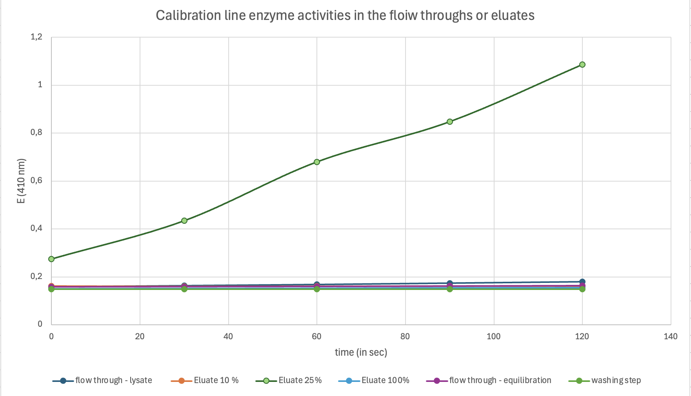
ANION EXCHANGE CHROMATOGRAPHY
O-NPG-test measured by photometer – enzymatic activity measurement
Test 50 μL eluate + 800 μL o-NPG-solution.
Observation: We saw the eluate 25% line go up, which means there is an increase in the absorption in the 25% eluate, which also turned yellow.
Evaluation: Difference in growth rate indicates a difference in lactase levels. This means the enzymatic activity was highest in 25 % eluate, and lower in the others.
Conclusion: The highest lactase activity was in eluate 25 %, therefore the highest lactase concentration, and has the most enzymatic activity.

Slide 7
Evaluation Steps of our Experiment
PARTICLE FREE LYSATE – o-NPG-test (enzymatic activity assay)
ANION EXCHANGE CHROMATOGRAPHY (AEXC) – o-NPG + photometer (enzymatic activity assay)
SDS – PAGE – gel + calibration line (purity, molecular weight – lactase)
RAW MILK TEST – colour change (conc. of glucose)
EVALUATION

Slide 8
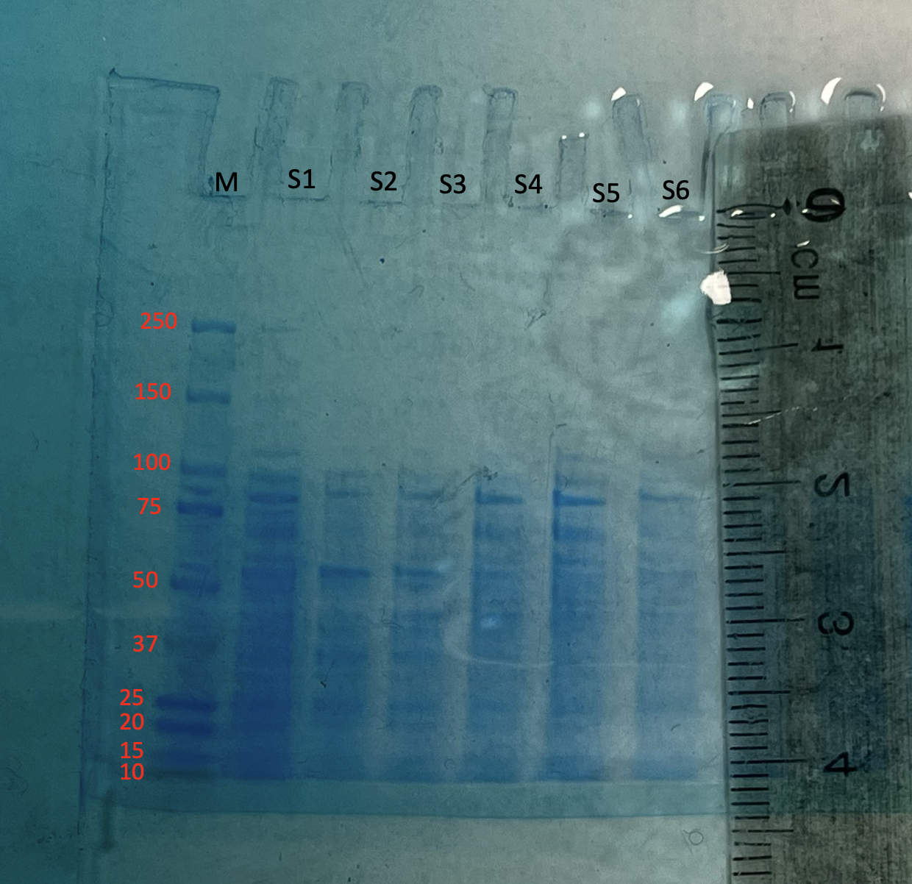
SDS - PAGE
MARKER
S1: lysate (dilution factor 10)
S2: loading flow through
S3: washing step
S4: eluate 10%
S5: eluate 25%
S6: eluate 100%
We have lactase in the lysate and the 25% eluate.
Conclusion: We saw the highest quantity of proteins in S1, and less in the others. In S2, S3 and S4 we saw a lot of smaller proteins and larger proteins in S5 (the 25 % eluate).

Slide 9
SDS - PAGE
Identification of the lactase subunit
in the gel is shown with the marker.
We could see the lactase as a clear band in S5 and S1, but not in the others. This means that we have purified the lactase successfully.
We reduced the number of proteins by AEXC, starting at 3000.

Slide 10
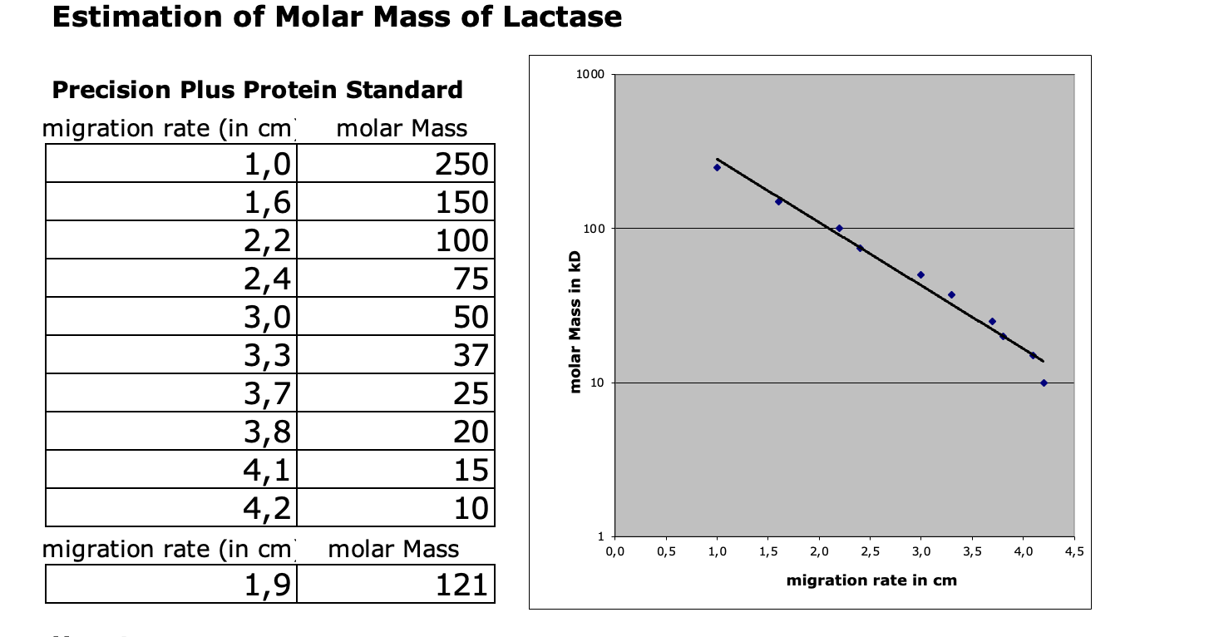
Evaluation of the SDS – PAGE
Identification of molecular weight of lactase subunit with our calibration line.
Migration rate: 1,9 cm
Molecular weight: 121 kDa
Log (kDa)
cm

Slide 11
Evaluation Steps of our Experiment
PARTICLE FREE LYSATE – o-NPG-test (enzymatic activity assay)
ANION EXCHANGE CHROMATOGRAPHY (AEXC) – o-NPG + photometer (enzymatic activity assay)
SDS – PAGE – gel + calibration line (purity, molecular weight – lactase)
RAW MILK TEST – colour change (conc. of glucose)
EVALUATION

Slide 12
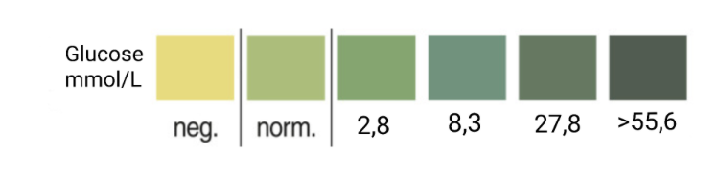
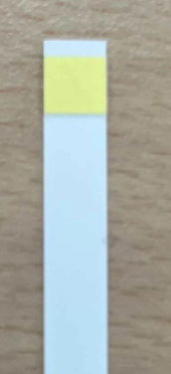

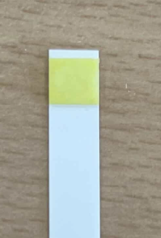
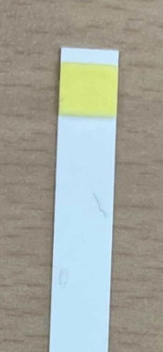
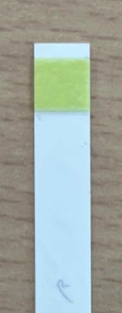

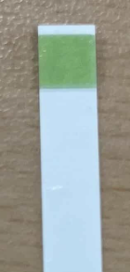

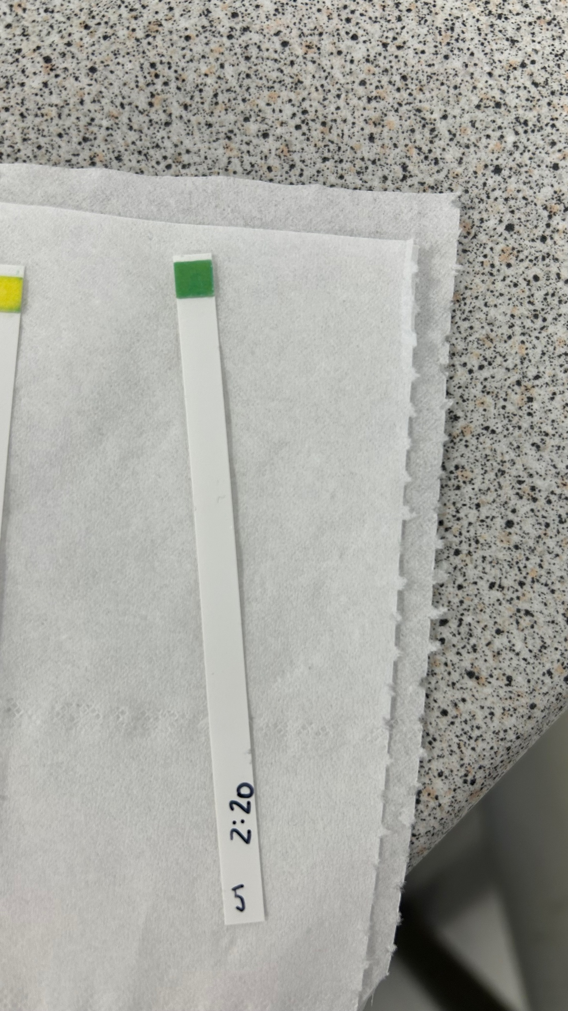
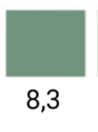
RAW MILK TEST
Test. 100 µL 25% eluate + 1 mL raw milk. The mixture was kept warm. After the second measurement, 100 µL more eluate was added, and the time was increased to 30 minutes.
Observation:
No colour change was seen in the control, t₀, t₂₀, and t₅₀ (negative). At t₈₀, the strip turned green, and at t₁₁₀ and t₁₄₀ it became darker green.
Evaluation:
No glucose was detected at first. At t₈₀ there was glucose (normal level), which increased to about 2.8 mmol/L at t₁₁₀ and 8.3 mmol/L at t₁₄₀.
Conclusion:
Lactase broke down lactose into glucose over time. Adding more enzyme and increasing time gave higher glucose levels.
t₀
t₂₀
t₅₀
t₈₀
t₁₁₀
t₁₄₀

Slide 13
Evaluation Steps of our Experiment
PARTICLE FREE LYSATE – o-NPG-test (enzymatic activity assay)
ANION EXCHANGE CHROMATOGRAPHY (AEXC) – o-NPG + photometer (enzymatic activity assay)
SDS – PAGE – gel + calibration line (purity, molecular weight – lactase)
RAW MILK TEST – colour change (conc. of glucose)
EVALUATION

Slide 14
EVALUATION
We concluded from AEXC that the highest amount of lactase can be found in the 25% eluate, because we saw the highest activity here. We also saw that the greatest amount of lactase on the SDS-PAGE was at the 25% eluate. Therefore, the purification of lactase was successful.
The 25% elution is the most appropriate for carrying out further research in the methods of producing lactase with the use of biotechnology, as our tests show that this is the sample that contains the most lactase.

Slide 15
Thank you for your attention!

