Slide 1
Summary of results from group 8

Slide 2
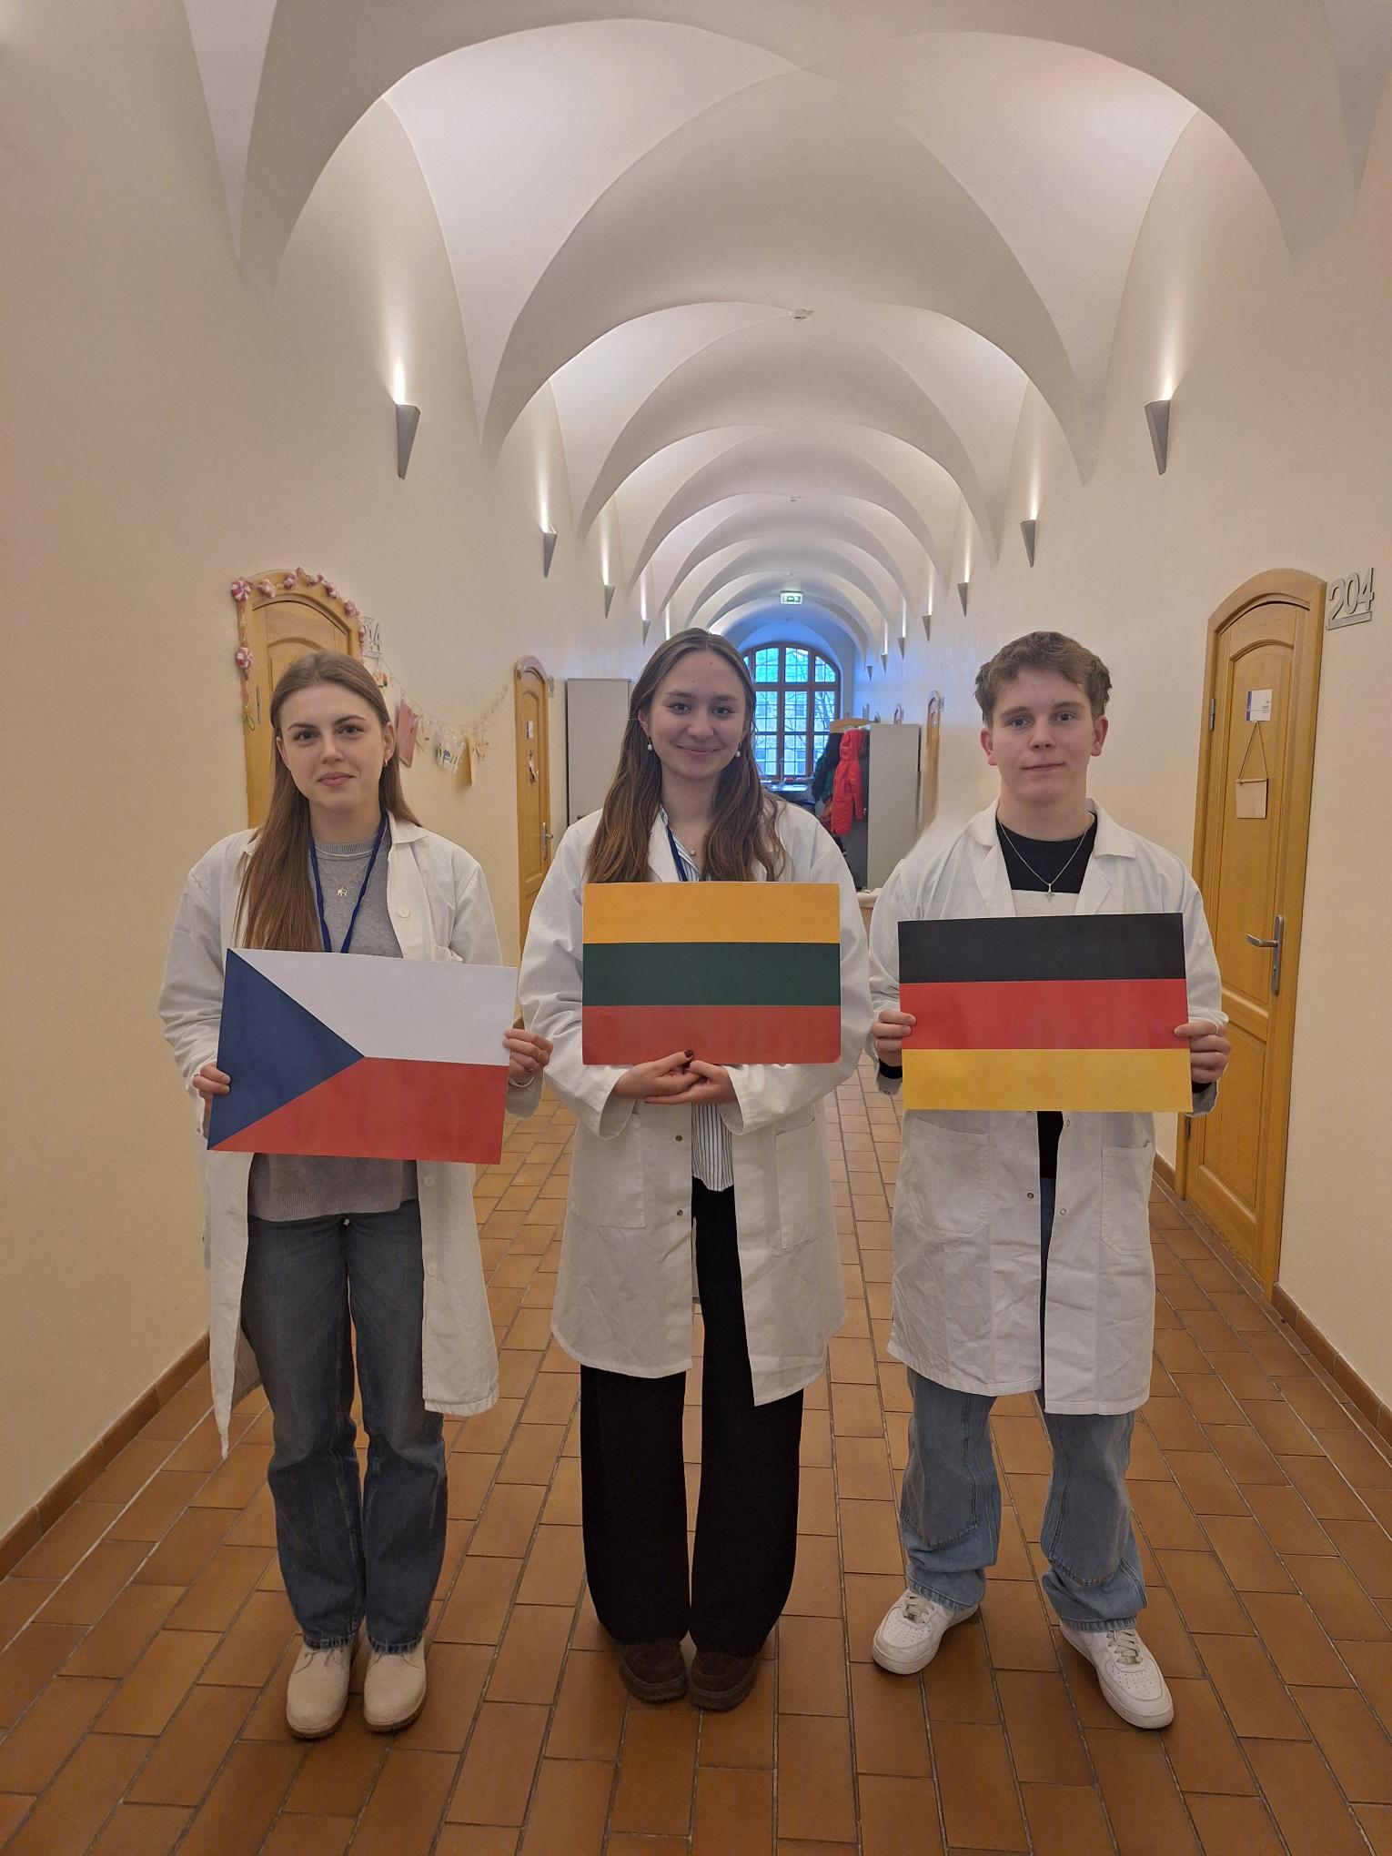



Group number 8 presentation of group members
Zuzana Žáčková
Teacher
Czech Republic
Kotryna Plyniūtė
Mentor
Lithuania
Thorben Ernst
Student
Germany

Slide 3
Introduction HIC
Goal: to separate GFP out of a mixture of 3000 proteins
Process:
Equilibration: 2 Molar buffer
Loading : because of the high salt concentration (Binding buffer 4 Molar, but 1:2 deluted with Lysate --> 2 Molar ) all the proteins were non-polar -->hydrophobic, they can interact with the stationary phase
Washing: Lowering salt concentration ( washing buffer 1,3 Molar) --> low hydrophobic proteins get washed out
Elution: No salt concentration ( destiled water) --> GFP is getting washed out, this is called elution
Ideally: GFP got separated from the other Proteins

Slide 4
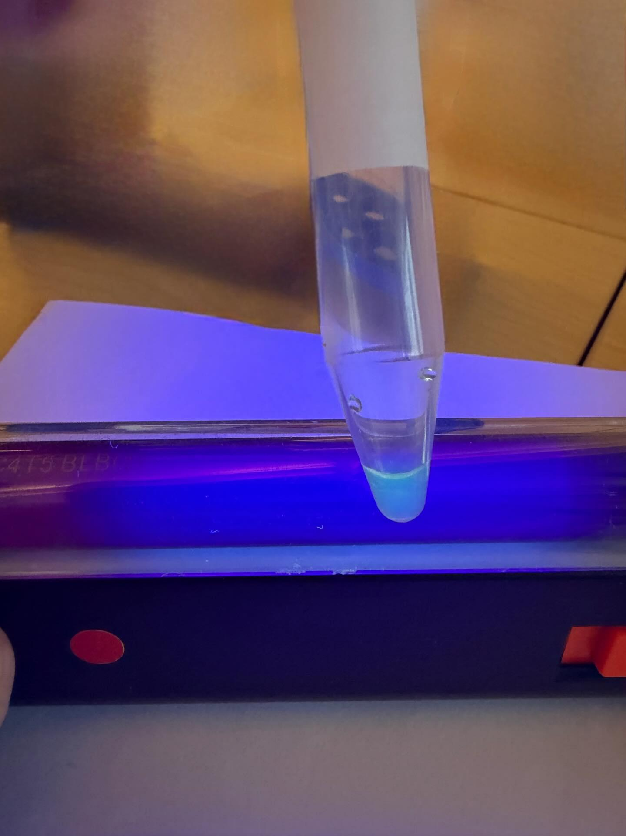
Result and Observation of HIC
Observation:
Lysate – with UV light glows, GFP is in it
After adding binding buffer – GFP on top of stationary phase
Washing- GFP migrates down stationary phase
Elution – GFP leaves Column fast
Results:
The bright glow in C4 indicates that GFP was in C4 in a high concentration. Now have to prove if it was isolated

Slide 5
Introduction SDS-PAGE:
Goal: to see if the purification was successful and for the estimation of the molar mass of GFP
Process:
Fill wells with samples of C1, C2, C3, C4, BL mixed with Laemmli buffer, fill in a Velt C4D ( with DTT ), and standard protein ladder
Run electrophoresis --> proteins migrate through the gel, speed is based on mass
Stain the gel, then destain, bands of other proteins are visible --> to see if purification was successful

Slide 6
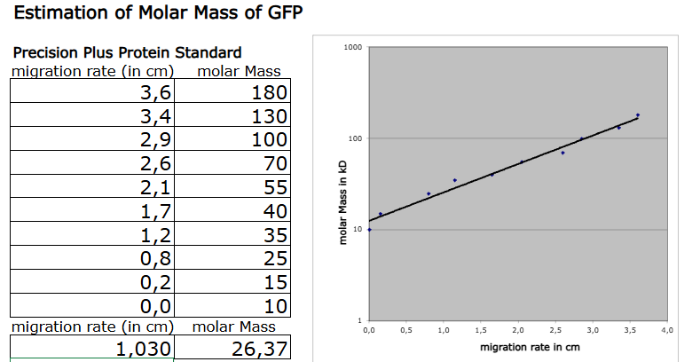
Results SDS-PAGE

Slide 7
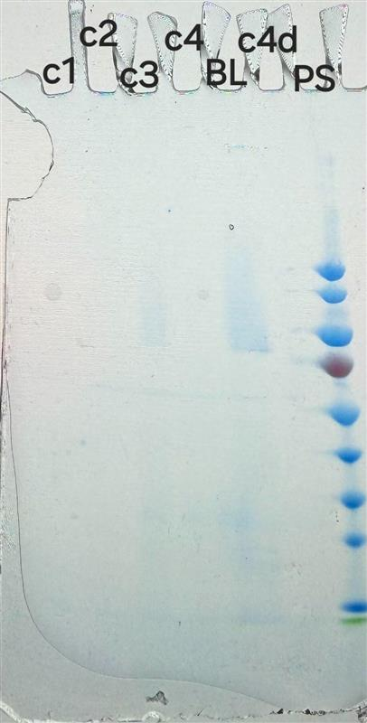
Conclusion based on SDS-Page
C1 no band visible --> all protein interacting with stationary phase
C2 bands visible --> a lot of bright bands visible, no at 27 kDa
C3 bands are visible --> around 27 kDa GFP from elution and around 85 kDa
C4 only line at around 27 kDa --> Elution sample only GFP should be in it
BL lots of bands visible --> lysate with all proteins
C4D band at around 27 kDa (GFP) --> Elution sample with DTT
Conclusion:
After staining the Proteins GFP was not glowing --> because of a color coding
C4D: GFP was glowing slightly --> SDS and DTT did not denatured GFP
Purification was really successful --> at C4 just band at 27 kDa (GFP)

Slide 8
Thanks for your attention

