Slide 1
Summary of results from group 3

Slide 2

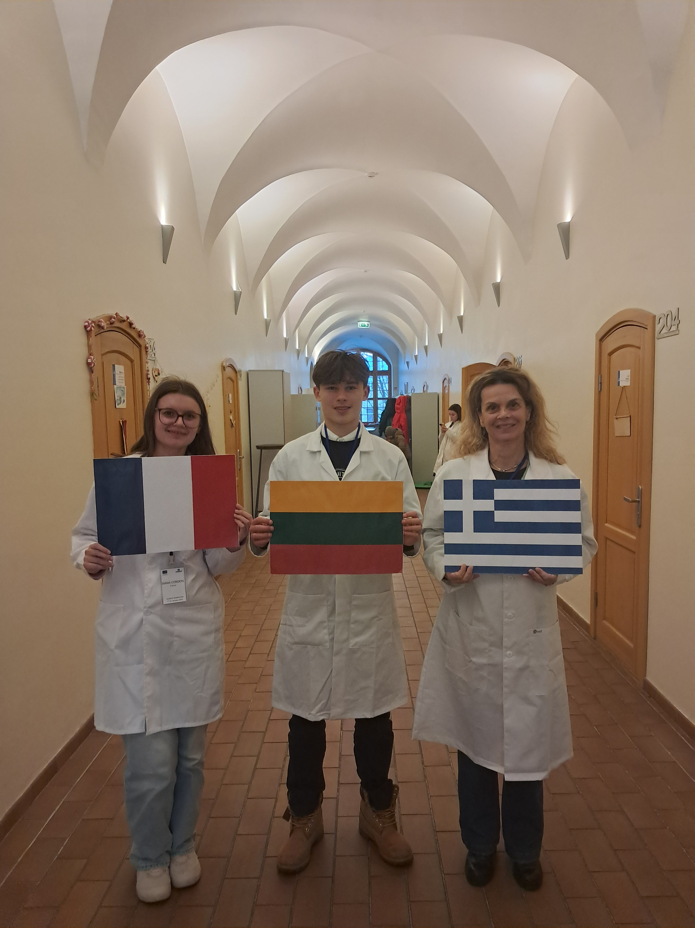


Group number 3 + presentation of group members
Emma Cordon
France
Aidenas Antanevicius
Lithuania (M)
Maria Elpiniki Lygourioti
Greece (T)
„flag“
„flag“
„group picture“

Slide 3
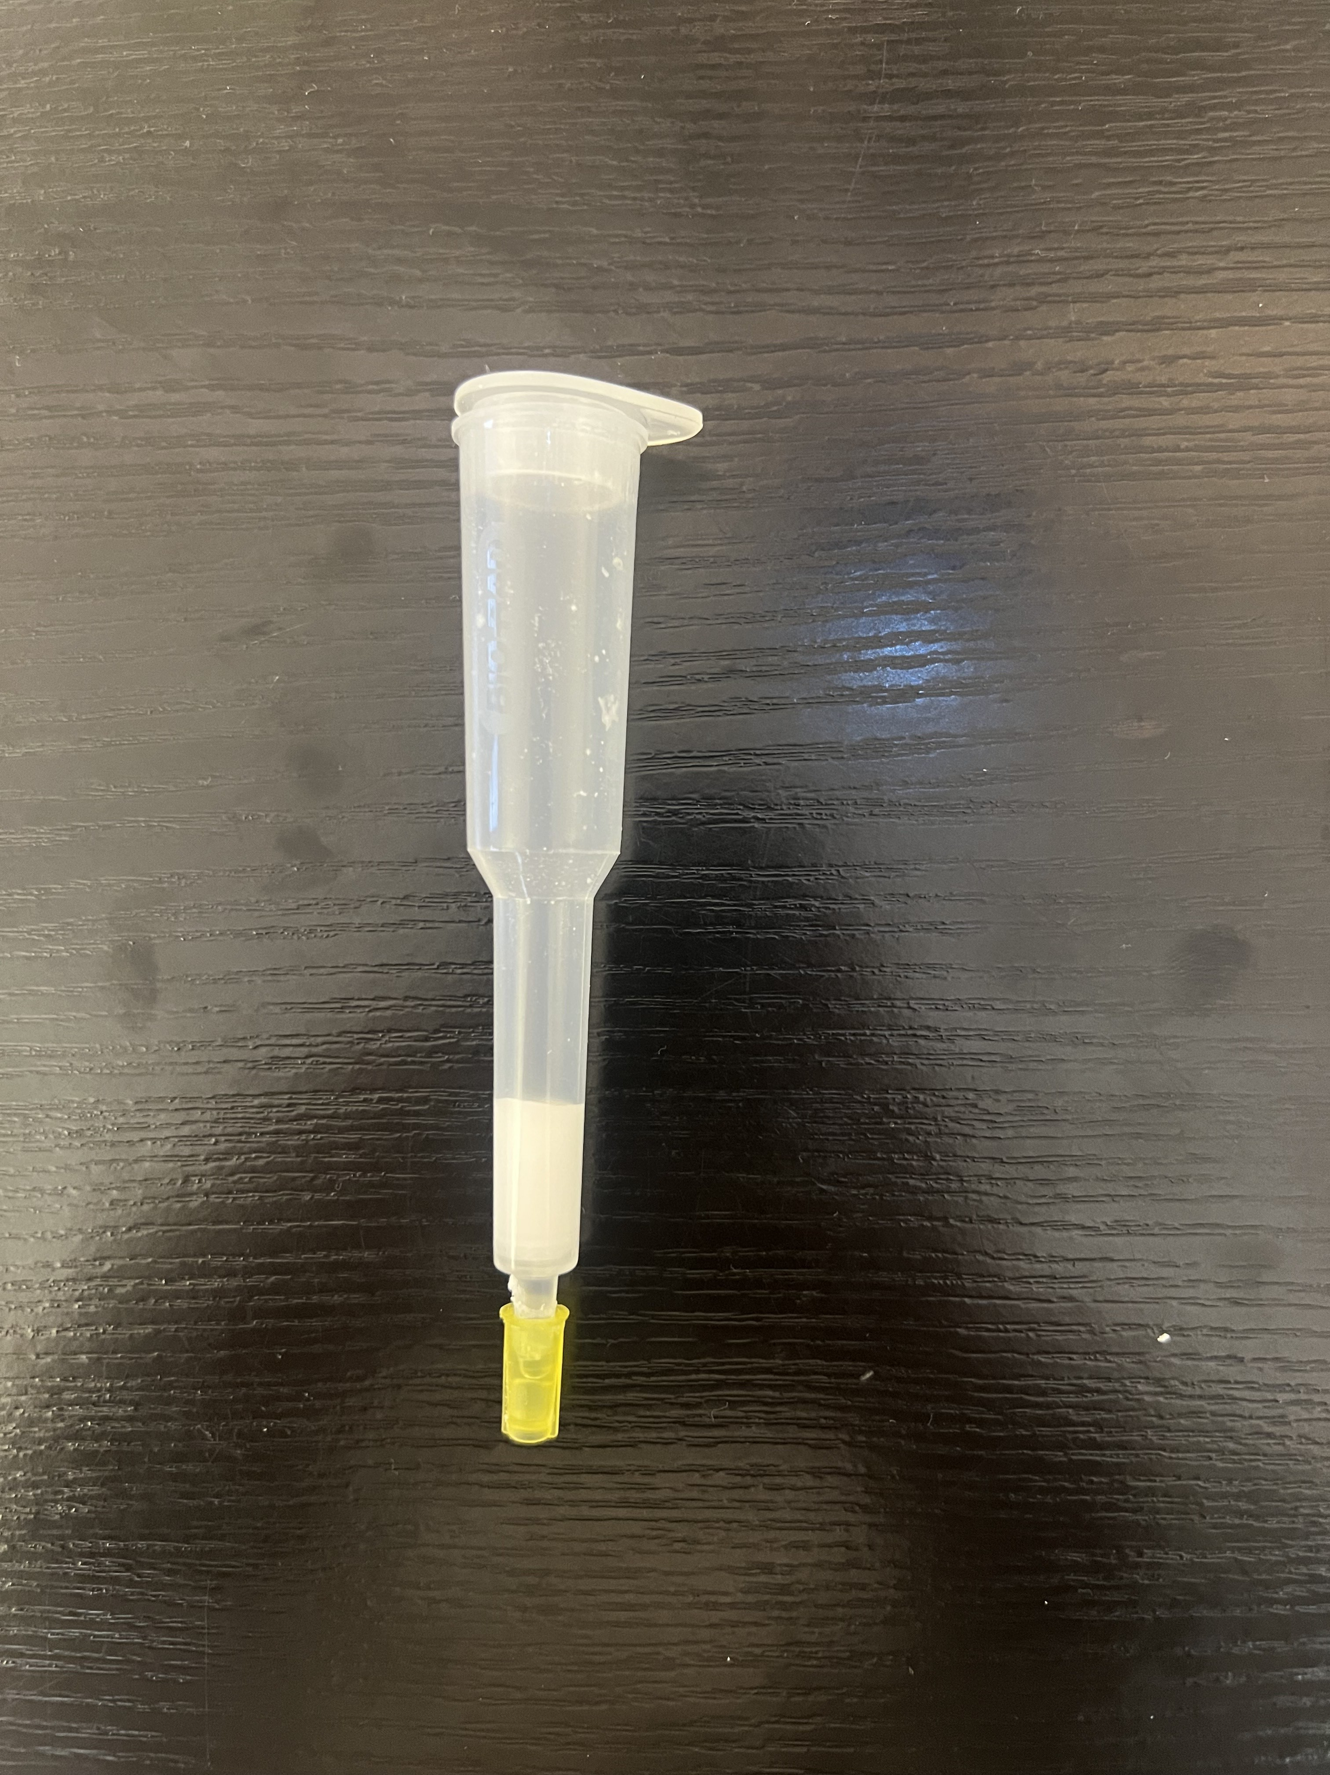
Introduction of our experiment
Column
Goal : Isolate GFP out of a mixture of proteins (E.coli lysate) by using HIC and evaluating our purification by SDS PAGE
Method:
Preparation : Equilibration buffer to prepare the GFP for column attachment.
Binding: Load the mixed binding buffer into the column; the GFP sticks to the stationary phase while other proteins drain out
Washing: Add Washing Buffer to rinse away remaining proteins while the GFP stays attached.
Elution: Add Elution Buffer to release the purified GFP from the column
Monitoring: Use UV radiation at each step to track the movement of the fluorescent GFP through the column.

Slide 4
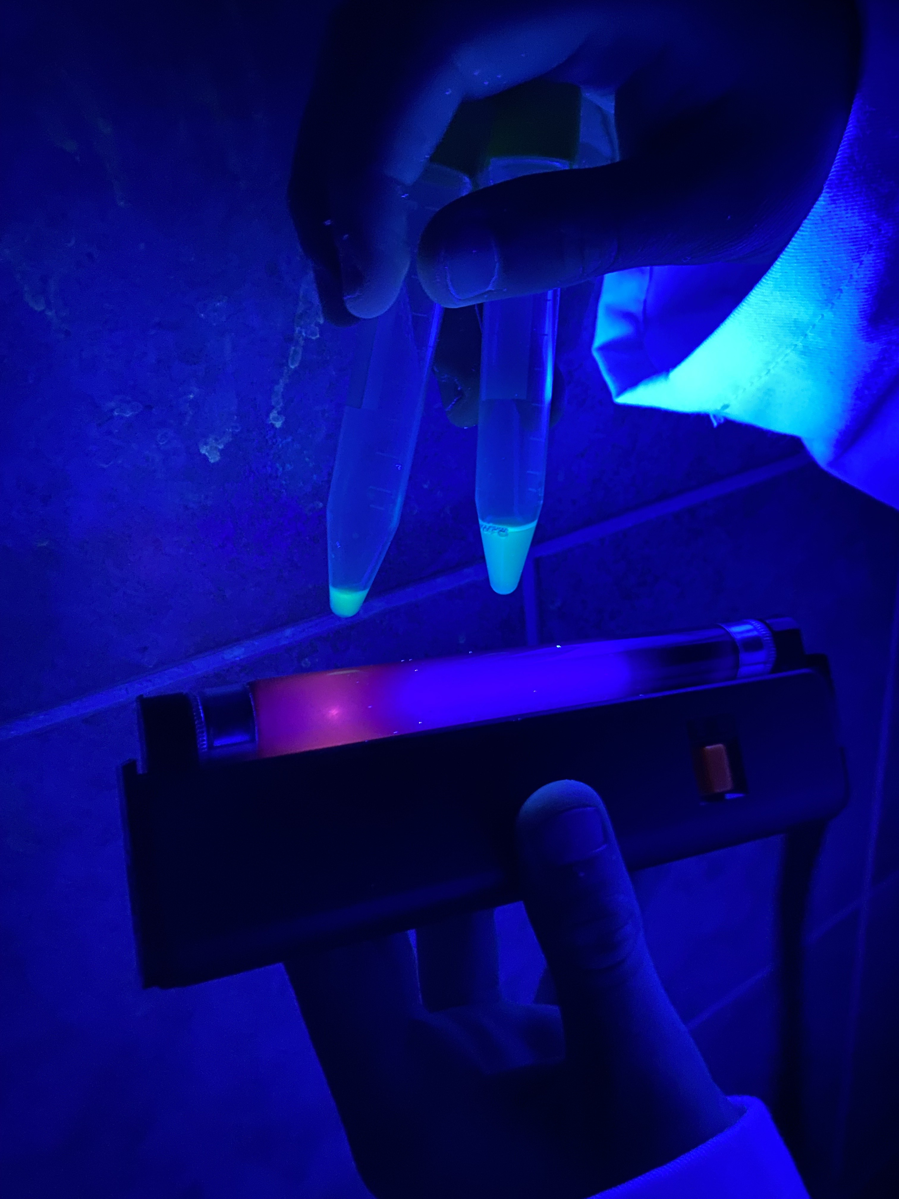
Results of HIC
C1 : Contains the proteins that didn't stick to the column during binding.
C2 : Contains proteins rinsed away by the washing buffer.
C3 : Contains the first part of the purified GFP as it starts to come off the column.
C4 : Contains the most concentrated, high-purity glowing GFP.

Slide 5
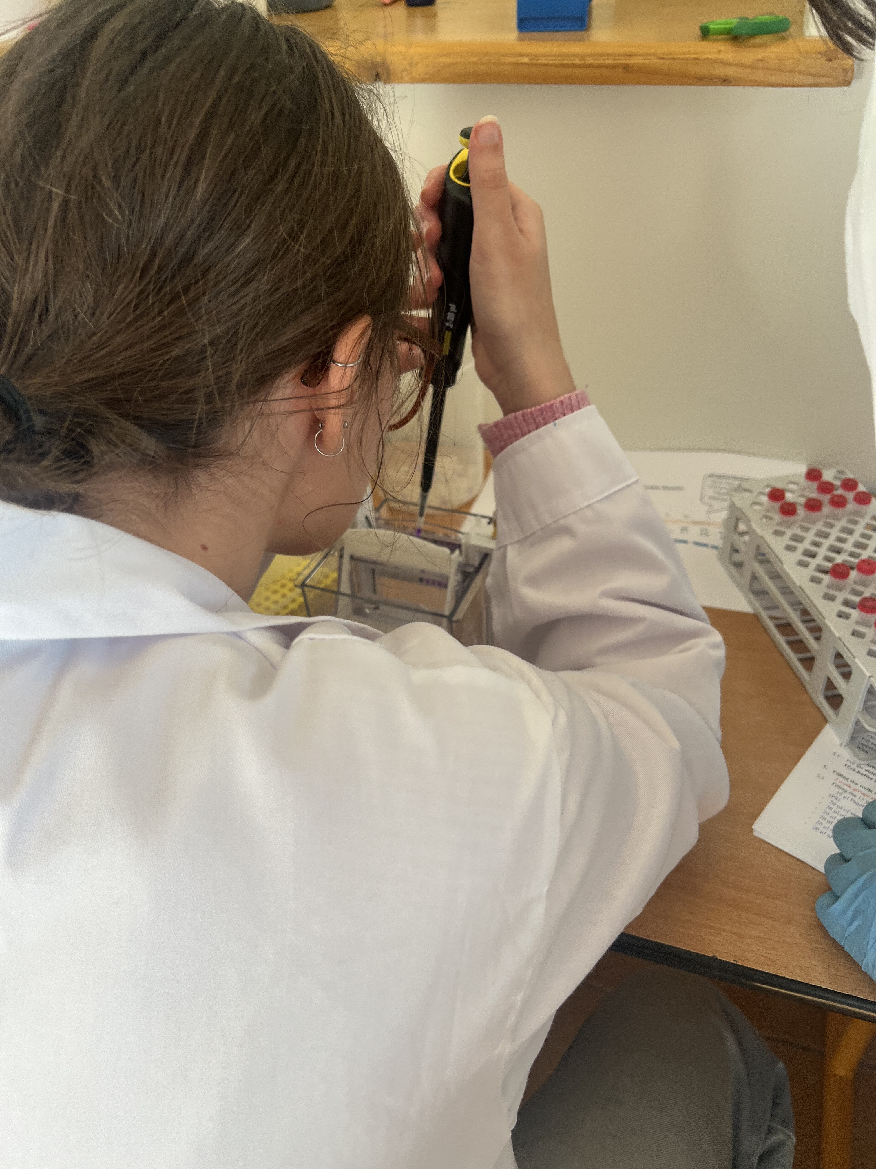
Introduction to SDS PAGE
Goal : evaluate the purity of the isolated GFP and estimate its molecular mass by comparing to a protein standard.
Method :
Electric Pull: proteins move toward the bottom of the gel.
Gel: smaller proteins move through it quickly, while larger proteins move slowly.
Verification: UV light allows us to identify exactly which band is the GFP because it glows, while staining reveals all other hidden proteins.

Slide 6
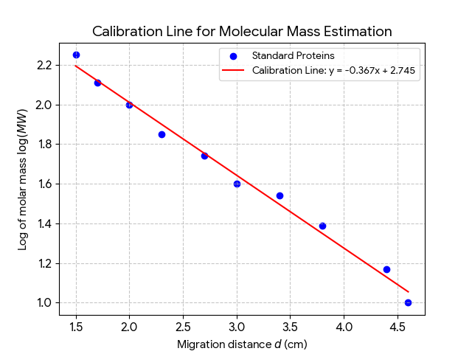
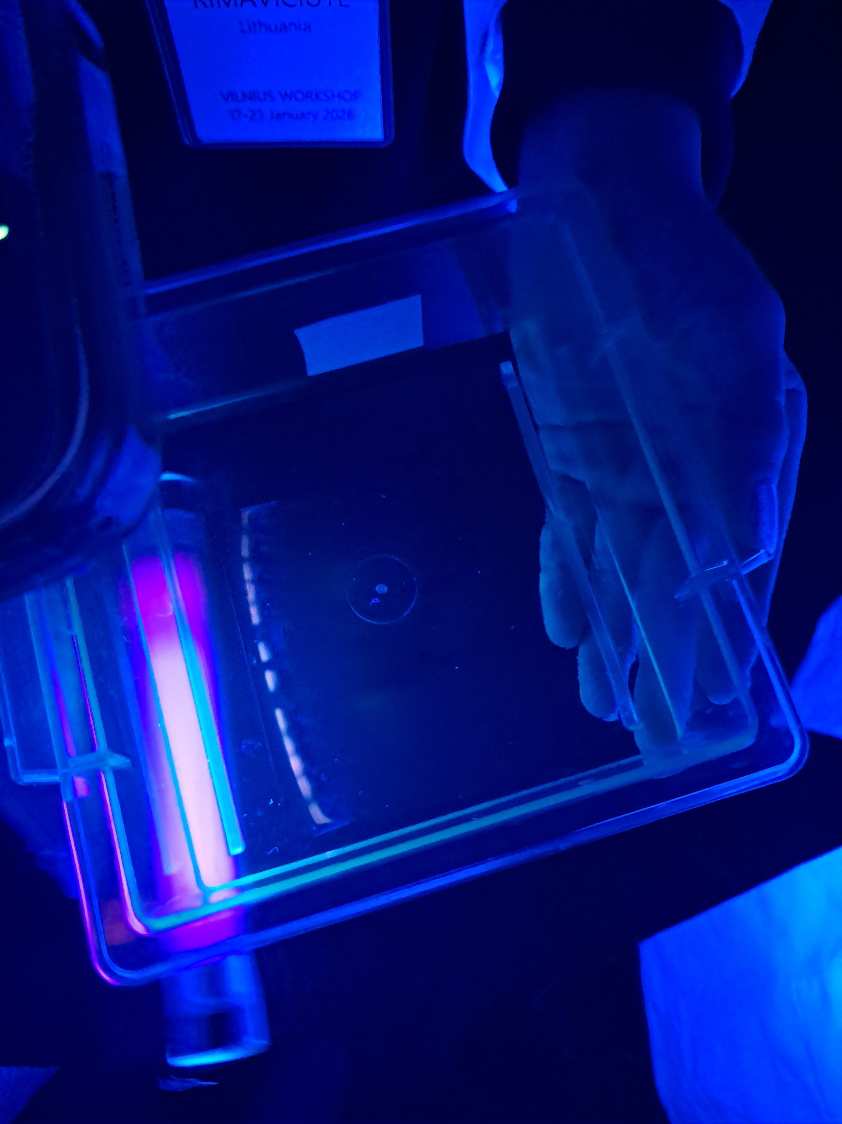
Results of SDS PAGE
Migration Distance: The GFP band migrated between 3.2 cm and 3.7 cm in the gel.
MW : 37.1 - 24.3 kD
d (cm) | 1.5 | 1.7 | 2.0 | 2.3 | 2.7 | 3.0 | 3.4 | 3.8 | 4.4 | 4.6
log(MW) | 2.25 | 2.11 | 2.00 | 1.85 | 1.74 | 1.60 | 1.54 | 1.39 | 1.17 | 1.00

Slide 7
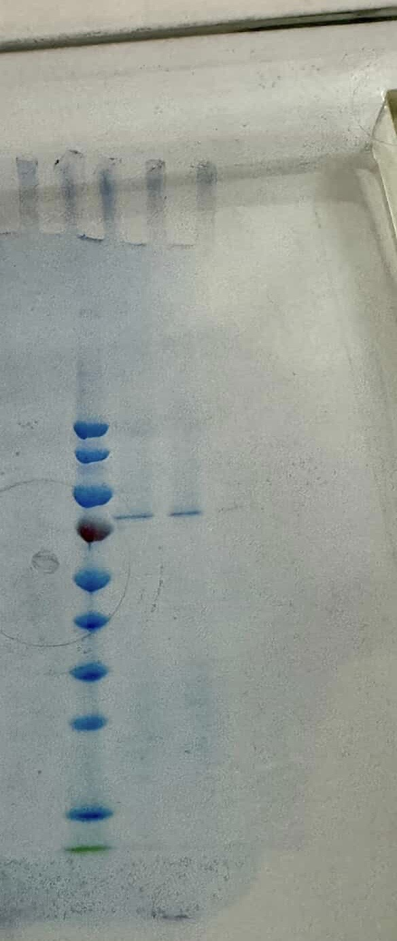
Conclusion
C4D PS BB C4 C3
GFP can resist electropheresis.
GFP was partly denatured in C4D because of DTT.
GFP was isolated but some proteins remained.
70
GFP

