Slide 1
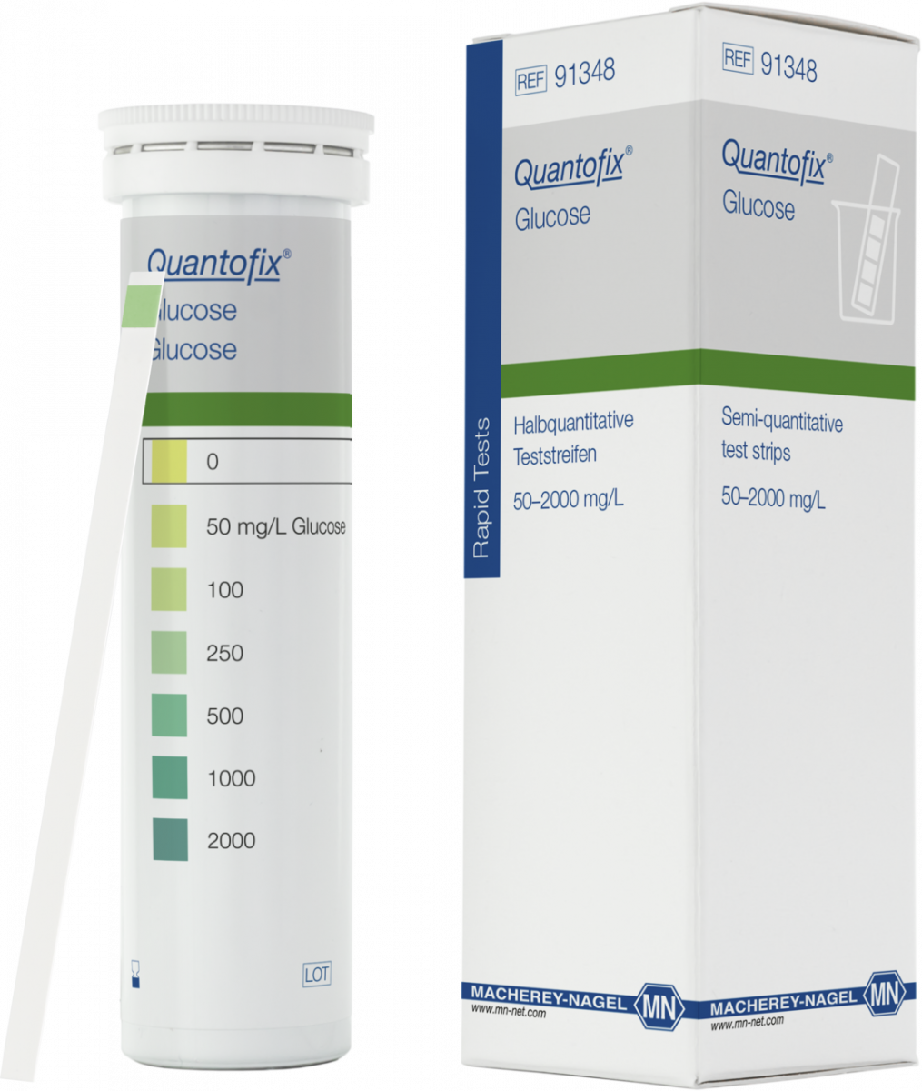
β-Galactosidase – Raw Milk Test
Dive test stripes for 2 seconds in raw milk
Excess of raw milk snip away
Wait for 30 seconds
Compare colour of test field of the stripe with colour scale of the stripe
box

Slide 2
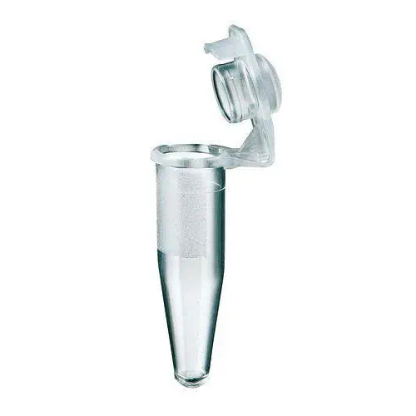
β-Galactosidase – Raw Milk Test
Control Assay
+
100 ml
H₂O
+
100 μl
25%
Eluate
?
mg/l
Glucose
?
mg/l
Glucose
Eppendorf-Tube
1 ml raw milk
20 °C
30 minutes
Eppendorf-Tube
1 ml raw milk
20 °C
30 minutes …

Slide 3
β-Galactosidase – Raw Milk Test
Control / Assay
time (min) | t₀ | t₁₀ | t₂₀ | t₃₀ | t∞
control (mg x L⁻¹ )
assay (mg x L⁻¹ )
Eppendorf-Tube
1 ml raw milk
20 °C
+
100 μl
H₂O or 25 % Eluate
?
mg x L⁻¹
Glucose

