Slide 1
Summary of results from group 15

Slide 2
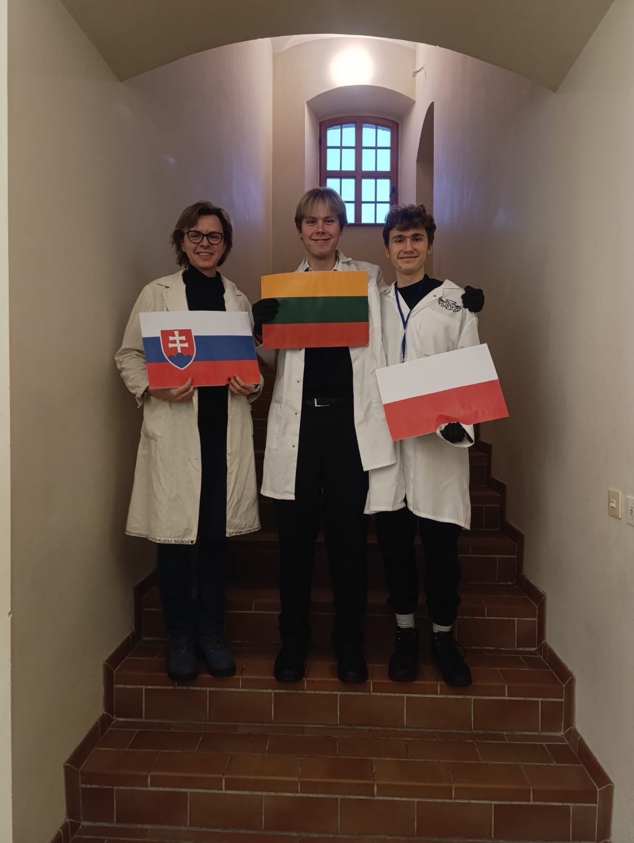



Presentation of group 15
Lucia Bizoňová
Benas Manstavičius
Mikołaj Klimczak
„flag“
„flag“
„flag“

Slide 3
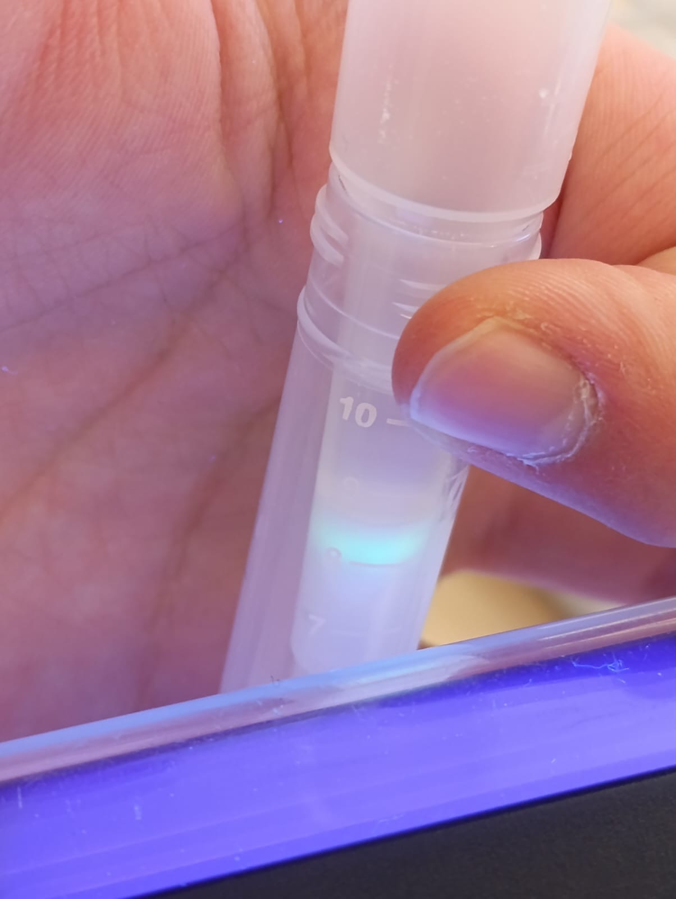
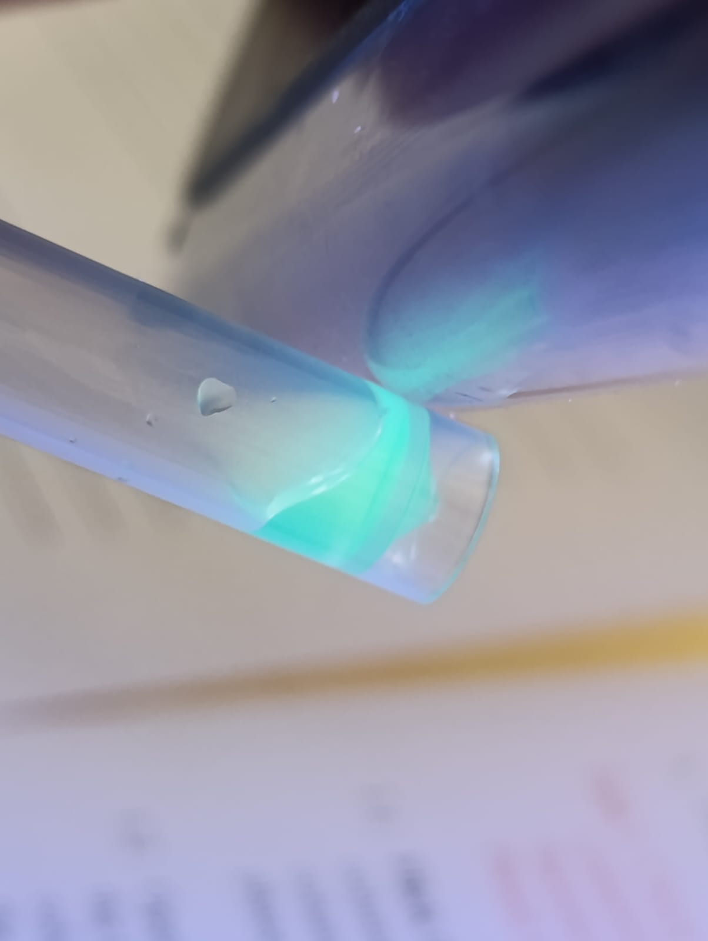
Introduction of HIC
Goal: Isolate GFP in E. coli lysate out of 3000 other proteins
Process:
Hydrophobic interaction (Van der Waals forces) between buffered GFP and the stationary phase
The isolation works by washing out the less hydrophobic proteins out of the stationary phase

Slide 4
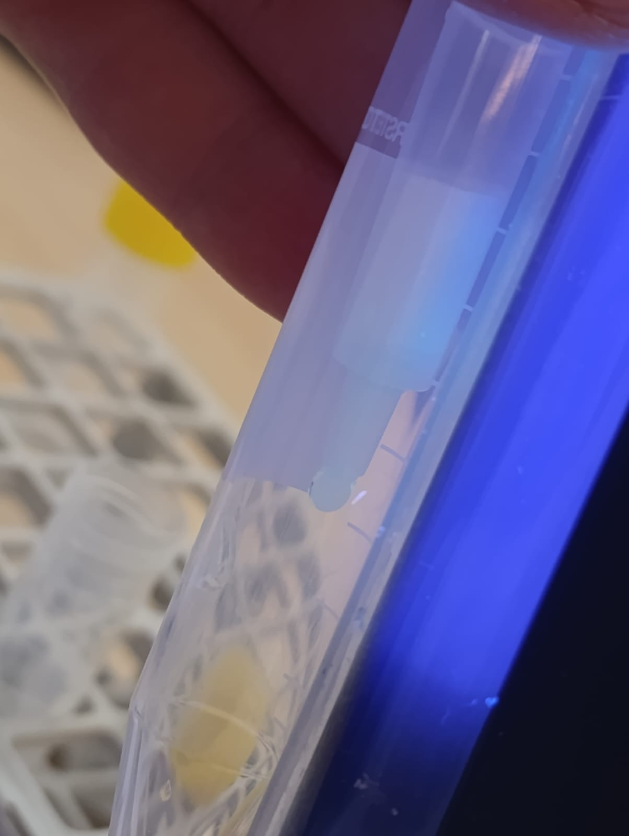
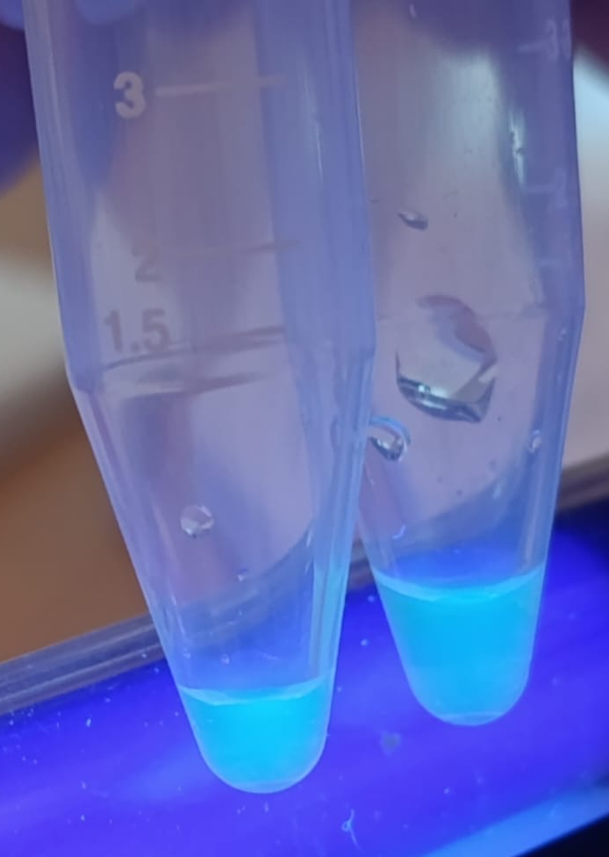
Results of HIC
GFP is going down the stationary phase after reducing the concentration of ammonium sulphate(2 M to 1,3 M and then 0 M distilled water)
The drops that contain the most GFP fall into C4
Some of GFP with the rest of the proteins fall into C3
C4 has less liquid than C3 → higher concentration
C4 C3

Slide 5
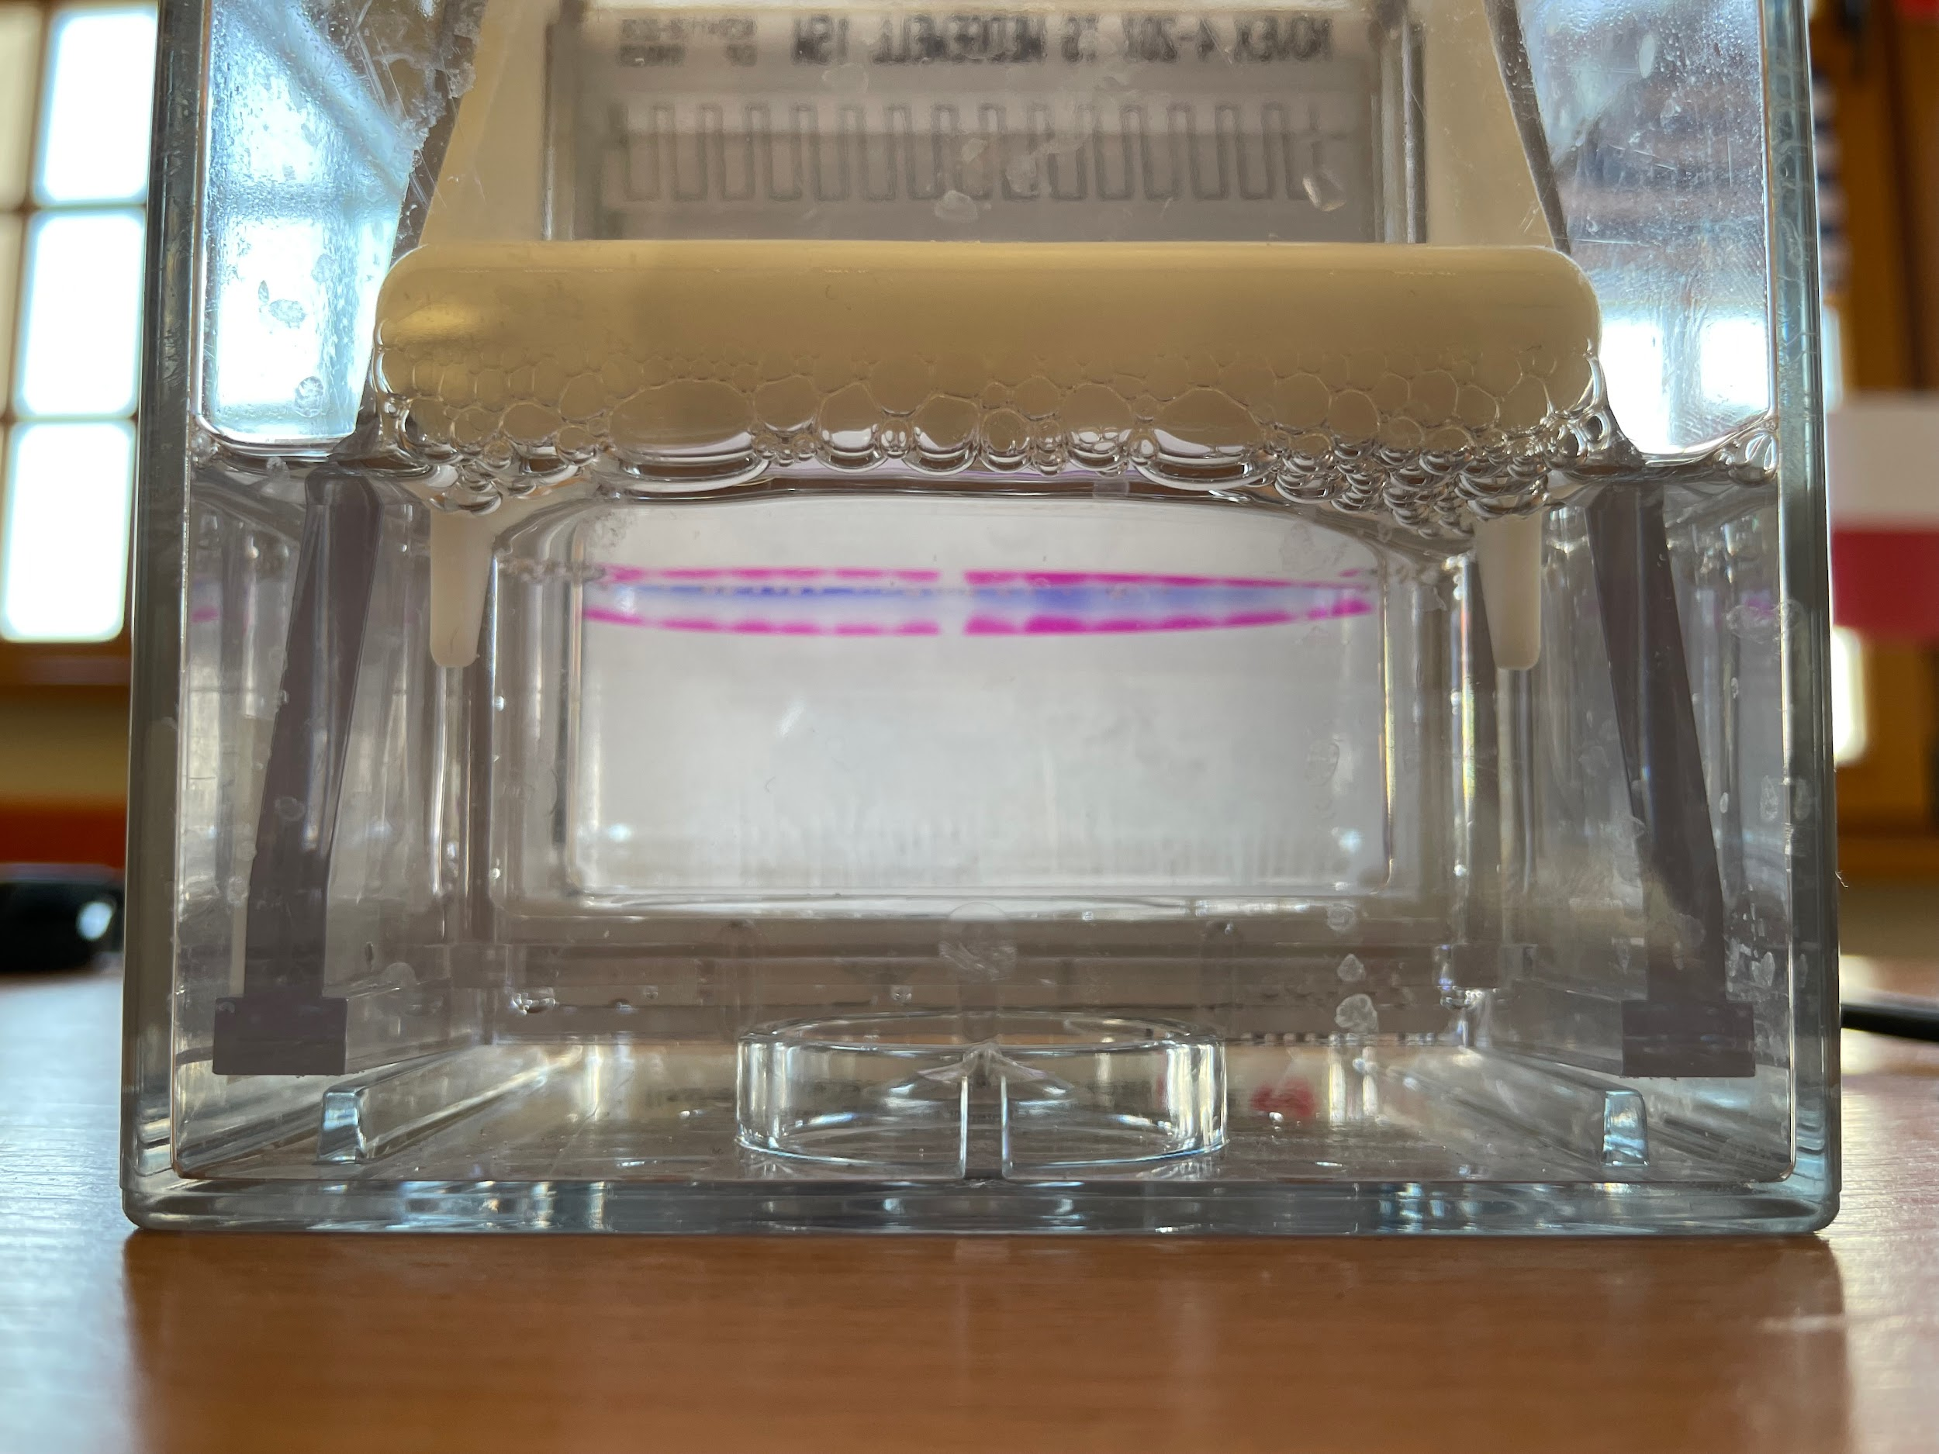
Introduction of SDS-PAGE
Goal: Estimate the molar mass of GFP and evaluating the success of isolation
Conditions:
200V
160 mA
SDS non reducing and SDS reducing

Slide 6
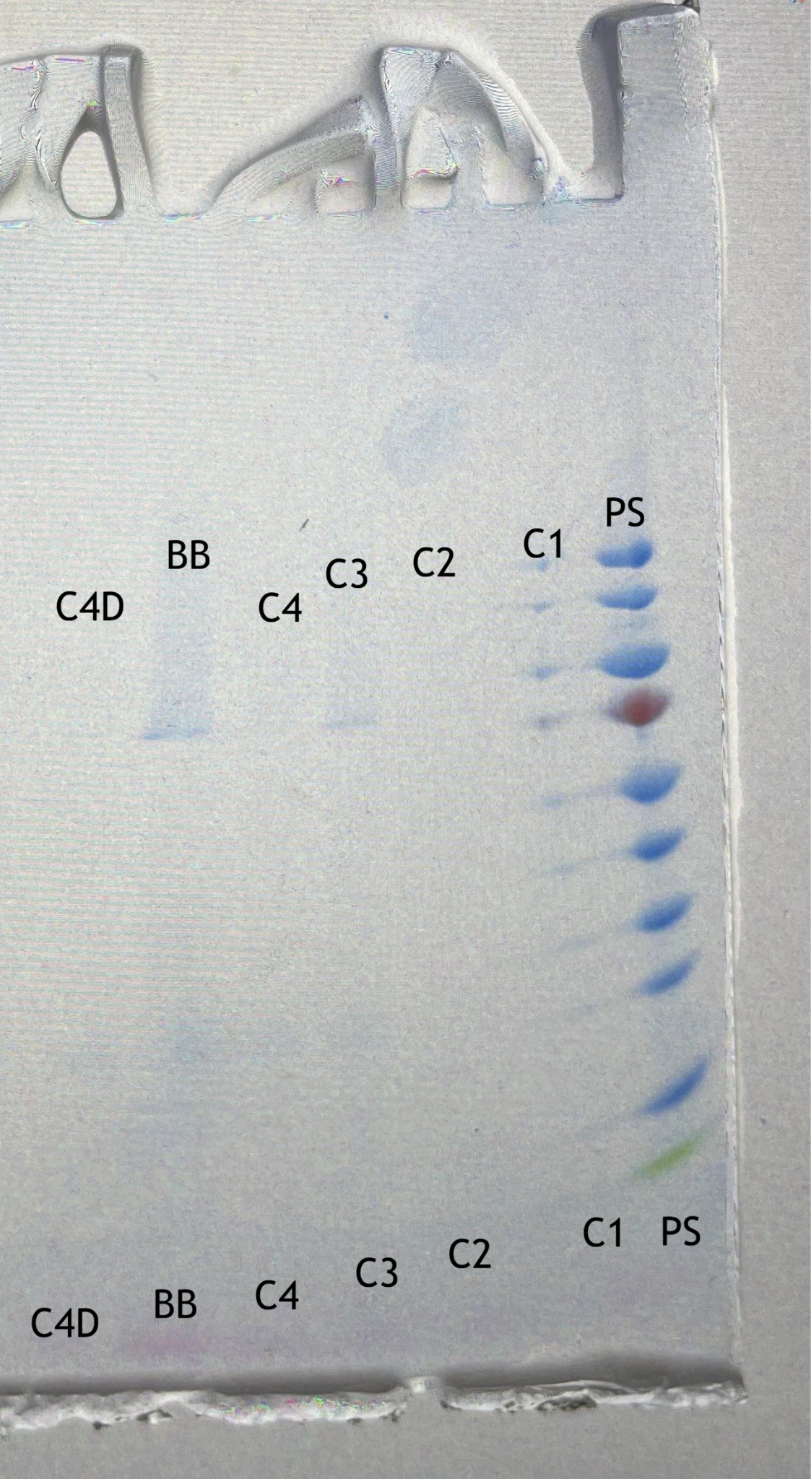
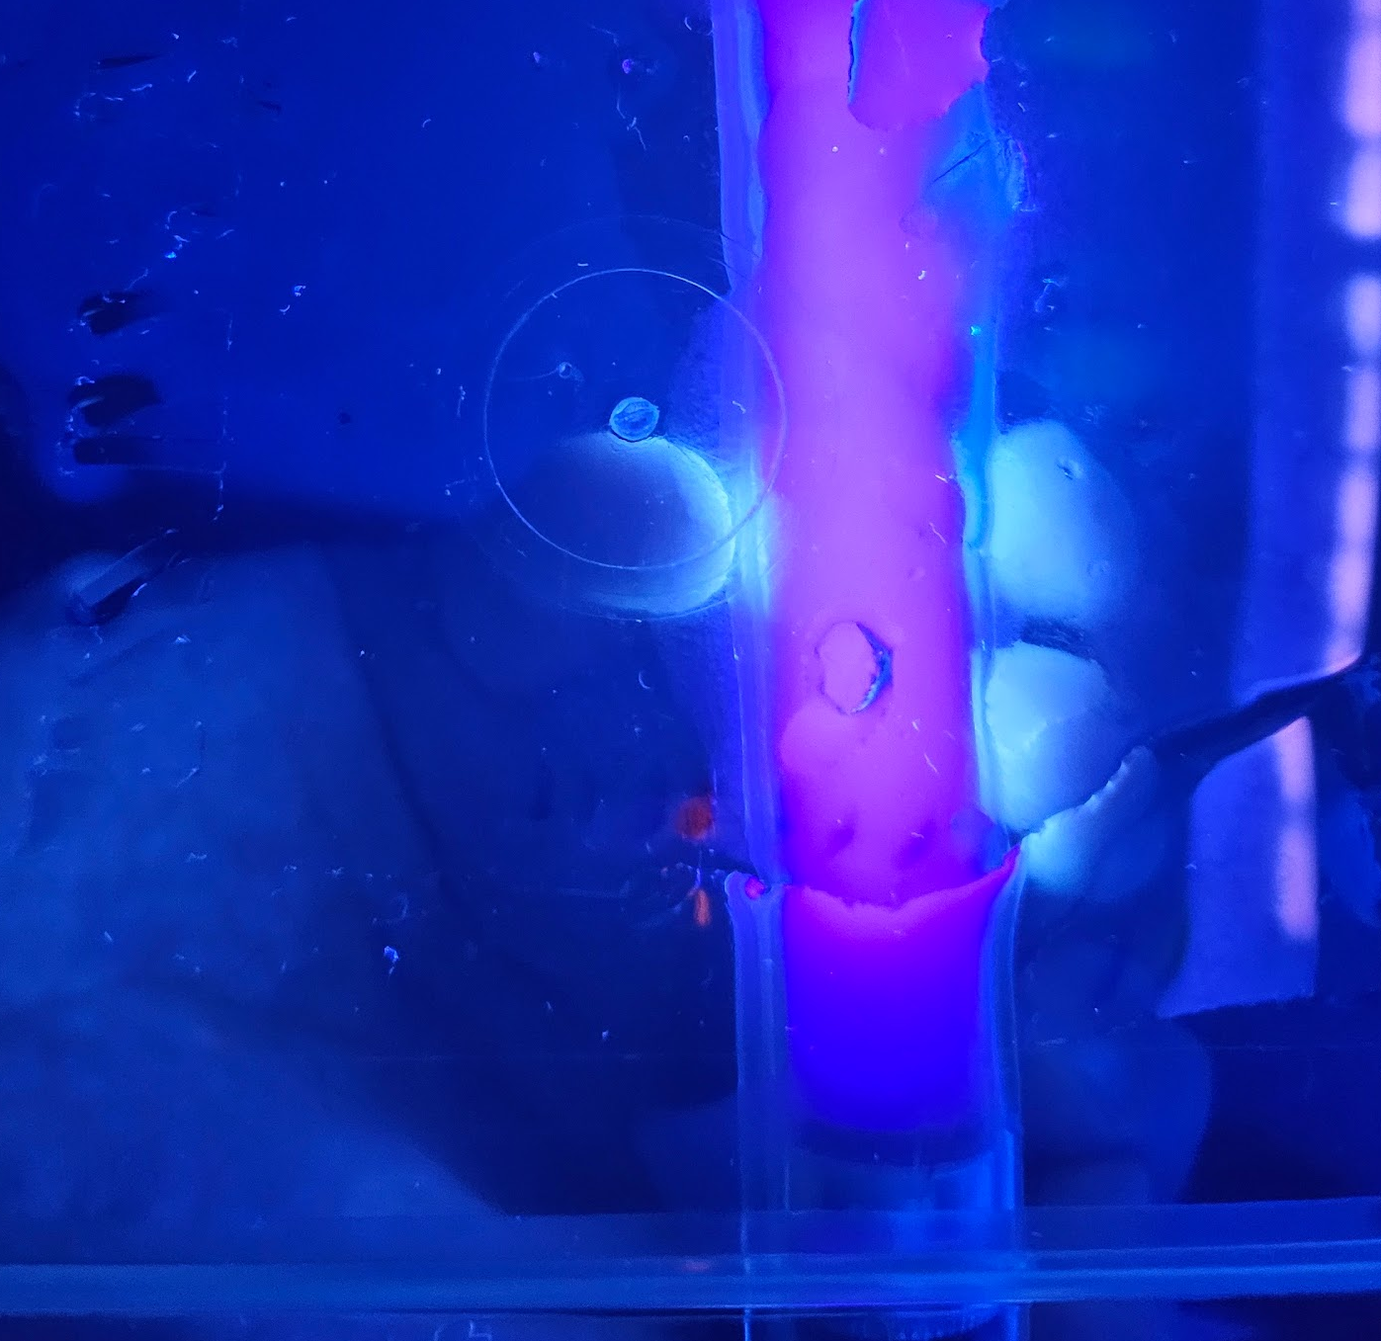
Results of SDS-PAGE
GFP was seen under UV light in the expected location
After dyeing less stripes are seen on the C4 line than BB → HIC was successful

Slide 7
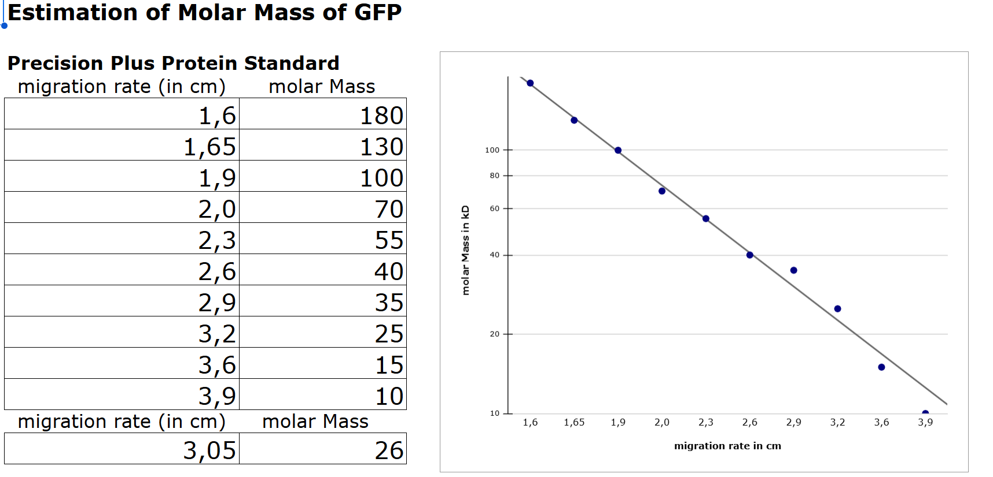

Slide 8
Conclusion
HIC was successful
The collection of drops could have been more optimised
The ladder could have been added to the centre instead of the sides of the gel

Slide 9
Thank you for your attention!

