Slide 1
Summary of results from group 6

Slide 2
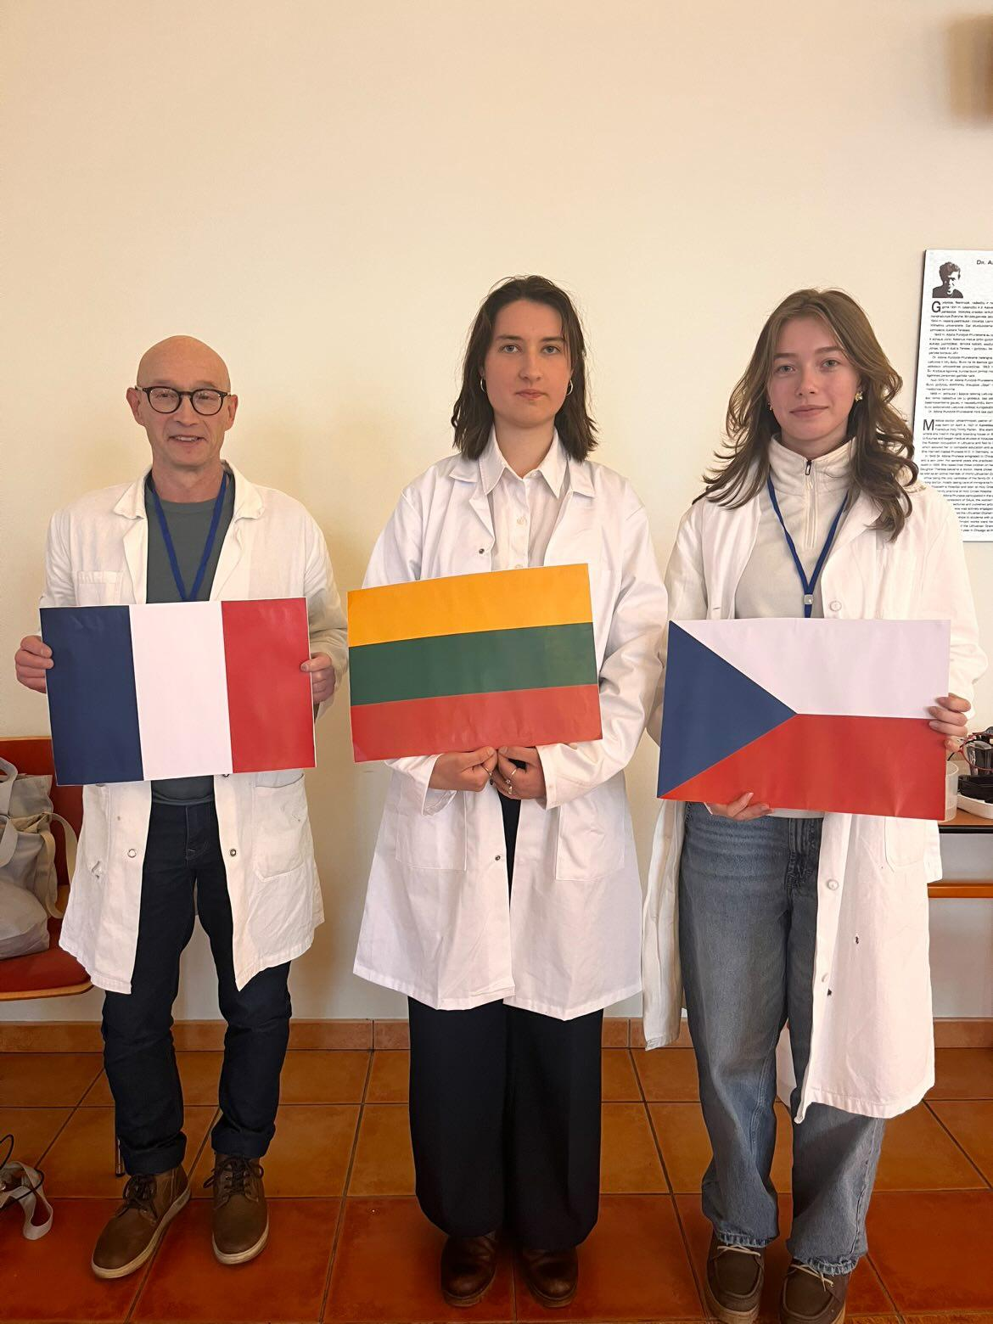



Group number 6 presentation of group members
Patrick Jobard
Teacher
France
Lucie Zoubková
Student
Czech republic
Mentor: Agota Kiesaité
Lithuania
flag
GROUP PICTURE
flag
flag

Slide 3
Introduction of our experiment
Goal: Isolation - Purification of GFP, and evaluation of purification.
Methods:
Method 1 : The isolation was made by chromatography.
Method 2 : Evaluation of purification was made by PolyAcrylamide Gel Electrophoresis.

Slide 4
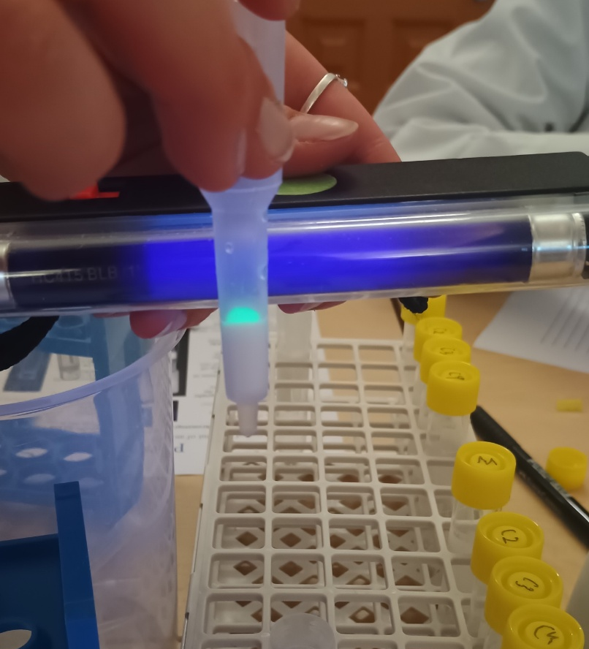
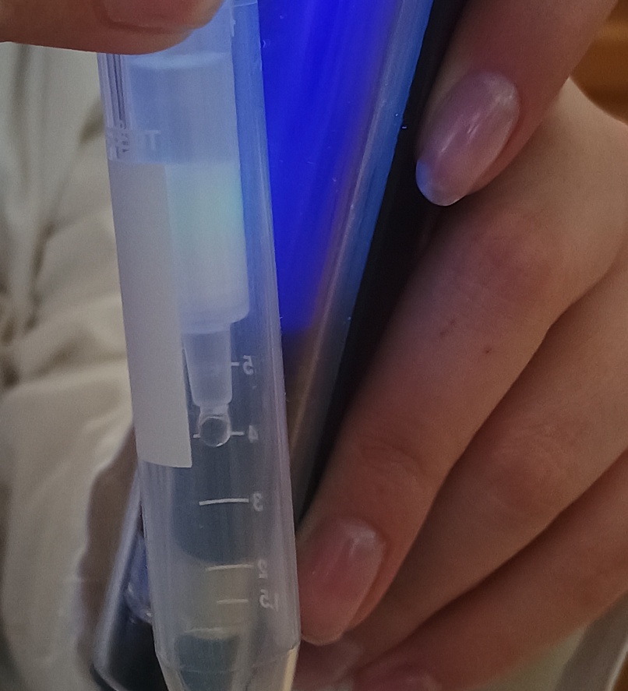
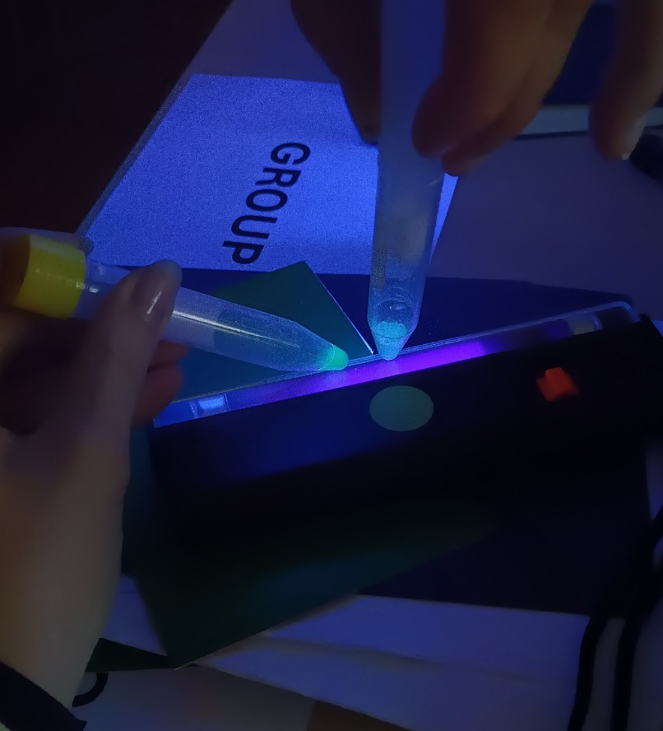

Method 1 : HIC (Hydrophobic Interaction Chromatography)
C1
C2
C4 C3
GFP is on the surface
GPF is going through stationary phase
Almost clear GFP

Slide 5
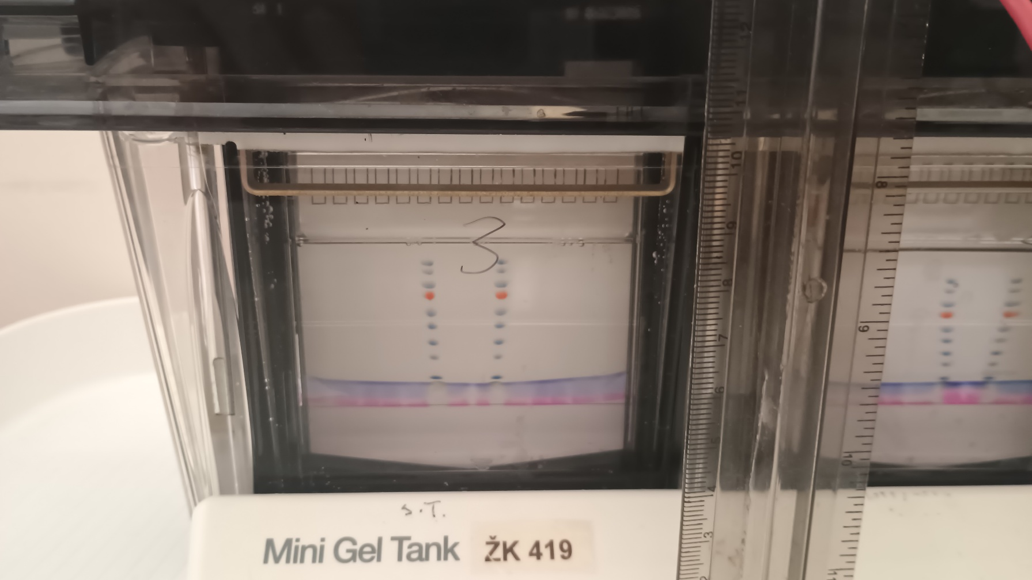
SDS-PAGE
Picture of the system, the gel, calibration line and GFP molar mass estimation

Slide 6
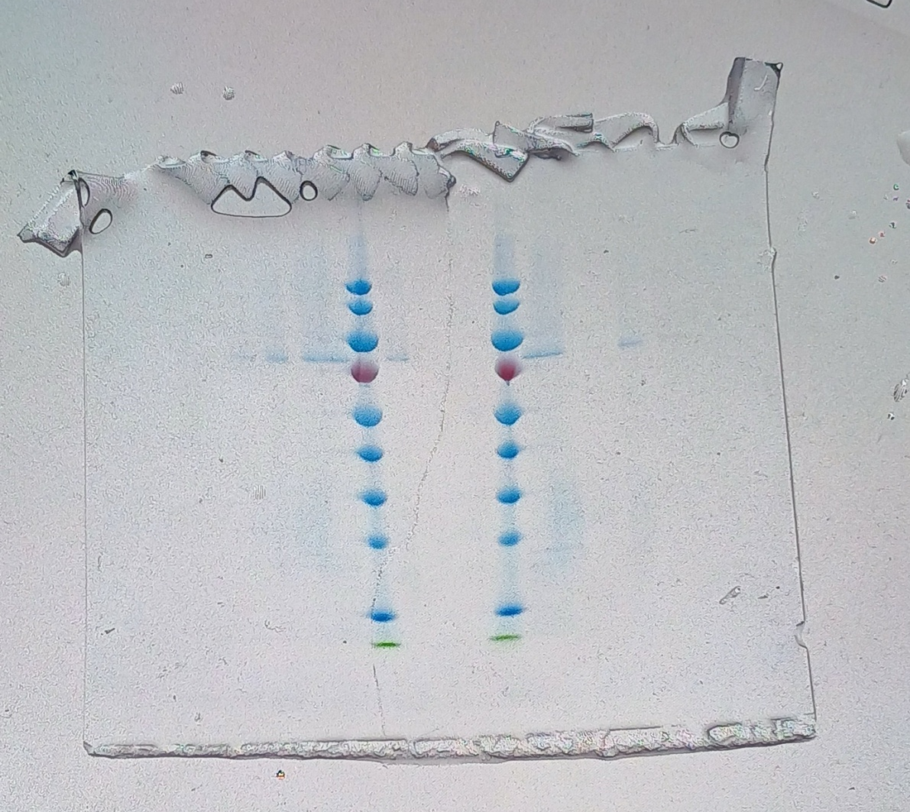
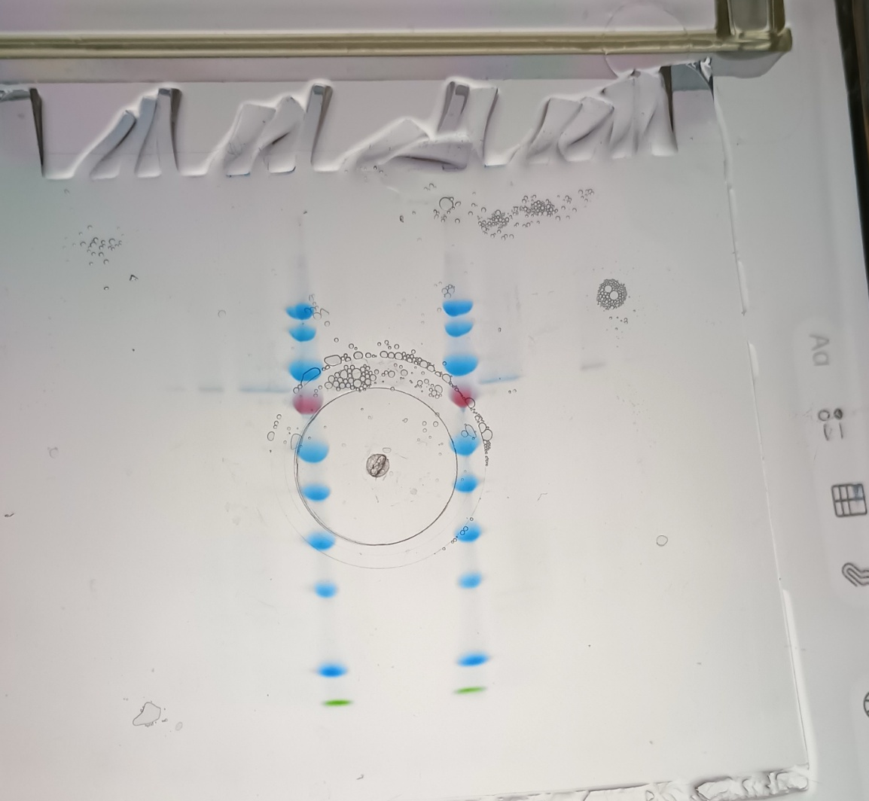
PS BB C4 C3 C2 C1 C4D
35
25
PS BB C4 C3 C2 C1 C4D

Slide 7
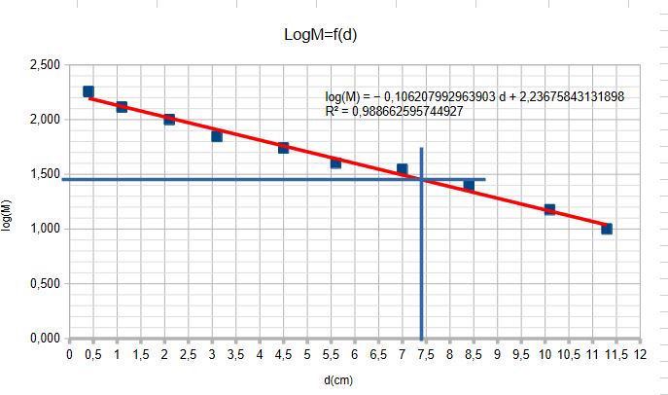
Calibration line
Measurment points
d(GFP) | 7,4
log(MkD) | 1,43
M(KD) | 26,67

Slide 8
Result
Orientation questions
From HIC:
Is GFP in the elution fractions? Yes, GFP is present in the elution fractions (as we could see in HIC)
Are the other proteins in the washing fractions? Yes, most of the other proteins are found in the washing fractions
From SDS-PAGE:
Is GFP pure? No, GFP is not completely pure, there are also other proteins
Does the chromatography work? Yes, the chromatography works
Overall
If there were any problems, what were they, how did you solve them?

Slide 9
Thank you for your attention!

