Slide 1
Summary of results from group 14

Slide 2

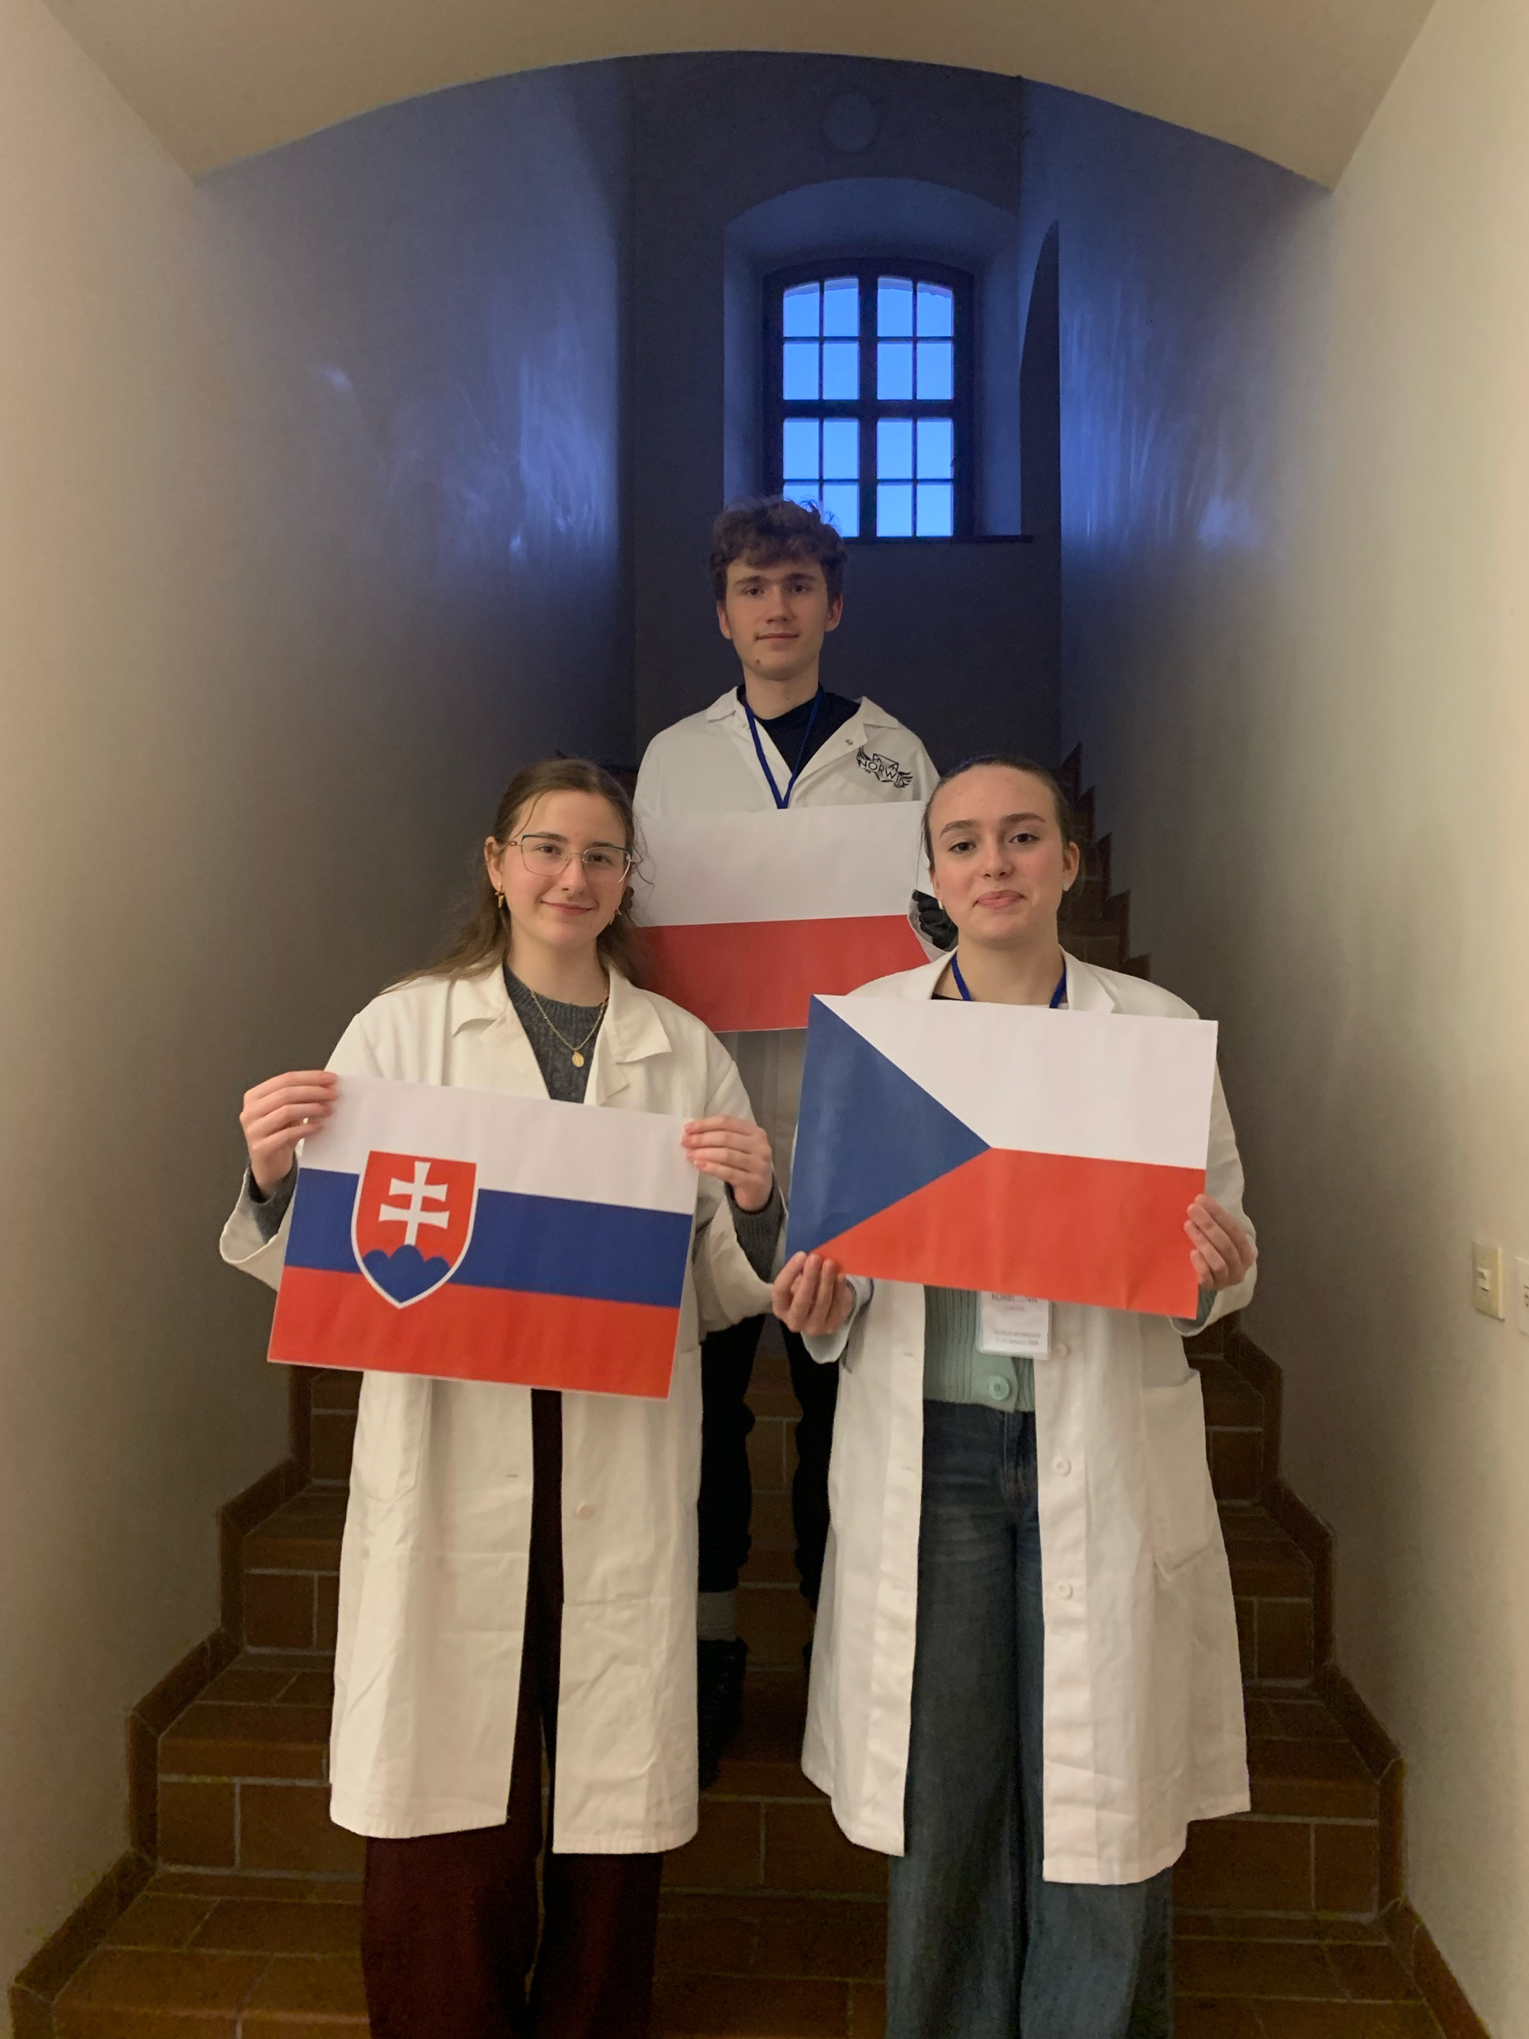



Group number 14 presentation of group members
Michaela Labudová
Student
Slovakia
Agáta Korbelová
Student
Czech
Mentor:
Mikołaj Klimczak
Poland
flag
GROUP PICTURE
flag
flag

Slide 3
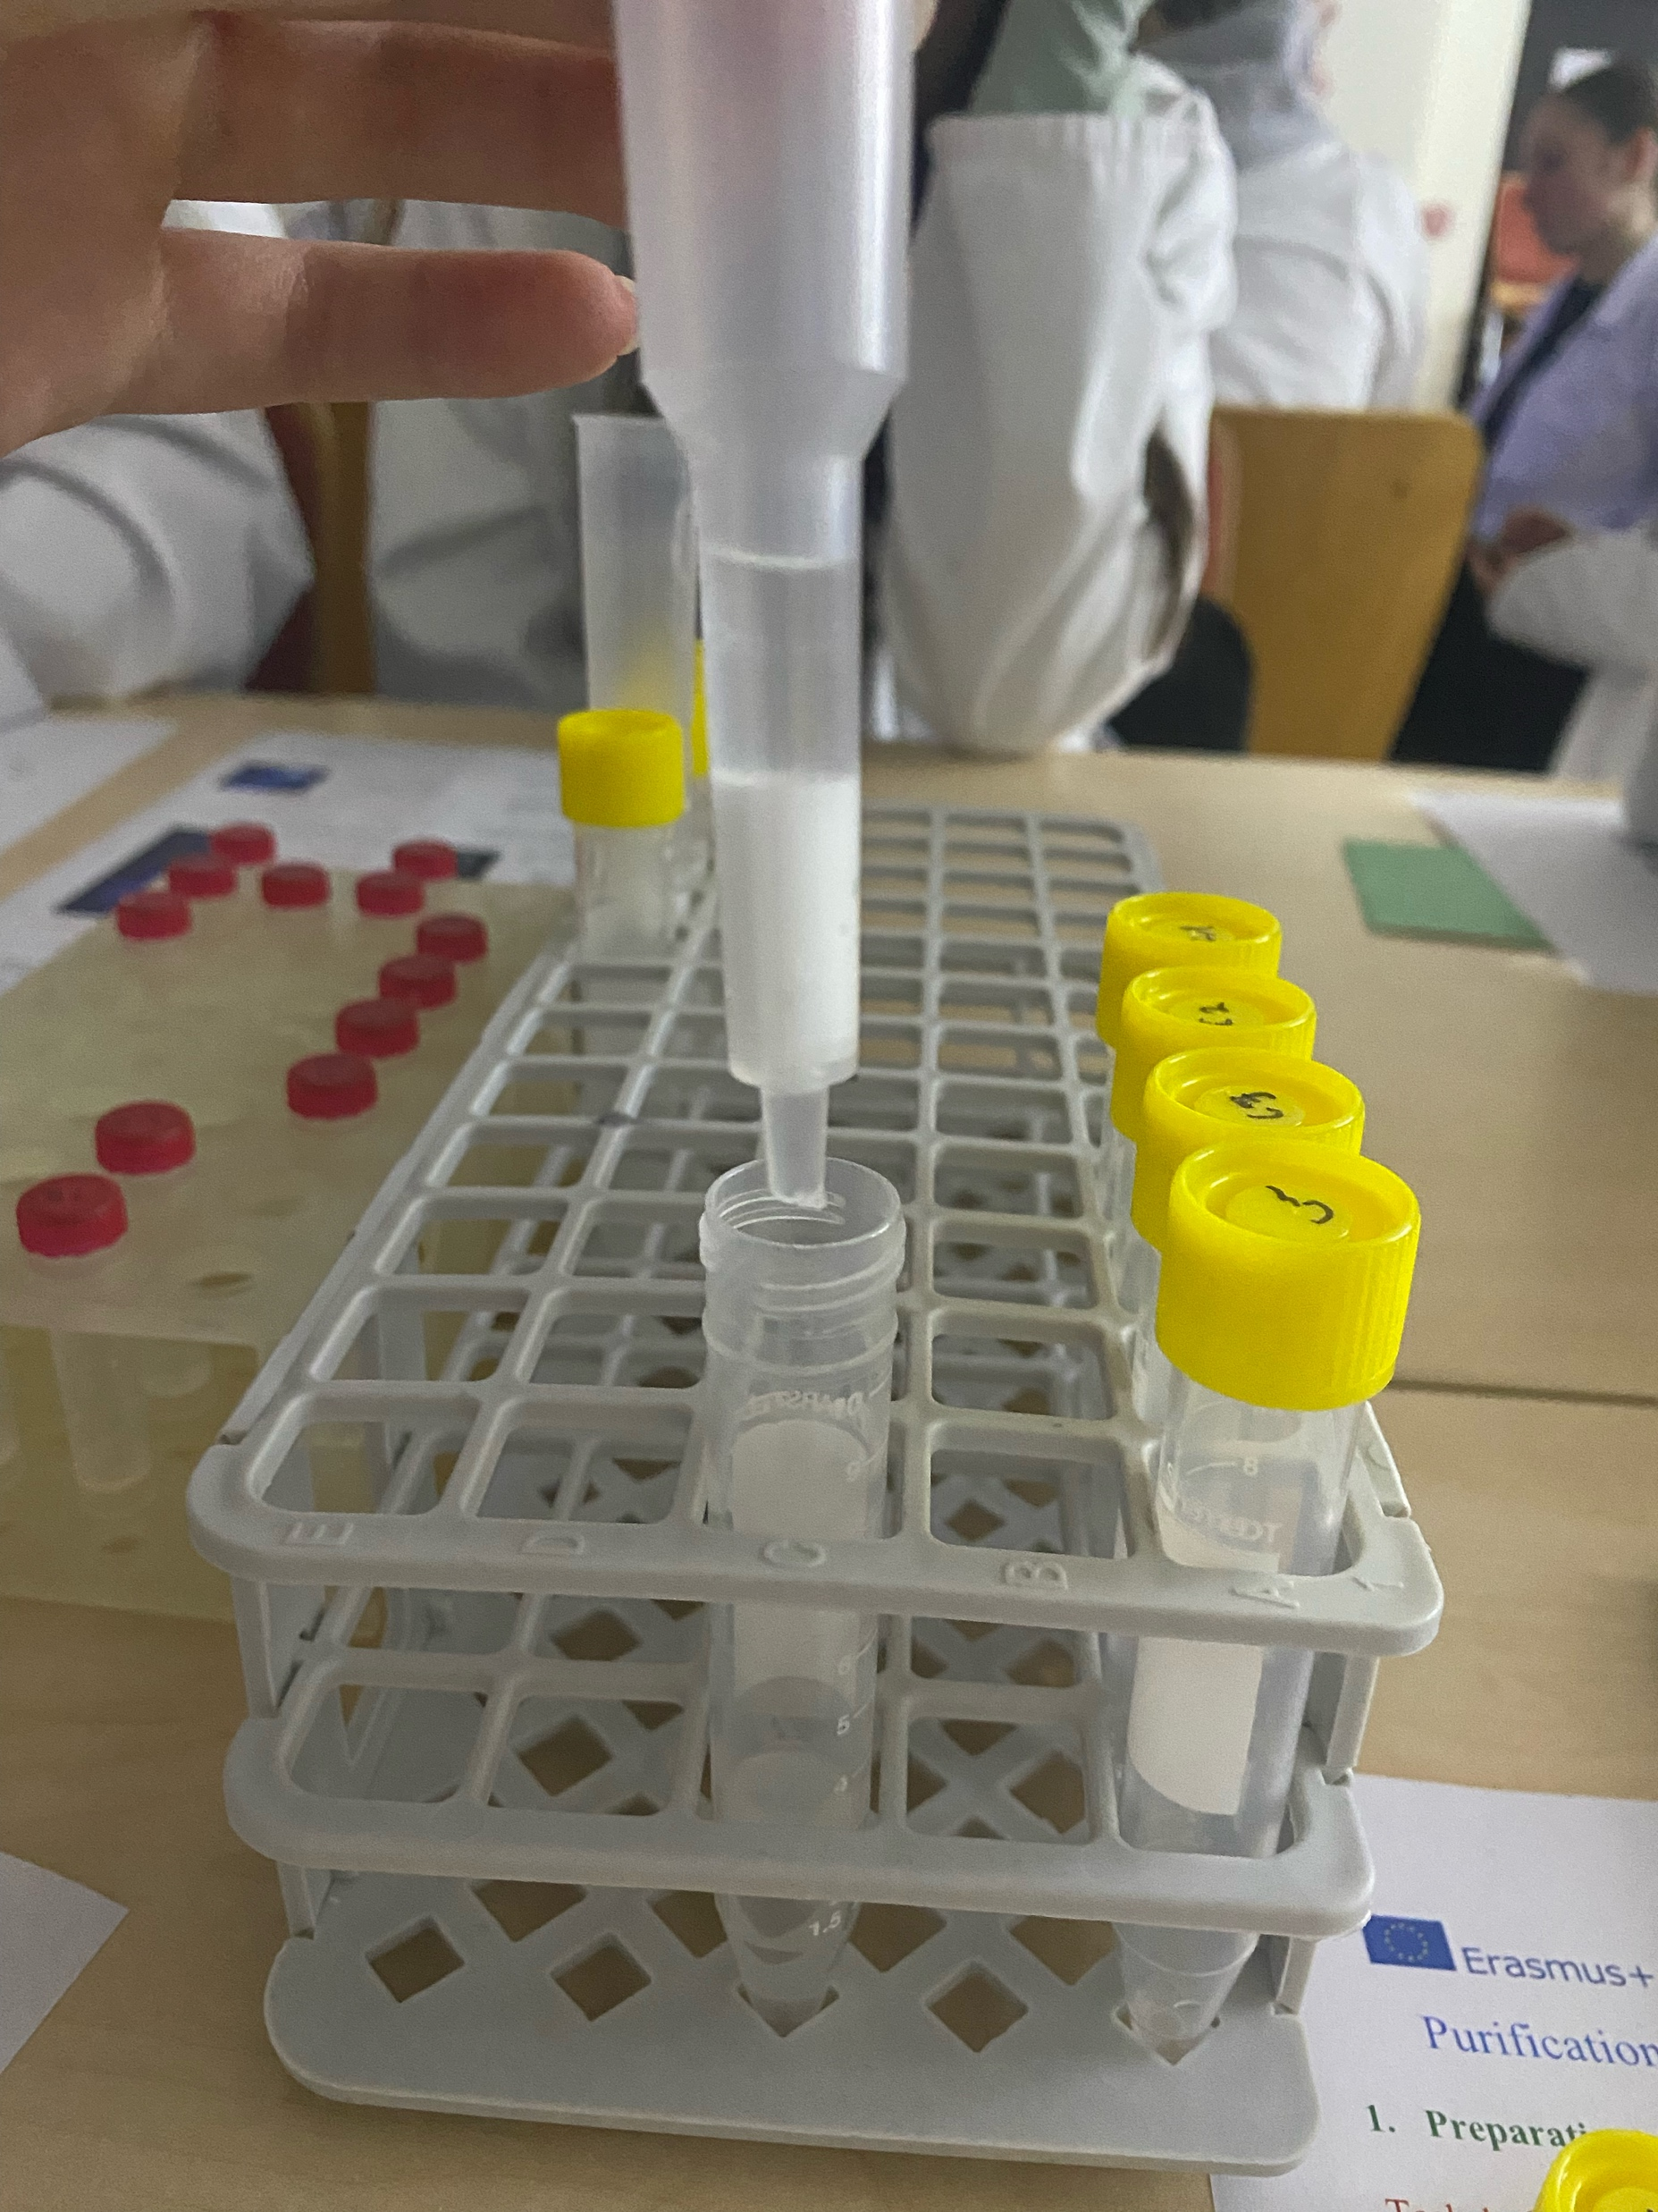
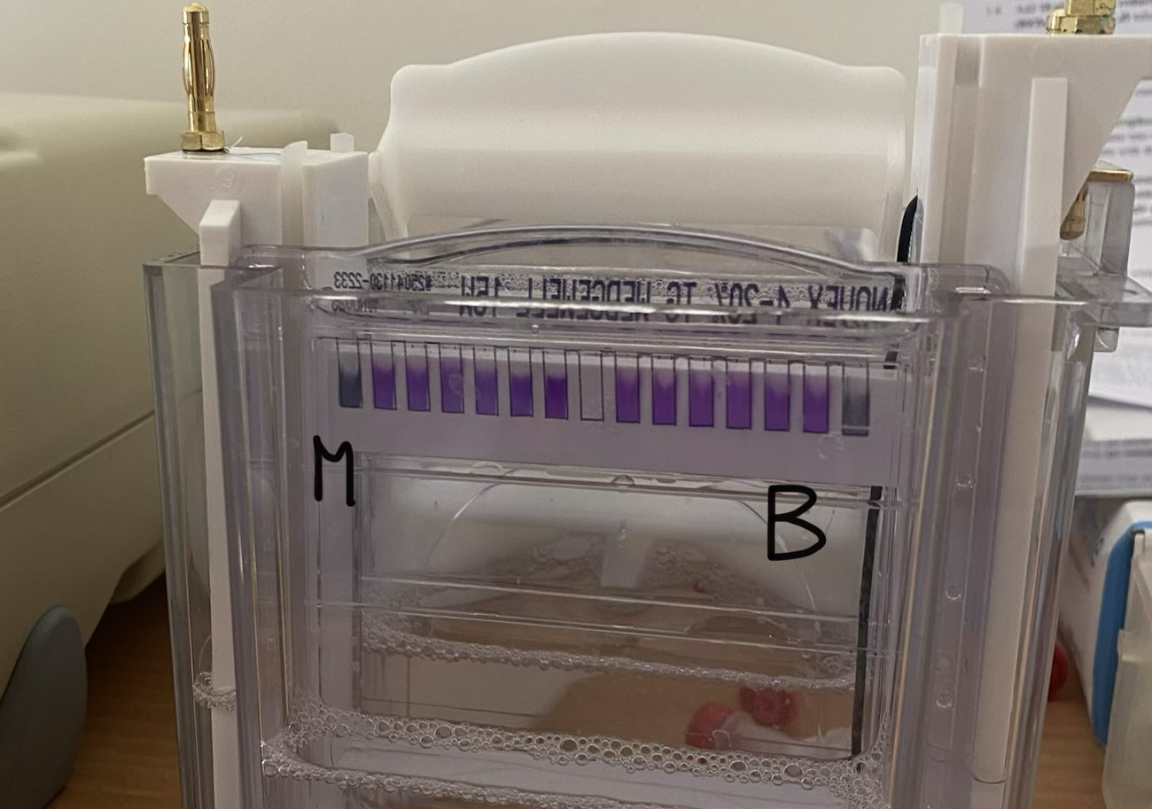
Introduction of our experiment
Goal: isolation of the GFP from all of the other proteins and verification of the GFP
Metods:
1.HIC: for isolation of the GFP
2.SDS-PAGE: for verification of the GFP

Slide 4
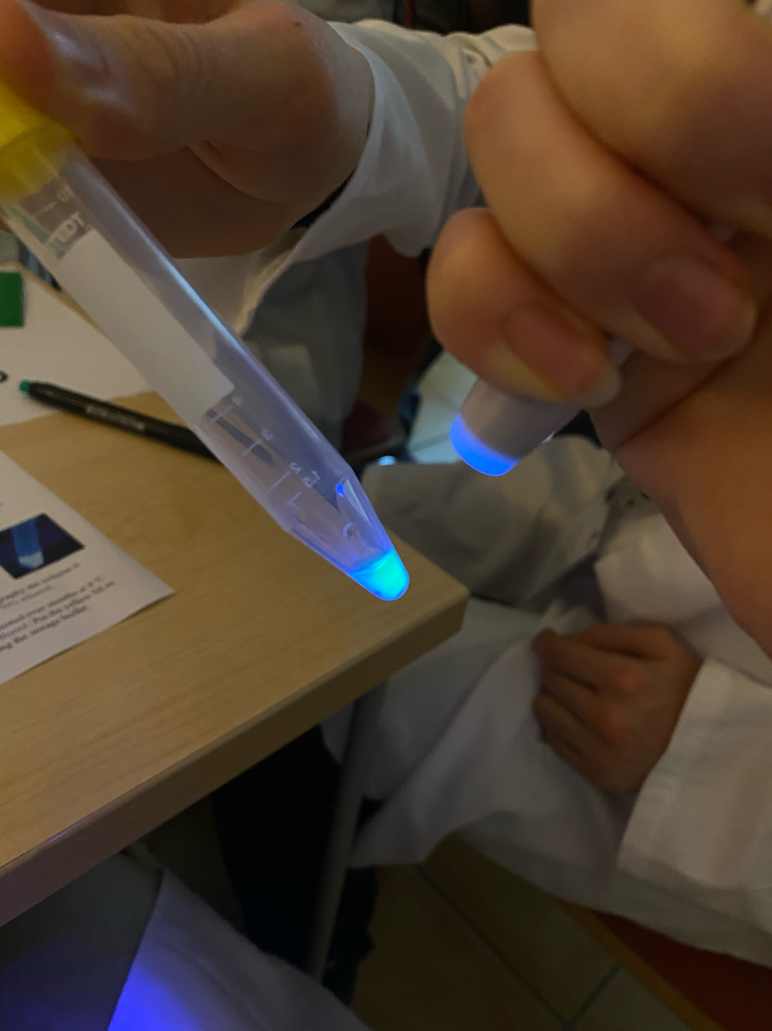
HIC
the BL tube contaning the E. coli lysate fluorescences in UV light meaning the GFP is present.
there is a line of fluorescent green on the top in UV light meaning the GFP is present and in the stationary phase
the line of fluorescent green is moving down and now is present at the bottom of the statiory phase
We collected three drops which were fluorescing green meaning the GFP was collected from the column to the tube

Slide 5
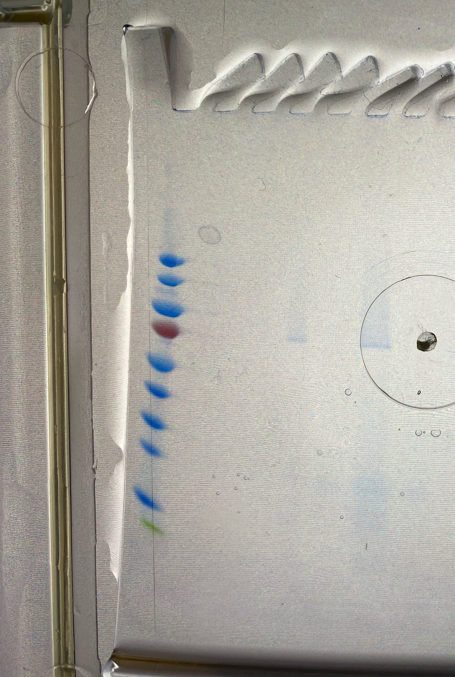
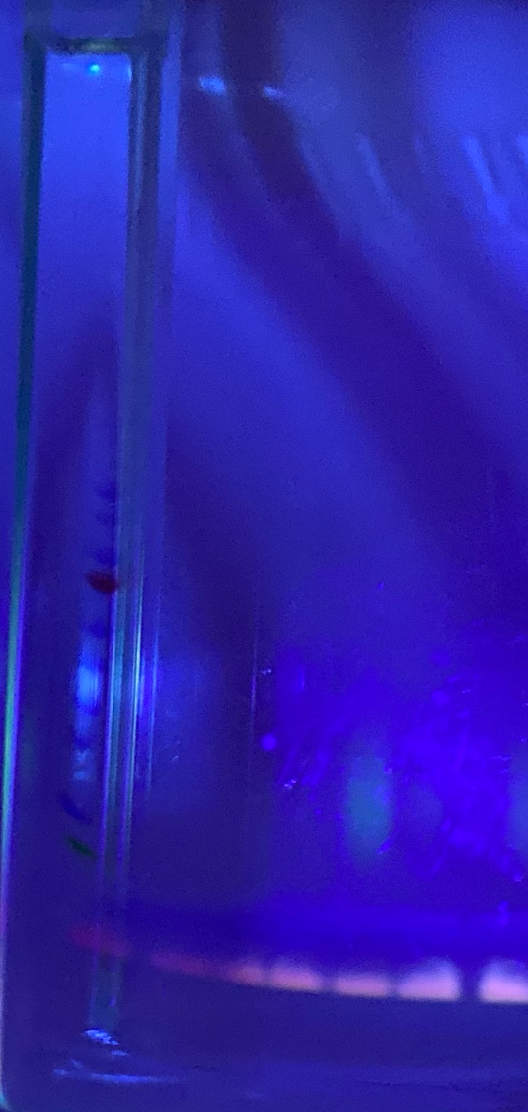
SDS-PAGE
In C1 and C2 we don’t see any proteins
There are a lot of bands of proteins in C3, because they are other proteins we separated during the HIC
In C4 we see a slight band which glows under UV meaning the GFP is present and survived the electrophoresis
In BB there are also a lot of bands because they are all the proteins from E.coli lysate
In C4D we don’t see any bands meaning there are no proteins
PS
C1
C2
C3
C4
BB
C4D

Slide 6
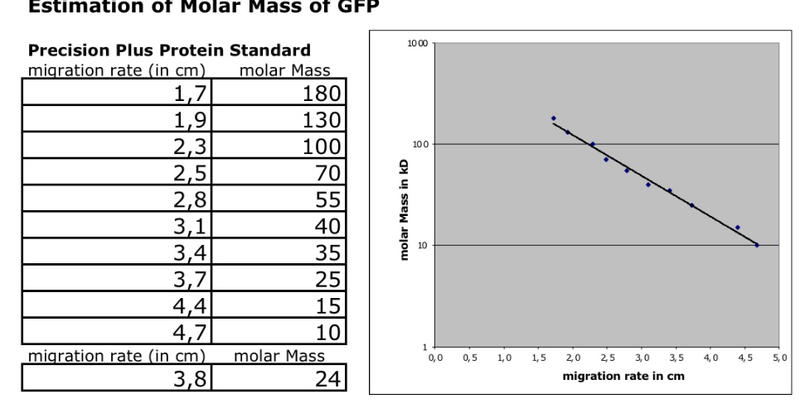
SDS-PAGE

Slide 7
Result
From HIC:
GFP is present in elution fractions(C4)
Other proteins are present in the elution fractions(C3)
From SDS-PAGE:
No, our GFP isn’t pure.
The chromatography worked.

Slide 8
Thank you for your attention!

