Slide 1
Summary of Results from Group 18

Slide 2

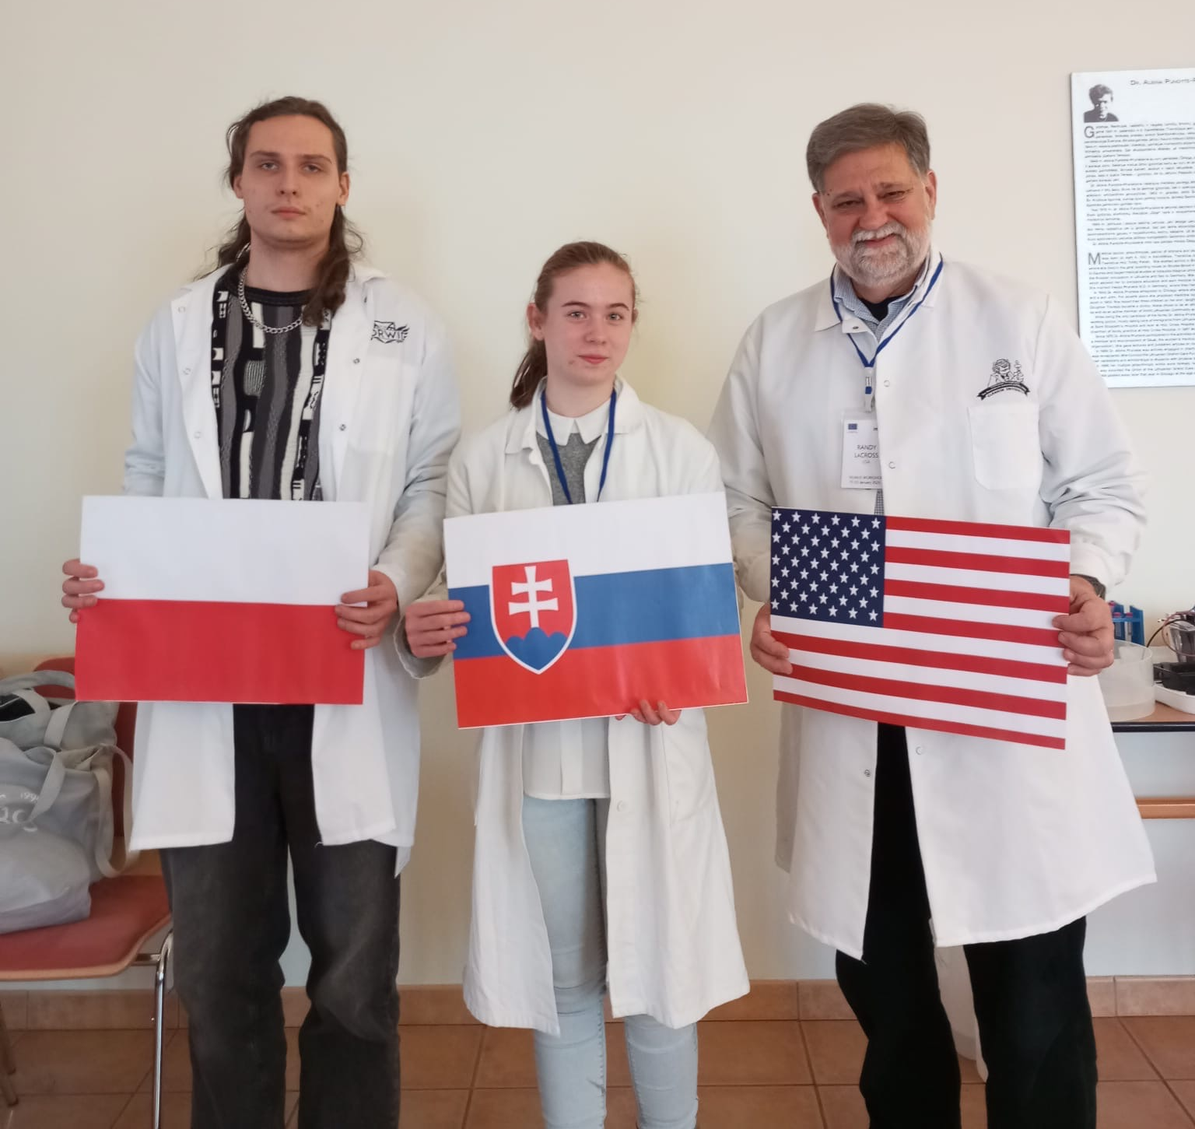


Group number 18 presentation of group members
Monika Dzurňáková
Student
Slovakia
Randy LaCross
Teacher
USA
Mentor:
Konrad Brodziak
Poland

Slide 3
Introduction of our experiment
Goal:
To isolate, purify GFP produced by E. coli by HIC
evaluate HIC by SDS-PAGE
Methods:
HIC (Hydrophobic-Interaction Chromatography)
SDS-PAGE
Molecular mass estimation

Slide 4
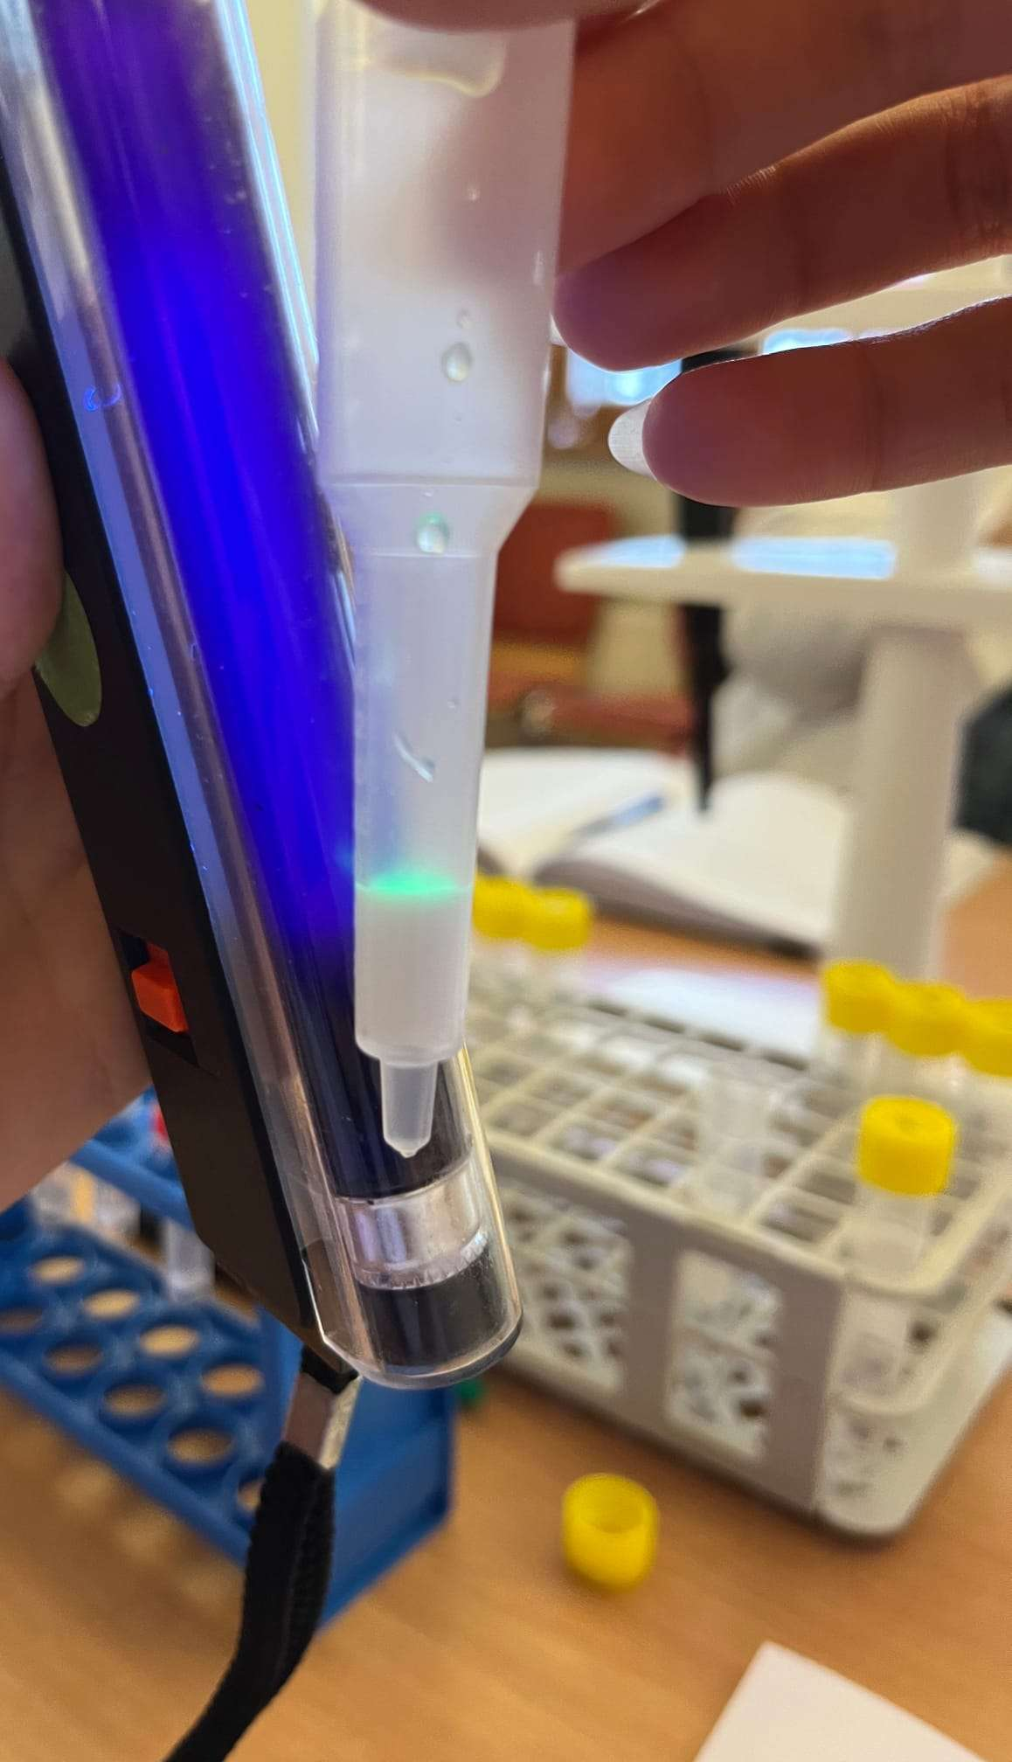
Introduction of HIC
Goal: To separate proteins based on hydrophobicity.
To prepare chromatography column (stationary phase)
Pipet 250 µl E.-coli-lysate in the tube with 250 µl of Binding Buffer (BB) (tube C1)
Pipet 750 µl of Washing Buffer (WB) into the column (tube C2)
Pipet 750 µl of Elution Buffer (EB) in the column (tube C3 and C4)
After the chromatography we washed the column in ethanol

Slide 5
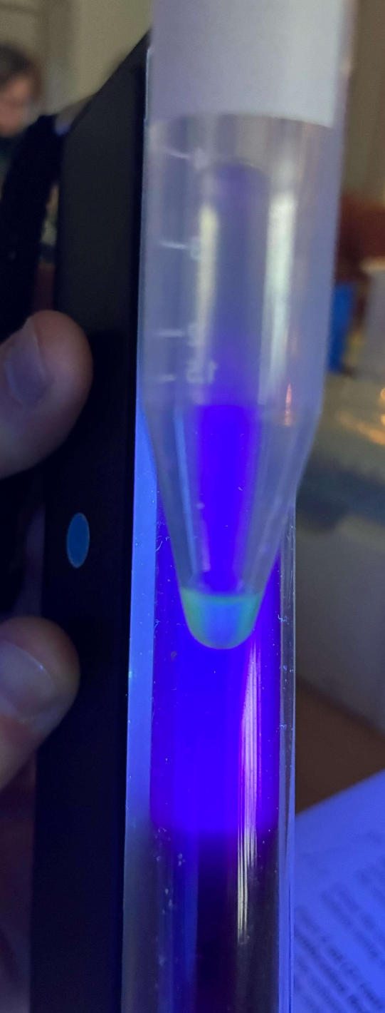
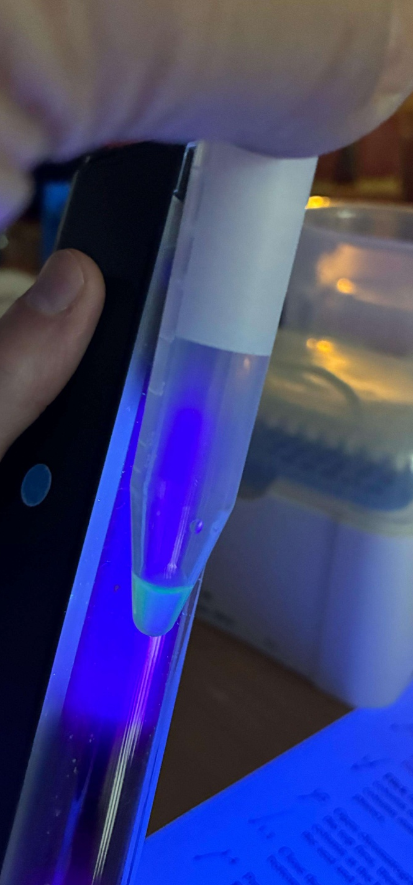
Result of HIC
C3
Observations:
tubes C1 And C2 were clear
tubes C3 And C4 were glowing under the UV lamp
Conclusion:
tubes C1 And C2 did not contain GFP
tubes C3 And C4 did contain GFP
C4

Slide 6
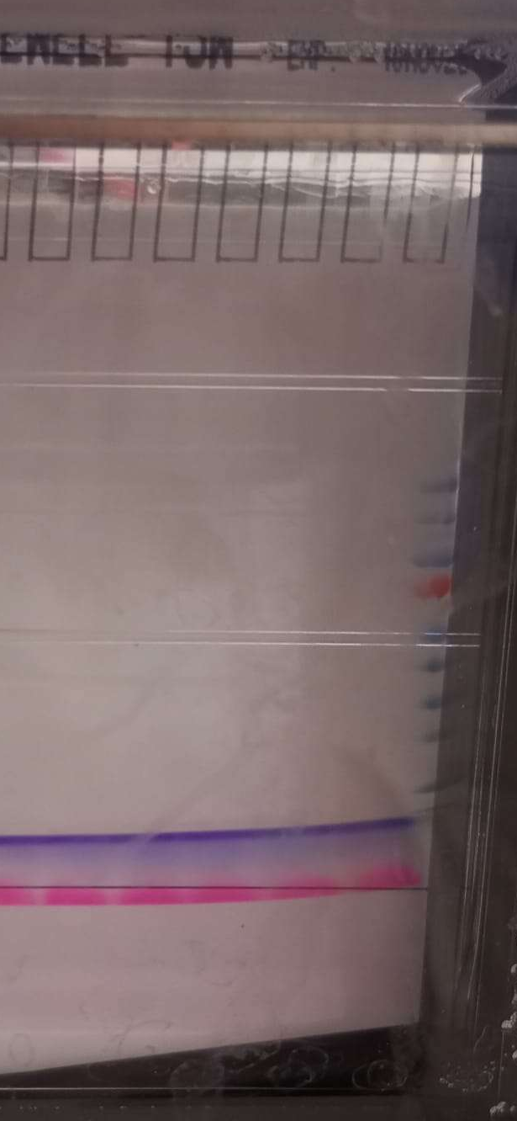
SDS-PAGE Introduction
Electrophoresis was done under 200V and 220mA
Electrophoresis was done succesfully

Slide 7
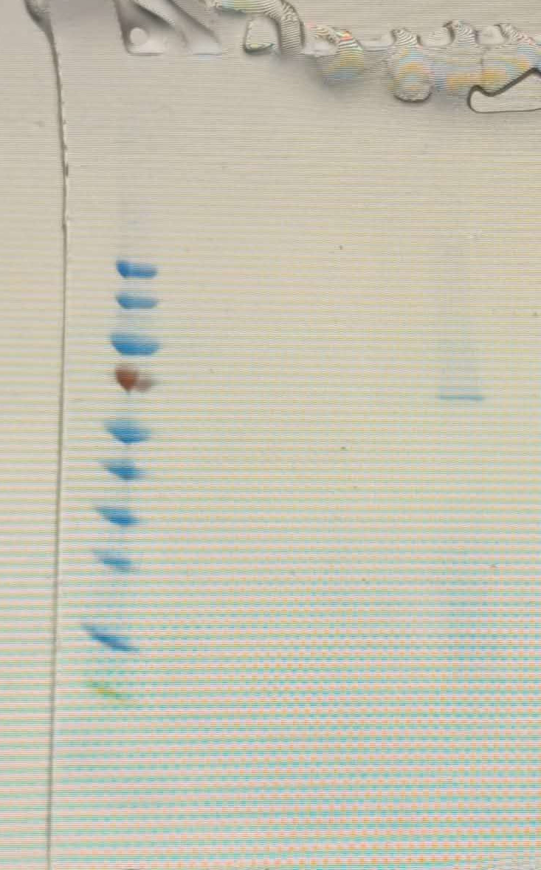
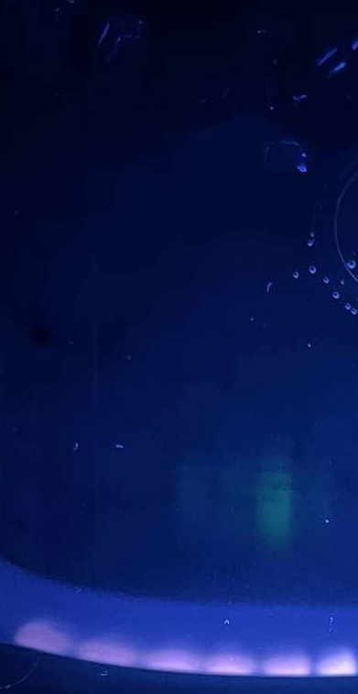
SDS-PAGE Result
PS C1 C2 C3 C4 BB C4D
In tube C3 there was more GFP than in C4
Glowing from C4 and C4D is the same -> DTT did not affect fluorophore of GFP
In C4 and C3, there were slightly visible bands at 65kDa and in 15-25kDa range.
Estimated GFP mass -> 19,9kDa
C3 C4 BB C4D

Slide 8
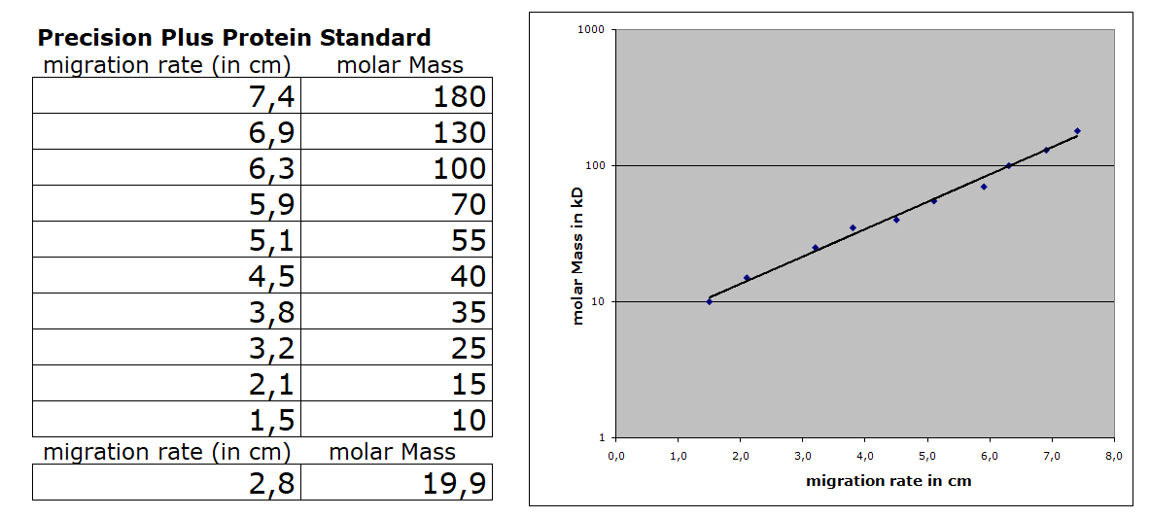
Calibration Line

Slide 9
Result
From HIC:
In tubes C1 and C2 GFP was not present,
In tubes C3 and C4 GFP was present,
In C4 and C3, there were slightly visible bands at 65kDa:
From SDS-PAGE
SDS-PAGE showed that there still were proteins left after elution, so GFP was not pure
Chromatography worked beacause of lower protein content in C4
Overall
Maybe there were problems with collum (mistake done in setup)
Wrong procedure while taking C4

Slide 10
Thank you for your attention!

