Slide 1
Summary of results from group 9

Slide 2

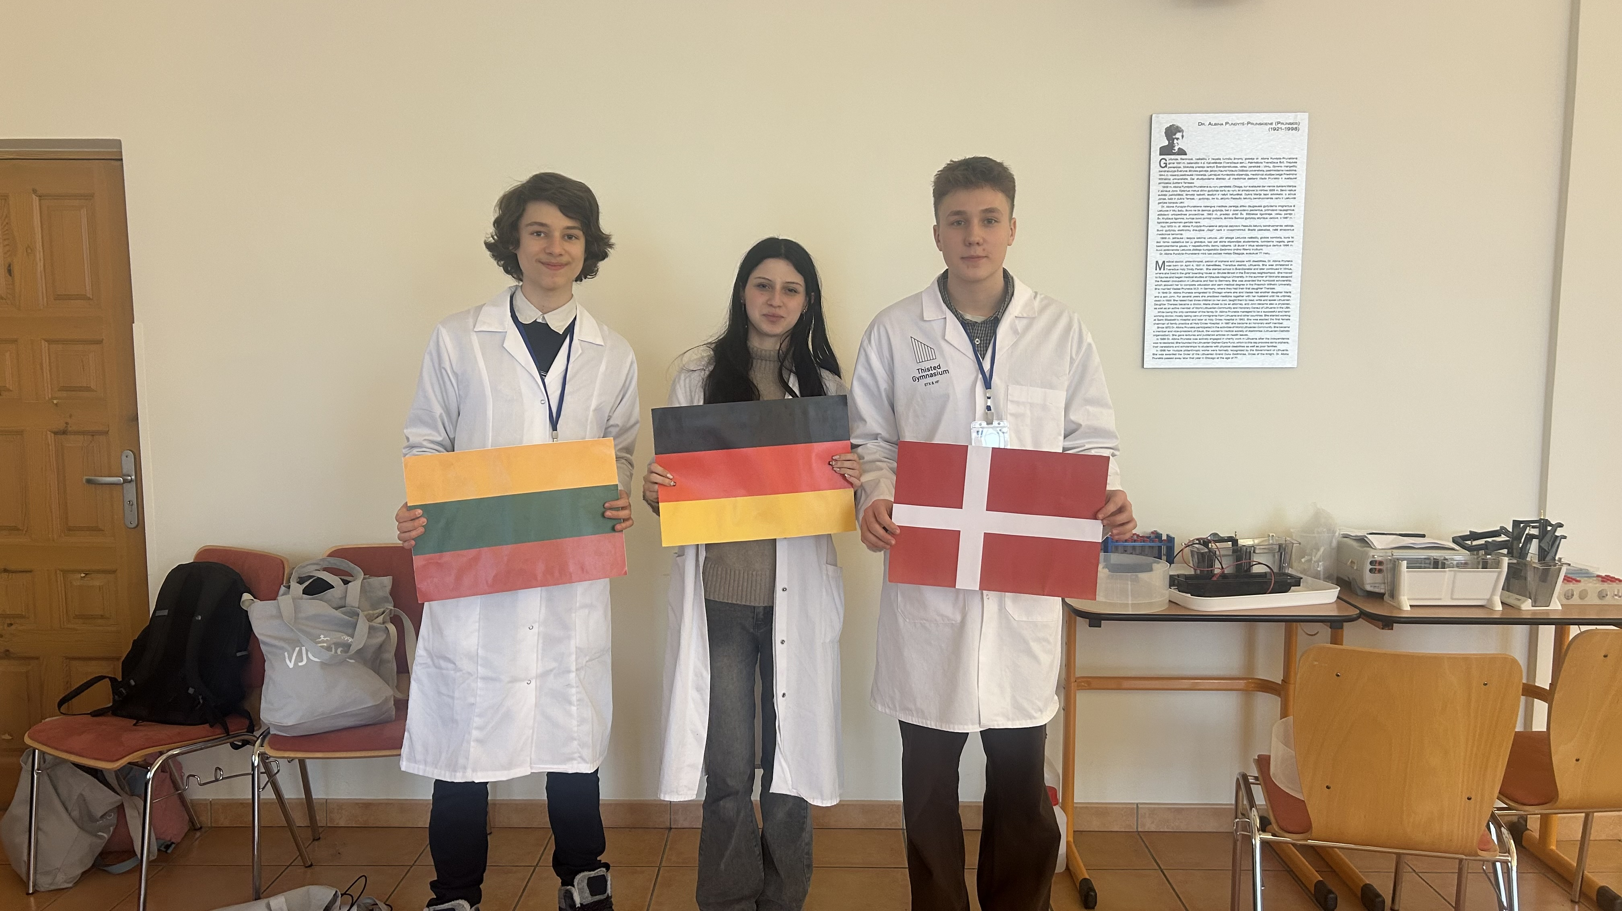


Group number + presentation of group members
Linas Ambrazevičus
Lithuania
Kimberly Bernatzky
Germany
Ivan Bannov Pedersen
Denmark

Slide 3
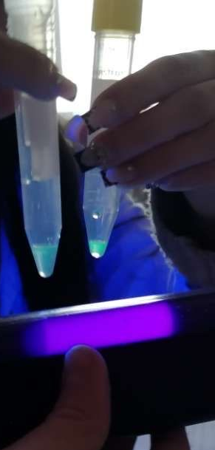
Introduction of Hydrophobic Interaction Chromatography
Goal: To isolate the GFP and separate proteins based on their hydrophobic interactions
Conditions:
High salt concentration
Hydrophobic stationary phase
Low salt concentration for elution

Slide 4
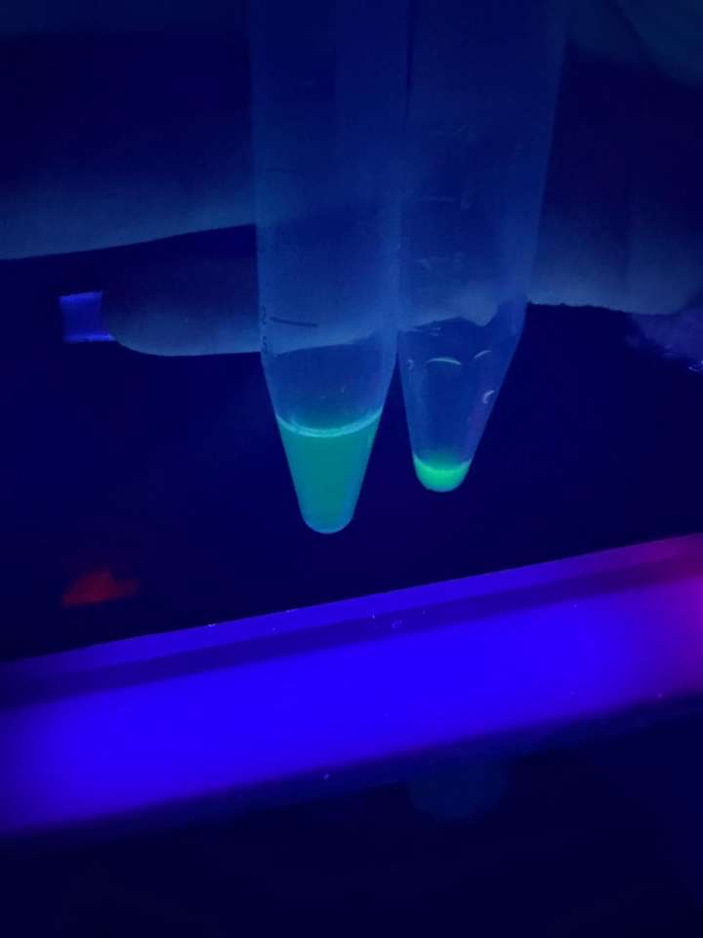
Results of HIC
C₃
C₄
Observations
Task 1:
Under UV light, the lysate floursced green, confirming the presence of GFP
Task 2:
In high-salt conditions, GFP bound to the hydrophobic stationary phase and was visible at the top of the column.
Task 3:
During the washing, non-target proteins were removed while GFP remained bound to the column.
Task 4:
After adding the EL GFP was released and collected as a fluorescent fraction.

Slide 5
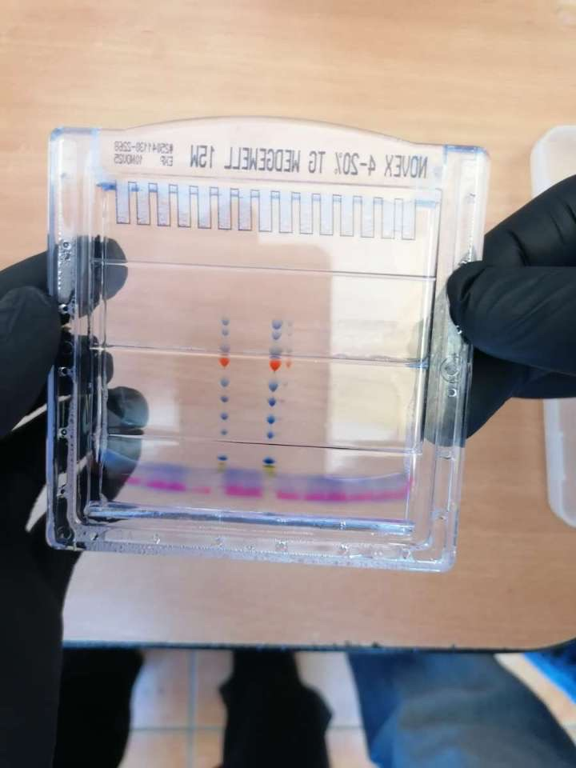
Introduction of PAGE
Goal: to separate biological macromolecules, most commonly proteins.
Electrophoretic mobility, influenced by their size, charge and shape.

Slide 6
Diagramm of PAGE
Distance in cm | Log molar Mass
5,0 | 2,26
4,6 | 2,11
4,1 | 2
3,8 | 1,85
2,8 | 1,74
2,4 | 1,6
1,7 | 1,54
1,1 | 1,4
0,3 | 1,18
0,0 | 1

Slide 7
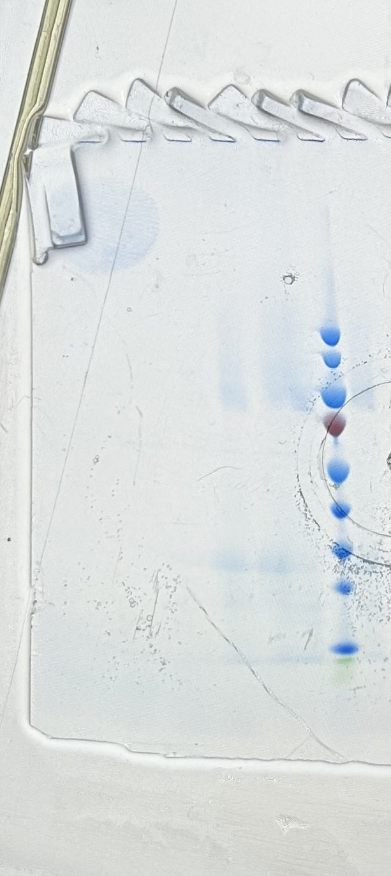
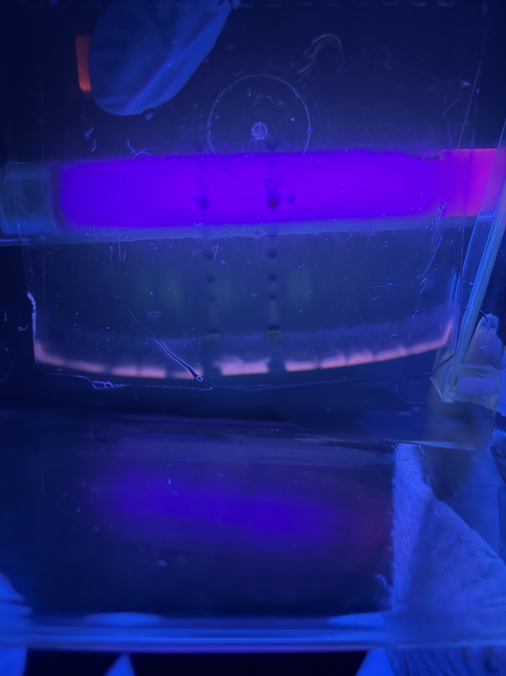
Results of PAGE
Based on our measurements of the migration of GFP from our starting point, GFP has a molar mass between 25-35 kDa.
GFP is stable after a treatment of 200 volt.
C₁
C₂
C₄
BB
C₄D
C₃
PS

Slide 8
Conclusion
HIC was a pretty effective way of seperating proteins
There was no GFP in C₁ and C₂, but there was GFP in C₃
We had other proteins in the washing fractions
PAGE is a great method of evaluating protein purification
PAGE showed that GFP was not pure after chromatography

Slide 9
Thank you for your attention

