Slide 1
Summary of results from group 4

Slide 2
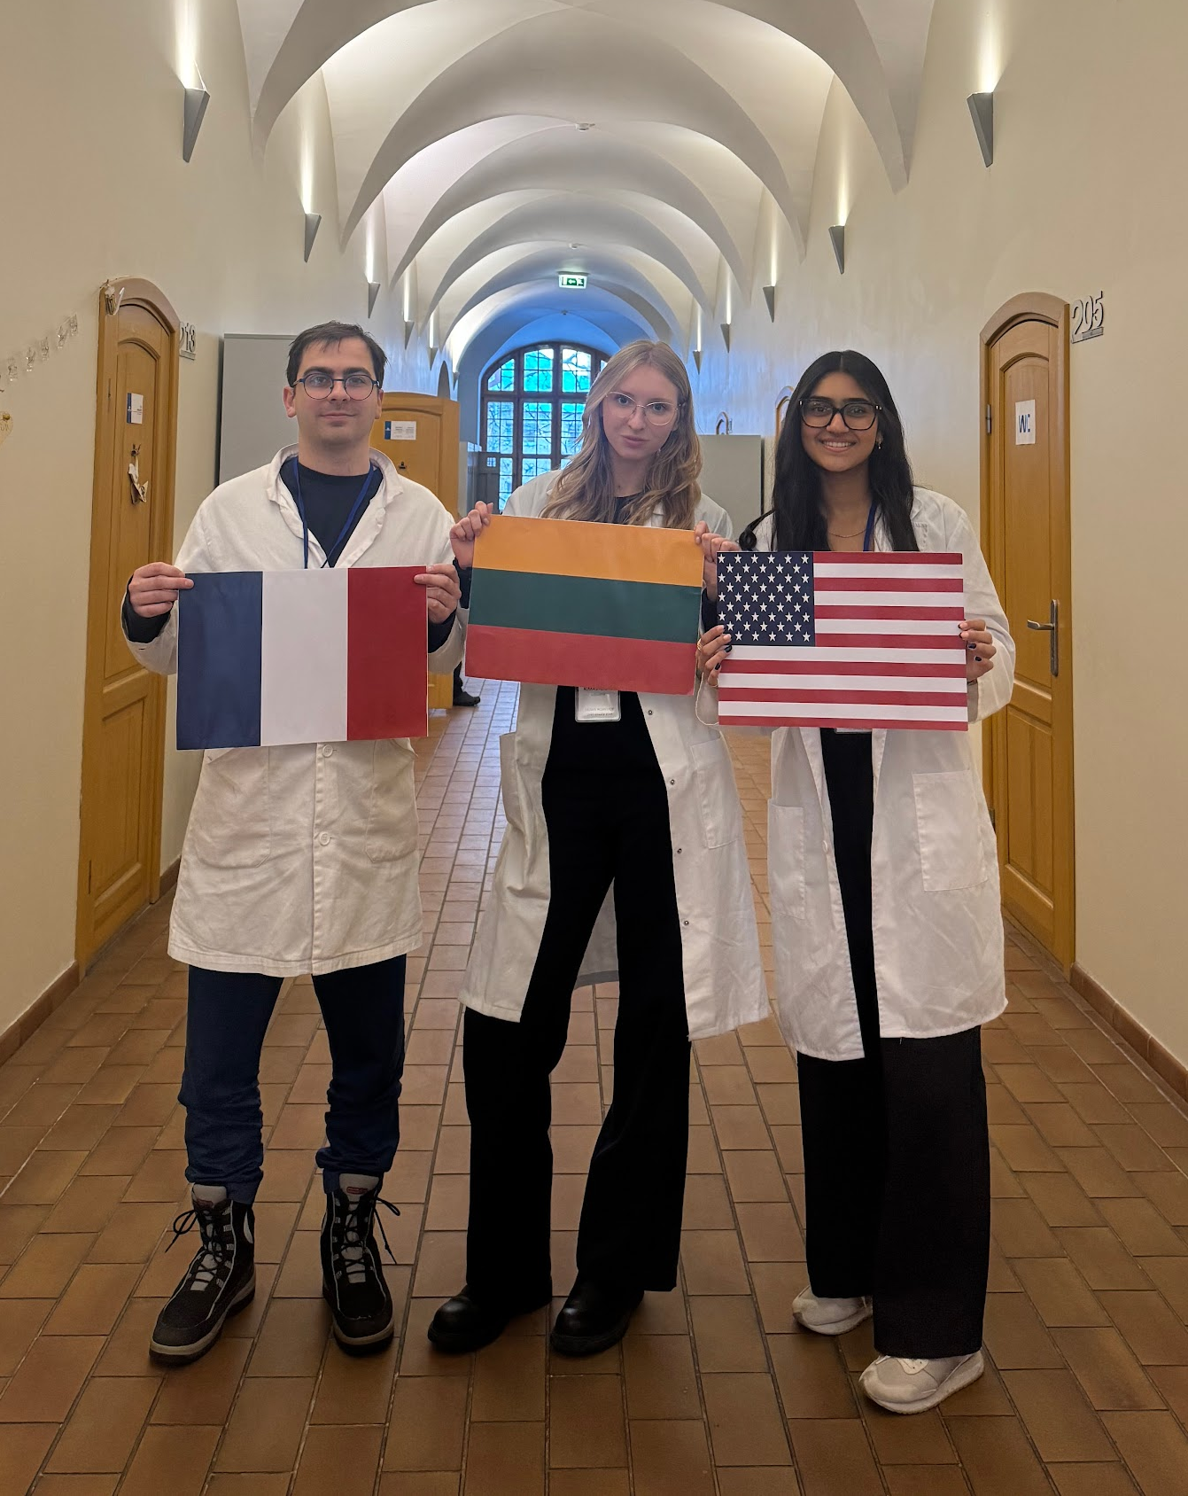



Presentation of group members
Diya Patel
United States
Valentin Baton
France
Ainė Rimavčiutė
Lithuania
„grou picture“

Slide 3
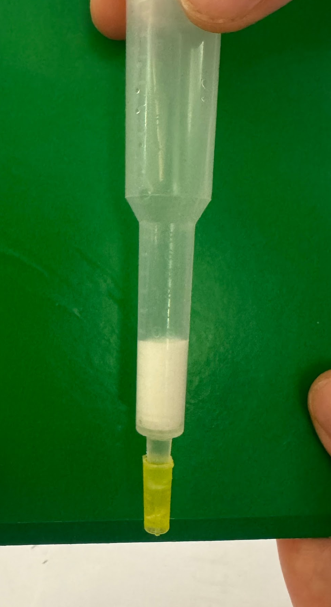
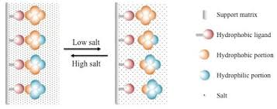
HIC Introduction
Goal: isolate and purify the GFP
EB added to column
to balance
Stationary Phase
BB/lysate added to column
proteins become more hydrophobic and bind
Support matrix
WB added to column
Washes away the more hydrophilic proteins
EL added to column
keeps only the most hydrophobic proteins
Hydrophobic ligand
Hydrophilic ligand
Hydrophilic portion
Salt

Slide 4
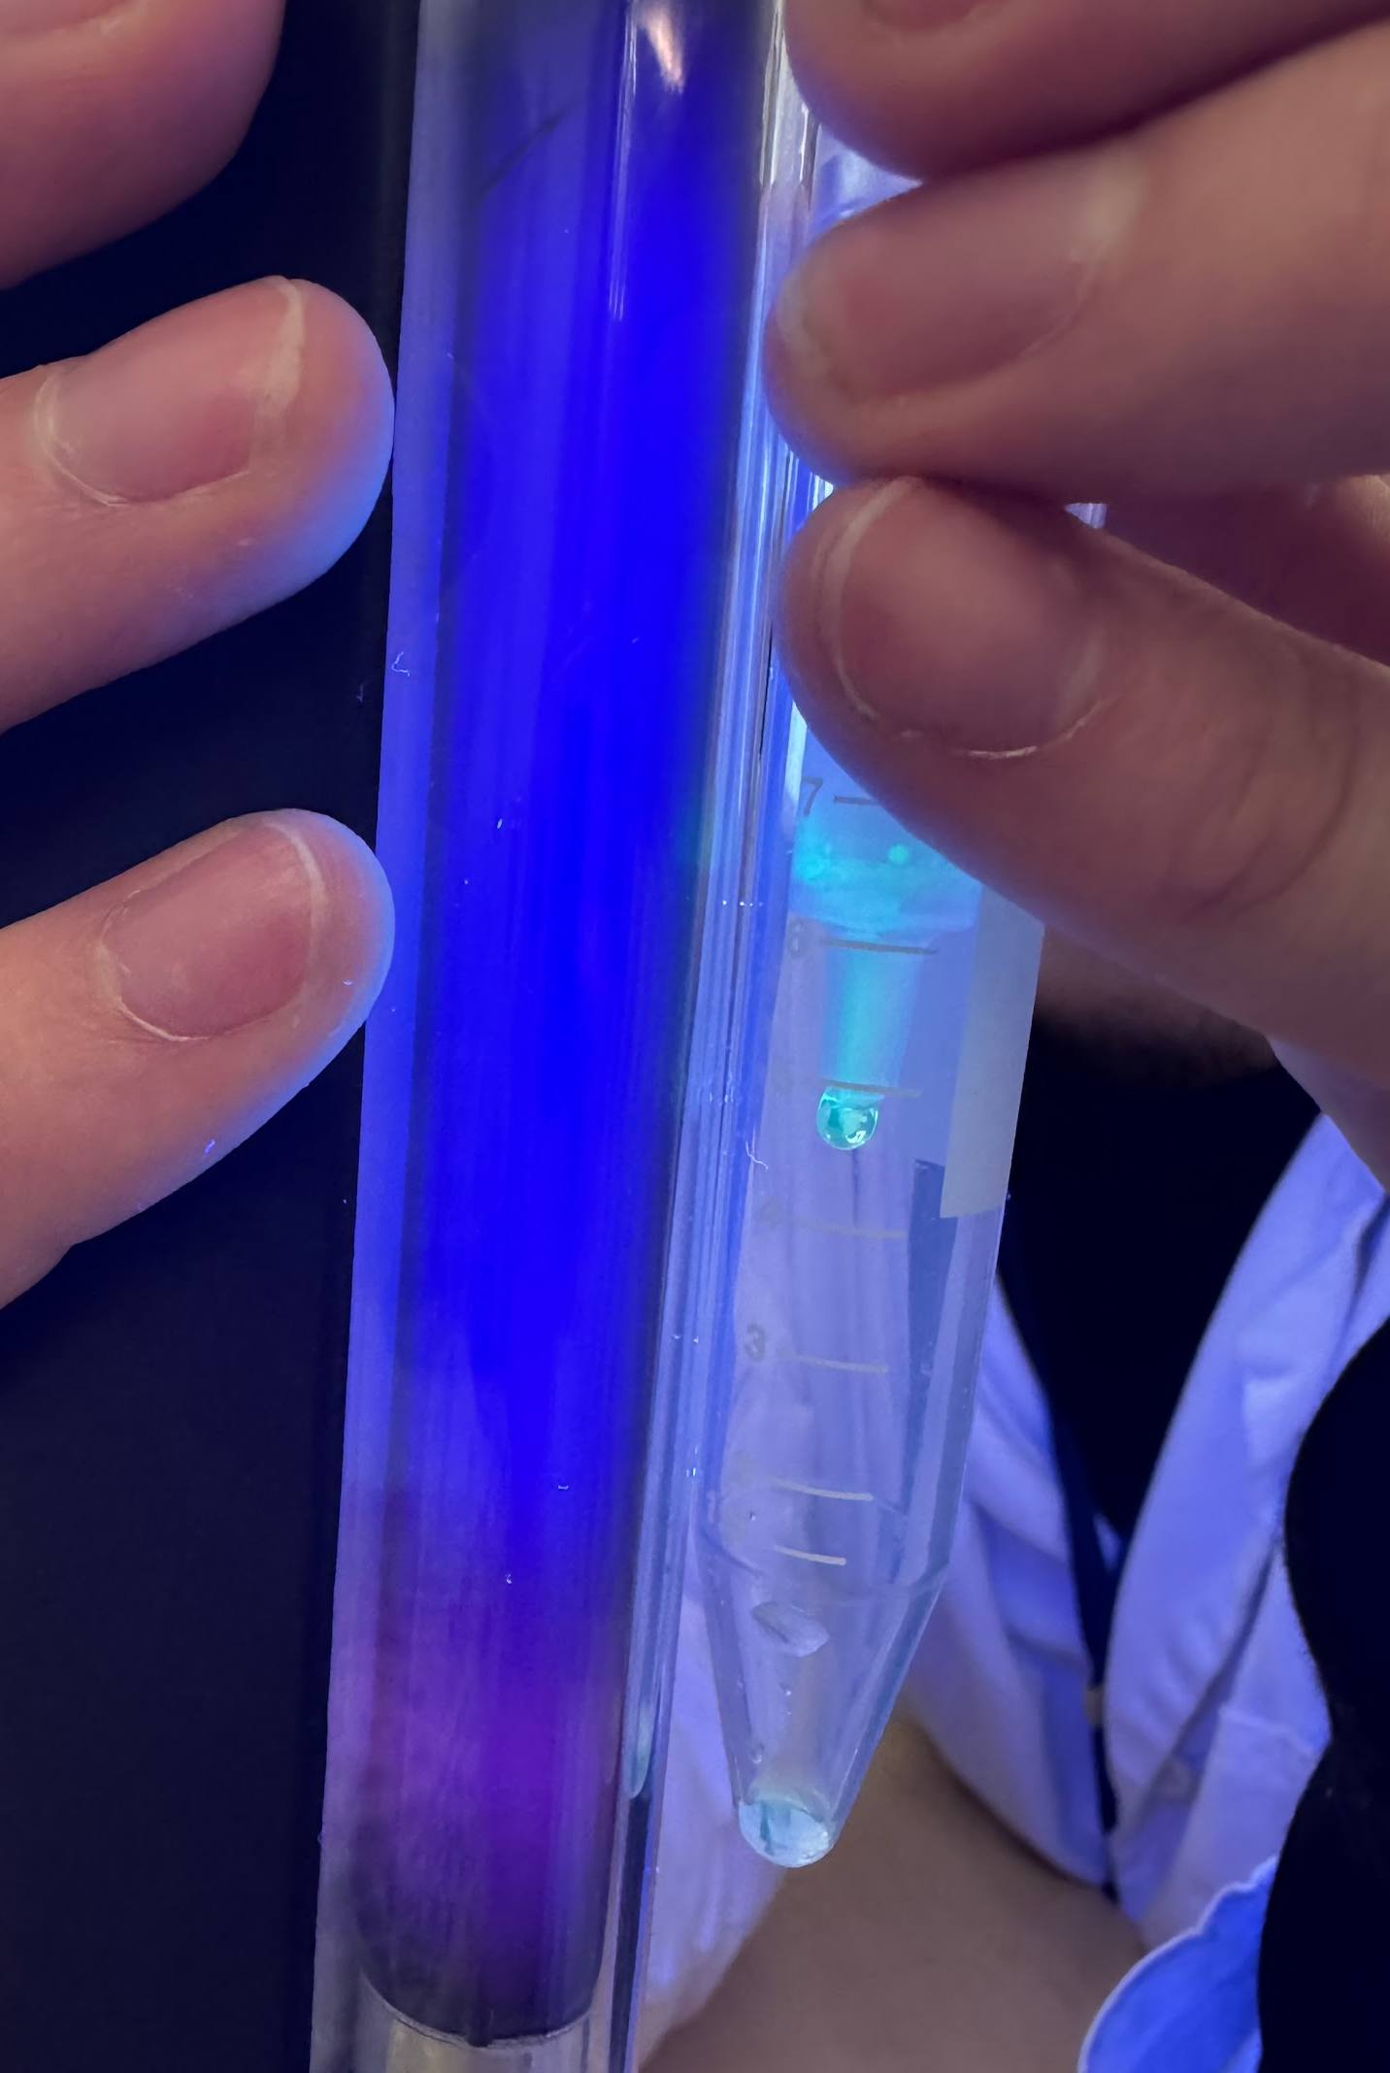
HIC Results
Tasks:
The green fluorescent proteins shows up in the lysate
There is green fluorescence in our column at the top of the stationary phase (BB)
The GFP is making its way down still in the stationary phase (WB)
We observe the GFP exiting the stationary phase drip by drip (EL)
Highly concentrated GFP

Slide 5
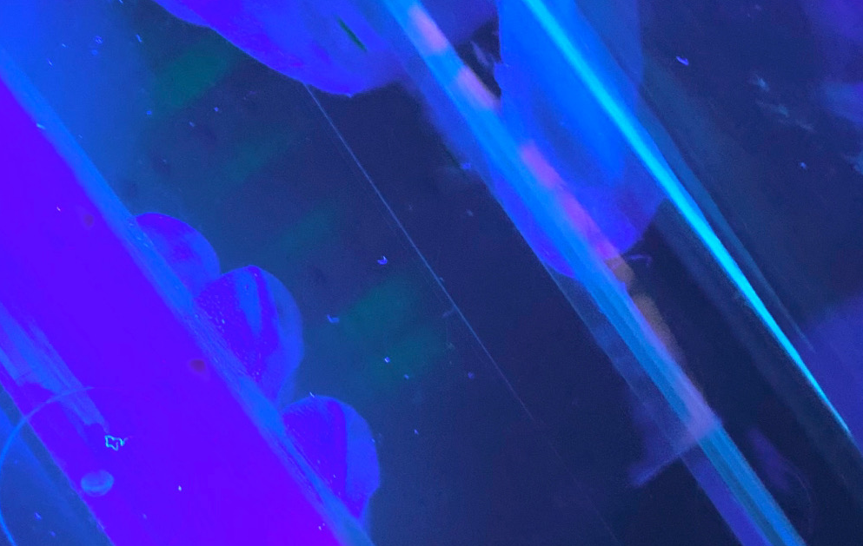
SDS-PAGE Introduction
Principle
separates the molecule by only the size
SDS makes all molecules negatively charged
C4D
BB + Bacteria lysate
C4

Slide 6
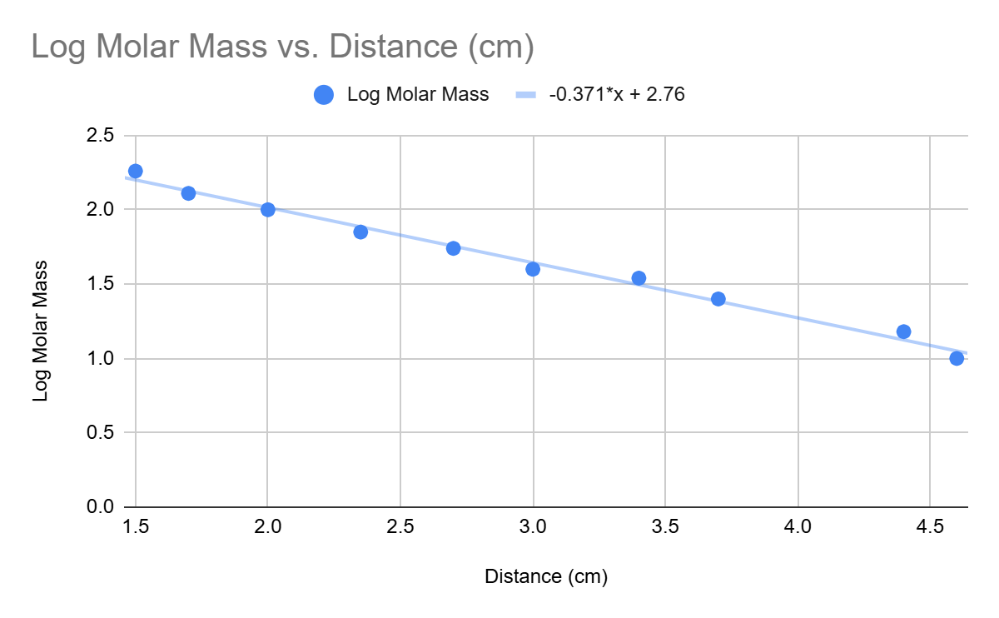
SDS-PAGE Results
d(GFP)=3.5 cm
log(MW_{GFP})=1.46
MW(GFP)=28.8 kDa
Notes:
N is an absolute number

Slide 7
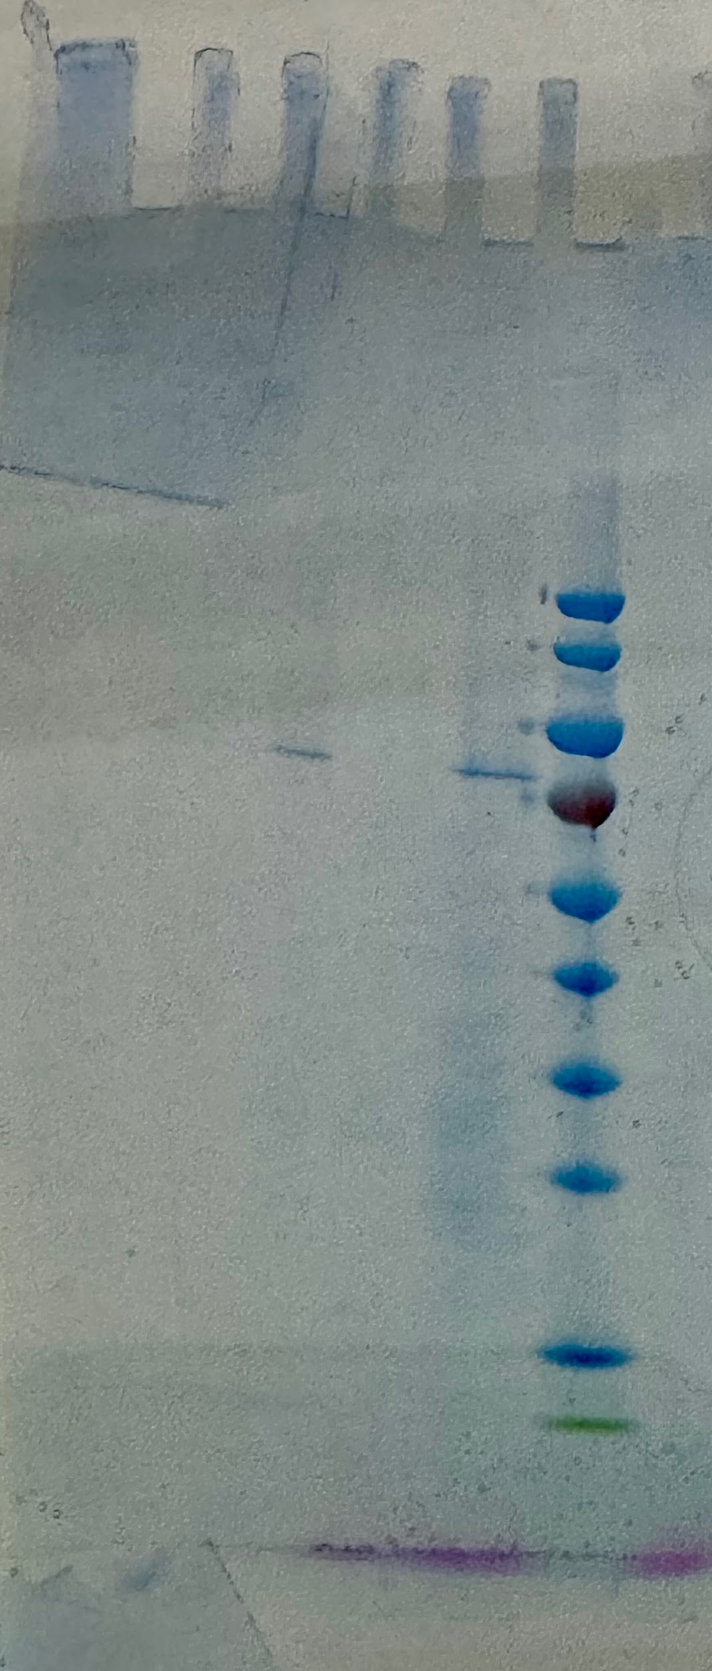
SDS-PAGE Results
Observation:
C1 and C2 nothing
C3 one strong band between 70-100 kDa but a small band between 25-35 kDa (GFP)
C4 band at 25-35 kDa (GFP)
BB + Lysate lots of bands
C4D band at 25-35 kDa (GFP)
Interpretation:
No protein C1 and C2
C3 some protein including GFP
C4 has the highest GFP concentration with only GFP visible
BB + Lysate lots of proteins
C4D small amount of GFP
BB + lysate
C4D
C4
C3
C1
C2

Slide 8
Conclusion
GFP can resist 200V
GFP molecular weight is around 28.8 kDa
isolated and purified GFP in C4
lysate has multiple whereas C4 has one
denaturation destroyed all proteins besides small trace of GFP

Slide 9
Thank you for your attention!

