Slide 1
Summary of results from group 13

Slide 2




Group number + presentation of group members
Barbora Pomikalová
Student
Slovakia
Abhi Samala
Student
USA
Mentor:
Faidra Kosteletou
Greece
„group picture“

Slide 3
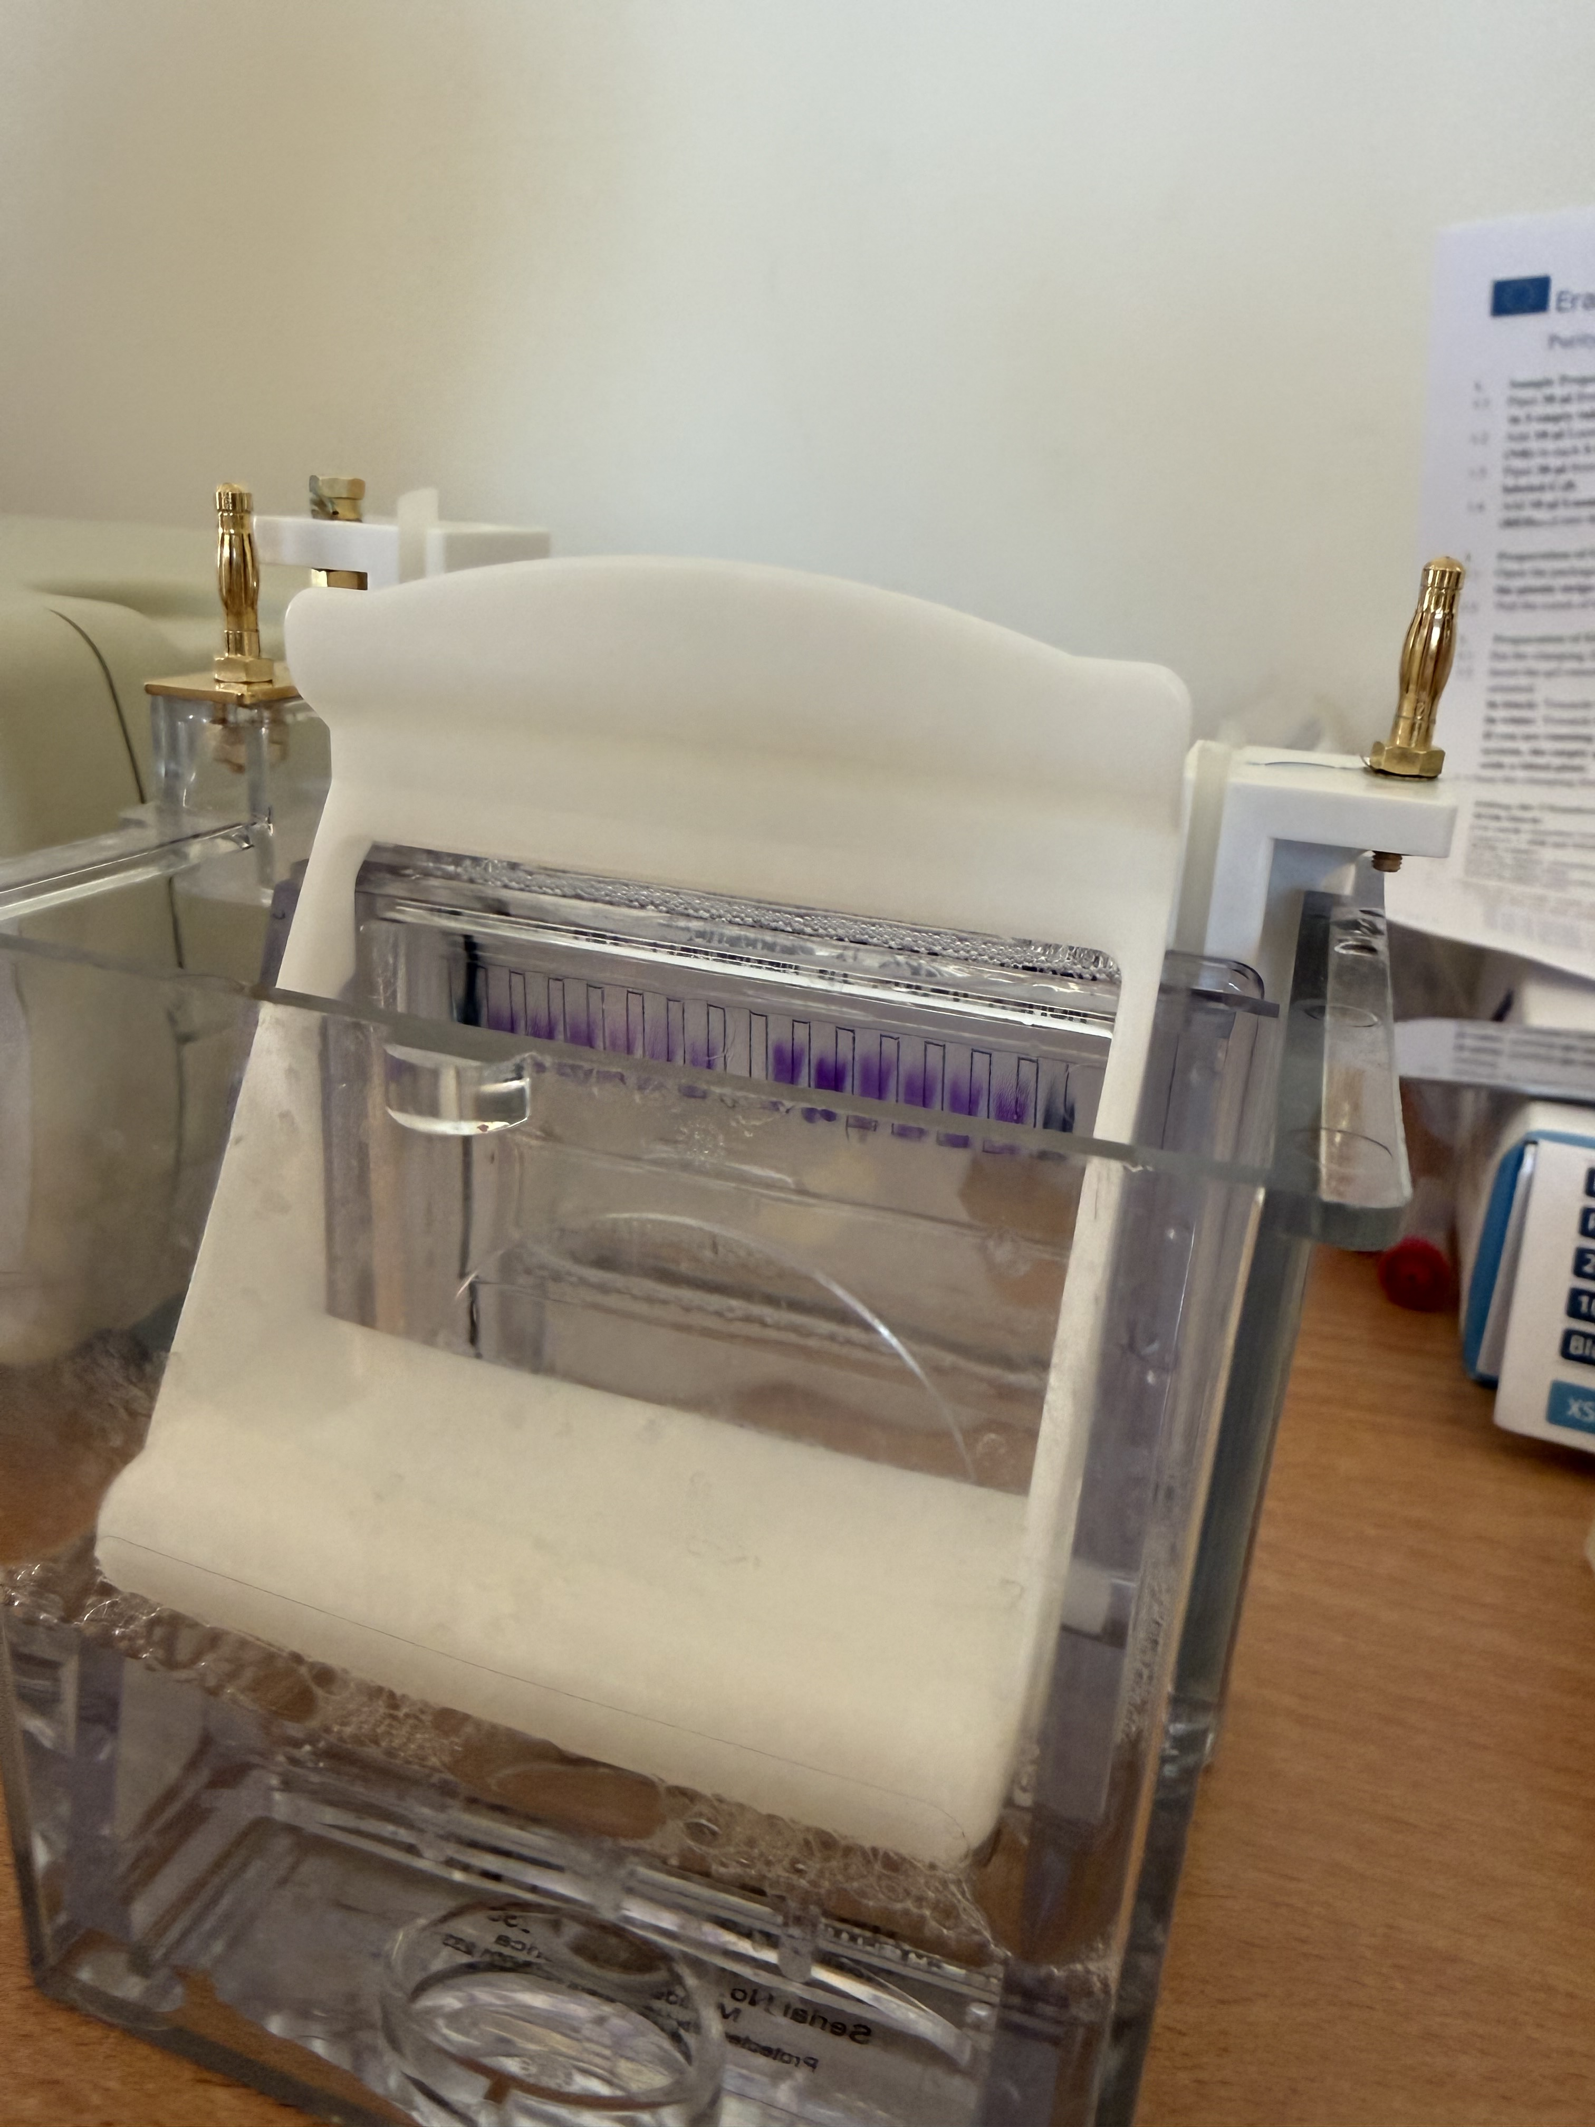
Introduction of our experiment
Goal: Isolate GFP in E. coli to have only GFP out of 3000 other proteins and verify its purity
Methods:
HIC for isolation of GFP
SDS-PAGE for verifying purity of GFP

Slide 4
HIC
PROCESS:
Equilibration: The hydrophobic stationary phase (SP) was equilibrated with Equilibration Buffer (EB) containing high salt concentration (2M Ammonium Sulfate [(NH₄)₂SO₂]).
Loading: A volume of Binding Buffer (4M) was diluted with our sample, and the mixture (2M) was loaded into the column under high salt conditions, allowing GFP to bind to the SP. GFP was at the top of SP. The other proteins are collected in tube C1.
Washing: Non-binding or weakly bound proteins were removed with Washing Buffer (1,3M), while GFP remained bound. The proteins was dropping into tube C2.
Elution: Elution Buffer (EB) was applied (0,005 M)– GFP was moving through SP and gradually eluted into the collection tube C3.
When drops became increasingly fluorescent the most purified GFP fraction was collected in tube C4.
Finally, the column was washed with 70% ethanol, stored with 20% ethanol.

Slide 5
SDS-PAGE
PROCESS:
SDS was applied to all the samples of proteins.
The gel has porous structure.
We also added a standard to compare our samples to create a calibration line to calculate the molar mass of our GFP.
We stained our samples with blue dye so that we could see all other proteins.
Most of our samples had non-reducing buffer except for the C4D sample which contained a reducing buffer (DTT).

Slide 6
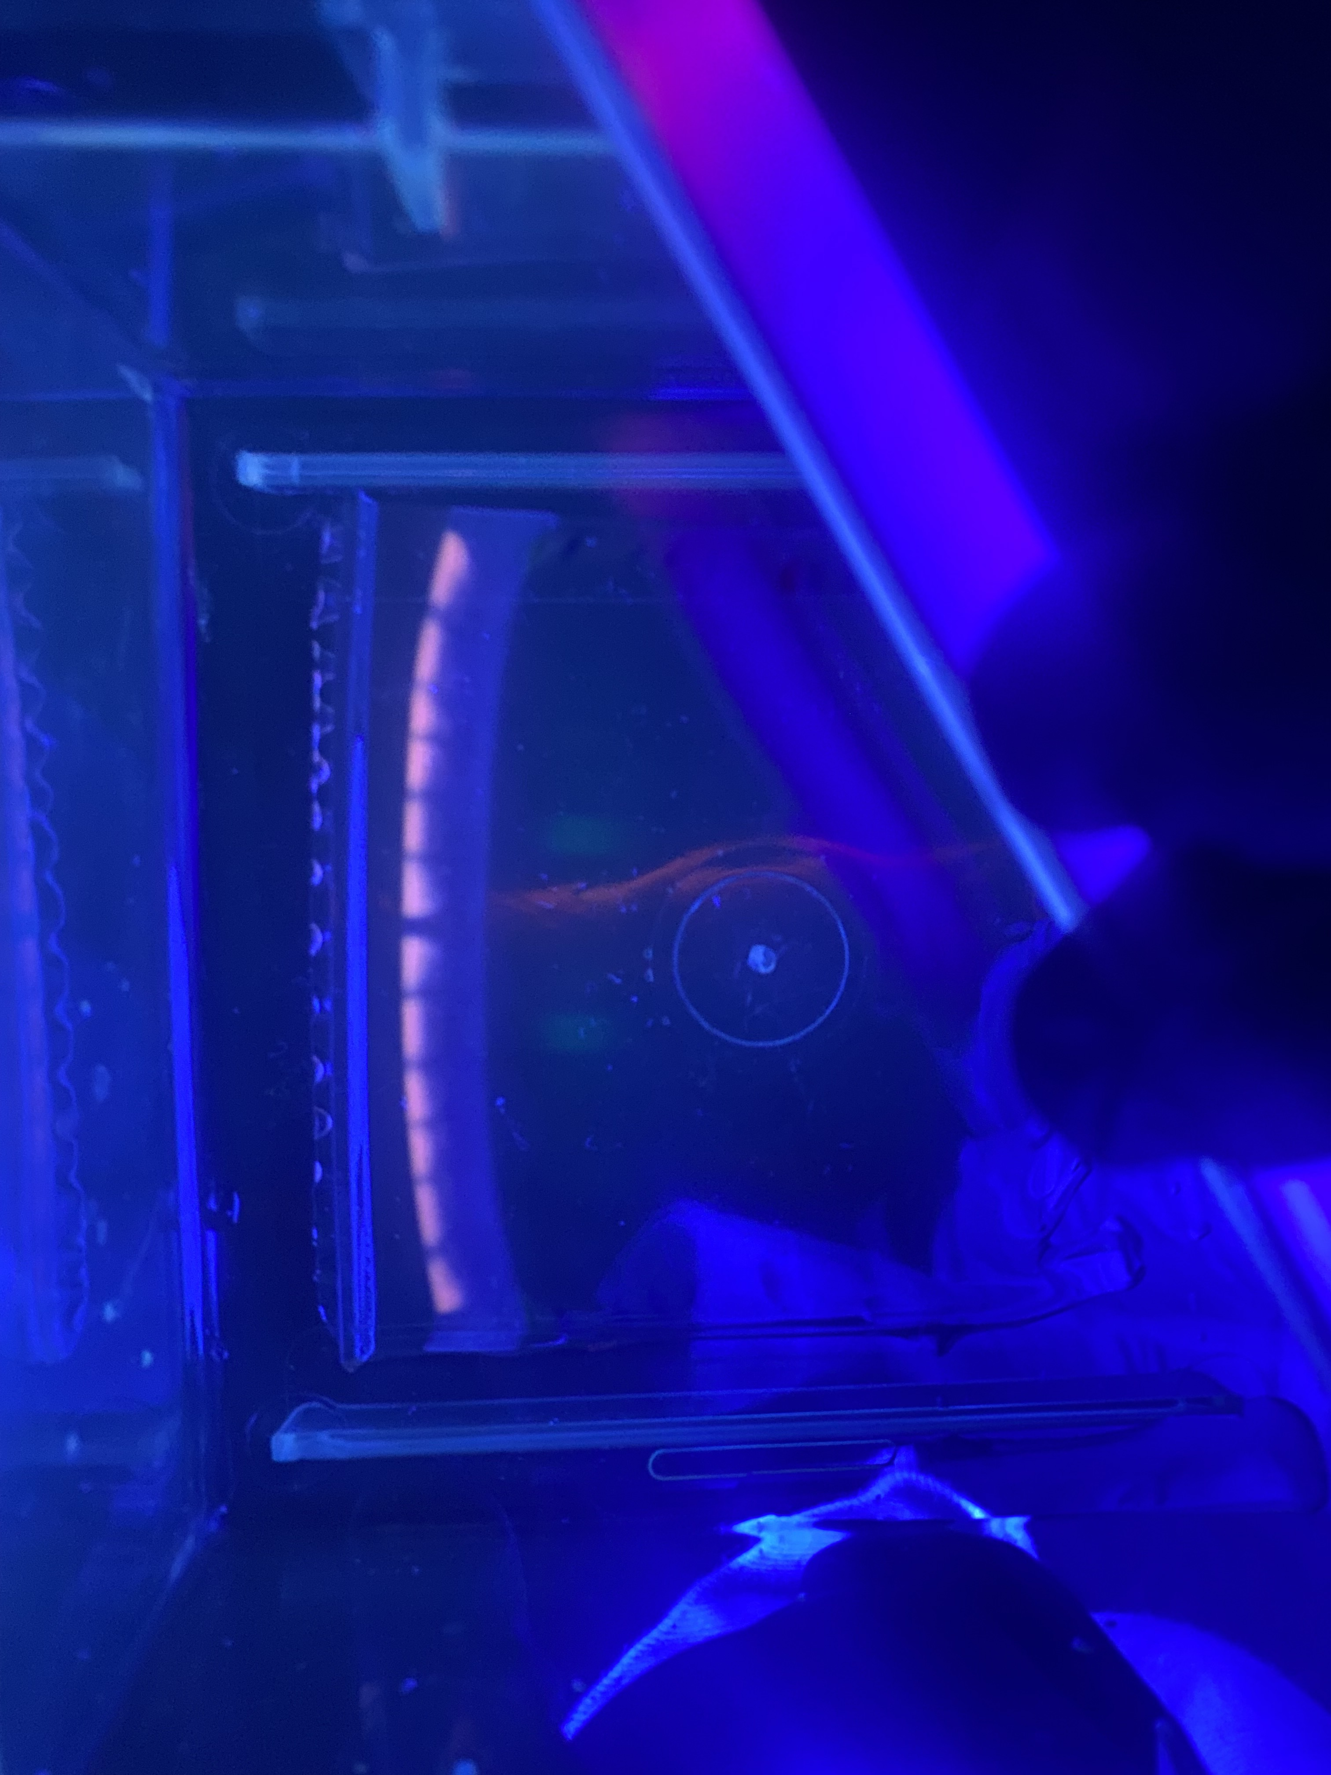
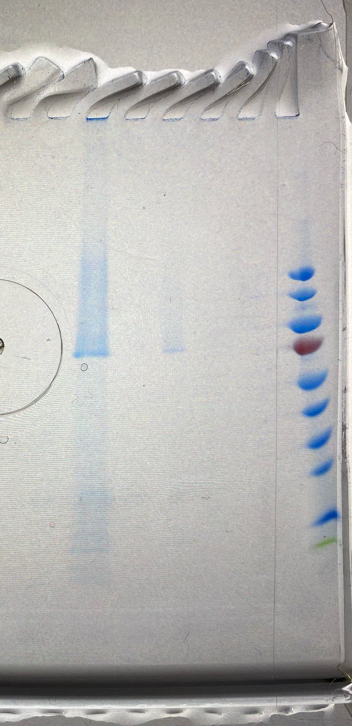
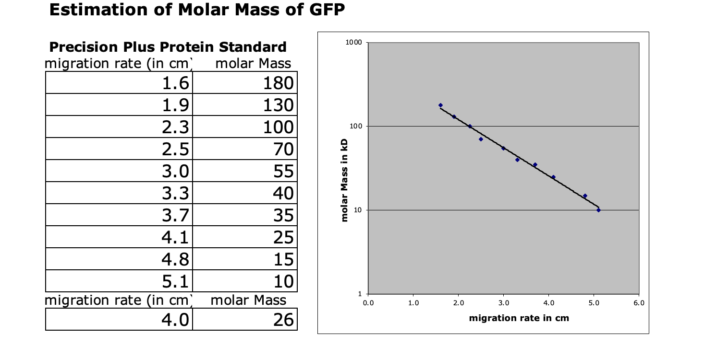
SDS-PAGE
C4D
BB
C4
C3
C2
C1
PS
PS
C4D
BB
C4
C3
C2
C1
GFP
C4D
BB
C4
C3
C2
C1
PS
Expected location of GFP

Slide 7
Results
From HIC:
We didn’t take pictures of the HIC
From SDS-PAGE:
The GFP is not pure as there are other bands in the gel
GFP was visible before staining on BB, but not after staining

Slide 8
Thank you for your attention!

