Slide 1
Summary of results from group 11

Slide 2
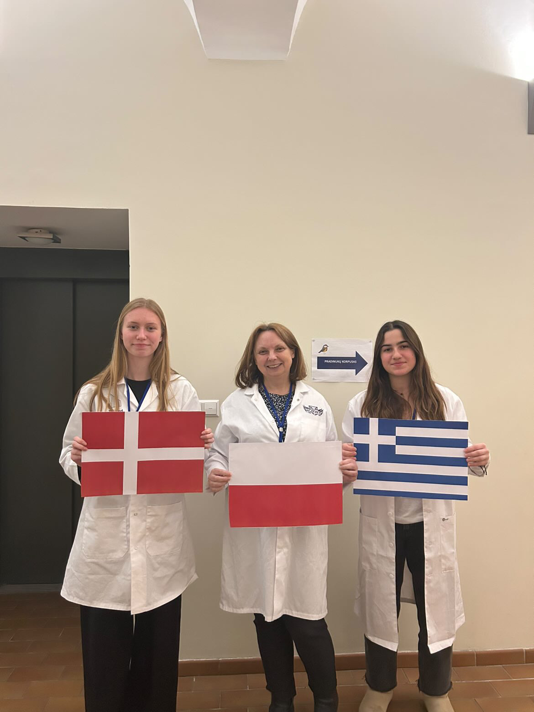



Presentation of group members
Katrine Smed
Denmark
Magdalena Korbyla
Poland (T)
Anastasia Athanasiou
Greece (M)
„flag“
„flag“
„group picture“

Slide 3
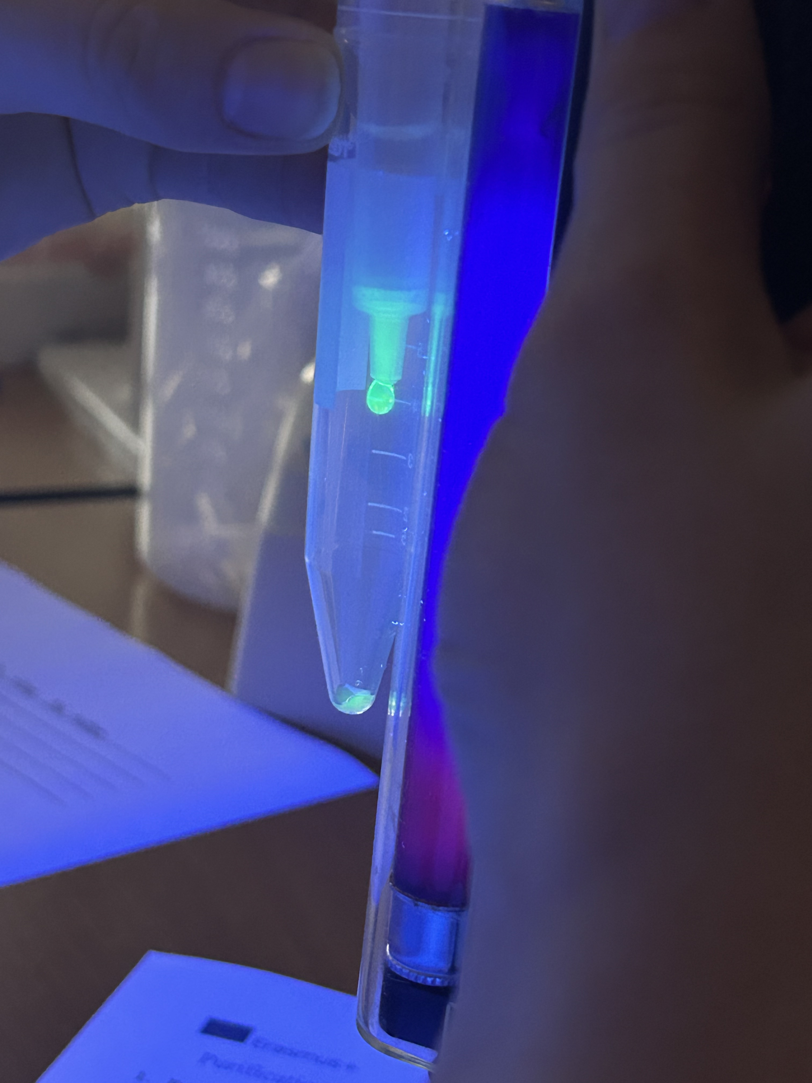
Introduction of our HIC experiment
Goal: Purification of GFP out of an E. coli lysate by Column Chromatography
GFP is visible under UV-light
Picture of purified GFP running though the column
under UV-light

Slide 4
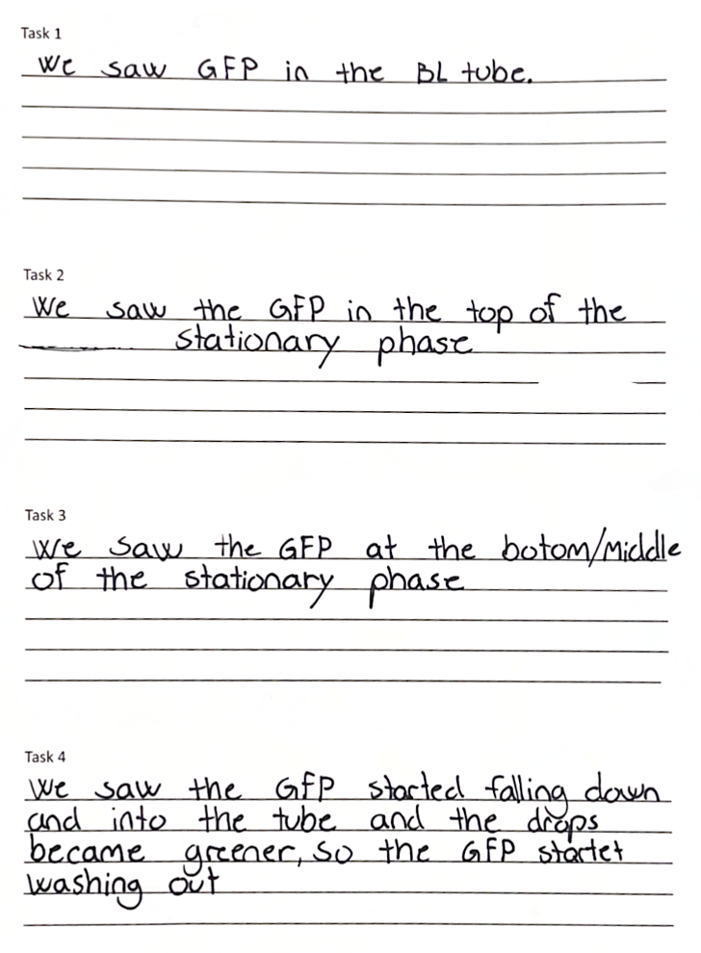
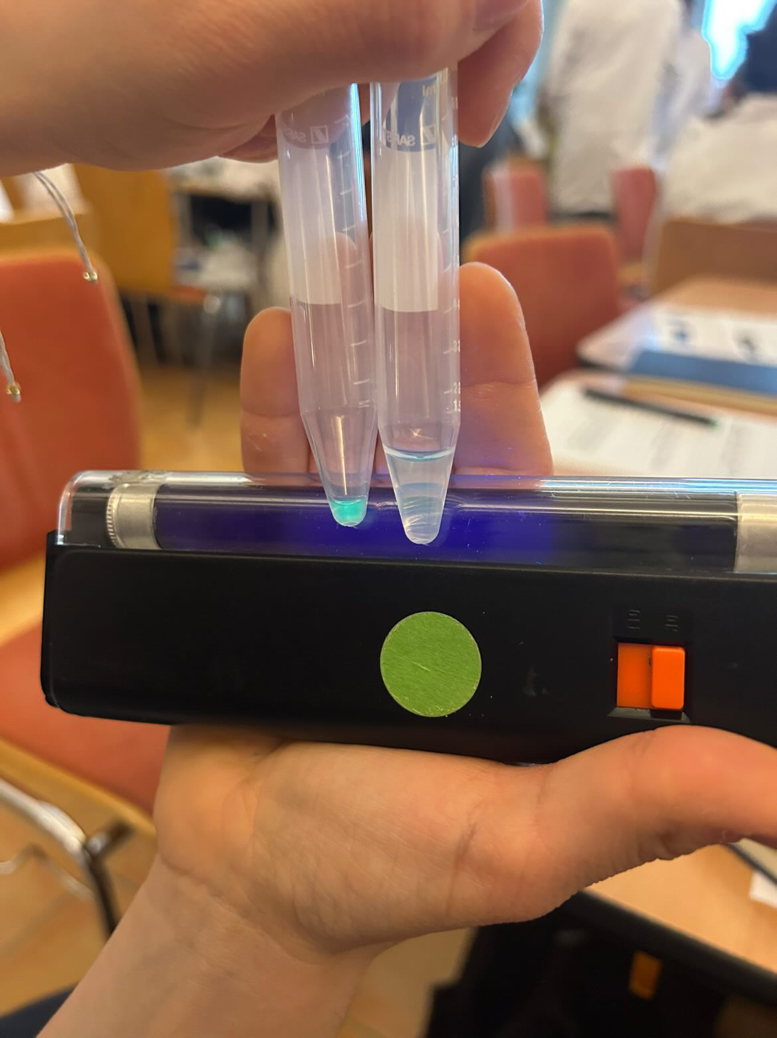
Results of our HIC experiment
GFP in the elution fractions

Slide 5
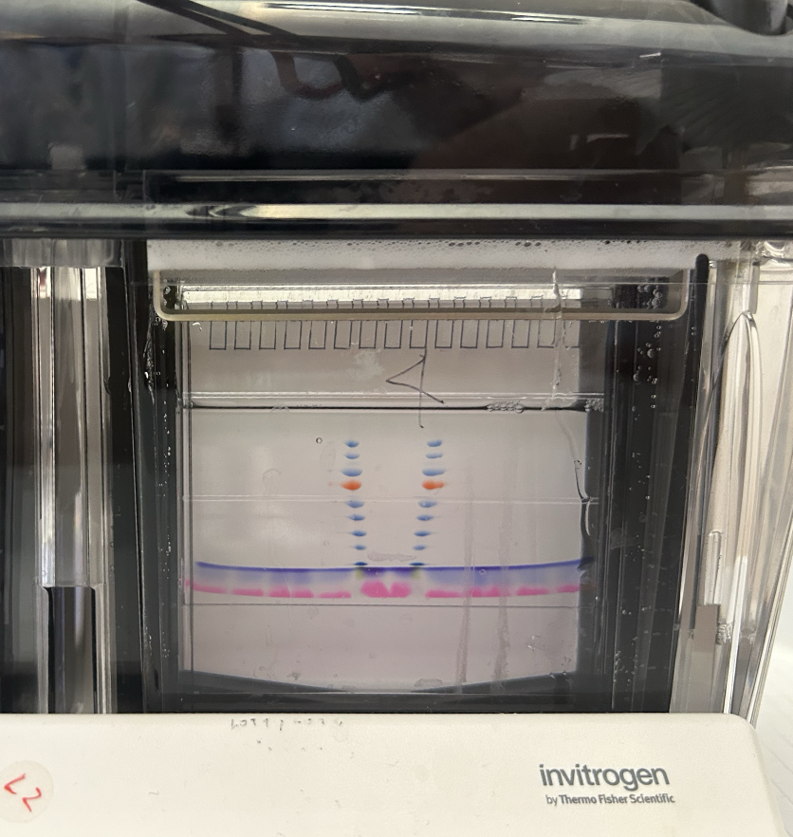
Introduction of our SDS-PAGE experiment
Goal: testing the purity of GFP after Purification by Column Chromatography
Conditions: 200 V

Slide 6
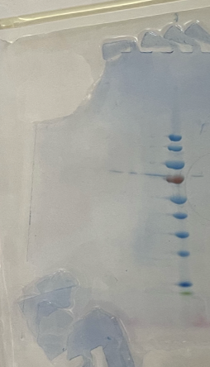
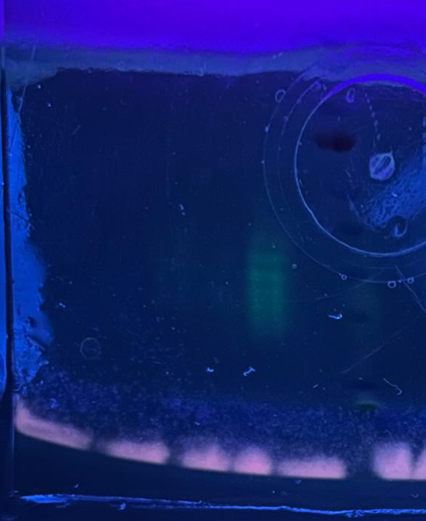
Results of our SDS-PAGE experiment
-
+
C₁ C₂ C₃ C₄ BB M DTT
C₁ C₂ C₃ C₄ BB M DTT

Slide 7
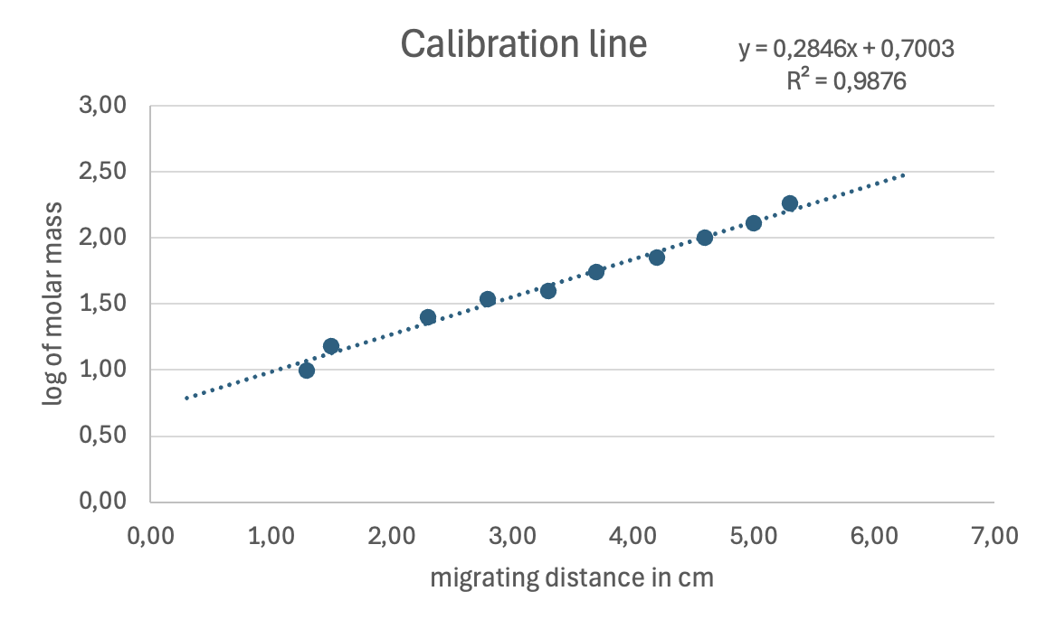
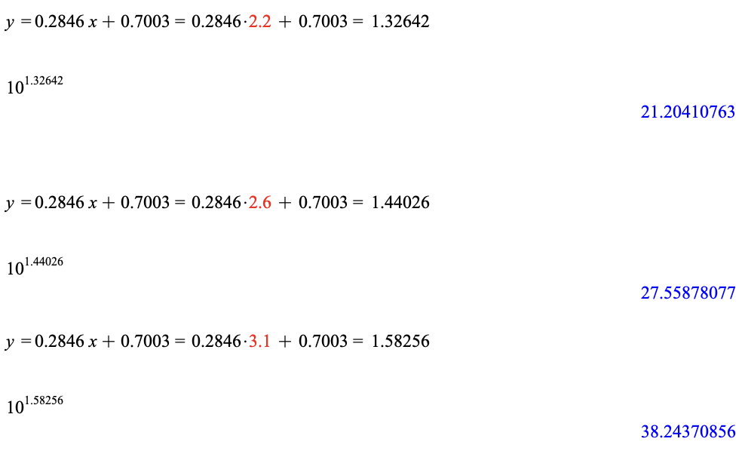
Estimation of Molar Mass of GFP
= 21.20
= 27.56
= 38.24

Slide 8
Conclusion
The GFP is stable after treatment of 200 V
We didn‘t succesfully purified GFP completely by Column Chromatography in our gel we can see kontamination in C₄
Column chromatography does work very well, for a complete purification of GFP more washing buffers would be necessary
The molecular mass of GFP is 21,20 kDa
Complication: Didn‘t have enough RED DTT so we borrowed from another group

Slide 9
The End!

