Slide 1
Summary of results from group 10

Slide 2

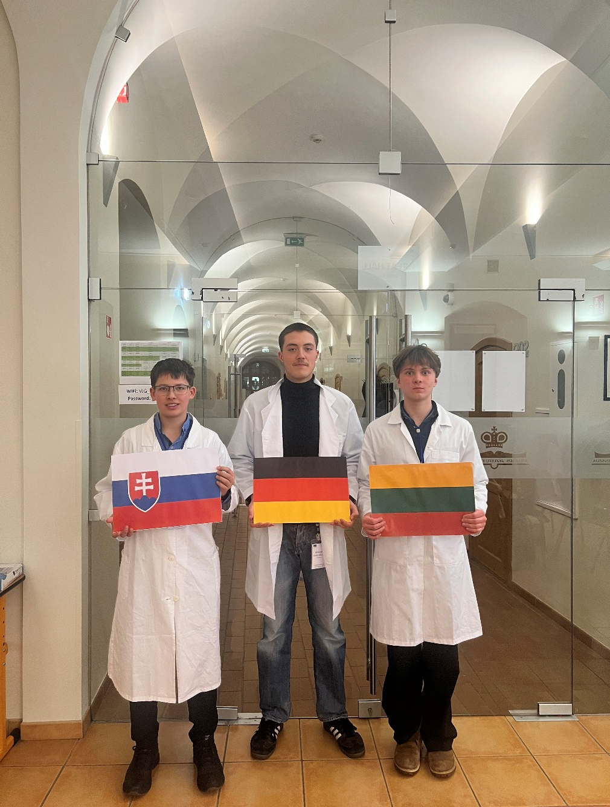


Group number + presentation of group members
Pranciškus Petrauskas
Lithuania
Benedikt Schillmöller
Germany
Oliver Schneider
Slovakia
„flag“
„flag“
„group picture“

Slide 3
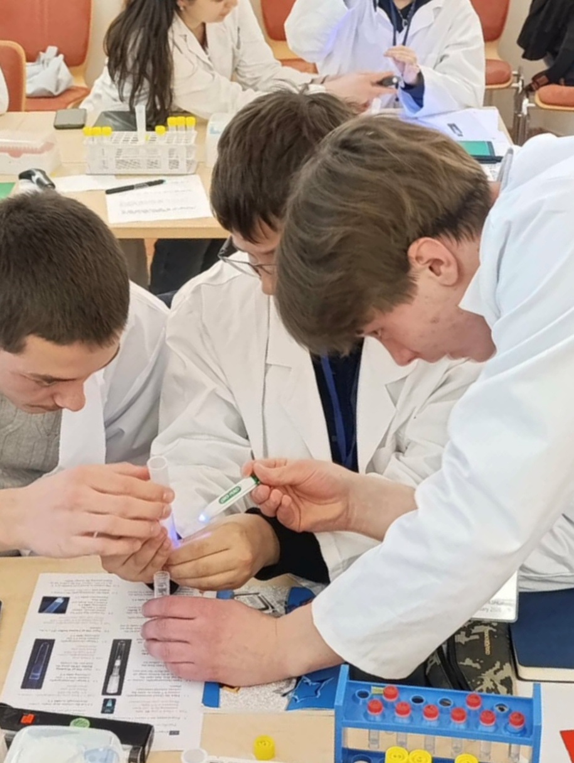
_{HIC Introduction}
Objective: Isolate GFP and seperate proteins based on differences on their hydrophobic properties
Process:
high salt conditions enhance hydrophobic interactions between proteins and the column material
Hydrophobic proteins bind to a stationary phase
Though lowering the salt concentration, the less hydrophobic proteins are wash out

Slide 4
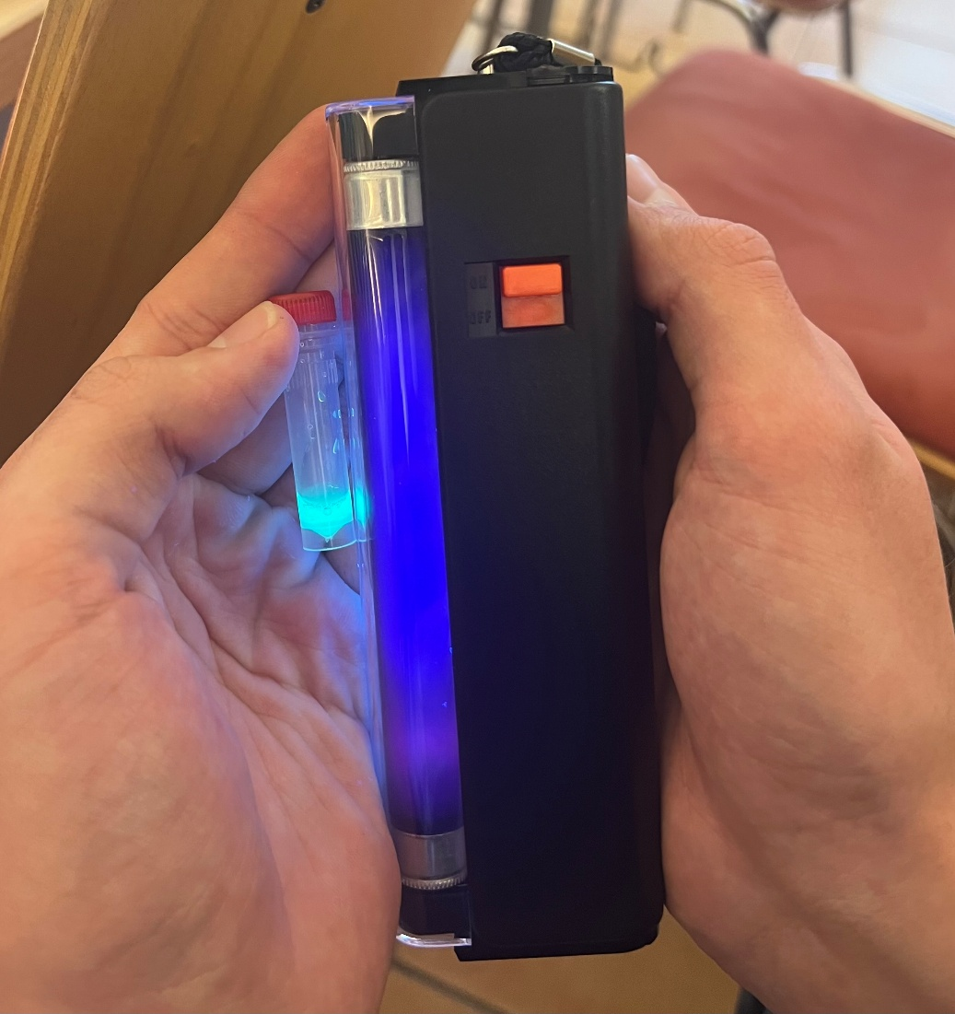
HIC Observation and Results
Equilibration: use equilibration buffer, contains salt condition
Loading : after adding the binding buffer (4 mol) with our GFP sample (then 2 mol) to the column GFP has binded to the Stationary phase
Washing: through adding washing buffer (1,3 mol) to the column more proteins are getting washed out but the GFP doesn´t leave the column
Elution: the elution buffer with (0 mol) is making the GFP leave the column fast, we had to collect the most intense drops in our collecting tube 4
At the end we washed the column with 70% ethanol, for storage we added 20% ethanol

Slide 5
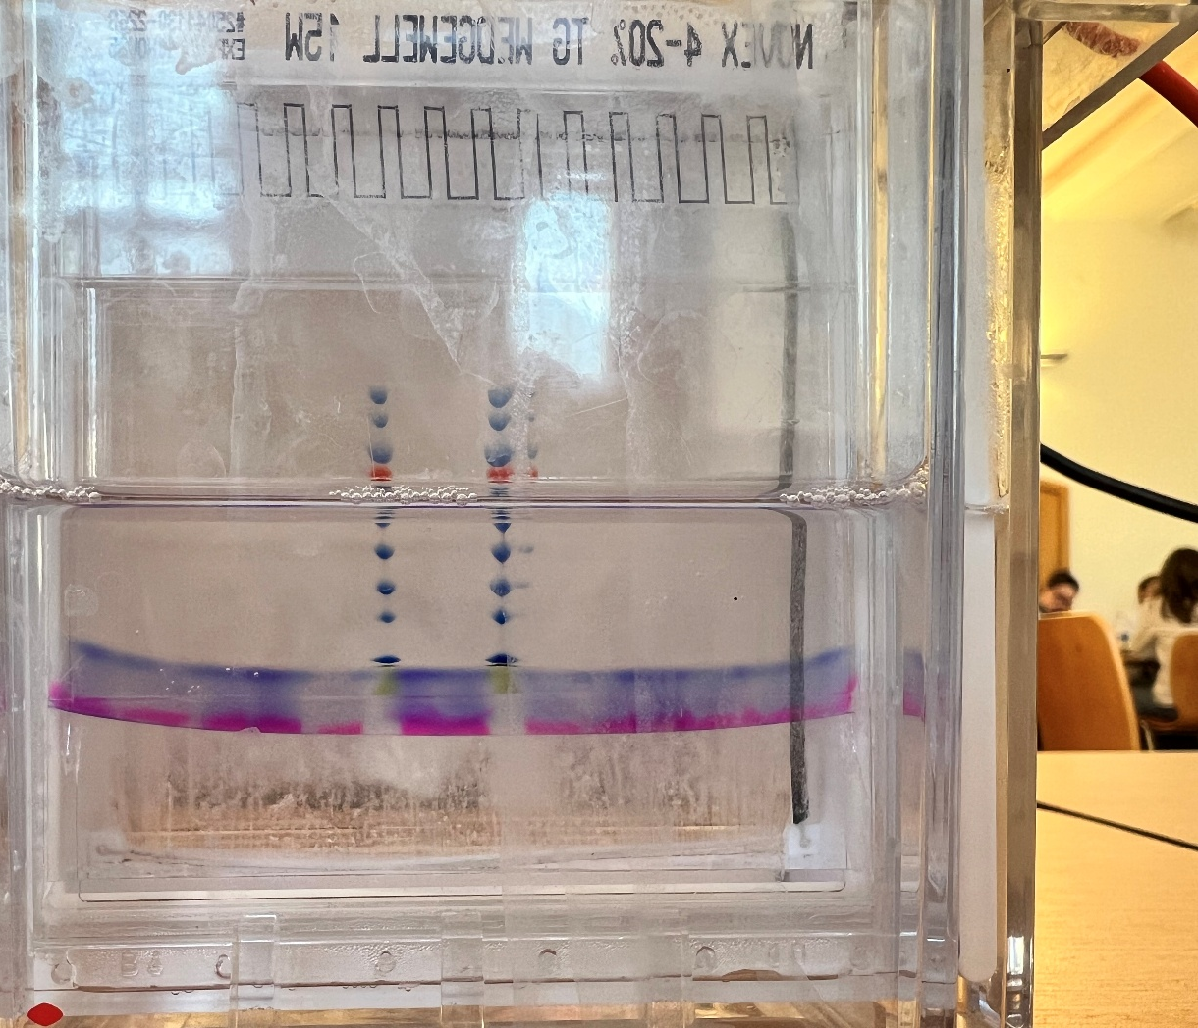
SDS-PAGE Introduction
Goal: PAGE is used to seperate, identify and evaluate the purity of GFP based on its molecular size.
Process:
Prepare 5 samples with non-reducing laemmli buffer, and one sample with reducing laemmli buffer
Prepare the gel cassete and the electrophoresis chambers and load the wells with our samples
After 30 min under 200 V we could take out the gel and shake it in a waterbath. Now we could see how far each protein traveled.

Slide 6
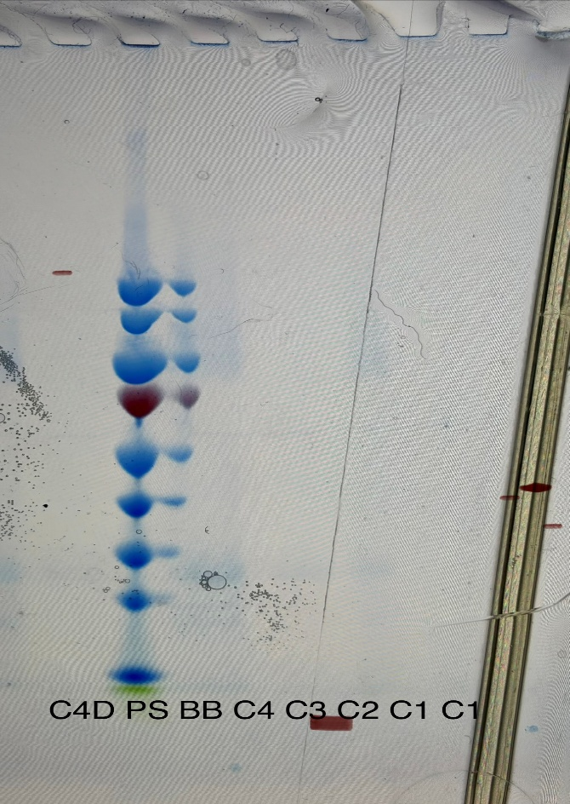
SDS-PAGE estimation of molar mass
Starting point 10 mol
Under UV-radiation we measured how far GFP migrated through the gel
GFP was found between 23-25 kDa

Slide 7
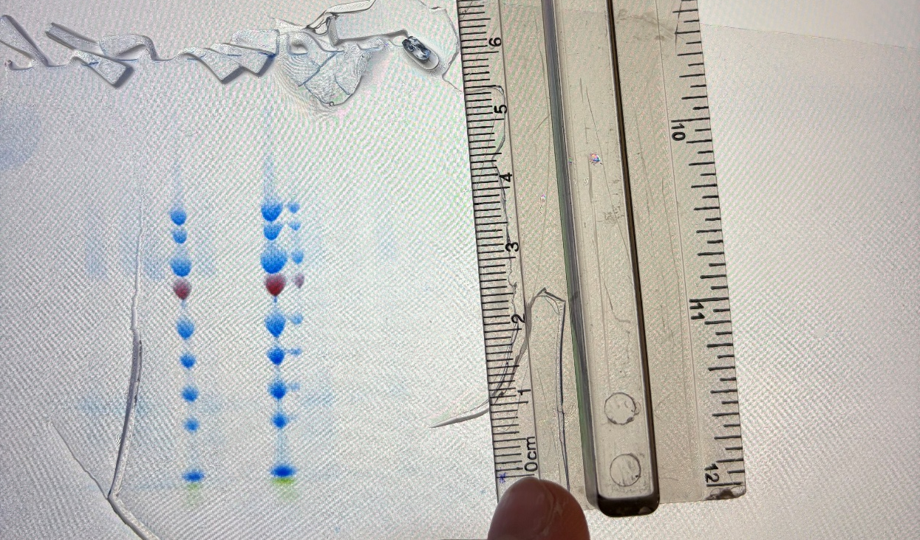
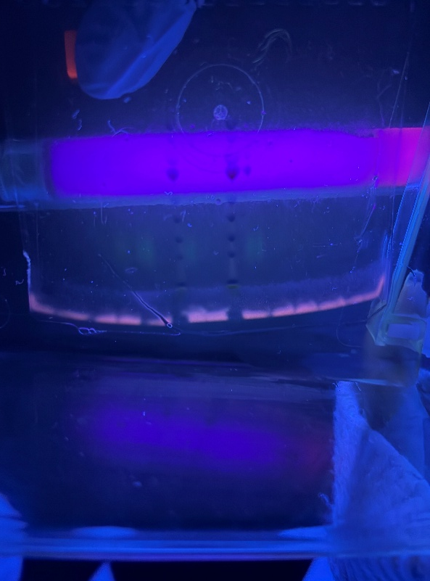
Conclusion of SDS-PAGE
In C1 we can´t see any visible band
In C2 the band is visible but nothing between 23-30 kDa
In C3 there are small Bands visible between 23-30 kDa
C4 has the most amount of GFP
In C4D there is a slight amount of GFP left, we can see it under UV-Light
C4D PS BB C4 C3 C2 C1

Slide 8
Thank you for your attention!

