Slide 1
Summary of results from group 1

Slide 2

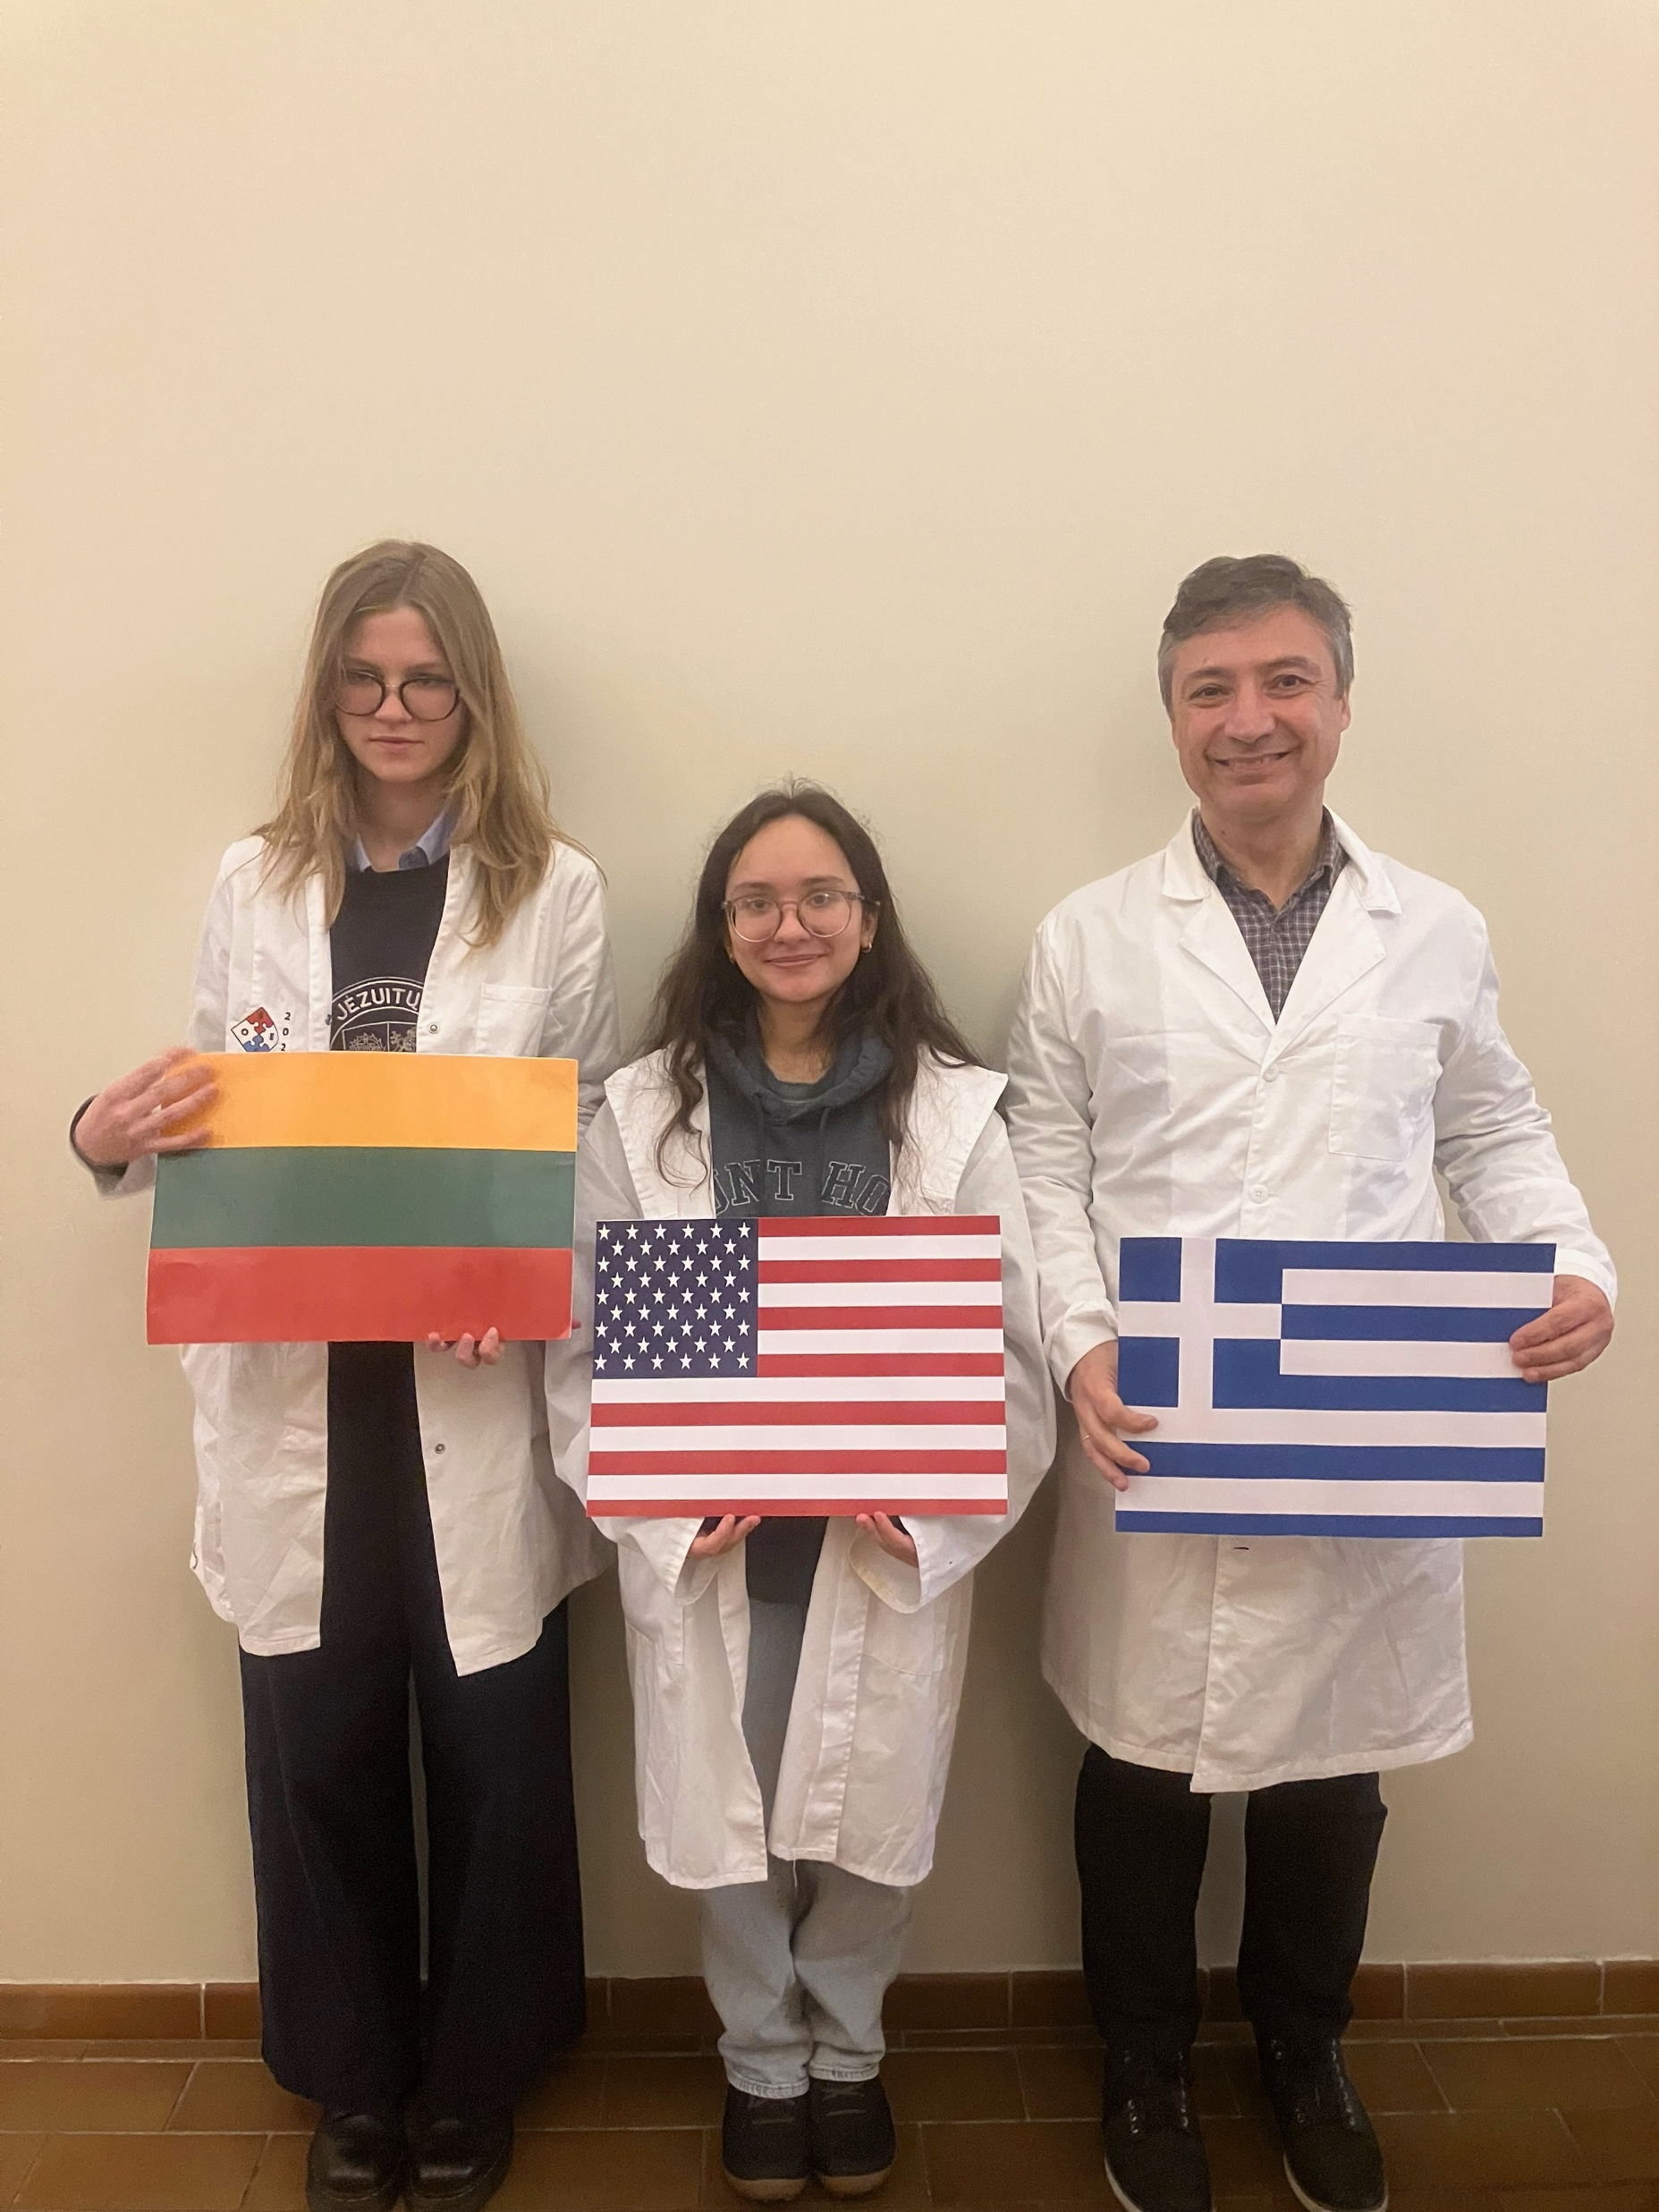


Group number + presentation of group members
Jennifer Relwani
USA
Antonios Krimitzas (T)
Greece
Kotryna Mieldazyte (M)
Lithuania
„flag“
„flag“
„group picture“

Slide 3
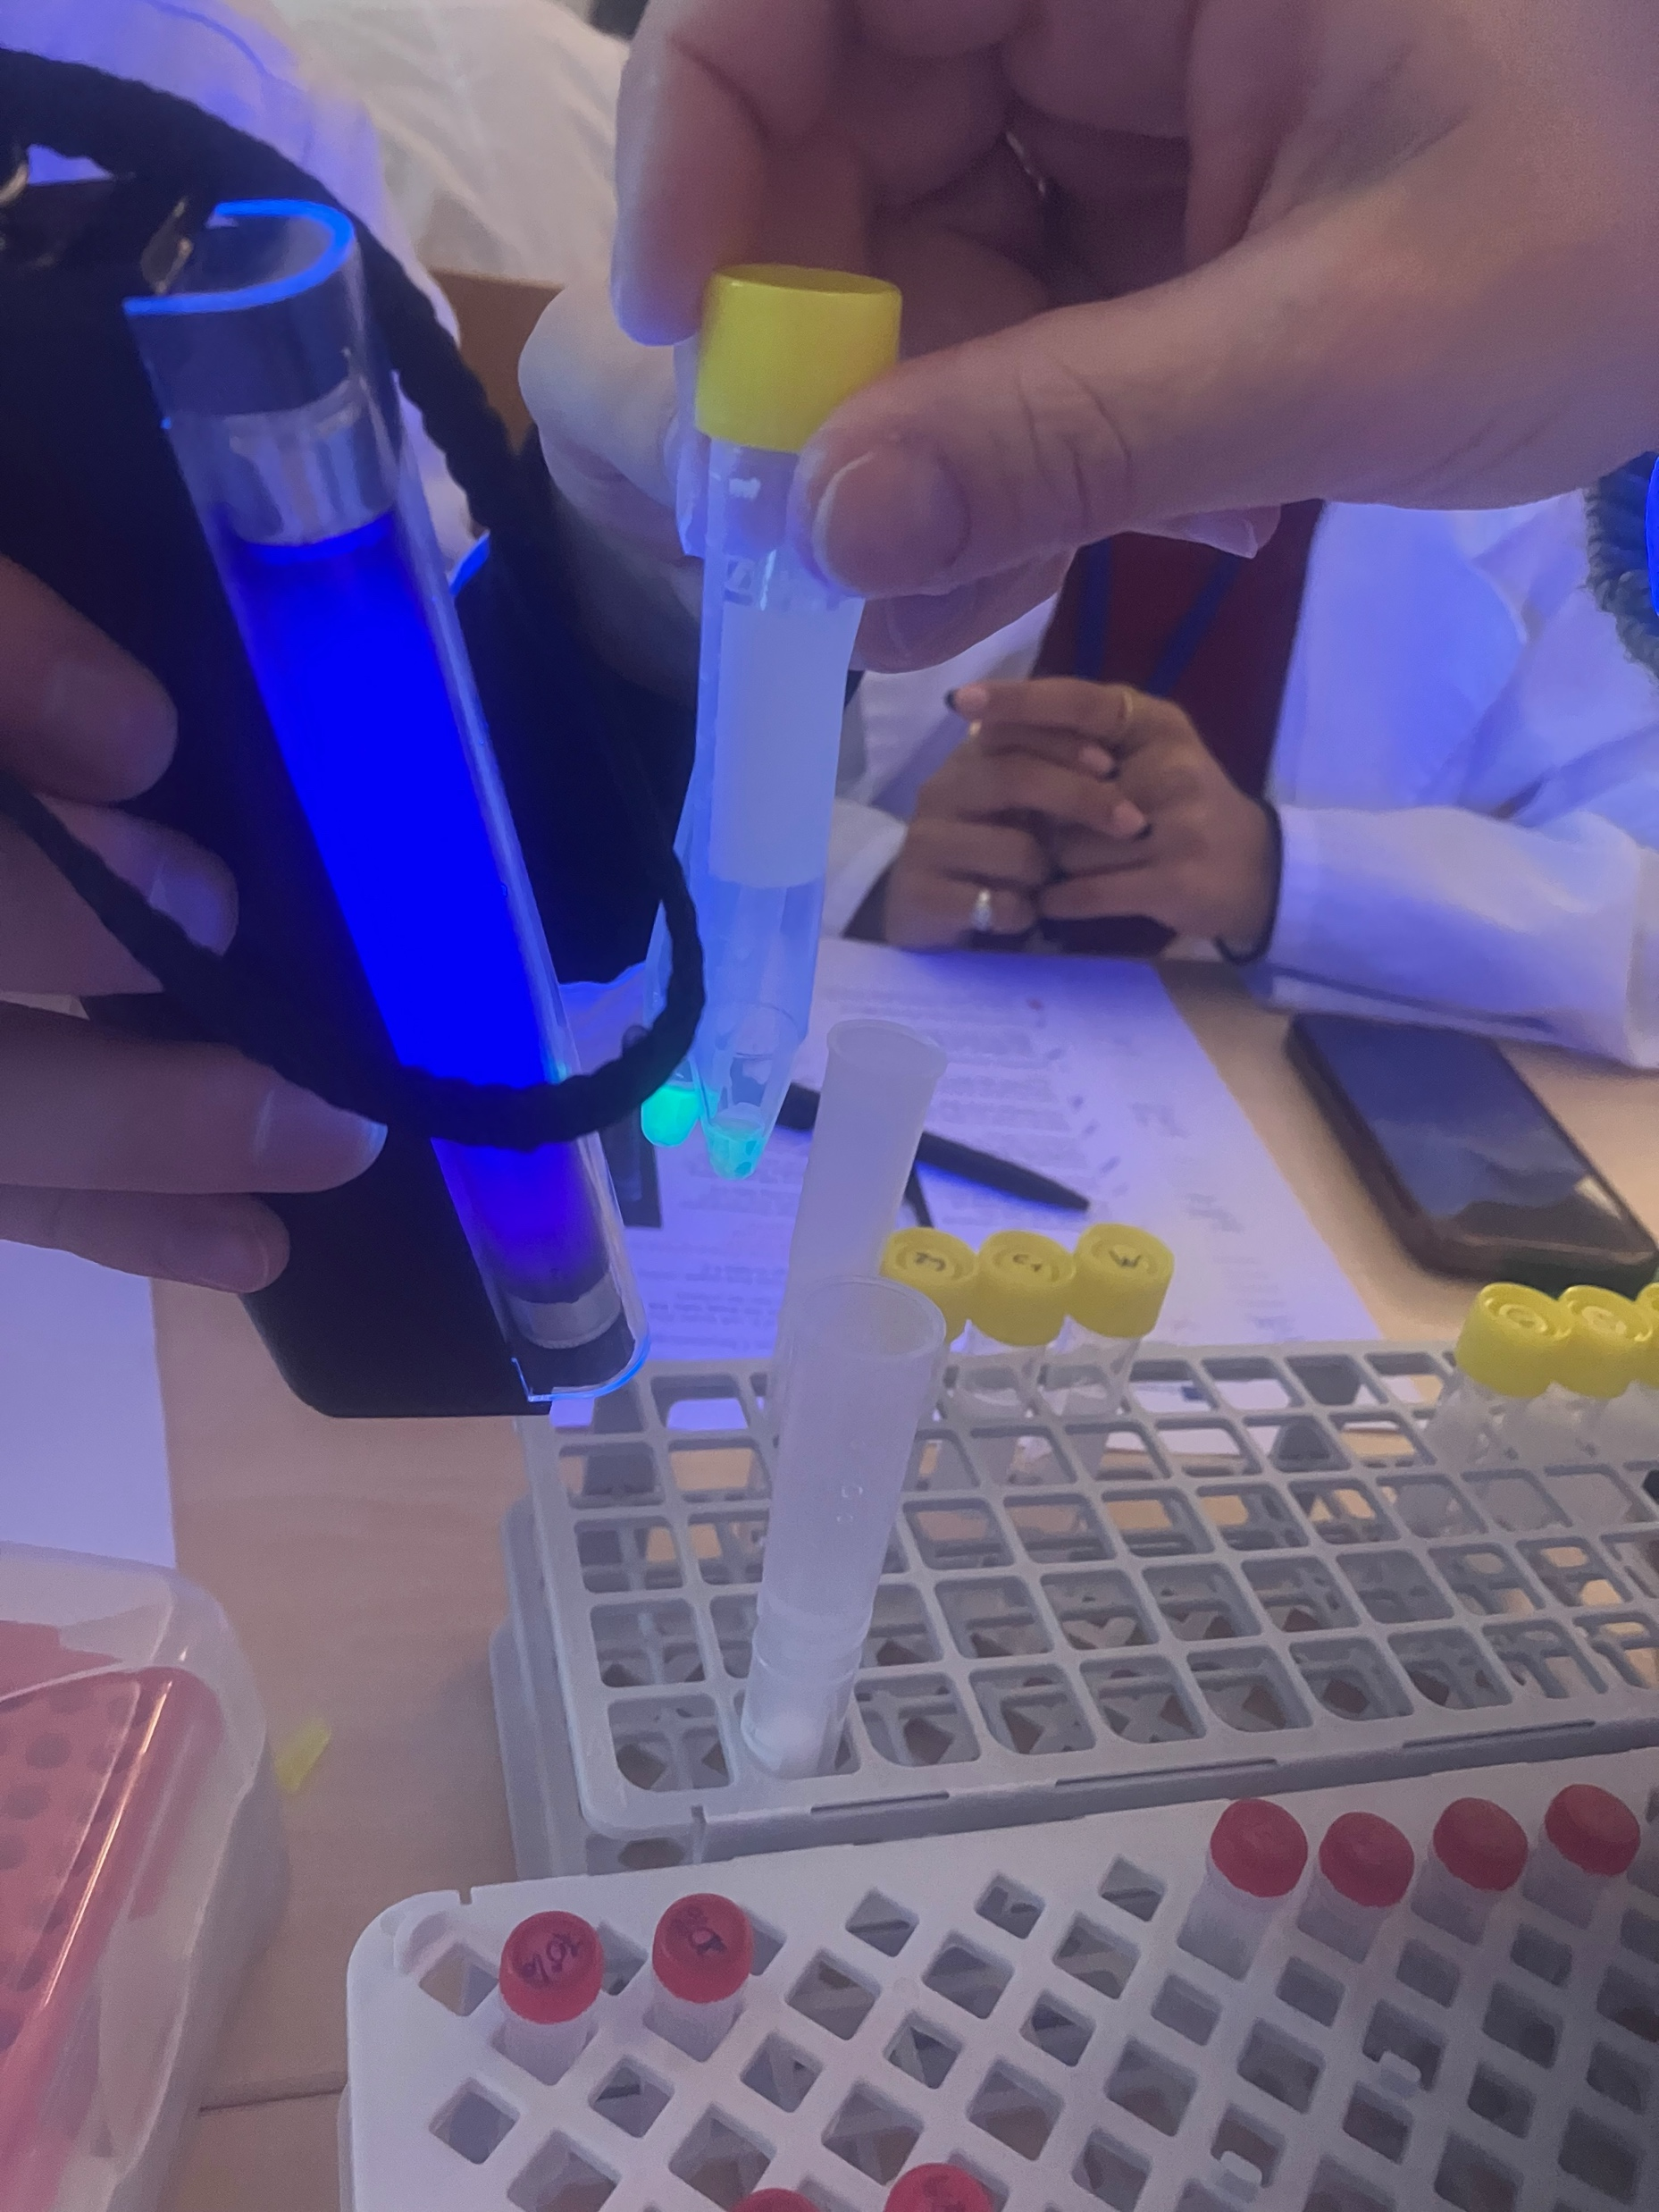
Introduction of our experiment
Goal:
Purify GFP from E.coli bacteria with column chromatography and PAGE electrophoresis
Explore the ability of GFP to glow after chemical and electrical procedure

Slide 4
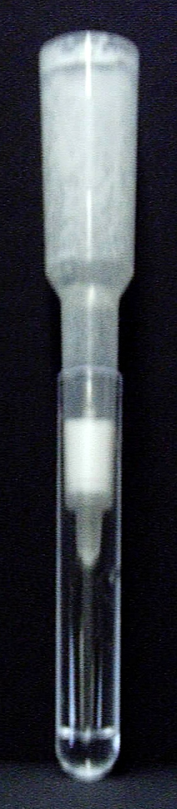
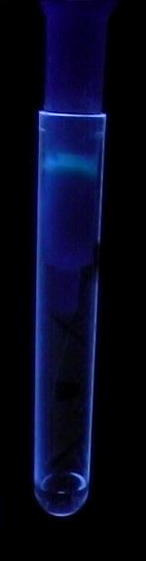
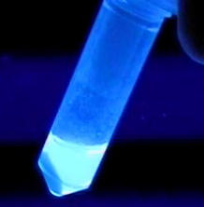
HIC Method
Preparations for Column Chromatography
Conduction of Column Chromatography

Slide 5
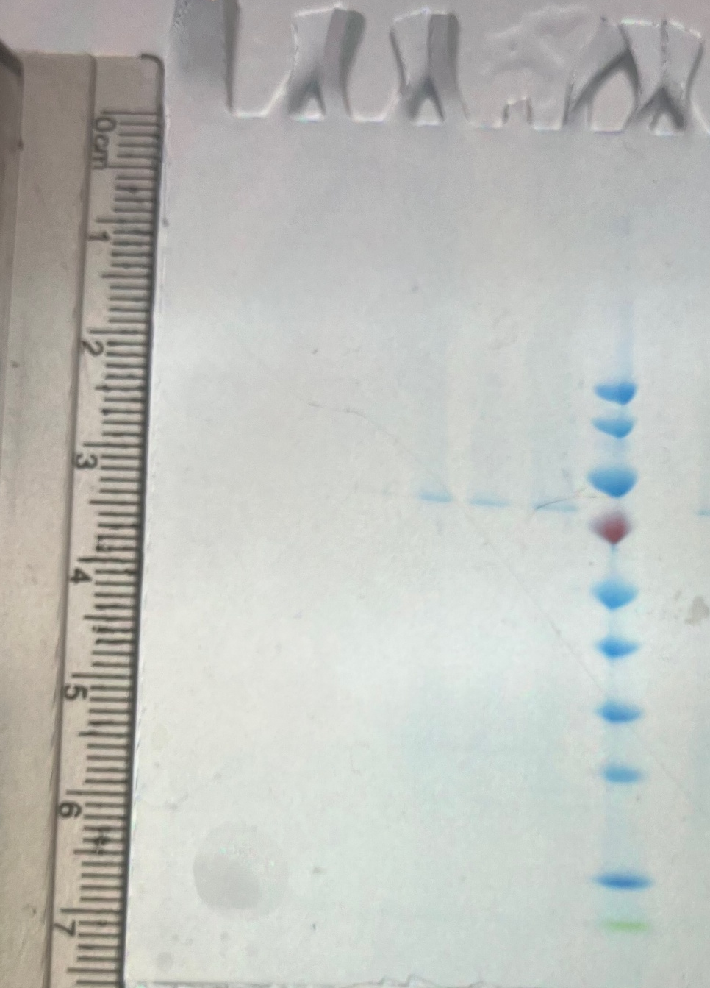
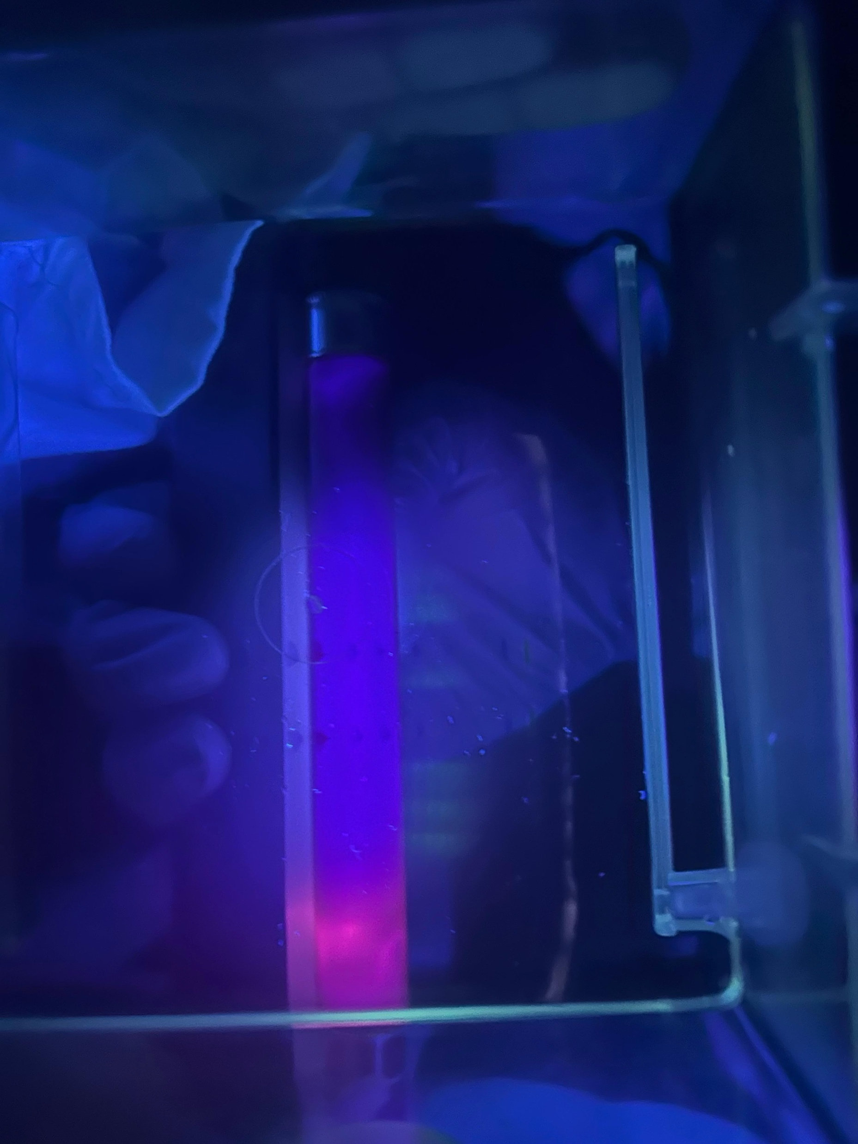
HIC Results The GFP protein is partially purified
C1 C2 C3 C4 BB DTT M
C1 C2 C3 C4 BB DTT M
180
180
70
70
GFP
Expected GFP band
10
10

Slide 6
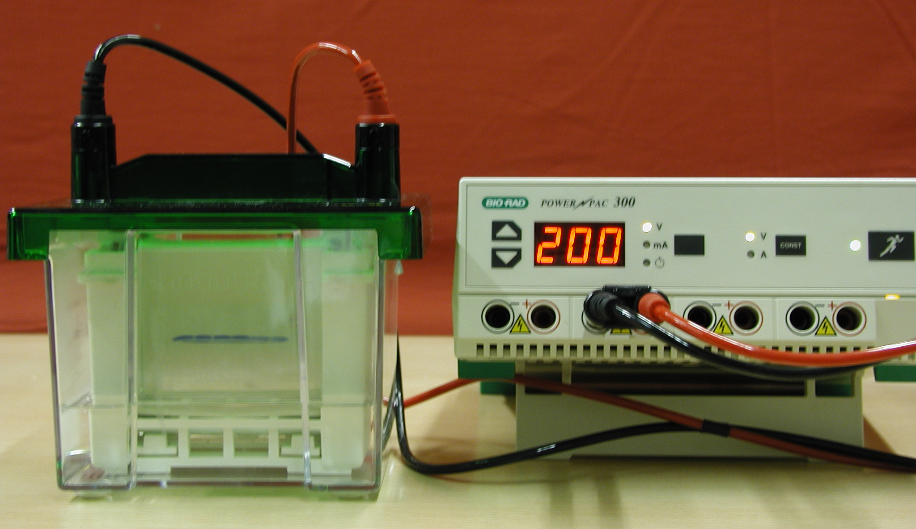
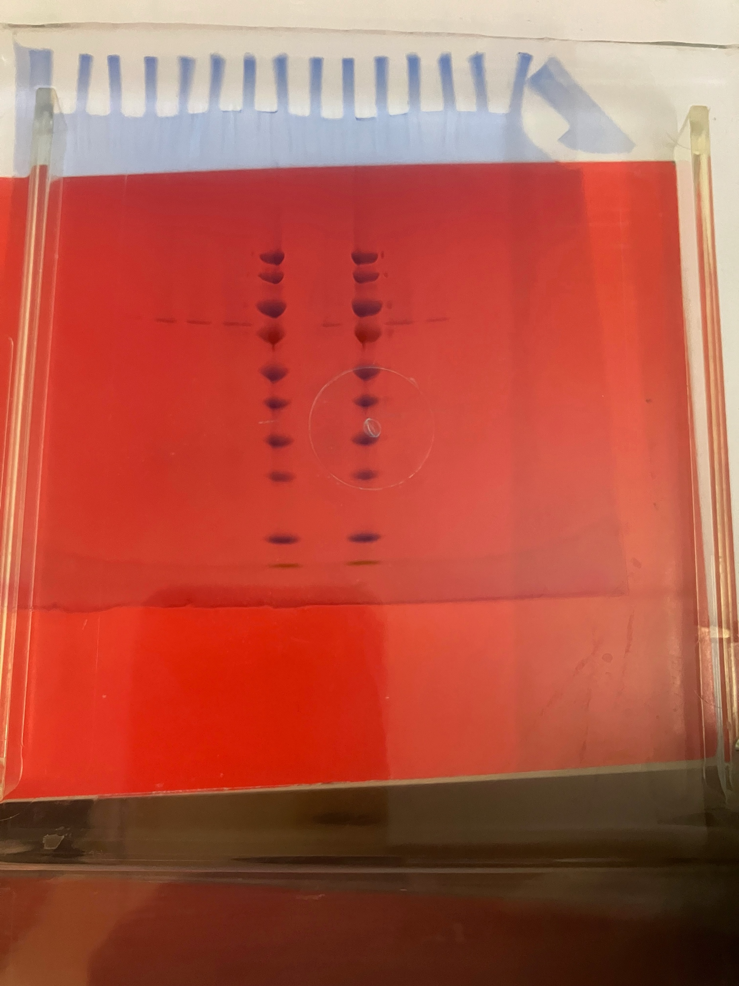
SDS-PAGE Method
3. Sample Preparation for PAGE
4. Preparation of Gel Cassette and Electrophoresis Chamber
5. Filling the Gel Wells with Samples
6. Execution of Gel electrophoresis
7. Staining the Gel
8. Evaluation of the Gel

Slide 7
SDS-PAGE Results
The GFP protein is partially purified
GFP
C1 C2 C3 C4 BB M DTT
Measurements were from 10-12cm, 23-38 KDa

Slide 8
Conclusion
GFP protein is a robust protein that keeps its ability of glowing after chemical and electrical field.
GFP keeps its three-dimensional structure
GFP can be used as a reliable biological marker

Slide 9
Thank you for your attention!

