Slide 1
Summary of results from group 7

Slide 2

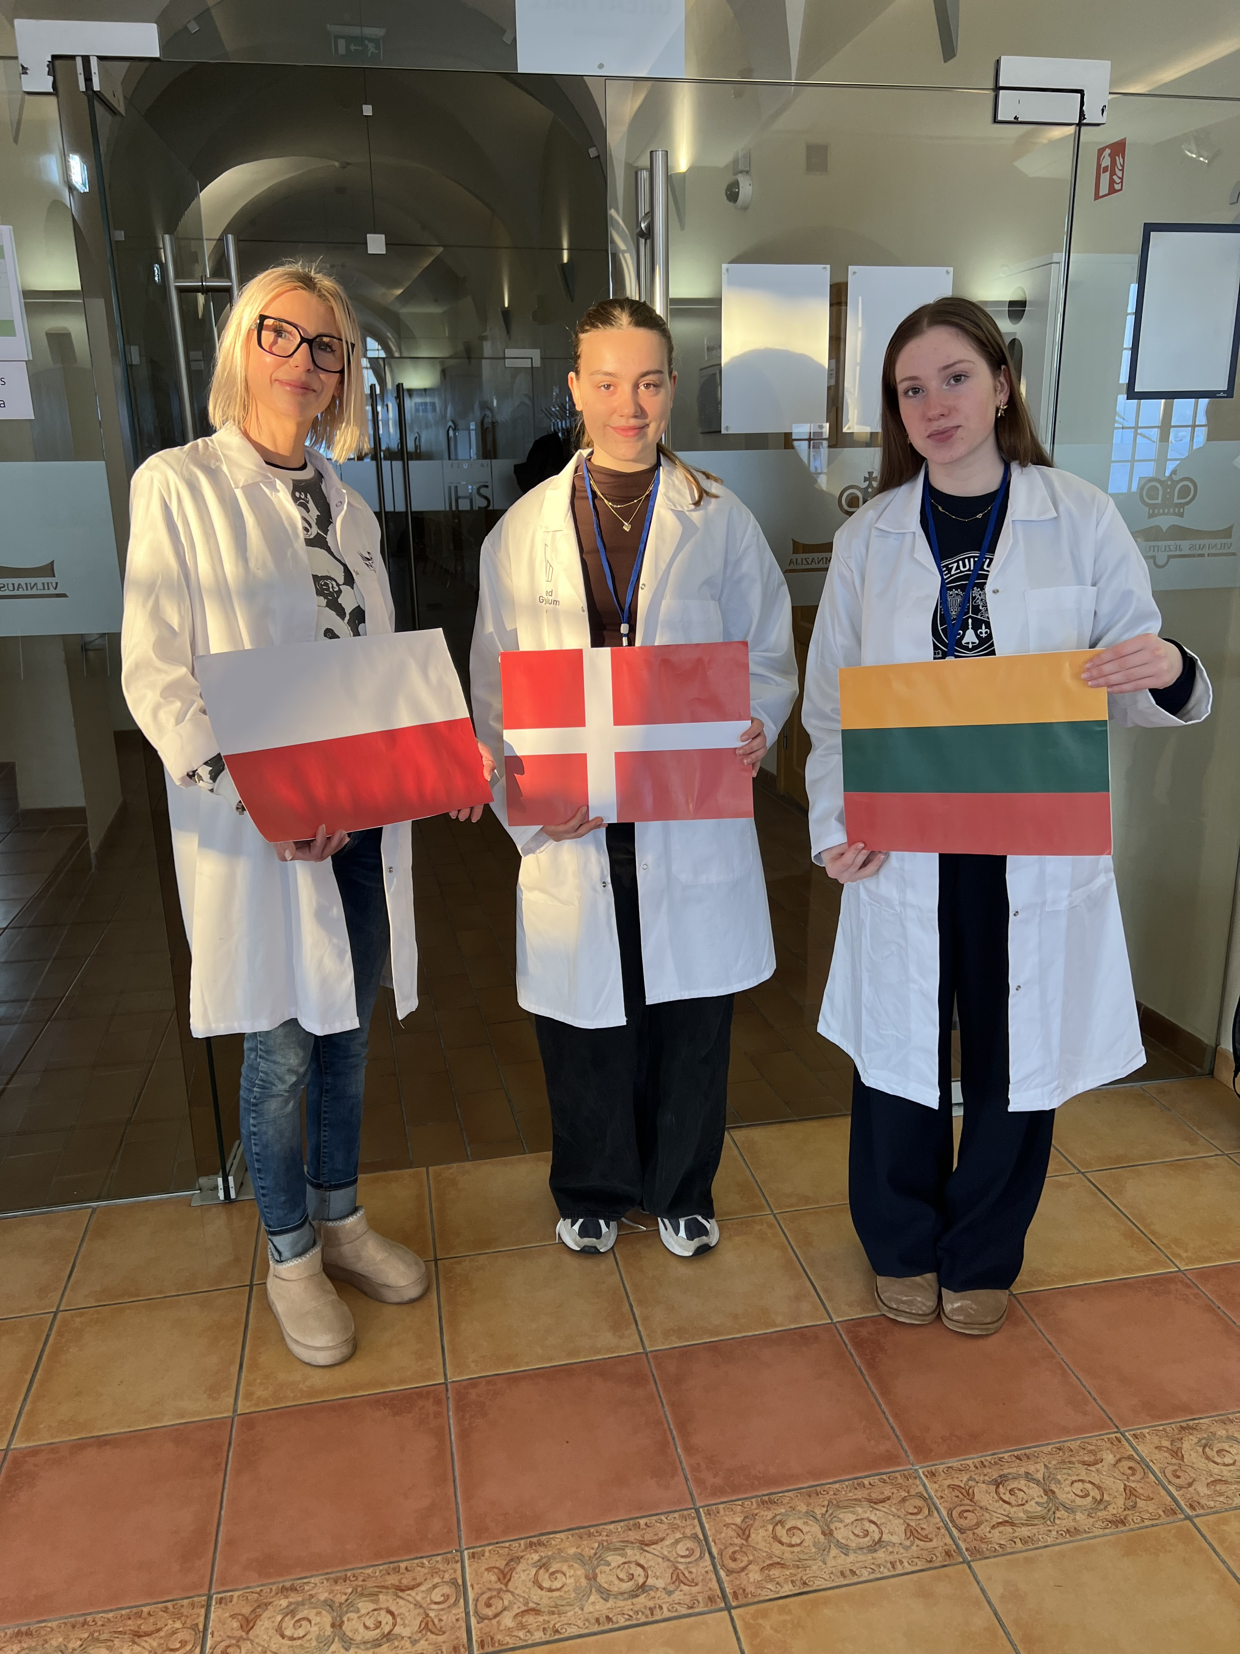


Group number + presentation of group members
Agnes Sørensen
Denmark
Ieva Stundžytė
Lietuva
Anna Teper
Poland
„flag“
„flag“

Slide 3
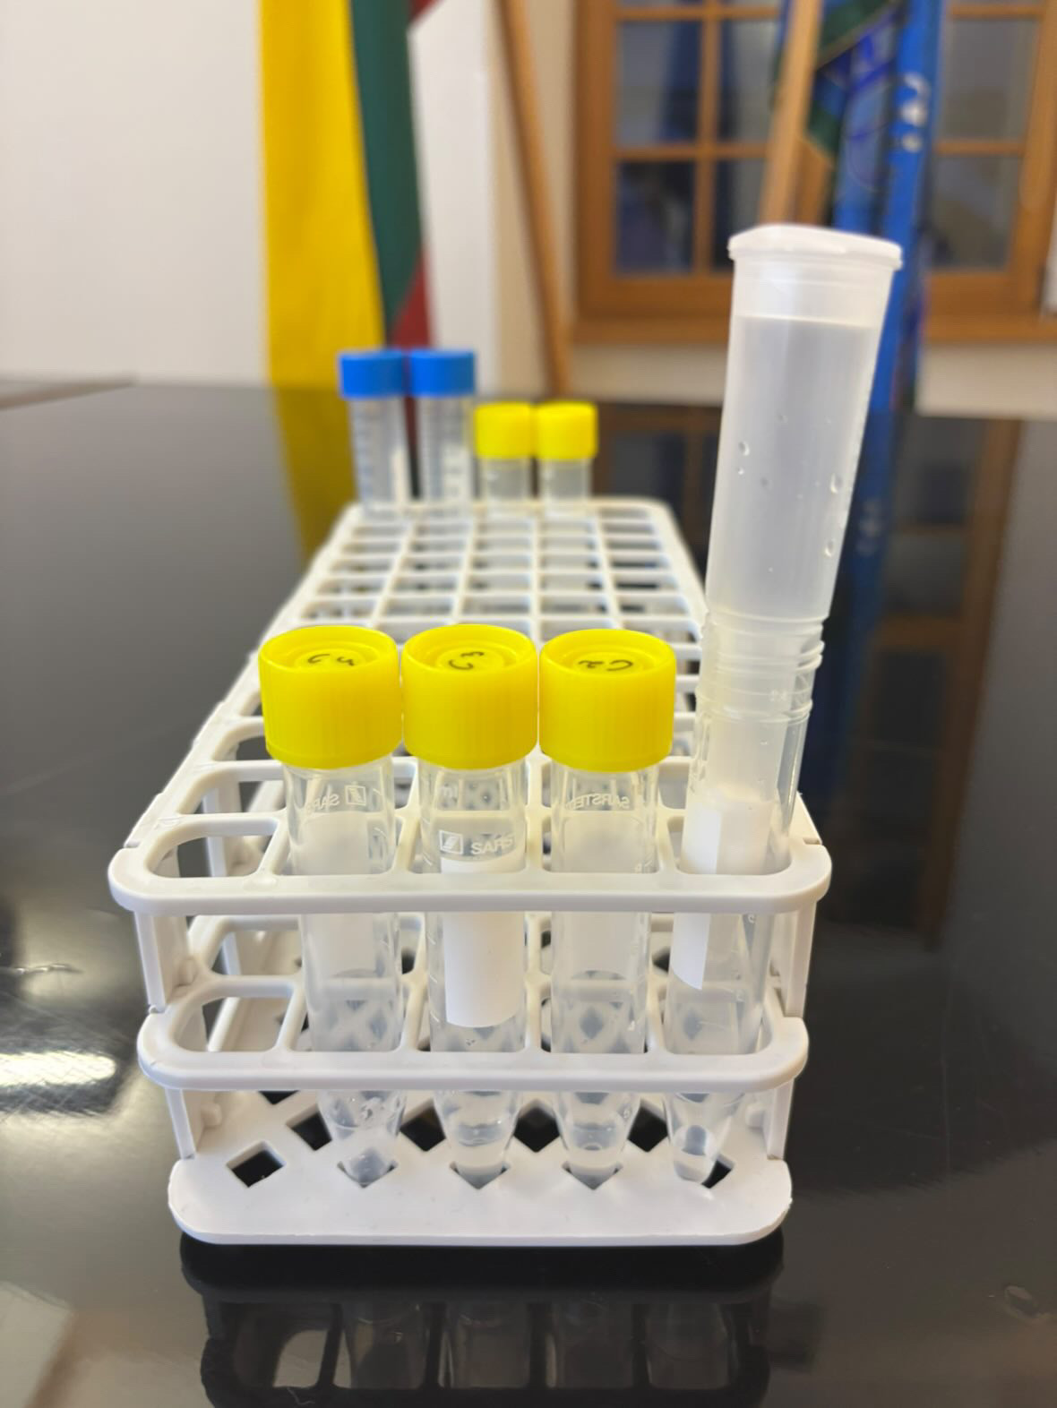
Introduction of HIC
Purification of GFP by hydrophobic interaction chromatography
Goal of HIC: to separate the GFP from other proteins
Methods:
  Proteins bind to a hydrophobic stationary phase
  Binding is promoted by high salt concentrations
  Proteins elute when salt is decreased

Slide 4
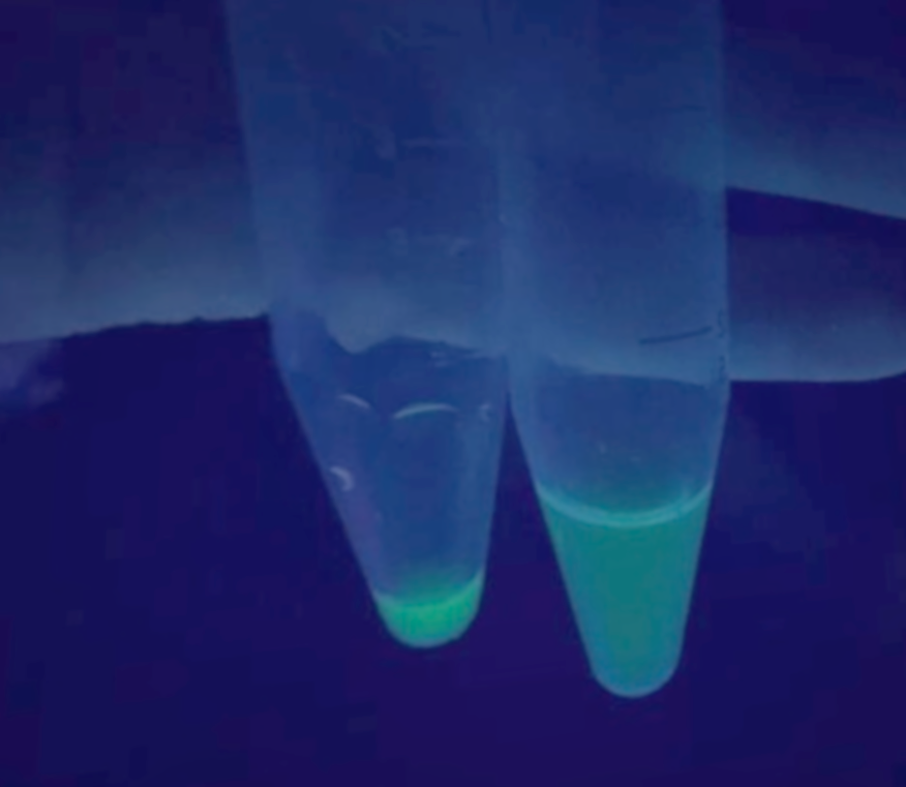
Observations during HIC
Task 1 | UV on the E. coli lysate | We saw green fluorescence | The lysate contained GFP
Task 2 | Pipet lysate to the column | Green fluorescence on the top of the stationary phase | GFP adsorbs to the stationary phase with Van der Wahls interactions
Task 3 | Pipet washing Buffer to the column | We saw the green fluorescence follow the mobile phase | This was not what we expected
Task 4 | Because we did not get the expected results we got advised to try running it through again and collect the greenest drops | We saw the green fluorescence drop | The GFP ran through again, and we could track it with UV and collect it into column C4
C4 C3

Slide 5
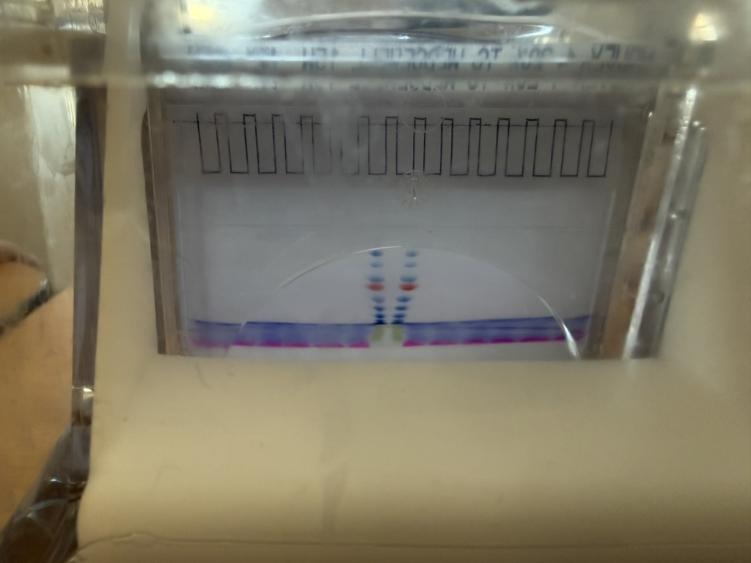
Introduction of SDS-PAGE
The goal is to check the presence and purity of GFP in the samples.
Methods: Proteins were separated by SDS-PAGE and visualized by stain and UV to assess GFP purity and size before and after HIC-chromatography.

Slide 6
Estimation of molecular mass
GFP distance = 1,05 cm
y = 0,31x + 1,10
Log Molar Mass = 0,31 · Distance + 1,10
Log Molar Mass (GFP) = 0,31 · 1,05 + 1,10
Log Molar Mass (GFP) = 1,43
Molar Mass (GFP) = 26,9 kDa

Slide 7
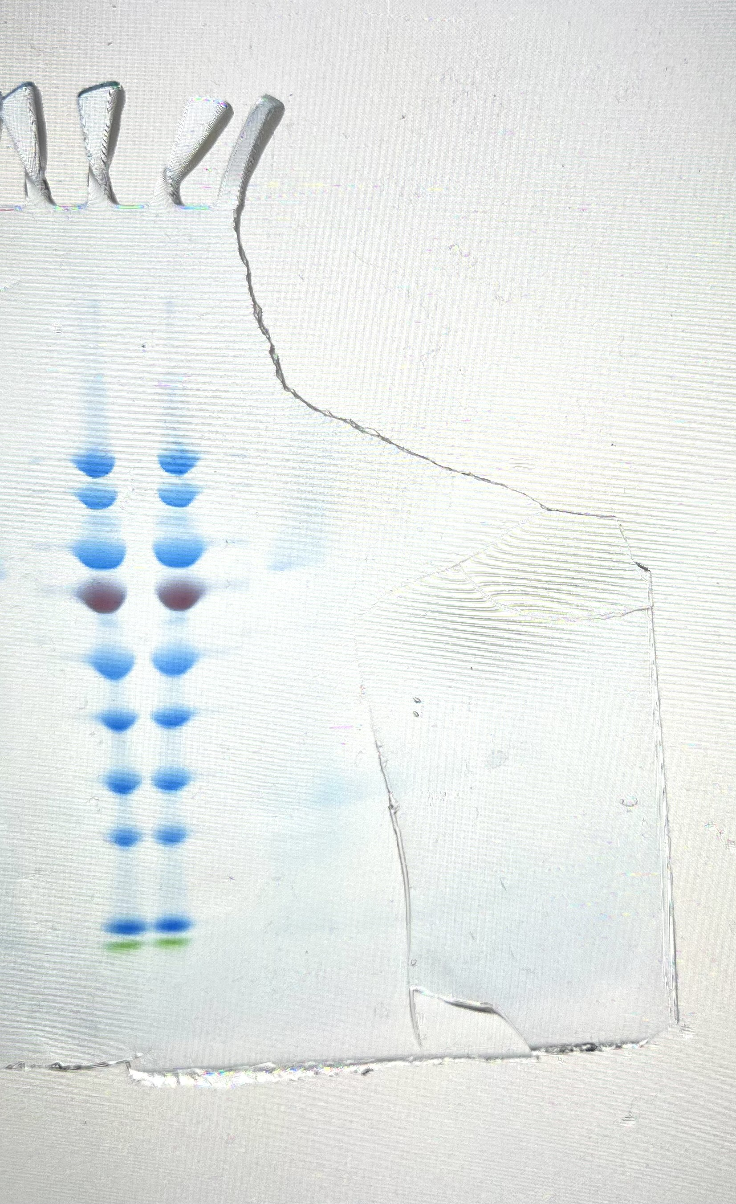
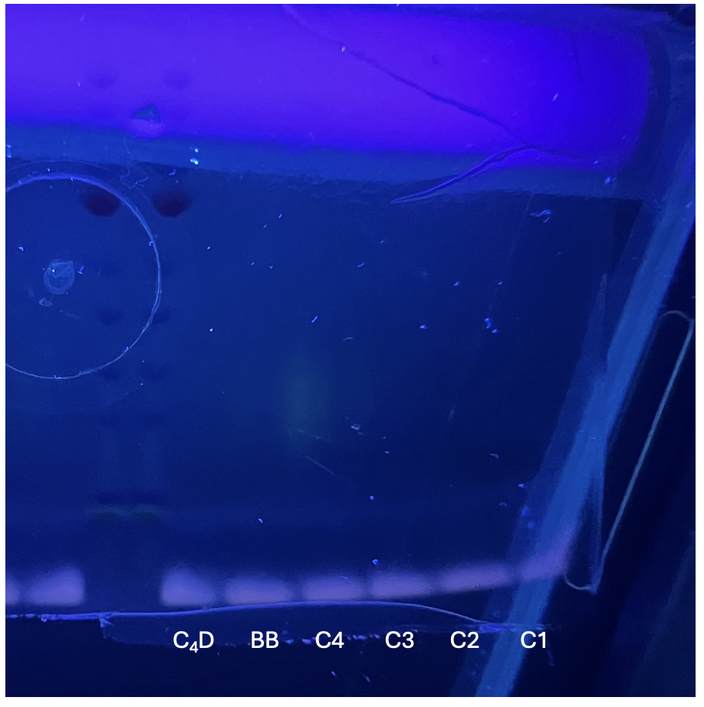
Results from SDS-PAGE
-
Evaluation of results by SDS-polyacrylamide gel electrophoresis
We saw green fluorescence in C4 and very faint in lysate
and C3
We saw no green
fluorescence in the
reduced, C2 and C1
Evaluation of purification
efficiency before and
after HIC
PS C₄D BB C4 C3 C2 C1
PS
+

Slide 8
Result
We had GFP the last two elution fractions in HIC (C3 and C4)
There were other proteins in the washing fractions
The GFP is partially purified
Chromatography was effective. It eliminated many other proteins and resulted in purified GFP.
We had an issue with HIC where GFP came through with the washing buffer. We got help to correct it and run it again. As a result, our GFP wasn’t as concentrated as it could have been.

Slide 9
Thank you for your attention!

