Slide 1
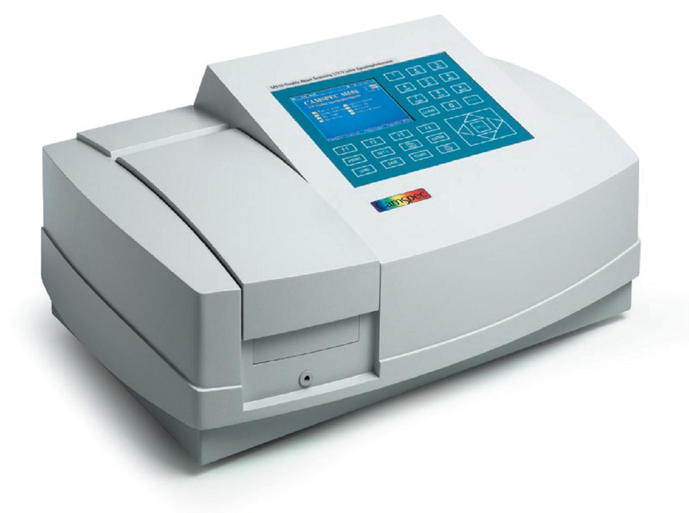
Introduction about Fotometry
Lactase activity by O-NPG Assay

Slide 2
How does a Fotometer works

Slide 3
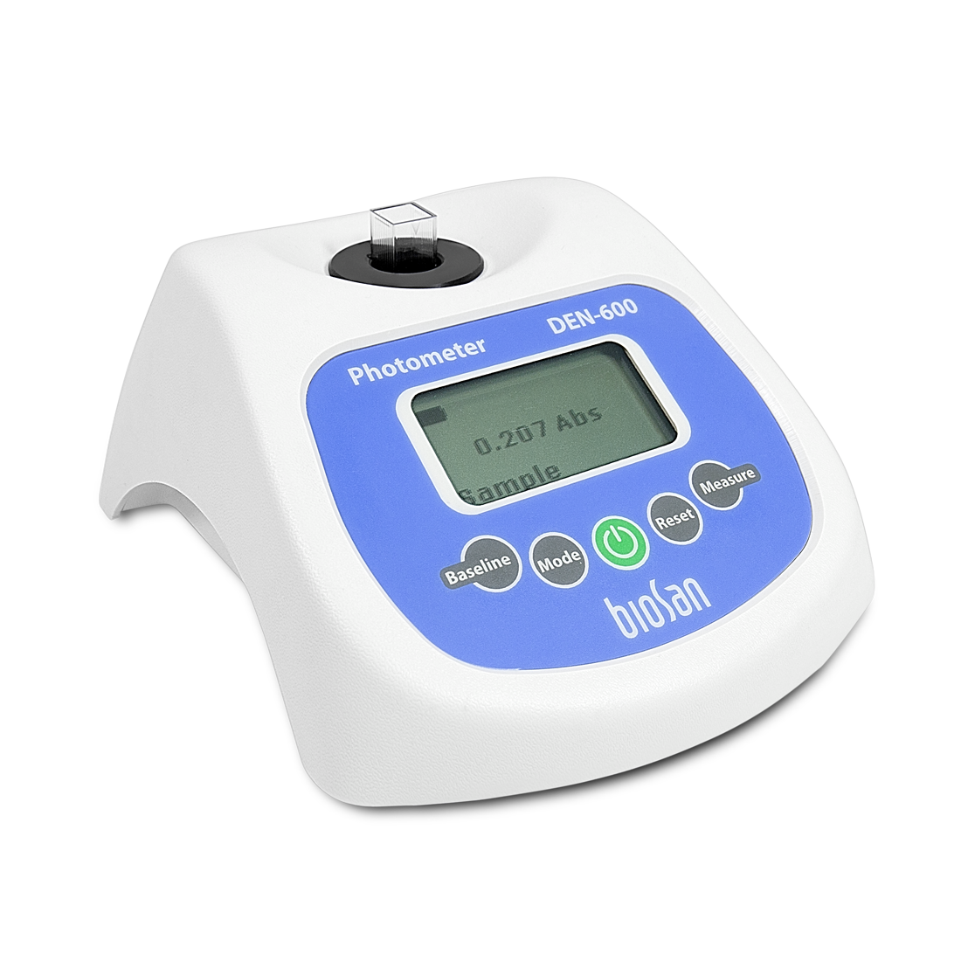
Photometry - basic information and use
Basic information
Origin: from Greek phos (light) and metrein (measure)
Definition: analysis of a solution using light
Principle: concentration determined by measuring absorbance
Usage: key method in biology, chemistry, engineering, pharmacy → essential in analytics

Slide 4
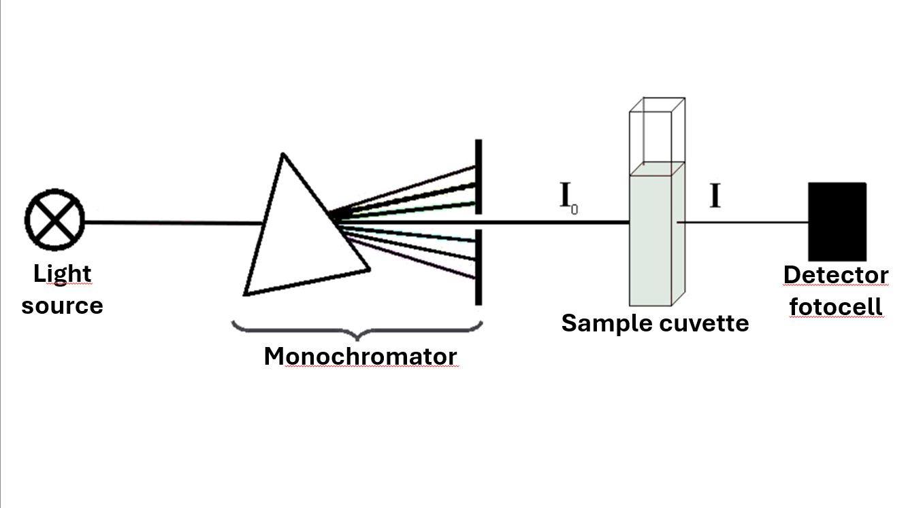
Principle of fotometric measurement
Light source: produces broad-spectrum of light
Monochromator: selects a single wavelength
Cuvette: transparent sample holder
Detector: measures transmitted light

Slide 5
Light Source
all of the wavelengths in one beam (200 - 800 nm)

Slide 6
Monochromator
Prism
Exit slit
light refraction
hole in the wall
wavelength selector

Slide 7
Sample / Cuvette cell
scattered light
reflected light
direct transmitted light
cuvette cell holds measured sample
2 transparent and
2 opaque sides

Slide 8
Light detector
measures the transmitted light

Slide 9
FOTOMETRY SHOW!!!

Slide 10
O-NPG Assay by Fotometry
Activity of lactase (ß-galactosidase) will be measured by fotometry.
It`s an direct measurement at 410 nm.

Slide 11
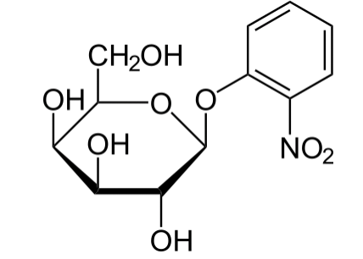
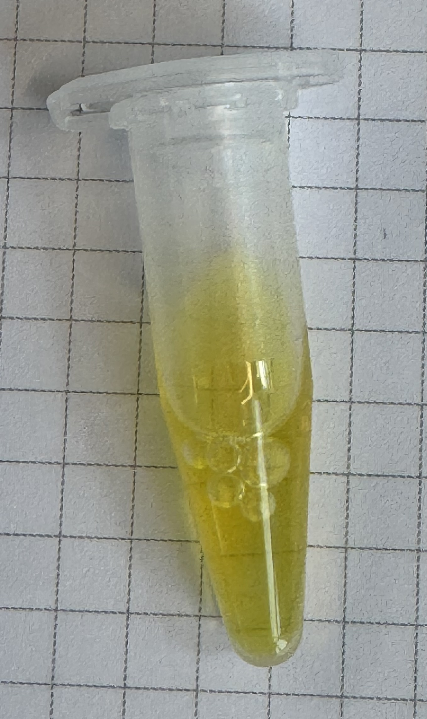
Lactase Activity Assay
In the ONPG-assay the synthetic galactoside o-nitrophenyl-β-D-galactopyranoside substitudes the natural substrate lactose (= β-galactoglucanoside).
ONPG is hydrolized like lactose by lactase (= β-Galactosidase).
Reaction products are β-galactose and o-nitrophenol.
o-nitrophenol is responsible for the absorption at 410 nm and the colour change of the solution to yellow.

Slide 12
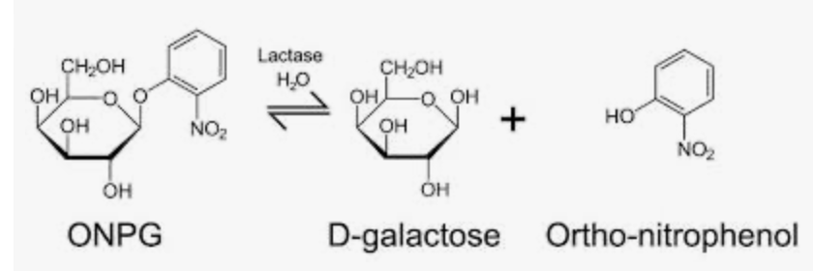
ONPG-Assay
At the beginning is an excess of ONPG in the assay → intensity of yellow colour produced ortho-nitrophenol by the β-Galactosidase is correspondent to the amount of enzymes and duration of the assay.

Slide 13
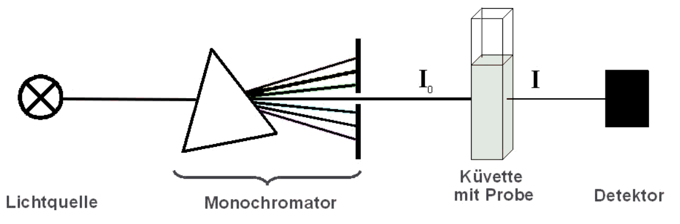
Absorptionsspektra of NAD⁺ und NADH + H
Fotometry Principe
Cuvette + sample
Detector
Fotocell
Light Source
Monochromator
E = ɛ ⋅ c ⋅ d
E ∼ c = f (I/I₀)

Slide 14
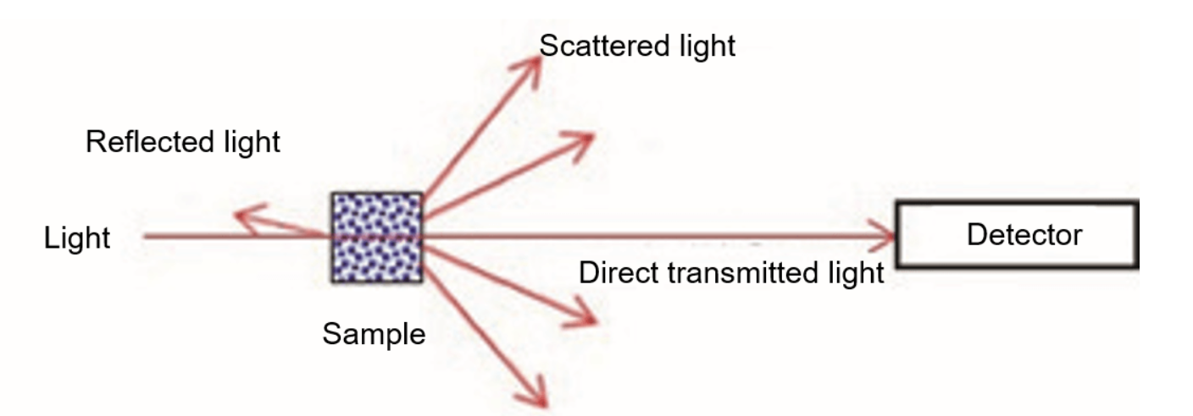
Estimation of Lactase Activity
Yellow
Light
410 (violet)
Sample contains an increasing concentration of o-nitro-phenol
Notes:
yeast cells in the sample don`t absorb light at 600 nm but they are scattering and reflecting the 600 nm, orange light.
As higher the number of yeast cells (produced biomass) as more light is reflected and scattered and as less light is direct transmitted and is reaching the detector.

