Slide 1
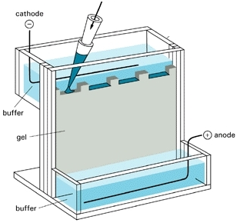

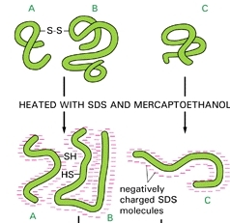
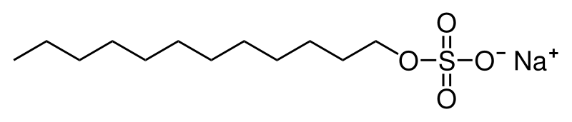


Purification Test by
SDS Polyacrylamide Gel Electrophoresis (SDS-PAGE)
2-ME
Sodium-Dodecylsulfate (SDS)

Slide 2
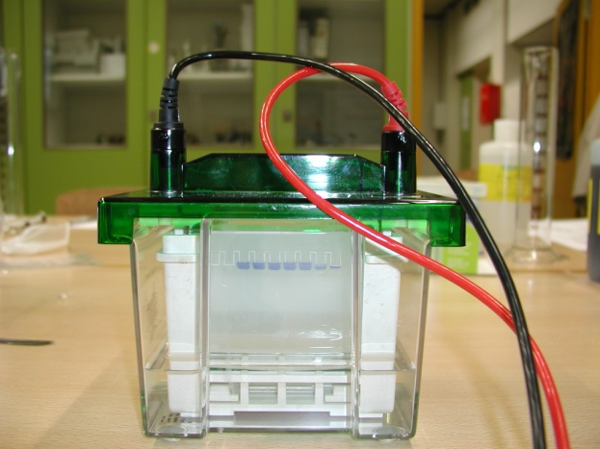
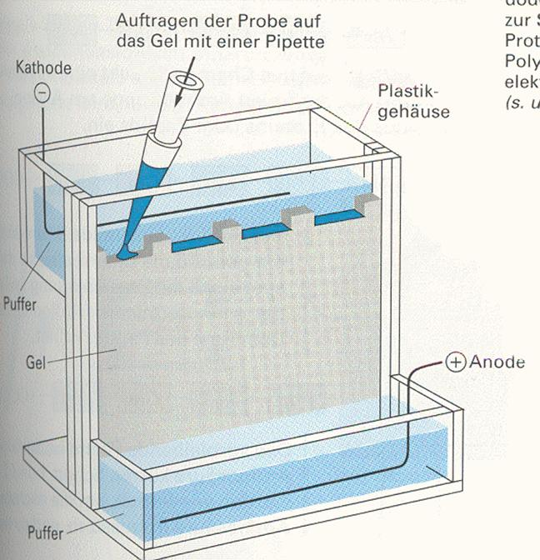
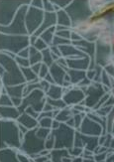
gel electrophoresis
protein sample
cathode
the porous gel is made of crosslinked chemical chains
proteins with negative charge move to the anode
proteins with positive charge move to the cathode
buffer
anode
gel
buffer

Slide 3
Model
Gel-Electrophoresis

Slide 4
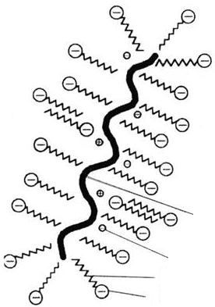
SDS-PAGE (SDS Polyacrylamide Gel Electrophoresis)
SDS = sodium dodecylsulfate
CH₃-(CH₂)₁₀-CH₂-O-SO₂-O⁻ Na⁺
SDS
SDS
SDS
lipophilic
hydrophilic
the lipophilic part of the SDS attaches to the lipophilic amino acids in the protein
the hydrophilic part/negative charge of the SDS shows to the outside of the protein
consequences of SDS treatment
all the proteins are negatively charged and migrate to the anode
all the proteins have the same shape = streched shape
protein
lipophilic
hydrophilic

Slide 5
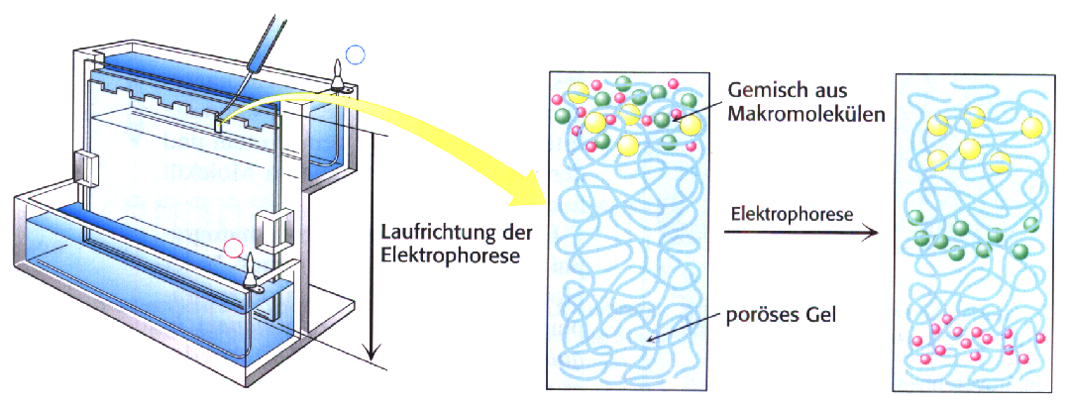
separation of proteins by SDS-PAGE
load SDS-treated protein mixture onto gel
protein mixture
-
electrophoresis
+
migration direction
Sodium-Dodecylsulfate (SDS)
CH₃-(CH₂)₁₀-CH₂-O-SO₂-O⁻ Na⁺
porous gel
negatively charged SDS-protein-complexes migrate to the anode
proteins are separated by their size by the filtration principle of the gel
→ small proteins migrate faster than large proteins

Slide 6
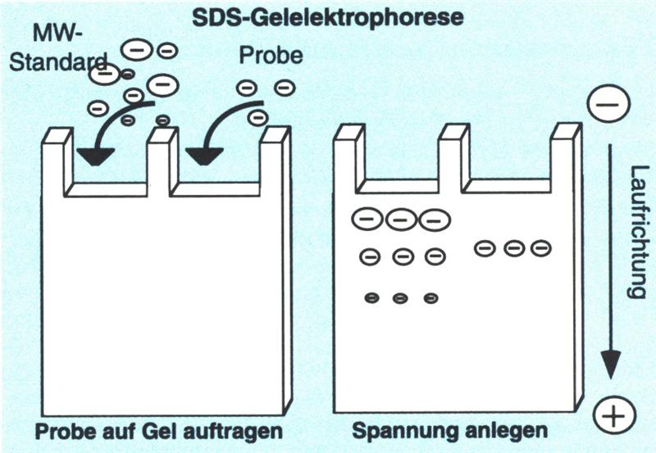
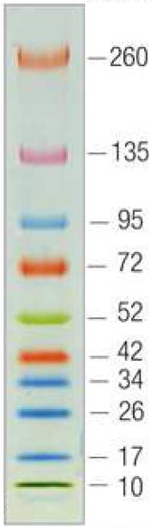
molecular weight (MW) determination by SDS-PAGE
MW standard
kDa
sample
migration
sample application
protein separation

Slide 7
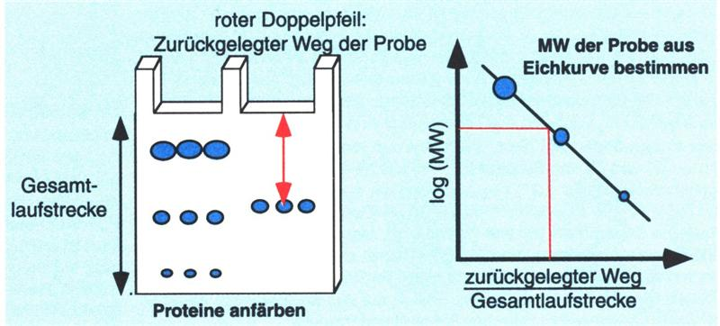
molecular weight (MW) determination by SDS-PAGE
migration distance of sample
calibration curve
determine MW of sample by calibration curve
migration distance of protein standard
migration distance
stain proteins

Slide 8
types of SDS-PAGE
reducing SDS-PAGE
non-reducing SDS-PAGE

Slide 9
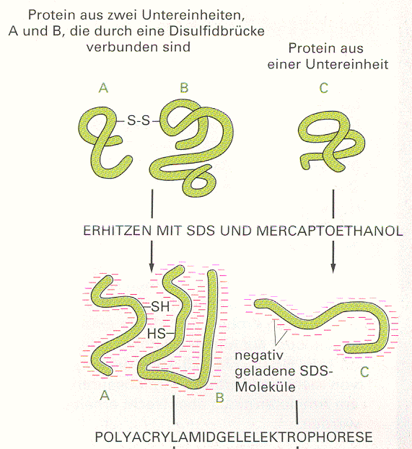
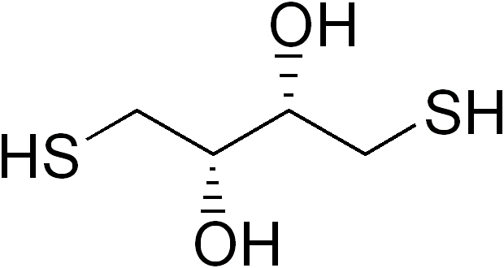
reducing SDS-PAGE of proteins
treatment (boiling) of proteins with reducing agents + SDS
reducing agents
  2-ME (2-mercaptoethanol, β-mercaptoethanol)
  DTT (dithiothreitol)
action on proteins
reduction of inter- and intramolecular disulfide bridges by the reducing agent → destruction of protein structure
determination of the molecular weight of the protein chains
protein with two chains A and B linked by disulfide bridge
single chain protein
treatment with 2-ME + SDS
2-ME
negative charge
DTT

Slide 10
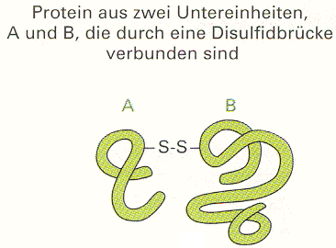
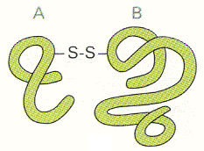
non-reducing SDS-PAGE of proteins
treatment of proteins with SDS, but not with reducing agents
action on proteins
no reduction of disulfide bridges
determination of the molecular weight of the complete protein
protein with two chains A and B linked by disulfide bridge
SDS
negative charge

Slide 11
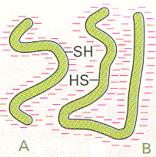
types of SDS-PAGE
reducing SDS-PAGE
non-reducing SDS-PAGE
protein chains
reducing SDS-treatment
protein with two chains A and B linked by disulfide bridge
non-reducing SDS-treatment
complete protein

Slide 12
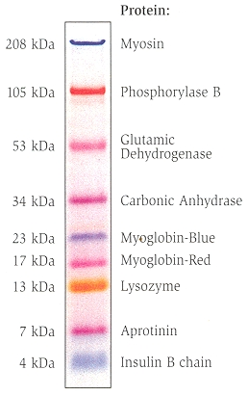
SDS-PAGE for MW determination
molecular weight standard
runs together with protein sample to the left and right side of sample
ready-to-use standards are commercially available, different standards for different MW ranges, mixture of 6 to 10 proteins
colored molecular weight marker

Slide 13
The End

Slide 14
