Slide 1
Sample Eluate 25 %
35 μl 25% Eluate
+ 5 μl Laemmli-Buffer
Pipet 20 μl sample in each well!
WORKSHOP β-Galactosidase
SDS-PAGE – Sheeme to fill the wells with sample
1 2 3 4 5 6 7 8 9 10
Team 1
Team 2
1:10 FT -- Eluate Buffer B -- M FT -- Eluate Buffer B --
2.2 3.2 10% 25% 100% 3.3 10% 25% 100%

Slide 2
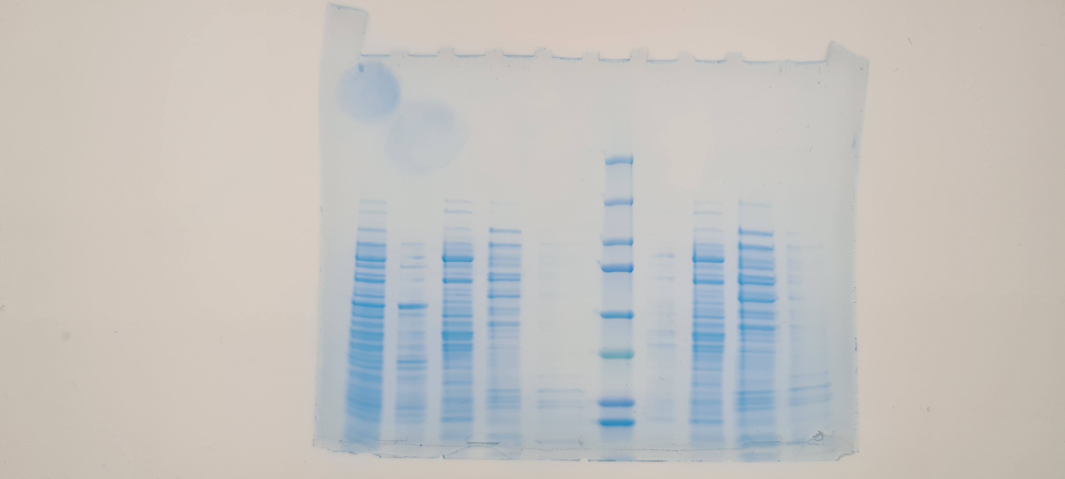
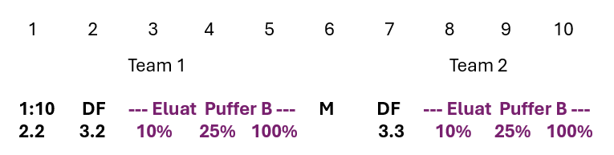
WORKSHOP β-Galactosidase SDS-PAGE – Sheeme to fill the wells

